Slide 1
Smart University
System
A software project developed by
M.G.Husny Ahamed

Slide 2
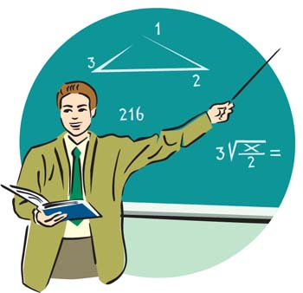



Why this project ?
To overcome some common
problems in ICBT
Faced by
Management/Staff
Students
Lecturers

Slide 3


icbt management – Problem No.1
Students can sit and learn inside a lecture room without paying the course fees
I don’t need any certificate. I want only the knowledge
I don’t pay fees

Slide 4


May lead to Crisis in the Business of ICBT
How can we track them? There are large number of students
Students payment arrears are loaded. Why is this?
ICBT management

Slide 5
icbt management – Problem No.2
Attendance are marked manually
Someone has to be hired. To enter them to the database,
It takes more time and cost
Entering attendance details in database

Slide 6

icbt management – Problem 3
Outsiders can enter lecture rooms or computer labs
It is a threat to the security
I'm not a student/
not a ICBT student
(No one noticed )
Computer lab

Slide 7

Problems faced by Students
Problem no.4
If a lecture schedule or lecture room is changed suddenly on the same day. Student and the lecturer both might find it difficult to find the lecture room
Student
Where is the lecture room today?
Bad management
I'm fed-up
What time is the lecture today?
Same problem faced by Lecturers if the lecture room is shifted to another place

Slide 8
Problems faced by lecturers
Problem no.5
Students are not in the lecture room when the lecturer comes
They may outside chatting with friends
Lecturer comes in to the class room
Where are these students????
I'm fed up with these students

Slide 9

Problems faced by Students
Problem no.6
No way to know if the lecturer came into the class room
Is the lecturer came to the class?
Student chatting outside assuming that lecturer did not come yet
Student

Slide 10
All those problems
should be solved

Slide 11
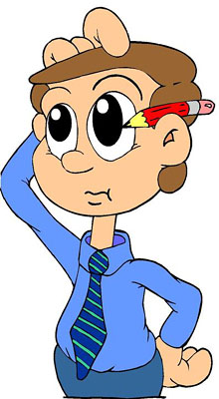
How Am I going to solve all those problems?
I was creative with many ideas in my mind
Staff member staying at the entrance for checking students card
Manpower cost , Accuracy issue ..
Finger print access control ?? IMAGE PROCESSING SUXX COST IS HIGH
Face recognition access control ???
Again image processing cost is high

Slide 12


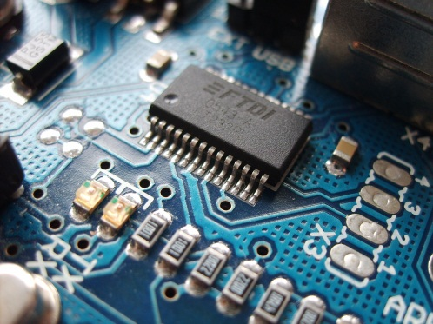


I have some knowledge of Micro controller and electronics I can use them to solve them
Yeah :D I found the solution
Micro controller
Radio frequency waves
RFID tag

Slide 13
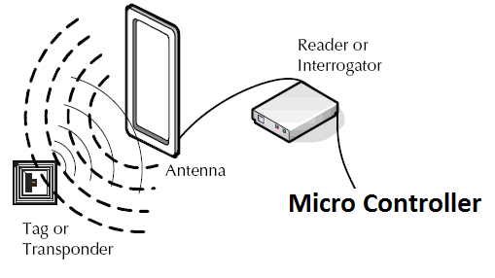
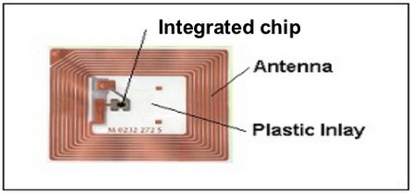
What are radio frequency waves
Type of electro magnetic waves with the frequency of 300GHz to as low as 3KHz

Slide 14
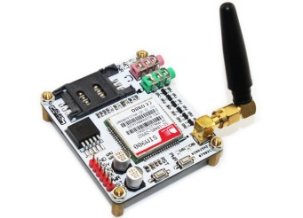
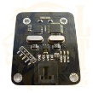
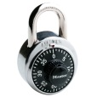

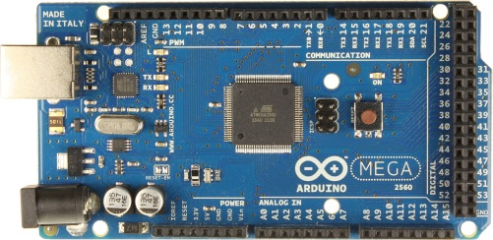
Architectural diagram
LAB 1
RFID 13.56MHz Reader Modules
LCD
University
Management system
software
SIMS900
GSM/GPRS Module
LAB 2
+
LCD
Arduino Mega 250
LAB 3
All the doors have door locks And rfid readers, Students have to swipe their rfid tag to access
LCD

Slide 15
Problem no.1
Students who haven’t paid arrears can still attend lectures
What is the solution?

Slide 16

When a student tries to enter class room, he/she has to swipe the rfid tag to the reader
Student with a particular amount of payment arrears will be blocked the entrance
Example condition fee = 540,000/-
If fee/2 > paidAmount
Student paid only 135,000/-
Class room
I didn’t pay arrears. I cant enter the lecture room
Access
Denied

Slide 17
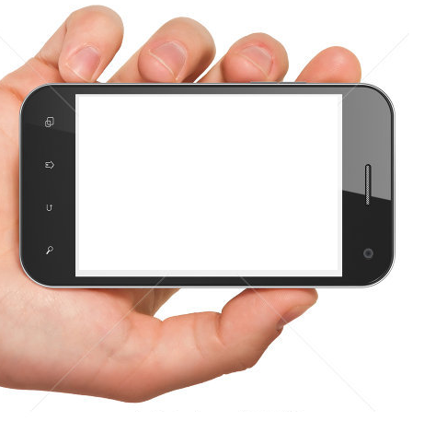
Text message received
From : ICBT
You cannot access any lecture room You have payment arrears to be settled. [Pay Rs.135,000/- to access lectures]
Contact accounts department

Slide 18
Problem No.2
Attendance are marked manually and it takes more time and cost
How is it solved??
When someone swipe the rfid card and enter a lecture room. A record will be saved in the central database

Slide 19

icbt management – Problem 3
Outsiders can enter lecture rooms or computer labs, It is a threat to the security
How is it solved?
Only registered members with rfid tags can access, the door is locked
Door locked

Slide 20
Problem no.4 faced by Students
If a lecture schedule or lecture room is changed suddenly on the same day. Student and the lecturer both might find it difficult to find the lecture room
How is it solved?
A text message will be sent to the students or lecturer when a lecture room or schedule is changed
Alert - ICBT
Lecture room changed from room 2 to room 5
Sorry for the inconvenience caused

Slide 21
Problem 5 and 6
Students might not be in the lecture room when the lecturer comes in
No way to know when the lecturer comes into the class room
How is it solved?
A text message will be sent to the students or lecturer when a lecture room or schedule is changed
Alert - ICBT
Lecture came into the class Please attend the lecture

Slide 22
Thank you

