Slide 1
Making Sense of Images on Twitter via Contextual Text
Independent Research Project by Chen Xiaochen
Supervisor: Dr. Wilfred Siu-Hung Ng

Slide 2

ESA Entity
Entity i is the i th esa ranking entity
E(i) = 1/i
In wiki graph, if entity j links to esa result entity i
O(i,j) = occurance of i in j article.
LW(j) = ∑ E(i)O(i,j)
Entity i and Entity j generation distance is
D(i,j)
DW(j) = ∑D(i,j)
Select j with Max(LW(j)) , if LW(j) is the same, then
Compare DW(j),chose Min(DW(j))
Entity1
Expand Entity
Entity A
Entity2
Entity B
Entity3

Slide 3
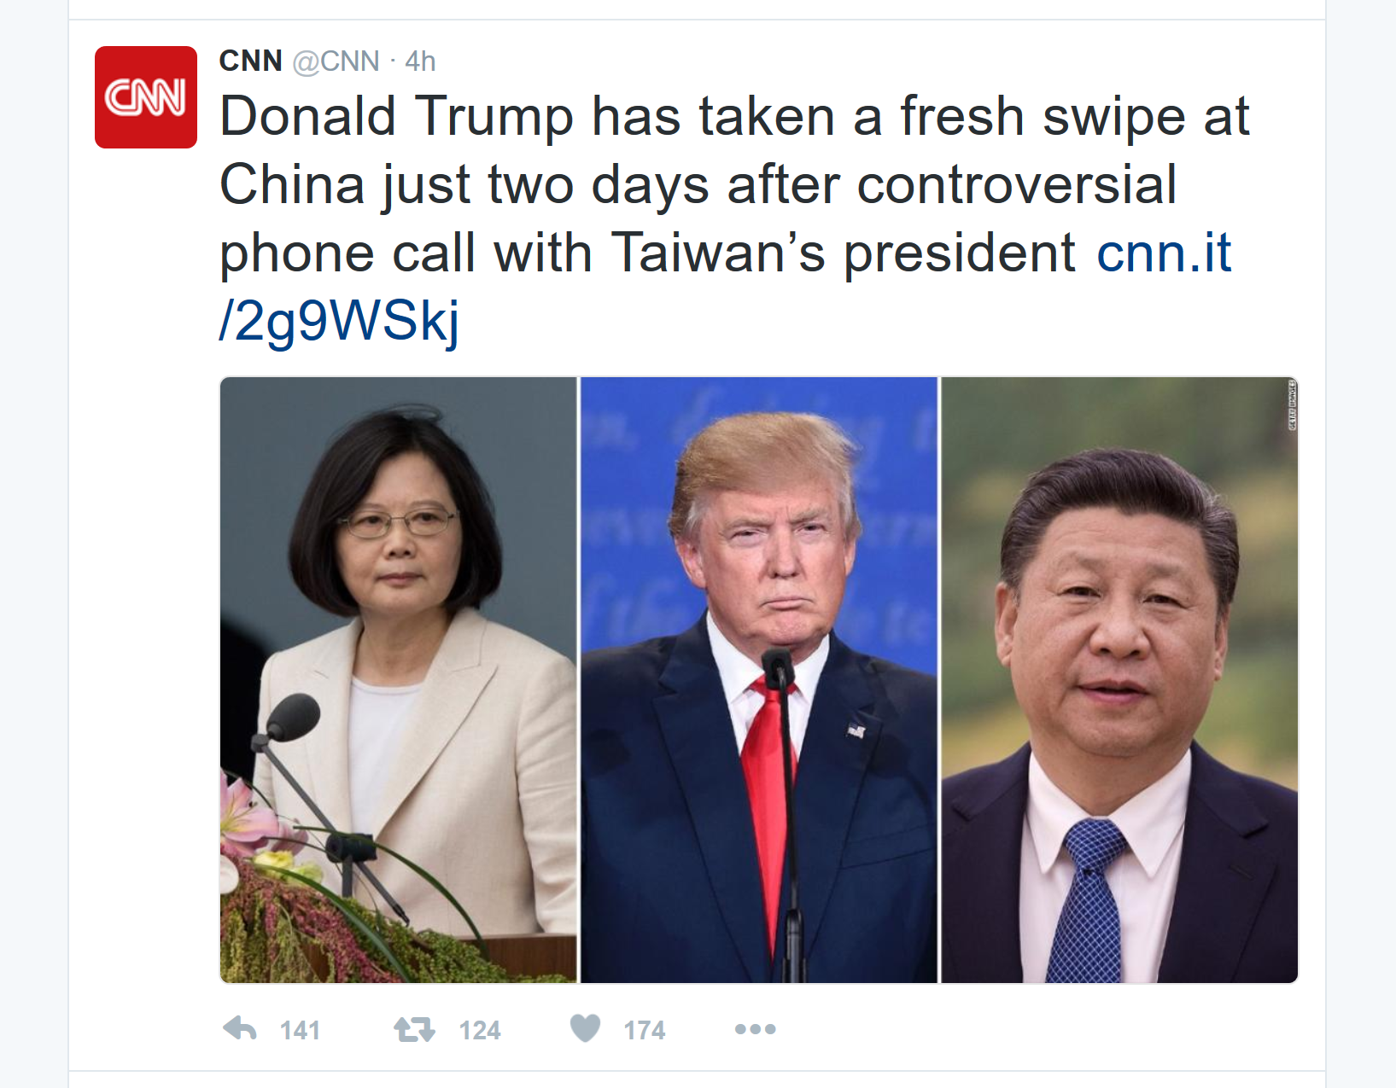
List of U.S. presidential campaign slogans
The Trump Organization
Fred Trump
Jared Kushner
Roger Stone
American Independent Party

Slide 4
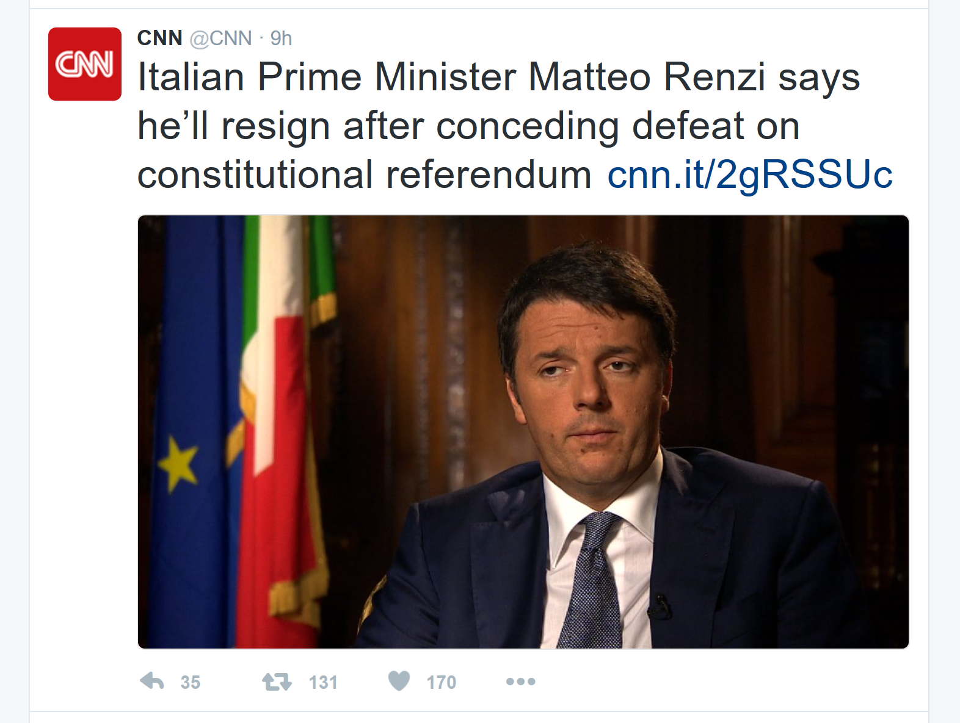
Democratic Party (Italy)
Italy
Paolo Gentiloni
Enrico Letta
List of mayors of Florence
List of Prime Ministers of Italy
Politics of Italy

