Slide 1
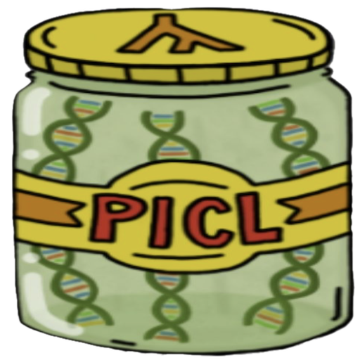
PICL: Phylogenetic Inference with Composite Likelihood
JPICL
Phylogenetic Inference with Composite Likelihood
PICL algorithms and C implementation by Laura Kubatko
https://github.com/lkubatko/PICL
Contributions to PICL algorithms and methodology by David Swofford, Julia Chifman, Shelby Moshier, Sungsik Kong, Jing Peng, Shawn Chen, Emerson Webb, Dhruv Arora
Cross-platform JavaFX graphical interface by Daniel H. Huson
https://github.com/husonlab/jpicl
PICL graphic:
Shelby Moshier

