Slide 1

Design and Implementation of an AI-Enhanced
Multi-Tenant Family Fund Management System
with Predictive Analytics and Intelligent Reporting
STUDENT NAME
DEPARTMENT
Aminu Danladi Hussain
Software Engineering
MATRIC NUMBER
SUPERVISOR
2024/A/SENG/0156
Dr. Ayodeji Samuel Makinde
MIVA Open University | Final Project Defence | 2026
Notes:
Open with the exact approved project title and identify the three design commitments: secure tenancy, a deterministic ledger, and governed intelligence.
Clarify that predictive analytics is part of the implemented software contract, but empirical model evaluation was not executed without an authorised dataset.
[Sources]
- docs/project-report/preliminary-pages.md — approved title, student, department and supervisor details.
- /Users/amisha/Downloads/MIVA_CS_Proposal_Template.pptx — official MIVA visual template.

Slide 2

Problem Statement
A family fund may be recorded across messages, notebooks, bank alerts and spreadsheets. No single record gives a defensible family balance.
Problem Evidence
• No shared source of truth or consistent role boundaries.
• Partial payments can be applied differently across records, delaying reports and reconciliation.
Why Existing Solutions Fall Short
• Reviewed tools address payments or savings, not the full family-governed ledger.
2
Notes:
Use the four recording locations as an illustrative workflow, not a population statistic.
The study problem is the absence of a purpose-built system combining tenancy, role governance, allocation, expenses, payment support and understandable reporting.
[Sources]
- docs/project-report/chapter-1.md, Sections 1.1-1.2.
- docs/project-report/chapter-3.md, Figure 3.1 and existing-system analysis.

Slide 3
Aim and Study Objectives
Aim
To design and implement FamilyFunds, an AI-enhanced multi-tenant web application for secure and transparent family contribution management.
Specific Objectives
1. Analyse family-fund practice and existing tools.
2. Design multi-tenant data, role and security controls.
3. Implement contributions, payments, expenses and reports.
4. Integrate controlled, confirmation-first AI assistance.
5. Implement activation-gated logistic regression; evaluate only with authorised data.
6. Test functionality, security, reliability and usability.
3
Notes:
Walk through all six approved objectives. Objective 5 includes evaluation only when an authorised historical dataset is available.
State explicitly that the software pipeline was implemented, while its empirical evaluation was not executed.
[Sources]
- docs/project-report/chapter-1.md, Sections 1.3-1.5.
- docs/project-report/chapter-5.md, Section 5.3 objective verdicts.

Slide 4
Scope and Evidence Boundaries
SCOPE
LIMITATIONS
• Multi-tenant workspaces, roles and subscription gates
• Contributions, oldest-first allocation and receipts
• Expenses, adjustments, reports and reconciliation
• Controlled AI and officer-only risk infrastructure
• No authorised CSV; no trained or active risk model
• No fresh hosted SHA, benchmark or recovery drill
• No live Paystack, messaging or AI-provider acceptance
• No native mobile app or longitudinal user study
4
Notes:
Separate implemented scope from evidence still required for operational-readiness claims.
A tested integration path is not the same as a live transaction, delivery, provider acceptance run or controlled restore.
[Sources]
- docs/project-report/chapter-1.md, Sections 1.8-1.9.
- docs/project-report/chapter-4.md, Sections 4.4.1-4.4.4.
- docs/project-report/chapter-5.md, Section 5.6.

Slide 5
Reviewed Tools: Governance Gap
Notebook, Chat and Spreadsheet
1
Flexible and familiar, but manual entry, weak access boundaries and fragmented balances limit auditability.
Consumer Savings and Payment Apps
2
Effective for personal saving or collections, but they do not model family-defined obligations, roles and allocation rules.
Formal Cooperative Platforms
3
Structured and auditable, but designed for institution-led schemes rather than flexible family membership and governance.
5
Notes:
Qualify the claim as applying to the approaches reviewed in Chapter Two, rather than every tool in the market.
The remaining gap is governed coordination: family-defined obligations, membership-scoped access, deterministic allocation and traceable reporting in one workflow.
[Sources]
- docs/project-report/chapter-2.md, literature and existing-system review.
- docs/project-report/references.md — PiggyVest, Cowrywise, Paystack, informal-finance and RBAC sources.

Slide 6
FamilyFunds: A Governed Ledger
Implemented System
FamilyFunds gives each family an isolated workspace. Members see only their own records; authorised officers manage the shared ledger.
Core Financial Workflow
• Family membership, officer roles and secure access
• Contributions, oldest-first allocation and receipts
• Expenses, adjustments, reports and reconciliation
Governed Intelligence
• AI reads only through permitted application tools
• Officer writes require preview and explicit confirmation
• Payment-risk scoring is officer-only and activation-gated
6
Notes:
Explain that both AI and predictive paths remain subordinate to Laravel authorisation, validation and the ledger.
Do not imply a trained active model or proven live-provider usefulness. The predictor currently fails closed without a validated model artifact.
[Sources]
- docs/project-report/chapter-3.md, architecture and module design.
- docs/project-report/chapter-4.md, Sections 4.2.1-4.2.6.

Slide 7
Method and Evaluation
Development Approach
Agile iterations moved from discovery to build and automated validation; reconciliation was recorded as a post-design audit extension.
Verified Environment
Backend Runtime
Frontend
PHP 8.5.8 · Laravel 13.24.0
Vue 3.5.41 · Inertia Vue 3.6.1
Database
ML Package
PostgreSQL 18.4
Python 3.12.3 · scikit-learn 1.7.2
Build and Quality
Testing
Composer · npm/Vite · Pint · PHPStan
Pest · pytest · PostgreSQL · Chromium
7
Notes:
Describe the work in past tense: discovery, implementation and validation were iterative.
Reconciliation is disclosed as a post-design extension rather than silently inserted into the original FR1-FR20 baseline.
[Sources]
- docs/project-report/chapter-3.md, methodology, environment and tools.
- docs/project-report/chapter-4.md, Sections 4.1.2 and 4.2.
- composer.lock, package-lock.json and ml/payment-risk/uv.lock — verified dependency state.

Slide 8
System Design and Control Flows
Application Architecture
Role and Use Cases
Oldest-First Allocation
Member
Own records
Validate amount, role
and family context
Member and officer UI
Vue + Inertia
Family administrator
Family operations
↓
↓
Lock open obligations
inside one transaction
Laravel application
Family context + policies
Financial secretary
Finance operations
↓
Allocate to the oldest
outstanding balance first
↓
Ledger and adapters
PostgreSQL · Paystack · AI
Platform administrator
Platform-wide oversight
↓
Commit ledger entries
and issue the receipt
Every family-ledger request
passes context + policy checks
Tenant context, policies and domain services govern every external event.
Members view their own data; officers receive scoped operational access.
Open obligations are locked and paid chronologically in one transaction.
8
Notes:
Read the simplified defence view from left to right: application boundaries, role permissions, then the deterministic payment rule. The report contains the full diagrams.
External services provide observations. They do not bypass family context, policies, validation or ledger services.
[Sources]
- docs/project-report/diagrams/slide-05-system-architecture-full-trimmed.png.
- docs/project-report/diagrams/slide-06-use-case-diagram-full-trimmed.png.
- docs/project-report/diagrams/panels/slide-07-payment-allocation-flowchart-panel-2.png.
- docs/project-report/chapter-3.md, Sections 3.4-3.10.

Slide 9
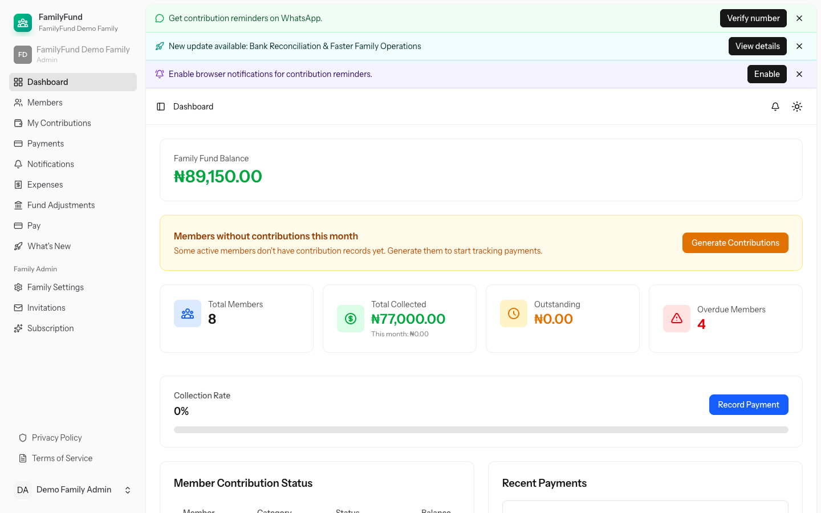
Implemented Product Evidence
EVIDENCE BOUNDARY
20 redacted screenshots from the synthetic tenant.
Captured workflows include dashboards, payments, reports and a seeded AI conversation.
No live provider call was made, and prediction remains unavailable without a validated model.
Officer dashboard — redacted synthetic development tenant
9
Notes:
These are real application screenshots from the synthetic development tenant, not mock-ups and not real user data.
The report contains 20 redacted interface images. The enlarged officer dashboard is shown here so its running-system evidence remains readable when projected.
[Sources]
- docs/project-report/screenshots/figure-4-02-admin-dashboard.png.
- docs/project-report/screenshots/figure-4-09-reports-exports-schedules.png.
- docs/project-report/chapter-4.md, Figures 4.1a-c through 4.14.

Slide 10
Executed Tests and Evidence Gaps
Evidence | Executed Result | Coverage / Gate | Status | Meaning
PHP / Pest | 1,421 tests / 6,904 assertions | 100.0% PHP | PASS | Canonical local gate
Python ML | 66 tests | 100% statements | PASS | Offline package contract
PostgreSQL | 138 tests / 440 assertions | Disposable DB smoke | PASS | PostgreSQL integration path
Chromium | 5 tests / 82 assertions | Browser acceptance | PASS | Roles, mobile, a11y
Final external | CSV / hosted / live NFRs absent | Required | PENDING | Claims remain gated
15 Aug 2026 local run · Pest 22.209 s · Focused runs overlap · No fresh post-change hosted SHA.
10
Notes:
Do not add focused suites to the canonical suite; they overlap and serve different evidence boundaries.
The local software checks passed. Final acceptance still requires an authorised private dataset, a fresh hosted SHA, live integrations, performance/concurrency evidence and a controlled recovery drill.
[Sources]
- docs/project-report/chapter-4.md, Tables 4.7-4.9.
- Local canonical composer ci:check result on 15 August 2026: 1,421 tests, 6,904 assertions, 100.0% PHP coverage, Pest 22.209 s.
- Local ML, PostgreSQL and Chromium focused-run evidence recorded in Chapter Four.

Slide 11
Selected References
Informal Family Finance
1
Bascom (1952); Anderson and Baland (2002); EFInA (2023); Wezel and Ree (2023).
Multi-Tenancy and Access Control
2
Amazon Web Services (2020); Sandhu et al. (1996); Sharma and Kaur (2021); Sommerville (2016).
Prediction and Cold Start
3
Khandani et al. (2010); Lessmann et al. (2015); Schein et al. (2002); Thomas (2000).
11
Notes:
These are selected anchors only; the report contains the complete 74-entry reference list.
[Sources]
- Bascom, W. R. (1952). The Esusu. Journal of the Royal Anthropological Institute, 82(1), 63-69. https://doi.org/10.2307/2844040
- Anderson, S., & Baland, J.-M. (2002). The economics of ROSCAs. Quarterly Journal of Economics, 117(3), 963-995. https://doi.org/10.1162/003355302760193931
- EFInA. (2023). Access to Financial Services in Nigeria 2023 Survey. https://efina.org.ng
- Amazon Web Services. (2020). SaaS tenant isolation strategies. https://docs.aws.amazon.com/whitepapers/latest/saas-tenant-isolation-strategies/
- Sandhu, R. S., et al. (1996). Role-based access control models. IEEE Computer, 29(2), 38-47. https://doi.org/10.1109/2.485845
- Khandani, A. E., et al. (2010). Consumer credit-risk models via machine-learning algorithms. Journal of Banking & Finance, 34(11), 2767-2787. https://doi.org/10.1016/j.jbankfin.2010.06.001
- Lessmann, S., et al. (2015). Benchmarking classification algorithms for credit scoring. European Journal of Operational Research, 247(1), 124-136. https://doi.org/10.1016/j.ejor.2015.05.030
- Wezel, T., & Ree, J. J. (2023). Nigeria: Fostering financial inclusion through digital financial services. International Monetary Fund. https://doi.org/10.5089/9798400237195.018
- Sharma, A., & Kaur, P. (2021). Tenant-centric object-based software defined storage for multitenant SaaS applications. Arabian Journal for Science and Engineering, 46(9), 9221-9235. https://doi.org/10.1007/s13369-021-05743-z
- Sommerville, I. (2016). Software Engineering (10th ed.). Pearson.
- Schein, A. I., et al. (2002). Methods and metrics for cold-start recommendations. Proceedings of ACM SIGIR, 253-260.
- Thomas, L. C. (2000). A survey of credit and behavioural scoring. International Journal of Forecasting, 16(2), 149-172. https://doi.org/10.1016/S0169-2070(00)00034-0
- docs/project-report/references.md — complete reference list.

Slide 12
Conclusion and Recommendations
Measured Conclusion
FamilyFunds turns informal contribution practice into governed, traceable records. The conventional application is substantially implemented and locally verified.
Recommended Next Action
Complete a fresh hosted run, live integration acceptance, performance testing and a controlled recovery drill before claiming operational readiness.
Future Work
Train and evaluate the risk model only with an authorised private dataset; keep scoring officer-only, advisory and activation-gated.
Thank you | Questions and discussion
12
Notes:
Close with the defensible result: the conventional application is substantially implemented and locally verified.
Operational readiness and predictive usefulness remain intentionally gated by evidence. Invite questions after stating the next action.
[Sources]
- docs/project-report/chapter-5.md, Sections 5.3-5.8.
- docs/project-report/chapter-4.md, Section 4.4.

