Slide 1

MIVA OPEN UNIVERSITY · FACULTY OF COMPUTING
FamilyFunds
Design and implementation of an AI-enhanced multi-tenant family fund management system
Predictive analytics and intelligent reporting remain governed by explicit evidence gates.
Secure tenancy
Deterministic ledger
Governed intelligence
AMINU DANLADI HUSSAIN · 2024/A/SENG/0156
Supervisor: Dr Samuel Makinde
01
Notes:
Timing: 35–40 seconds.
Introduce the project as a software-engineering response to fragmented family-fund administration.
State the evidence rule early: the conventional system and predictive pipeline are discussed separately from claims that need hosted services or authorised private data.
[Sources]
- docs/project-report/preliminary-pages.md
- docs/project-report/chapter-1.md
- public/app-icon-1024.png

Slide 2
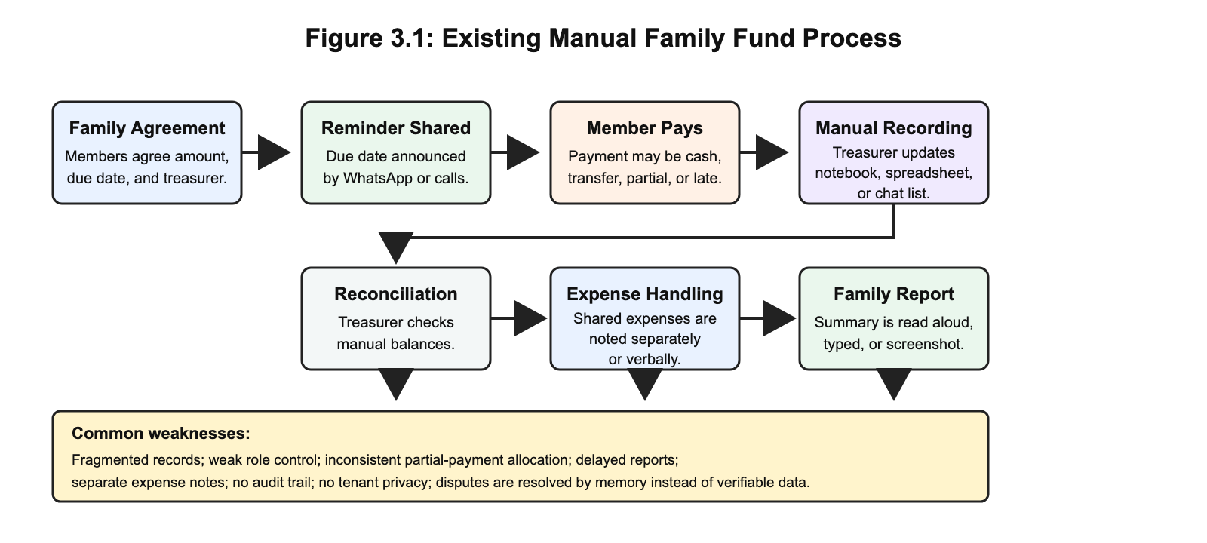
THE PROBLEM
Manual records fragment one financial story
A contribution can exist in four places—yet still lack one defensible balance.
01
No shared source of truth
02
Weak role boundaries
03
Inconsistent partial-payment allocation
04
Delayed reporting and reconciliation
FAMILYFUNDS · FINAL PROJECT DEFENCE
02
Notes:
Timing: 45 seconds.
Explain that the problem is not simply a lack of digital payment. It is the absence of one governed record linking obligations, receipts, expenses and reports.
Use the workflow to show why disputes are resolved by memory when partial payments and corrections are recorded inconsistently.
[Sources]
- docs/project-report/chapter-1.md
- docs/project-report/chapter-3.md
- docs/project-report/diagrams/chapter-3-existing-system-flow.png

Slide 3
THE GAP
The missing capability is governed coordination
Adjacent tools solve pieces of the problem; none combines the full family-fund workflow.
Approach
Contribution rules
Tenant / role control
Auditable allocation & reports
Notebook / chat / spreadsheet
Manual
Weak
Fragmented
Consumer savings and payment apps
Limited
Individual
Payment-led
Formal cooperative platforms
Structured
Organisation-led
Formal-scheme fit
FamilyFunds
Family-defined
Family membership
Deterministic + traceable
FamilyFunds is a governed ledger and workflow—not another payment button.
FAMILYFUNDS · FINAL PROJECT DEFENCE
03
Notes:
Timing: 45 seconds.
Compare system categories, not marketing claims. Savings apps, spreadsheets and cooperative platforms each address part of the need.
Emphasise that the contribution rule, family-specific role and allocation audit trail must work together.
[Sources]
- docs/project-report/chapter-1.md
- docs/project-report/chapter-2.md

Slide 4
STUDY OBJECTIVES
Six objectives connect the study to evidence
01
Review
02
Design
Practice, tools and literature
Multi-tenancy, roles and data structures
03
Implement
04
Govern AI
Core financial and reporting modules
Family-scoped assistance with confirmation
05
Evaluate prediction
06
Test
Logistic regression against two baselines
Functional, security, reliability and usability
FAMILYFUNDS · FINAL PROJECT DEFENCE
04
Notes:
Timing: 50 seconds.
Present the objectives as a chain: understand the domain, design the controls, implement the system, govern intelligent features and test the result.
Objective five is deliberately conditional: evaluation requires an authorised historical dataset rather than synthetic claims.
[Sources]
- docs/project-report/chapter-1.md

Slide 5
METHOD
Agile iterations exposed the real accounting boundaries
Applied system development converted each finding into a reviewable increment.
01
02
03
DISCOVER
BUILD
VALIDATE
Problem, literature,
requirements
Tenant controls, ledger,
reports and integrations
Automated evidence,
external evidence gates
Post-design extension
Reconciliation was added after implementation exposed the audit need; it is not backdated into the original FR1–FR20 baseline.
FAMILYFUNDS · FINAL PROJECT DEFENCE
05
Notes:
Timing: 45 seconds.
Describe the method as applied and iterative, not as an abstract Agile checklist.
Point out the reconciliation extension as an example of honest scope evolution: it was valuable, but it was documented after the original baseline rather than silently rewritten into it.
[Sources]
- docs/project-report/chapter-3.md
- docs/project-report/chapter-4.md

Slide 6
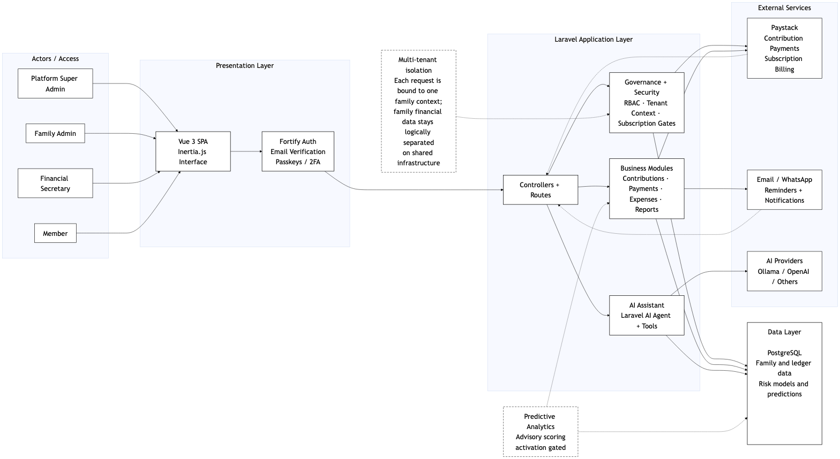
SYSTEM ARCHITECTURE
Laravel governs every external event
Family context
Every request is bound to one active family membership.
Governed application
Policies, validation and domain services decide what may reach the ledger.
Recoverable integrations
Paystack, messaging and AI responses remain observations—not authority.
FAMILYFUNDS · FINAL PROJECT DEFENCE
06
Notes:
Timing: 55 seconds.
Follow the request from the user interface into Laravel, where the active family, policy and subscription context are enforced.
Explain that providers attest to payment, delivery or generated text; they do not own authorisation or the financial ledger.
[Sources]
- docs/project-report/chapter-3.md
- docs/project-report/chapter-4.md
- docs/project-report/diagrams/slide-05-system-architecture-full-trimmed.png

Slide 7
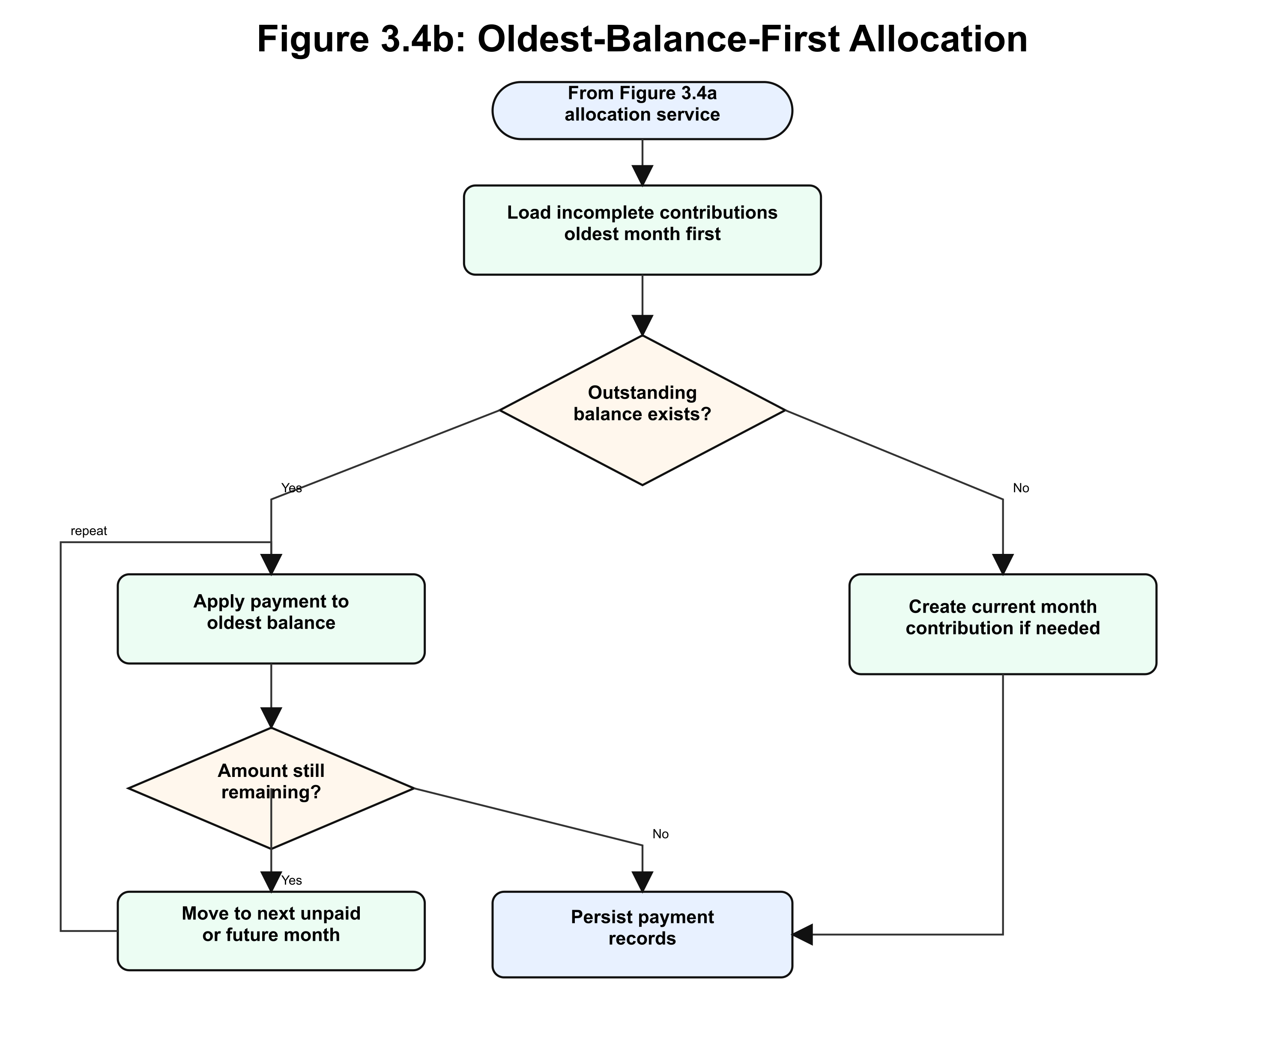
PAYMENT ALLOCATION
One deterministic rule makes partial payments explainable
01
Validate the receipt
Manual input or verified Paystack event enters the same governed service.
02
Lock incomplete obligations
Load family-owned balances in chronological order inside one transaction.
03
Allocate oldest first
Persist the batch and immutable allocation lines; repeat until exhausted.
FAMILYFUNDS · FINAL PROJECT DEFENCE
07
Notes:
Timing: 55 seconds.
Use a partial or lump-sum payment example: the oldest unpaid period is reduced first, and the service moves forward only when that balance is settled.
This rule is shared by manual and online payments, which keeps reports and member statements consistent.
[Sources]
- docs/project-report/chapter-3.md
- docs/project-report/chapter-4.md
- docs/project-report/diagrams/panels/slide-07-payment-allocation-flowchart-panel-2.png

Slide 8
AI AND PREDICTIVE GOVERNANCE
Intelligence is constrained, not autonomous
Controlled AI assistant
Payment-risk advisory
Family-scoped tools
Offline model, native scoring
Authoritative data is read through permitted application queries.
Schema, checksum and activation gates separate training from production requests.
Preview before writes
Officer-only and advisory
An officer must explicitly confirm a proposed action; members cannot write.
Cold-start tiers can show unavailable; a score cannot sanction, remind or mutate records.
Neither path can bypass Laravel authorisation, validation or the financial ledger.
FAMILYFUNDS · FINAL PROJECT DEFENCE
08
Notes:
Timing: 55 seconds.
Contrast the two intelligent features. The assistant is a governed interface over application tools; the predictor is an advisory classifier with activation and history gates.
Make the safety boundary explicit: neither feature can create a financial event or automatic reminder by itself.
Do not claim live provider usefulness or predictive accuracy; those experiments were not executed.
[Sources]
- docs/project-report/chapter-3.md
- docs/project-report/chapter-4.md

Slide 9
EXECUTED TEST EVIDENCE
Local checks passed across implemented boundaries
Final canonical local rerun: 15 August 2026 · Pest 22.209 s. Focused runs overlap and are not combined.
1,421
66
138 + 5
Pest tests
Python ML tests
Boundary runs
6,904 assertions
100.0% PHP coverage
100% statement coverage
Locked Python environment
138 PostgreSQL tests / 440 assertions
5 Chromium tests / 82 assertions
Local result only · no fresh post-change hosted SHA
FAMILYFUNDS · FINAL PROJECT DEFENCE
09
Notes:
Timing: 55 seconds.
Report the final canonical local Laravel rerun from 15 August 2026 first: 1,421 Pest tests, 6,904 assertions, 100.0% PHP coverage and 22.209 seconds Pest duration.
Then report 66 Python tests at 100% statement coverage and the focused PostgreSQL and Chromium boundary runs.
Clarify that focused runs overlap the canonical suite. These are not summed, and there is no accepted final hosted SHA.
[Sources]
- docs/project-report/chapter-4.md

Slide 10
OBJECTIVE VERDICTS
Design goals were met; operational and predictive claims remain open
No.
Evidence-based outcome
Verdict
01
Review relevant practice, tools and literature
Met for report scope
02
Design multi-tenant family-fund system
Met for design scope
03
Implement proposed system
Partially Met overall
04
Integrate controlled AI features
Partially Met
05
Implement and evaluate logistic regression
Partially Met; evaluation Not Executed
06
Test against key requirements
Partially Met
FAMILYFUNDS · FINAL PROJECT DEFENCE
10
Notes:
Timing: 55 seconds.
Read the verdict pattern rather than every cell. Literature and design objectives are met within their stated scope.
Implementation, AI and testing are partially met because external and hosted evidence is incomplete.
The predictive engineering path exists, but the evaluation itself is Not Executed because the authorised dataset was absent.
[Sources]
- docs/project-report/chapter-4.md
- docs/project-report/chapter-5.md

Slide 11
EVIDENCE BOUNDARY
Evidence gaps still limit operational claims
01
Predictive evaluation
No authorised private CSV; no threshold, coefficients, confusion matrix, model metrics or populated prediction.
02
Hosted acceptance
No fresh post-change hosted SHA; a699a821 remains a pre-change baseline only.
03
Live integrations
Paystack, messaging and AI-provider acceptance were not executed for the final revision.
04
Operational non-functionals
Performance, concurrency, recovery and longitudinal user evidence remain pending.
Interface evidence captured: 20 redacted synthetic-tenant images, Figures 4.1a–c through 4.14; prediction remains inactive and advisory.
FAMILYFUNDS · FINAL PROJECT DEFENCE
11
Notes:
Timing: 50 seconds.
A complete 20-image redacted synthetic-tenant interface set now covers Figures 4.1a–c through 4.14; interface evidence is no longer listed as a gap.
State the remaining limitations directly. Live external/provider, hosted, performance, recovery and authorised-data model evidence remain pending.
The predictive software can be tested without claiming that a useful real-world model has been trained.
These gaps define the next acceptance work and prevent overstatement in the conclusion.
[Sources]
- docs/project-report/chapter-4.md
- docs/project-report/chapter-5.md

Slide 12
CONCLUSION
FamilyFunds turns informal contribution practice into governed, traceable records.
The conventional application is substantially implemented and locally verified. Operational readiness and predictive usefulness remain intentionally gated by evidence.
Secure tenancy · Deterministic ledger · Governed intelligence
Questions
AMINU DANLADI HUSSAIN · MIVA OPEN UNIVERSITY
12
Notes:
Timing: 35–40 seconds, then invite questions.
Resolve the opening problem: one governed system can replace fragmented family-fund records and apply consistent rules.
Close with the measured verdict. The core implementation is locally supported; operational and predictive claims remain gated until their declared evidence exists.
[Sources]
- docs/project-report/chapter-5.md

