Slide 1
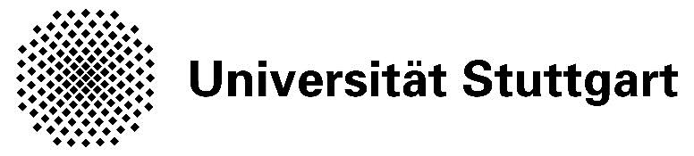

Fachpraktikum “Interactive Systems”
Final Prototype
Flying Platy
Group Members:
-Hamza Manya
-Le Minh Triet
-Muzahid Hussain

Slide 2
Motivation
To make an android game which has a feel of classical space shooting computer game of last decade along with sudo 3D acrade/Action design and eye catchy animations .

Slide 3
Game Story
Our little hero, Platy, on his way to a party from the planet Saturn toward Pluto is suddenly pulled towards a black hole and disappears together with Pluto. Only to reappear in Stuttgart. Despite being a friendly being is misunderstood by our kind and is chased backed to his home land. The game is a story of his journey from Earth to Saturn which spaceships from other planets want to shoot him with other obstacles.

Slide 4
Concept
An arcade mission oriented shooting game
How to Play
-Use motion sensor to move right and left
-Use on screen buttons to shoot and change weapons.

Slide 5

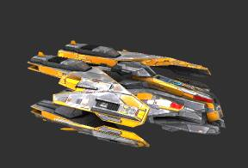
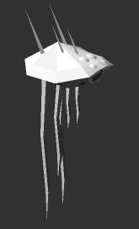
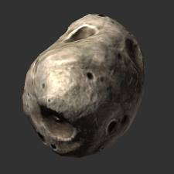
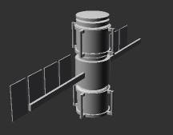
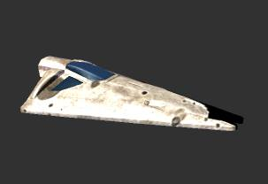
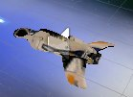
Design: Characters
Enemy Ships
Main Character: Platy
Jet Pack
Hurdle

Slide 6
Weapons
Bullets
Shield
Bomb

Slide 7
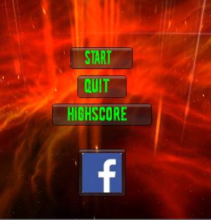
Design: Main Menu

Slide 8
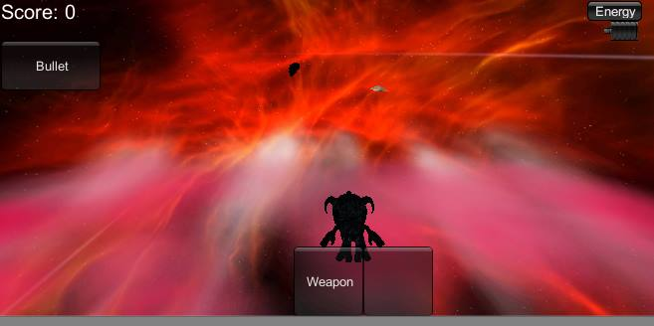
Design: Level 1: Platy In Action

Slide 9
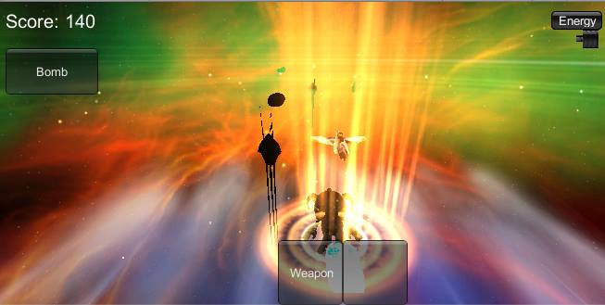
Design: Level 2: Platy In Action
Platy’s in trouble. Enemies have become more powerful.
Shield Animation

Slide 10
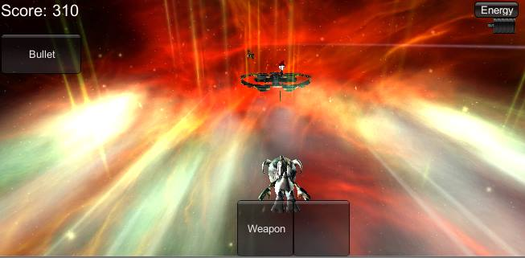
Design: Level 3: Platy In Action

Slide 11
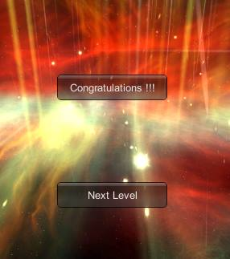
Design: Inter-Level Menu

Slide 12
ToDo:
Facebook integration: We tried to integrate facebook through facebook SDK for Unity but unfortunately it still has a bug.

Slide 13
Thank you for
your attention!
Time for the Demo

