Slide 1
LEC # 1
INTRODUCTION TO DATA STRUCTURES

Slide 2
Data:
Data is any value or set of values that a computer program needs to store and process to achieve a goal.
Data is simply information that we can store and process on a computer.
Example:
Numbers like 5, 10, 15
Words like "Hello" or "Apple"
Temperature readings like 28°C
Student names, IDs, and marks in a database

Slide 3
Data Structure?
A data structure is a way of organizing data that is stored in computer.
Examples:
List / Array: like a row of boxes, each holding one item (like seats in a bus).
Stack: like a stack of plates — you can only take the top one first (Last In, First Out).
Queue: like a line at a ticket counter — first person in line is served first (First In, First Out).
Tree: like a family tree, where one parent has children, and those children can have their own children

Slide 4
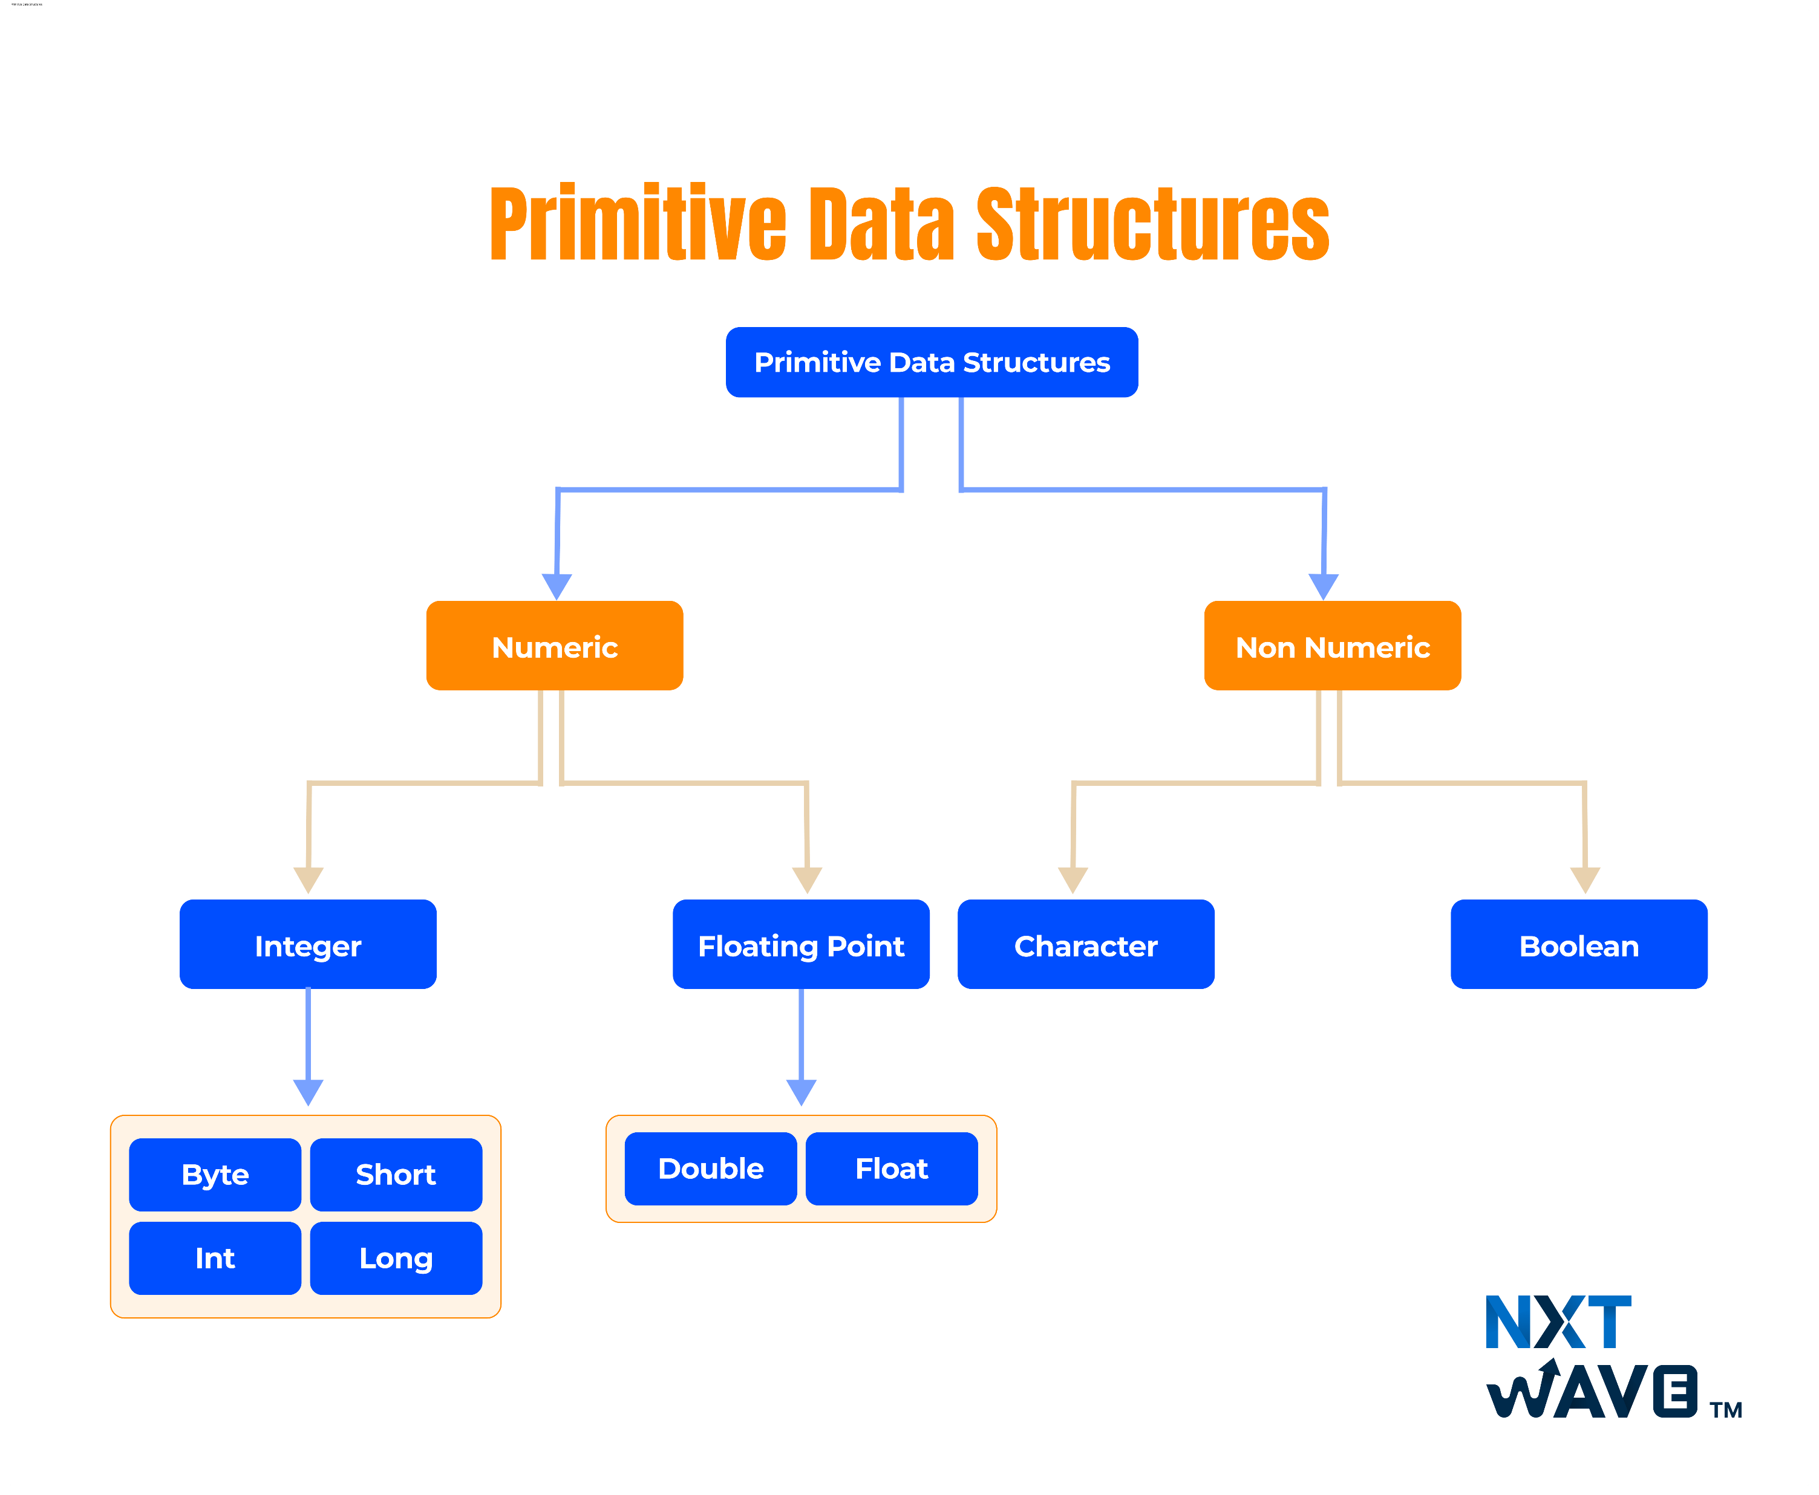
Classification of Data Structures
Data Structures are classified into:
Primitive Data Structures
Non-Primitive Data Structures
Primitive Data Structures
Store a single value at a time
Examples:
Byte → 10,−5, 125 8 bits (1 byte)
int → 10, 20, -5, 8 bits (2 bytes)
float → 3.14, -0.99 32 bits (4 bytes)
Long → 1234567890 64 bits (2 bytes)
char → 'A', ‘b’ 16 bits (2 bytes)
bool → true / false 1 bit

Slide 5
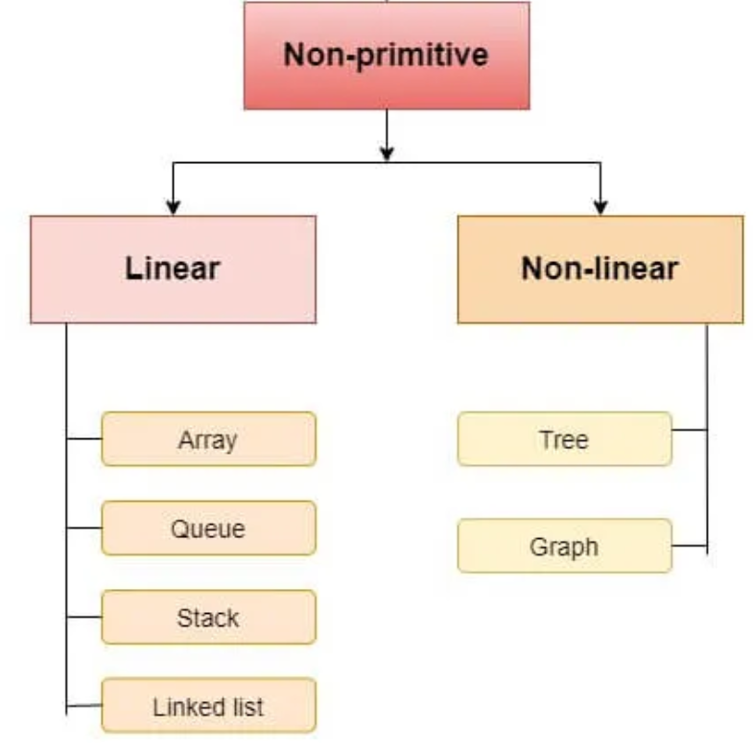
Non-Primitive Data Structures
Non-Primitive Data Structures
Derived from primitive data types.
Used to store large or complex data efficiently.
Examples:
Array – fixed size, easy access
Linked List – flexible, can grow/shrink
Stack – Last In First Out (LIFO)
Queue – First In First Out (FIFO)

Slide 6
Summary Table
Category | Type | Description | Example | Analogy
Primitive | int, float, char, bool | Basic types | int x = 5 | Ingredients
Non-Primitive | Linear | Sequential storage | Array, Stack | Queue / Shelf
Non-Primitive | Non-Linear | Hierarchical / Network | Tree, Graph | Family tree / Map
Key Takeaways:
✅ Data structures help in storing and organizing data efficiently ✅ Two main types: Primitive and Non-Primitive ✅ Non-Primitive further divided into Linear and Non-Linear ✅ Each structure has its own advantages and real-life analogies

Slide 7
What is an Algorithm?
An algorithm is a set of step-by-step instructions to solve a problem.
Example: Making tea algorithm:
Boil water
Add tea leaves
Add milk and sugar
Stir
Serve

Slide 8
The Big Picture
Data is what we work on.
Data Structures organize the data.
Algorithms perform actions on data (like searching, sorting, etc.).

Slide 9
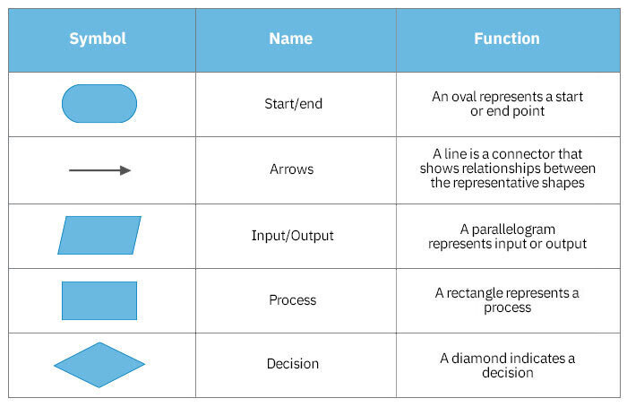
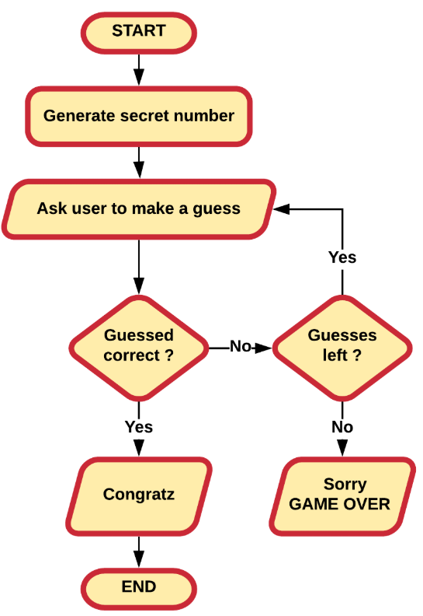
Flowchart Building Blocks

Slide 10
Stepwise Refinement
Breaking a big problem into smaller, easier parts.
Example:
Goal: Take a number as input and check whether it is positive, negative, or zero.
Start
Take input from the user
Check if the number is greater than 0
If yes → print “Positive”
Else if number is less than 0 → print “Negative”
Else → print “Zero”
End
In programming, we do the same — solve the problem step by step.

