Slide 1
Introduction to Artificial Intelligence and Neural Networks

Slide 2
What is Intelligence?
The capacity for logic, understanding, self-awareness, learning, emotional knowledge, reasoning, planning, creativity, critical thinking, and problem-solving.

Slide 3
What is Artificial Intelligence?
Artificial Intelligence (AI) means making computers or machines think and act like humans.
AI systems can:
- Think (analyze problems)
- Learn (from data or experience)
- Decide (choose the best action)
- Act (perform tasks such as speaking, driving, or recognizing faces)

Slide 4
How AI Works
AI follows a simple process:
1️⃣ Think → 2️⃣ Learn → 3️⃣ Decide → 4️⃣ Act
Example: A self-driving car observes the road, learns from data, decides when to stop, and then acts by applying brakes.

Slide 5
Examples of AI in Everyday Life
- Voice Assistants (Siri, Google Assistant)
- Netflix & YouTube Recommendations
- Face Recognition in Phones
- ChatGPT Conversations
- Smart Home Devices (Alexa, Lights)

Slide 6
Examples of AI in Engineering & Technology
- Robotics and Automation Systems
- Smart Grids in Electrical Systems

Slide 7
Types of AI
- Narrow AI: Performs a specific task (e.g., Google Search, Face Unlock)
- General AI: Can think and learn like a human (not yet achieved)
- Super AI: Smarter than humans (exists only in science fiction)

Slide 8
Alan Turing — The Father of AI
Alan Turing (1912–1954) was a British mathematician who asked one key question:
“Can machines think?”
He proposed the famous 'Turing Test' to check if a computer could behave like a human.

Slide 9
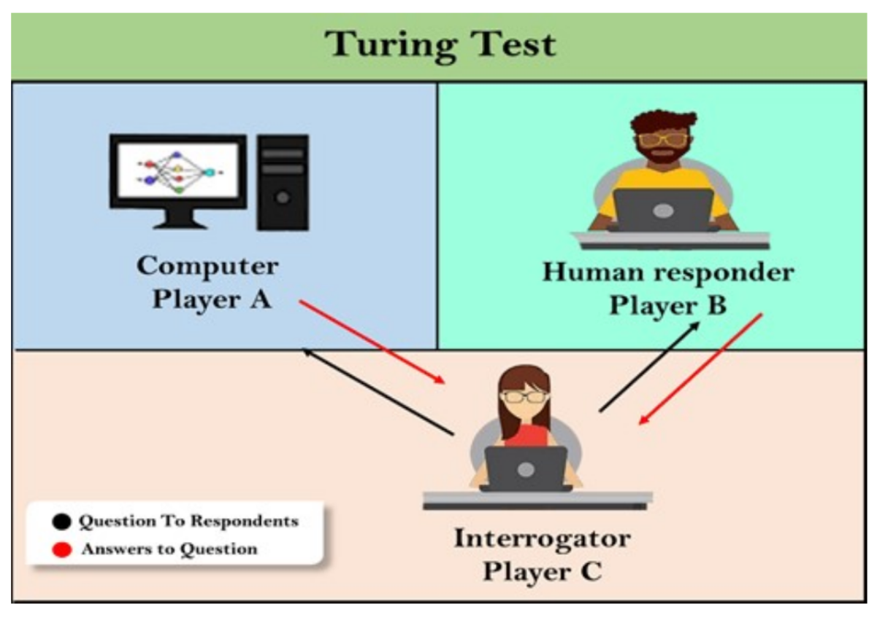
What is the Turing Test?
The Turing Test checks if a computer can fool a human into thinking it’s also human during a conversation.
If the human can’t tell which is the computer, the machine passes the test.

Slide 10
Modern Relevance
Do you think ChatGPT, Alexa, or Google Assistant could pass the Turing Test today?
Can machines truly 'think', or do they just 'imitate' humans?

Slide 11
Discussion & Homework
Question: Do you believe machines will ever really think like humans?
Write a short paragraph explaining your opinion with one real-life example.

