Slide 1
Lecture # 4
Problem Solving by Searching

Slide 2
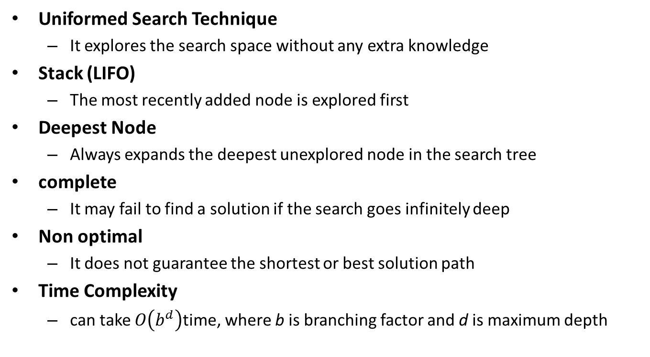
Depth-First Search (DFS)
Uniformed Search Technique
It explores the search space without any extra knowledge
Stack (LIFO)
The most recently added node is explored first
Deepest Node
Always expands the deepest unexplored node in the search tree
complete
It may fail to find a solution if the search goes infinitely deep
Non optimal
It does not guarantee the shortest or best solution path
Time Complexity
can take $O\left(b^{d}\right)$time, where b is branching factor and d is maximum depth

Slide 3
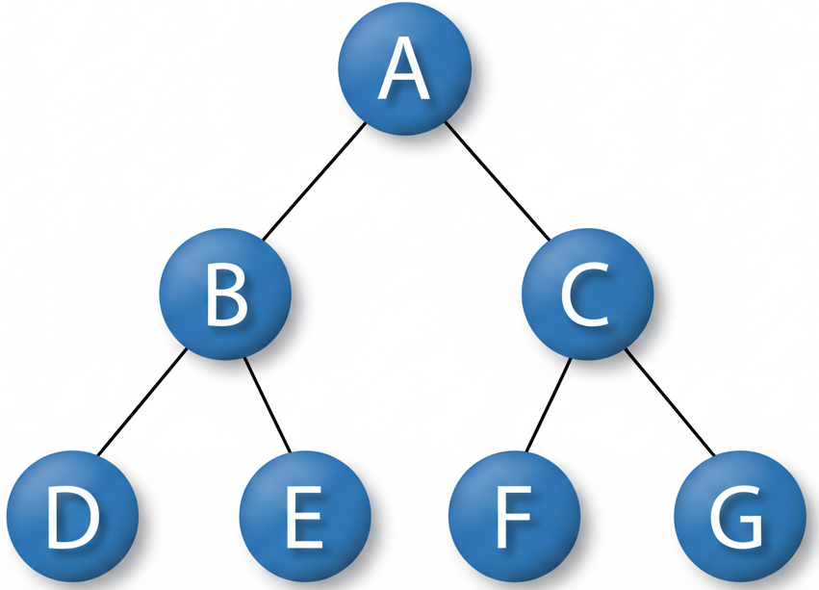
Depth-First Search (DFS)

Slide 4
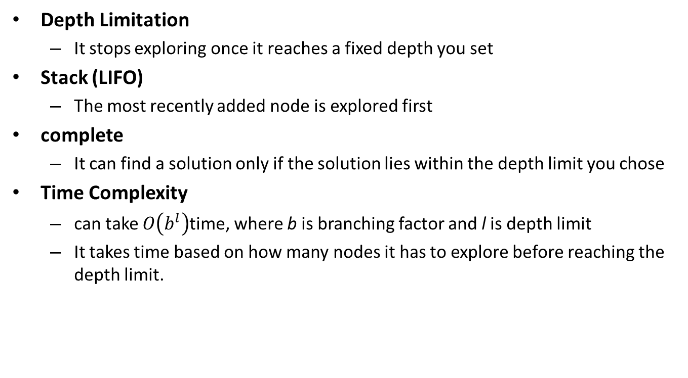
Depth-Limited Search (DLS)
Depth Limitation
It stops exploring once it reaches a fixed depth you set
Stack (LIFO)
The most recently added node is explored first
complete
It can find a solution only if the solution lies within the depth limit you chose
Time Complexity
can take $O\left(b^{l}\right)$time, where b is branching factor and l is depth limit
It takes time based on how many nodes it has to explore before reaching the depth limit.

Slide 5
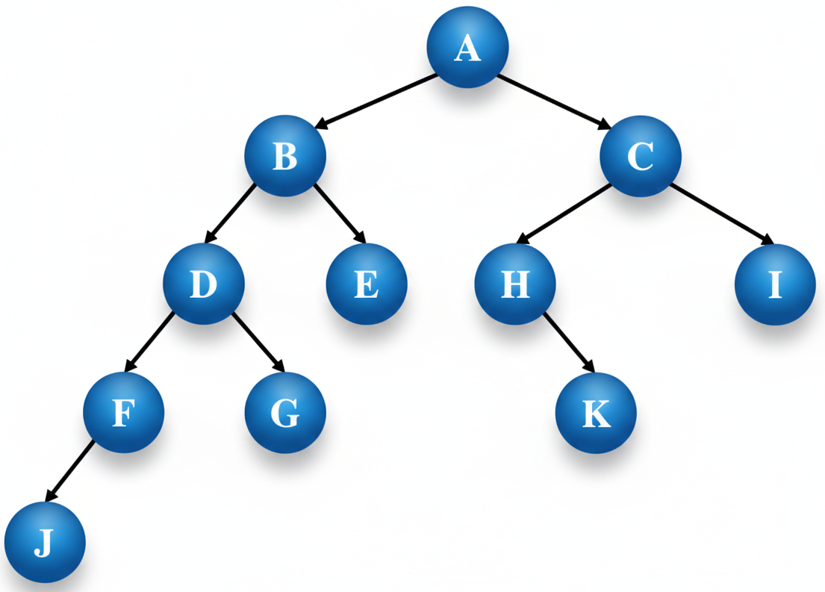
Depth-Limited Search (DLS)

Slide 6
Iterative Deepening Search (IDS)
Combines DFS and BFS advantages. (complete, space efficient)
Searches to a limited depth, increasing the limit with each iteration
Ensure both completeness and optimality
Ensure exploration of all nodes at each depth before going deeper

Slide 7
Iterative Deepening Search (IDS)

Slide 8
Comparison Summary
Search | Key Advantage | Key Disadvantage / Cost
BFS | Complete, optimal | High memory
UCS | Finds least-cost solution | High computational cost
DFS | Space efficient | Not optimal, may get stuck
DLS | Prevents infinite loops | May miss solution beyond depth limit
IDS | Combines BFS & DFS advantages | Repeated search → slightly more time

