Slide 1
Lecture # 6

Slide 2
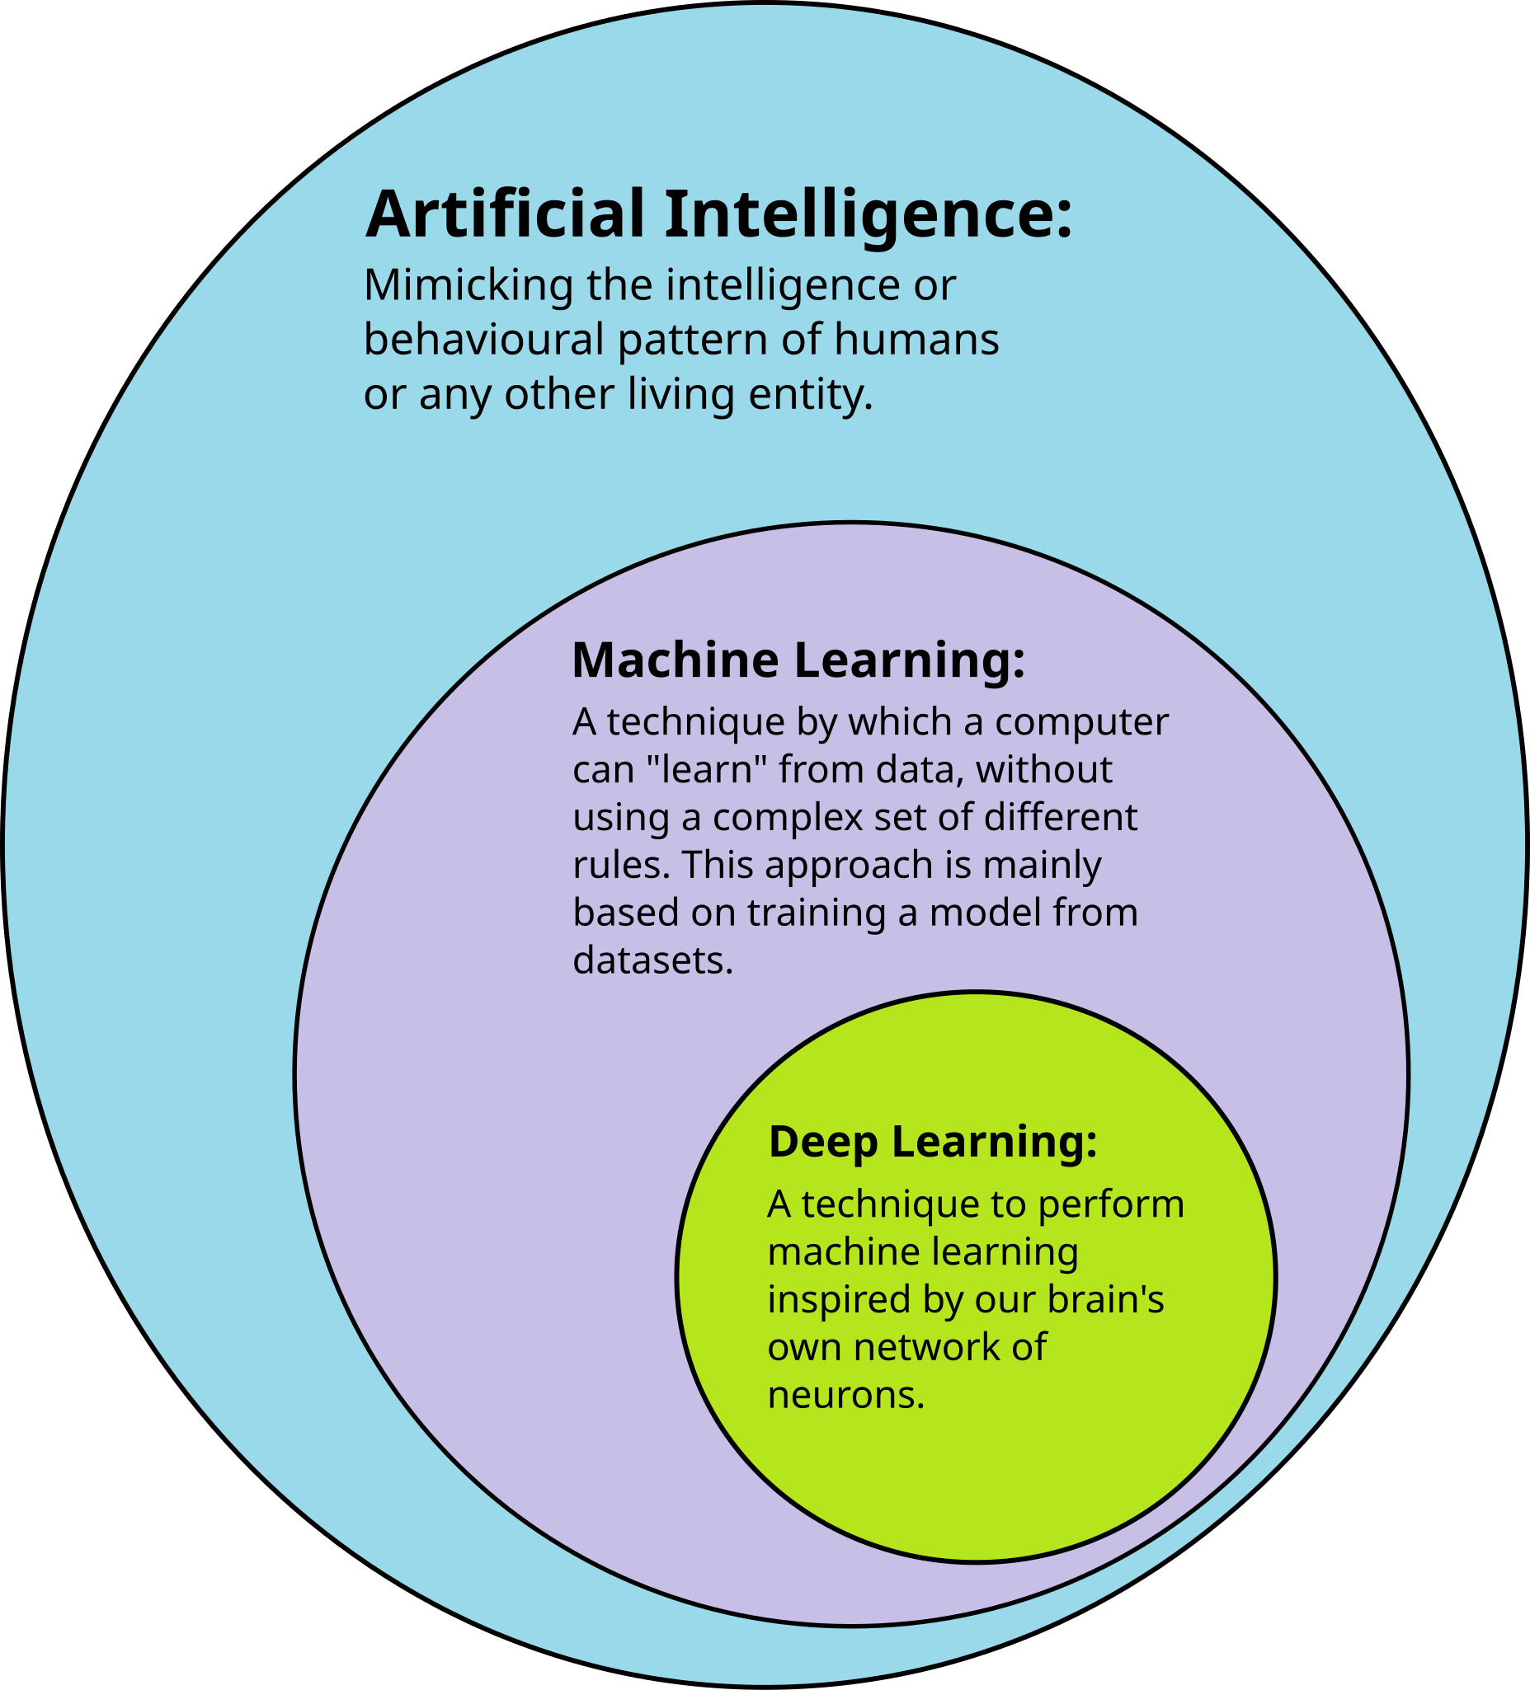
Introduction to Machine Learning

Slide 3

Introduction to Machine Learning
• Machine Learning (ML) is a field of Artificial Intelligence that enables computers to learn from data without being explicitly programmed.
• Instead of writing rules, the system finds patterns from data and makes decisions.
• The more data it learns from, the better its performance becomes.

Slide 4
What is Machine Learning?
• Machine Learning is teaching computers to learn from data
• Instead of programming every rule, we let the computer find patterns
Think of it like this:
• Traditional: You teach a child every single rule
• ML: You show examples and let them figure out the pattern
Example:
• Show 1000 cat photos → Computer learns what a cat looks like

Slide 5
Traditional Programming vs Machine Learning
Traditional Programming:
Input + Rules → Output
Example:
• Input: Number
• Rule: If number > 0, output 'Positive'
• Output: 'Positive' or 'Negative'
Limitations:
• Need to write all rules
• Can't handle complex patterns
• Hard to update
Machine Learning:
Input + Output → Rules
Example:
• Input: 1000 cat photos
• Output: Labels (cat/not cat)
• ML finds the rules automatically
Advantages:
• Learns from examples
• Handles complex patterns
• Improves with more data

Slide 6
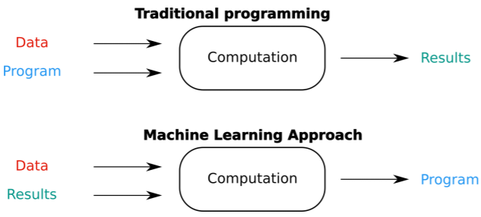
Traditional Programming Vs ML

Slide 7
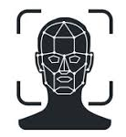


Why do we need Machine Learning?
Machine Learning means teaching computers by examples, not by rules.
1. Pattern Recognition
• Recognizing faces in photos
• Understanding speech
No fixed rules, so ML learns from examples
2. Too Many Rules
• Email spam: Rules change constantly
• Stock market: Millions of factors
Rules change, ML adapts automatically
3. Personalization
• Netflix recommendations
• YouTube video suggestions
Different users get different results

Slide 8
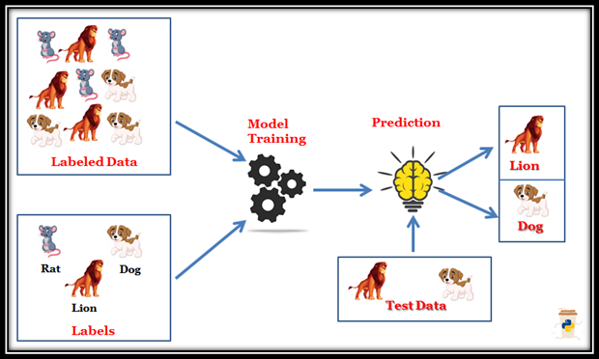
Types of Machine Learning
1. Supervised Learning
It is a type of Machine Learning where the model is trained using labeled data. The model learns the relationship between input and output and then makes predictions on new data. It has two types: classification and regression.
Learning with labeled examples
Like learning with answer key

Slide 9
Supervised Learning
• We provide labeled training data
• Model learns the relationship
• Then predicts on new data
Examples:
• Images: Cat, Dog, or Bird
• Grades: Predict student performance
Two types:
• Classification: Categories (spam/not spam)
• Regression: Numbers (house price, temperature)
Predict Pass / Fail ➝
Predict Marks out of 100 ➝
Predict House Price ➝
Predict Spam / Not Spam ➝

Slide 10
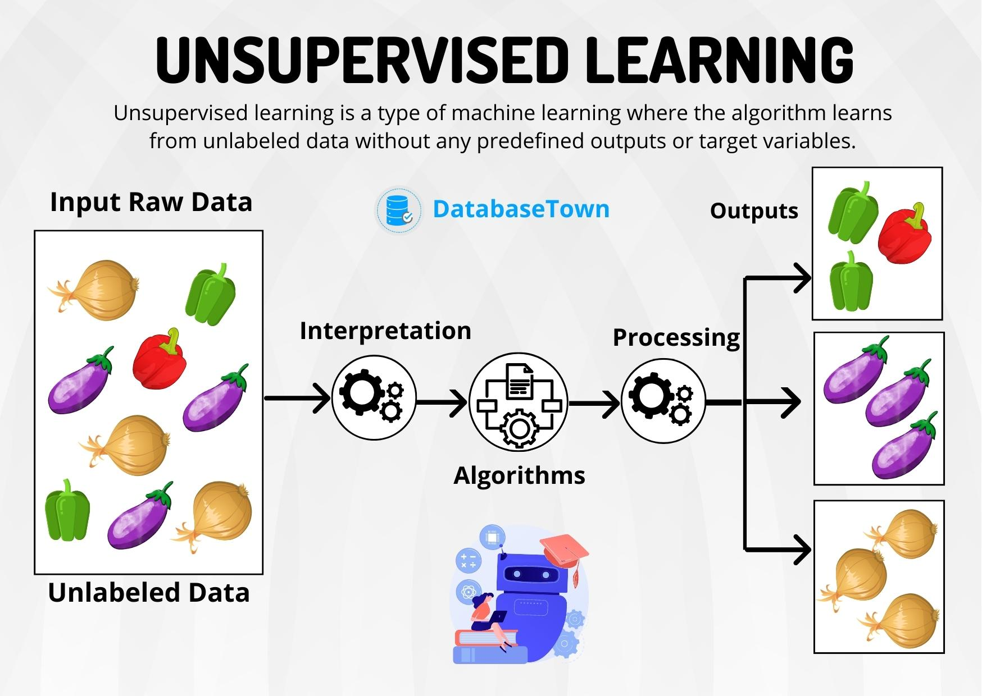
Types of Machine Learning
2. Unsupervised Learning is a type of Machine Learning where no labeled data is provided. The model finds hidden patterns and structure in data.
Unsupervised learning finds hidden patterns and often groups similar data points without using labels
Finding patterns in unlabeled data
Like exploring without a map

Slide 11
Unsupervised Learning
An online store has thousands of customers but no labels like “cheap buyer” or “premium buyer”.
What ML does:
Looks at buying frequency
Looks at money spent
Looks at product types
Result:
Group 1: High spenders
Group 2: Budget buyers
Group 3: Occasional buyers
Students with different learning styles.
What ML does:
Groups students by performance, speed, and behavior
No labels like “good” or “weak”
Result:
Fast learners
Average learners
Needs-help learners

Slide 12
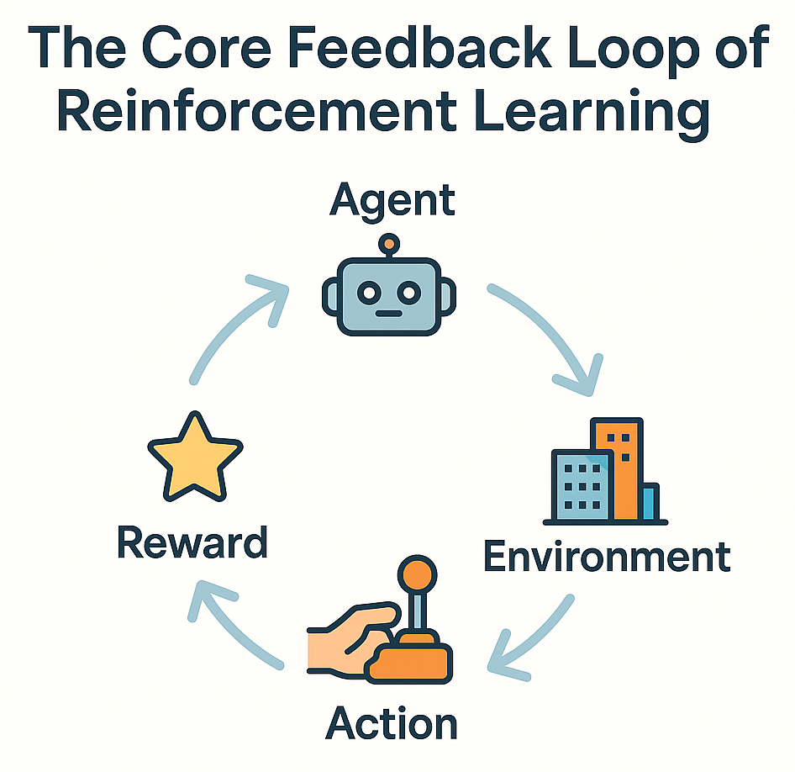
Types of Machine Learning
3. Reinforcement Learning is a type of Machine Learning where an agent learns by interacting with the environment. It receives rewards for good actions and penalties for bad actions. Over time, it learns the best actions to achieve its goal.
Reinforcement Learning = Learn by trying, get rewards or penalties, improve over time.
Learning through trial and error
Like learning to ride a bike

Slide 13
Reinforcement Learning
Definition:
• Agent learns by interacting with environment
• Gets rewards for good actions
• Gets penalties for bad actions
Real-world examples:
• Game playing (Chess, Go)
→ Learn winning strategies
• Robot navigation
→ Learn to avoid obstacles
• Recommendation systems
→ Learn what users like
Key concept:
• Trial and error with feedback

Slide 14
Real-world Example: Email Spam Detection
Problem:
• Millions of emails daily
• Spam changes constantly
• Can't write rules for everything
ML Solution:
• Train on thousands of emails
• Learn patterns:
- Words like 'FREE', 'WIN', 'URGENT'
- Suspicious sender addresses
- Unusual formatting
• Classify new emails automatically
Result:
• Gmail filters 99.9% of spam automatically

Slide 15
Real-world Example: Face Recognition
Problem:
• Identify people in photos
• Used in:
- Phone unlock
- Security systems
ML Solution:
• Train on millions of face images
• Learn facial features:
- Eye shape, nose, mouth position
- Face structure patterns
Result:
• Recognize faces in new photos

Slide 16
Real-world Example: Recommendation Systems
Netflix & YouTube:
• Problem: Too many videos to choose from
• Solution: Recommend what you might like
How it works:
• Track what you watch
• Find users with similar tastes
• Recommend what they liked
Example:
• You watched: Action movies
• Similar users also watched: Sci-fi
• Recommendation: Try 'Interstellar'
Result:
• 80% of Netflix views come from recommendations

Slide 17
Machine Learning Workflow
1. Data Collection
• Gather examples (photos, text, numbers)
2. Data Preprocessing
• Clean and organize data
• Remove errors and duplicates
3. Feature Extraction
• Convert raw data into features
4. Model Training
• Teach the model using data
5. Evaluation
• Test on new data
• Measure accuracy
6. Prediction
• Use model for real predictions

Slide 18
Common Machine Learning Applications
In Daily Life:
• Virtual assistants (Siri, Alexa)
• Social media feeds (Facebook, Instagram)
• Online shopping (Amazon recommendations)
• Navigation (Google Maps route optimization)
In Industry:
• Healthcare: Disease diagnosis
• Finance: Fraud detection
• Transportation: Self-driving cars
• Education: Personalized learning
In Research:
• Drug discovery
• Climate prediction
• Language translation

Slide 19
Key Takeaways
What we learned:
✓ Machine Learning = Learning from data
✓ Three types: Supervised, Unsupervised, Reinforcement
✓ Used everywhere: Email, photos, recommendations
✓ Workflow: Data → Features → Model → Prediction
Next:
→ How to extract features from data
→ How classification works
→ Practical examples

