Slide 1
Lecture # 7

Slide 2
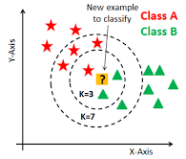
K-Nearest Neighbors (KNN)
Definition:
K-Nearest Neighbors (KNN) is a supervised machine learning algorithm used for:
Classification
Regression
It makes predictions based on the similarity between data points.
Key: "Similar things exist close to each other"

Slide 3
Why it is Called K-Nearest Neighbors?
K = Number of neighbors
Nearest = Based on distance
Neighbors = Closest data points
Example values of K:
K = 1 (Nearest neighbor only)
K = 3
K = 5

Slide 4
Simple Real-Life Analogy
Imagine you moved to a new area and want to know your neighbors' language.
You ask your 5 nearest neighbors:
3 speak Urdu
2 speak English
You will most likely speak Urdu.
This is exactly how KNN works.

Slide 5
How KNN Works (Step-by-Step)
Choose the value of K
Calculate distance between test point and all training points
Select K nearest neighbors
Take majority vote (classification)
Assign the predicted class

Slide 6

Distance Measures in KNN
Euclidean Distance
$Distance=\sqrt{\left(x2−x1{\left.)\right.}^{2}+\left(y2−y1{\left.)\right.}^{2}\right.\right.}$
Other distances:
Manhattan Distance
Minkowski Distance

Slide 7
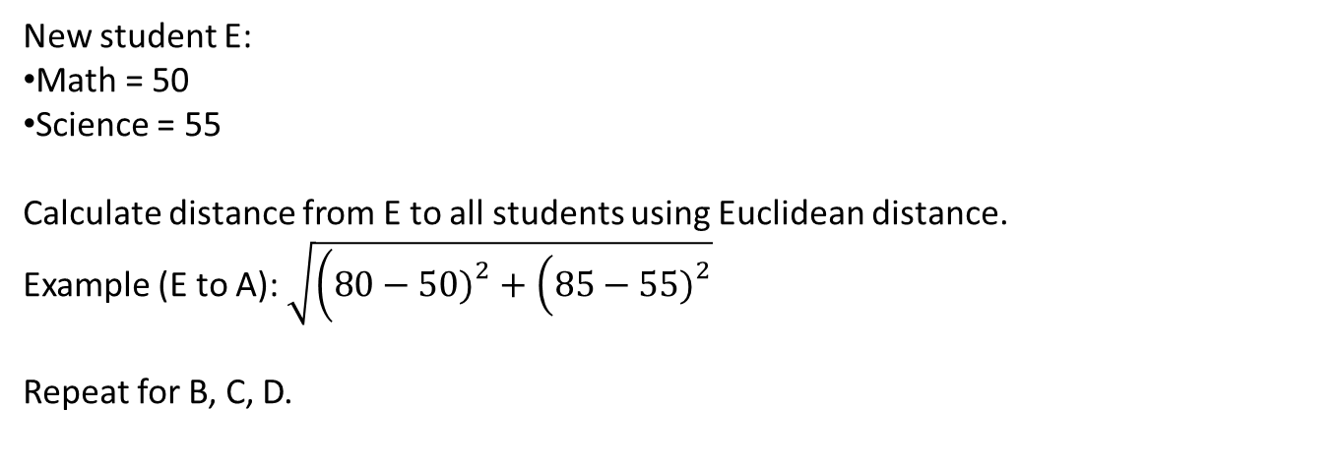
Example Dataset
Students | Math Marks | Science Marks | Result
A | 80 | 85 | PASS
B | 60 | 65 | PASS
C | 30 | 35 | FAIL
D | 40 | 45 | FAIL
New student E:
Math = 50
Science = 55
Calculate distance from E to all students using Euclidean distance.
Example (E to A): $\sqrt{\left(80−50{\left.)\right.}^{2}+\left(85−55{\left.)\right.}^{2}\right.\right.}$
Repeat for B, C, D.

Slide 8
Choosing the Value of K
Small K (K=1):
Sensitive to noise
Large K:
More stable
Rule:
Choose odd value (3,5,7)
KNN has no training phase
All computation happens during testing
That is why KNN is called a Lazy Learning Algorithm

Slide 9
Advantages/Disadvantages
Advantages of KNN
Simple and easy to understand
No training required
Works well with small datasets
Disadvantages of KNN
Slow for large datasets
Requires large memory
Sensitive to noise
Choice of K is critical

Slide 10
Applications:
Recommendation systems
Image classification
Medical diagnosis
Pattern recognition
KNN Summary:
Supervised ML algorithm
Uses distance to find neighbors
Predicts using majority voting
Simple and easy to understand

Slide 11
Training and Testing Error
In Machine Learning, we build models to make predictions. But predictions are never perfect. So, we need a way to measure mistakes. This measurement is called Error.
In Machine Learning, data is divided into:
Training Data → Used to learn patterns
Testing Data → Used to evaluate performance
Error means the number of wrong predictions made by a model.
Errors help us understand how good or bad a model is.
Typical split:
70% Training
30% Testing

Slide 12
Training Error
Definition: Training Error is the error calculated on the training dataset.
It shows:
How well the model learned the training data
Simple Words: "How many mistakes the model makes on data it has already seen."
Real-Life Example - Training Error
Imagine preparing for an exam using past papers.
You practice the same questions again and again
You score 95% on those practice papers
This is like low training error.

Slide 13
Testing Error
Definition: Testing Error is the error calculated on the testing dataset.
It shows:
How well the model performs on new, unseen data
Simple Words: "How many mistakes the model makes on new questions.“
Real-Life Example - Testing Error
In the final exam:
Questions are new
You score 60%
This is like high testing error.

Slide 14
Ideal Machine Learning Model
An ideal model should have:
Low Training Error
Low Testing Error
Means:
Model learned well
Model generalizes well

Slide 15
Overfitting Concept
Overfitting:
Model learns training data too perfectly
Results:
Very low training error
Very high testing error
Real-Life Example - Overfitting
A student:
Memorizes answers instead of understanding concepts
Scores 100% in practice tests
Fails final exam
This is Overfitting.

Slide 16
Underfitting Concept
Underfitting:
Model is too simple
Does not learn patterns properly
Results:
High training error
High testing error
Real-Life Example - Underfitting
A student:
Does not study properly
Scores low in practice tests
Scores low in final exam
This is Underfitting.

Slide 17
Balanced Model (Good Fit)
Good Fit:
Training error is low
Testing error is also low
Student:
Understands concepts
Performs well everywhere
Case | Training Error | Testing Error | Meaning
Underfitting | High | High | Model too simple
Overfitting | Low | High | Model memorized data
Good Fit | Low | Low | Model learned well

