Slide 1
Lecture # 3
Problem Solving by Searching

Slide 2
What is Problem Solving by Searching?
Finding a sequence of actions that transforms the initial state into a goal state.
State Space Search
No. of state in which problem can be solved
Precise (How to represent the problem precisely)
Analyze ( Can analyze the problem )
State space search helps us clearly define a problem, allowing the agent to understand the situation and decide which actions to take to reach its goal.

Slide 3
What is Problem Solving by Searching?
Problem Formulation:
Problem formulation means defining a problem clearly so that an intelligent agent knows what the goal is, where to start, and what actions it can take to reach that goal.
• State – Start and Goal
• Actions – possible moves | Set of actions | All possible actions
• Transition Model – result of an action
• Goal Test – checks if goal reached
• Path Cost – cost of reaching the goal

Slide 4
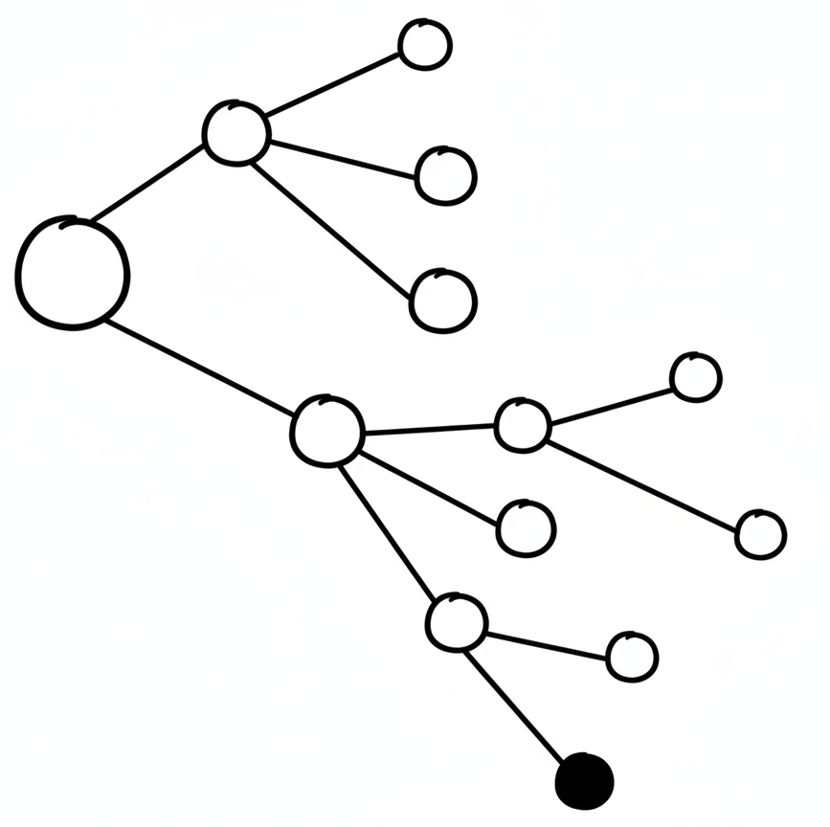
Uninformed Search Strategies
Searching Without Information
Searching without information
no prior knowledge of goal location
More time consumption and high chances of optimal solution
Explores state space systematically.
Includes:
BFS (Breadth-First Search)
UCS (Uniform-Cost Search)
DFS (Depth-First Search)
DLS (Depth-Limited Search
IDS (Iterative deepening DFS)

Slide 5
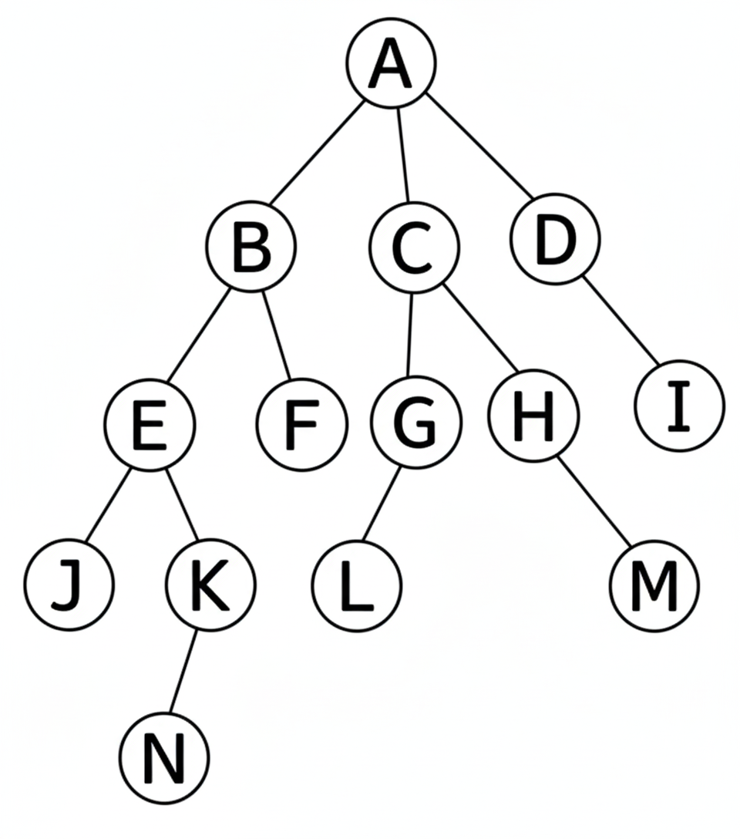
Breadth-First Search (BFS)
Uniformed search technique
Expands shallowest nodes first using a FIFO queue.
Complete
Optimal
Time & Space complexity: O(b^d)
AI Example: Chatbot exploring shortest conversation paths to reach desired user intent.

Slide 6
What is Breadth-First Search?
BFS explores neighbor nodes first, before moving to the next level of neighbors. It explores "wide" before it explores "deep."
Step | Current Node | Queue | Visited Node | Action
1 | A

Slide 7
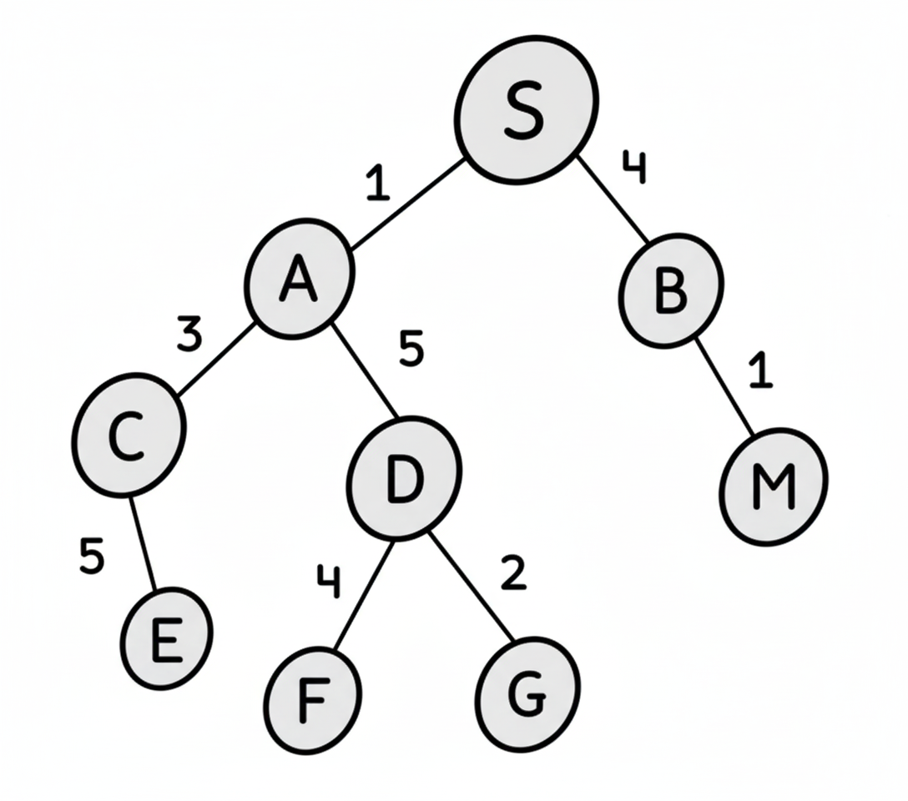
Uniform-Cost Search (UCS)
UCS is an uninformed search algorithm
By default, uses a BFS method (uses a weighted graph)
Find the least cost path from a start node to a goal node in a weighted graph
Guarantees optimal solution if step cost are non-negative
Explore the nodes with the lowest cumulative cost first
Uses a priority queue to manage nodes

Slide 8
Uniform-Cost Search (UCS)
Step | Current Node | Queue | Visited Node | Action
1 | S | [A(1), B(4)] | - | Push (A,B)
2 | A | [B(4), C(4), D(6)] | [S, A] | Push (C,D) Pop (A)
3 | B | [C(4), D(6), M(5)] | [S, A, B] | Push (M) Pop (B)
4 | C | [D(6), M(5), E(9)] | [S, A, B, C] | Push (E) Pop (C)
5 | M | [D(6), E(9)] | [S, A, B, C, M] | Pop (M)
6 | D | [E(9), F(10), G(8)] | [S, A, B, C, M, D] | Push (F,G) Pop D
7 | G | [E(9), F(10)] | [S, A, B, C, M, D, G] | Pop G
8 | E | [F(10)] | [S, A, B, C, M, D, G, E] | Pop E
9 | F | [ ] | [S, A, B, C, M, D, G, E, F] | Pop F

