Slide 1
Lecture # 4
Problem Solving by Searching

Slide 2
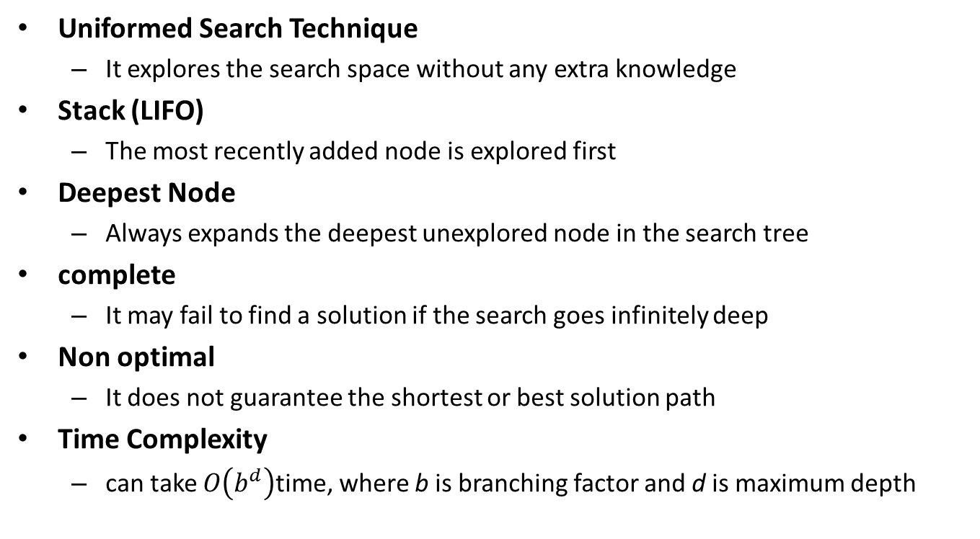
Depth-First Search (DFS)
Uniformed Search Technique
It explores the search space without any extra knowledge
Stack (LIFO)
The most recently added node is explored first
Deepest Node
Always expands the deepest unexplored node in the search tree
complete
It may fail to find a solution if the search goes infinitely deep
Non optimal
It does not guarantee the shortest or best solution path
Time Complexity
can take $O\left(b^{d}\right)$time, where b is branching factor and d is maximum depth

Slide 3
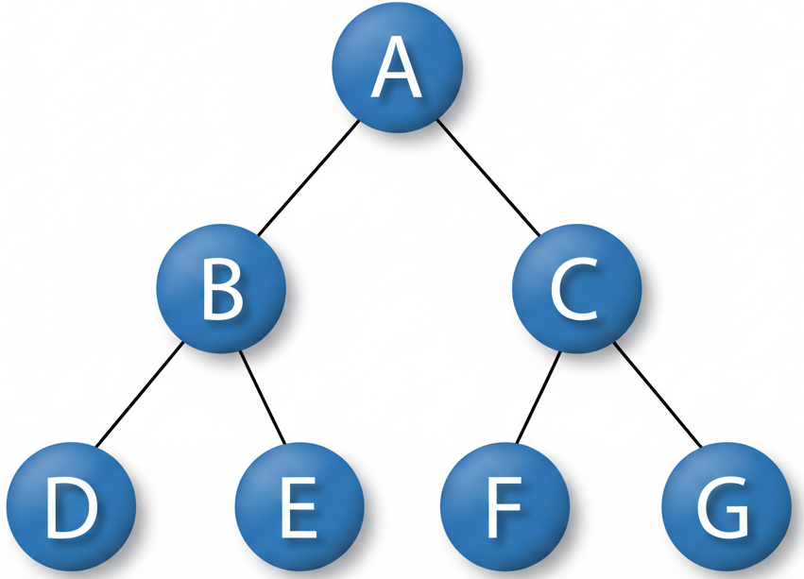
Depth-First Search (DFS)

Slide 4
DFS Traversal — Step 1 of 7: Visit A
⬤ Current
⬤ Visited
○ Unvisited
A
B
C
D
E
F
G
Stack (LIFO): [ B, C ] | Visited: A

Slide 5
DFS Traversal — Step 2 of 7: Visit C
⬤ Current
⬤ Visited
○ Unvisited
A
B
C
D
E
F
G
Stack (LIFO): [ B, G, F ] | Visited: A, C

Slide 6
DFS Traversal — Step 3 of 7: Visit F
⬤ Current
⬤ Visited
○ Unvisited
A
B
C
D
E
F
G
Stack (LIFO): [ B, G ] | Visited: A, C, F

Slide 7
DFS Traversal — Step 4: Visit G
A
● Current
● Visited
○ Unvisited
B
C
D
E
F
G
Stack: [B] | Visited: A, C, F, G

Slide 8
DFS Traversal — Step 5: Visit B
A
● Current
● Visited
○ Unvisited
B
C
D
E
F
G
Stack: [D, E] | Visited: A, C, F, G, B

Slide 9
DFS Traversal — Step 6: Visit E
A
● Current
● Visited
○ Unvisited
B
C
D
E
F
G
Stack: [D] | Visited: A, C, F, G, B, E

Slide 10
DFS Traversal — Step 7: Visit D ✓ Complete!
A
● Current
● Visited
○ Unvisited
B
C
D
E
F
G
Stack: [ empty ] | DFS Order: A → C → F → G → B → E → D

Slide 11
DFS Problem — Step-by-Step Solution
Step | Current Node | Stack (LIFO) | Visited
1 | A | B, C | A
2 | C | B, G, F | A, C
3 | F | B, G | A, C, F
4 | G | B | A, C, F, G
5 | B | D, E | A, C, F, G, B
6 | E | D | A, C, F, G, B, E
7 | D | — | A, C, F, G, B, E, D
Graph: A→B,C | B→D,E | C→F,G DFS uses Stack (LIFO) — explores deepest node first

Slide 12
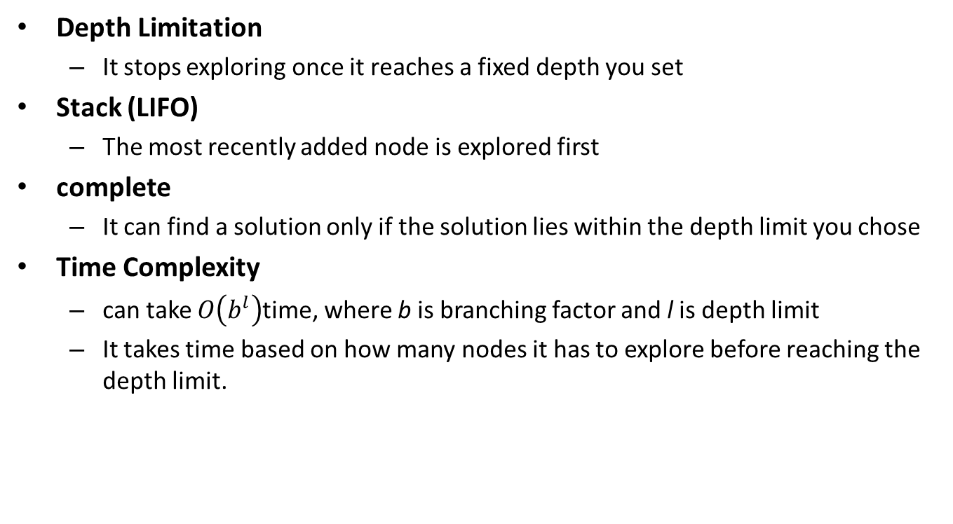
Depth-Limited Search (DLS)
Depth Limitation
It stops exploring once it reaches a fixed depth you set
Stack (LIFO)
The most recently added node is explored first
complete
It can find a solution only if the solution lies within the depth limit you chose
Time Complexity
can take $O\left(b^{l}\right)$time, where b is branching factor and l is depth limit
It takes time based on how many nodes it has to explore before reaching the depth limit.

Slide 13
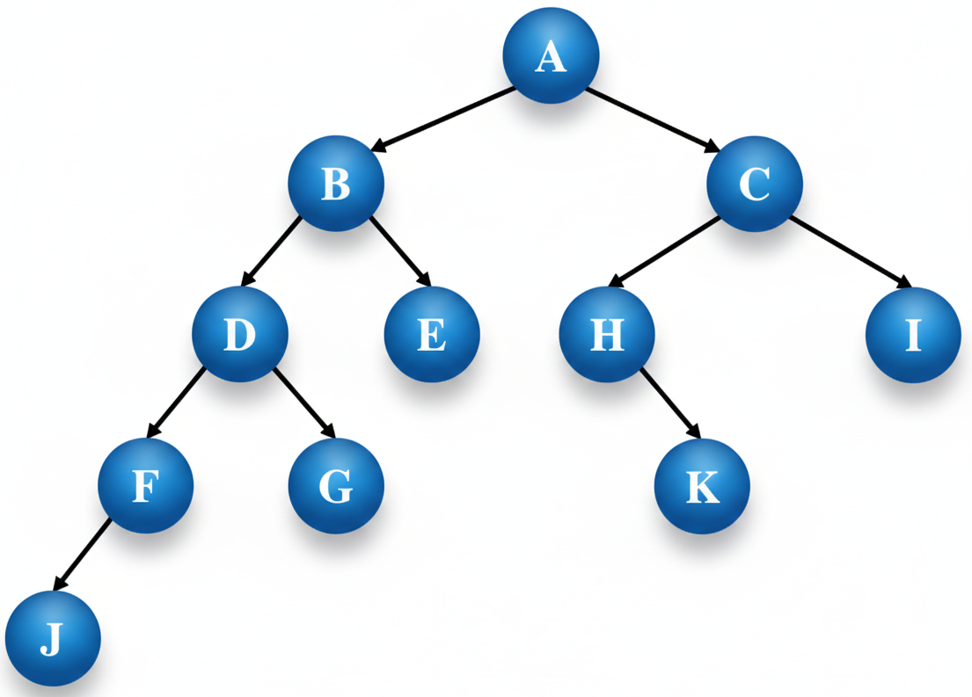
Depth-Limited Search (DLS)

Slide 14
Depth-Limited Search (DLS) — Solution | Depth Limit = 2 | Goal = G
Step | Node Popped | Depth | Action | Stack (top→bottom) | Visited
1 | A | 0 | Expand → push B, C | B, C | A
2 | B | 1 | Expand → push D, E | D, E, C | A, B
3 | D | 2 | At limit — no expand | E, C | A, B, D
4 | E | 2 | At limit — no expand | C | A, B, D, E
5 | C | 1 | Expand → push H, I | H, I | A, B, D, E, C
6 | H | 2 | At limit — no expand | I | A, B, D, E, C, H
7 | I | 2 | At limit — no expand | — | A, B, D, E, C, H, I

Slide 15
Iterative Deepening Search (IDS)
Combines DFS and BFS advantages. (complete, space efficient)
Searches to a limited depth, increasing the limit with each iteration
Ensure both completeness and optimality
Ensure exploration of all nodes at each depth before going deeper

Slide 16
Iterative Deepening Search (IDS)

Slide 17
Iterative Deepening Search (IDS) — Solution | Goal = G
Iteration | Depth Limit | Nodes Explored (order) | Result
0 | 0 | A | Goal not found
1 | 1 | A → B → C | Goal not found
2 | 2 | A → B → D → E → C → H → I | Goal not found
3 | 3 | A → B → D → F → G | ✓ GOAL FOUND (G at depth 2)
IDS re-runs DFS from scratch at each deeper limit — combines DFS space efficiency + BFS completeness

Slide 18
Algorithm | Time Complexity | Space Complexity | Complete? | Optimal?
BFS (Breadth-First) | O(b ^ d) | O(b ^ d) | Yes (on finite graphs) | Yes
DFS (Depth-First) | O(b ^ m) | O(b * m) | No (may loop) | No
DLS (Depth-Limited) | O(b ^ l) | O(b * l) | No (fails if d > l) | No
IDS (Iterative Deepening) | O(b ^ d) | O(b * d) | Yes | Yes

Slide 19
Comparison Summary
Search | Key Advantage | Key Disadvantage / Cost
BFS | Complete, optimal | High memory
UCS | Finds least-cost solution | High computational cost
DFS | Space efficient | Not optimal, may get stuck
DLS | Prevents infinite loops | May miss solution beyond depth limit
IDS | Combines BFS & DFS advantages | Repeated search → slightly more time

