Slide 1
Problem Solving by Searching
Artificial Intelligence – Uninformed Search Strategies
Muhammad Hussain | Air University Karachi

Slide 2
What is Problem Solving by Searching?
Finding a sequence of actions from an initial state to a goal state.
• Initial State – where the agent starts
• Actions – possible moves
• Transition Model – results of actions
• Goal Test – checks if the goal is reached
• Path Cost – total cost of reaching a goal

Slide 3
Process of Problem Solving
1. Formulate the Problem
define states
actions
transition model
2. Search for a Solution
explore the state space
3. Execute the Actions
perform the found plan to reach goal
Example: AI assistant finding optimal steps to answer a query.

Slide 4
Uninformed Search Strategies
Also called Blind Search
no prior knowledge of goal location.
Explores state space systematically.
Includes:
BFS
DFS
UCS
DLS
IDS, and Bidirectional Search.

Slide 5
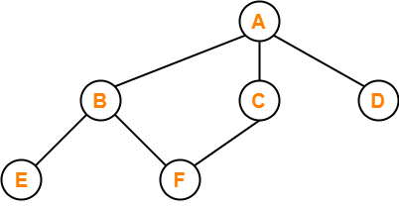
What is Breadth-First Search?
BFS explores neighbor nodes first, before moving to the next level of neighbors. It explores "wide" before it explores "deep."

Slide 6
Breadth-First Search (BFS)
Expands shallowest nodes first using a FIFO queue.
✅ Complete,
Time & Space: O(b^d)
AI Example: Chatbot exploring shortest conversation paths to reach desired user intent.

Slide 7
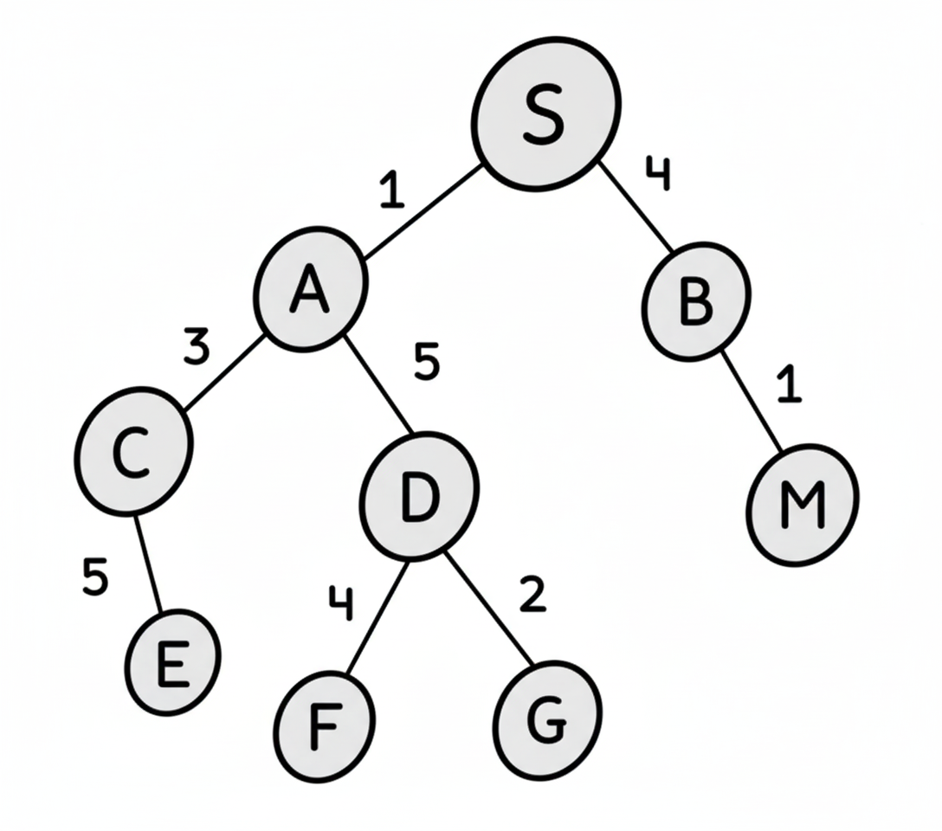
Uniform-Cost Search (UCS)
Expands node with the lowest path cost using a priority queue.
Find least cost path to reach the goal
Explore the nodes with the lowest cumulative cost first
Priority queue used for implementation

Slide 8
Uniform-Cost Search (UCS)

Slide 9
Depth-First Search (DFS)
Expands the deepest node first using a LIFO stack.
❌ Not complete for infinite spaces, ❌ Not optimal.
AI Example: AI agent exploring possible reasoning chains deeply before backtracking.

Slide 10
Depth-Limited Search (DLS)
DFS variant with depth limit to prevent infinite loops.
❌ Not complete if solution deeper than limit.
AI Example: AI game bot searching moves up to limited depth (due to time constraints).

Slide 11
Iterative Deepening Search (IDS)
Combines BFS and DFS benefits by gradually increasing depth limit.
✅ Complete, ✅ Optimal for unit costs.
AI Example: Word transformation problem in NLP (‘cat’ → ‘dog’) using minimal steps.

Slide 12
Bidirectional Search
Runs two searches: forward from start, backward from goal.
They meet in the middle, reducing search time drastically.
✅ Complete & Optimal if BFS used.
AI Example: Finding shortest semantic connection between two AI knowledge graph nodes.

Slide 13
Comparison Summary
BFS – Complete, Optimal, High Memory
DFS – Space Efficient, Not Optimal
UCS – Least-Cost Solution, High Cost
DLS – Prevents Infinite Loop, May Miss Solution
IDS – Combines BFS & DFS Benefits
Bidirectional – Fastest for Large Problems

Slide 14
Key Takeaways
Uninformed search = no domain knowledge
BFS finds shortest path; DFS uses less memory
UCS finds least-cost path; IDS is efficient and complete
Bidirectional search reduces time significantly
AI uses search algorithms in planning, pathfinding, and reasoning

