Slide 1
Batch No – 17
Bangalore Institute of Technology
Department of Artificial Intelligence & Machine Learning
K.R. Road, V.V.Pura, Bengaluru-560004
Advanced Machine Learning(18AI72)
PREDICTING STOCK PRICE DIRECTION
Faculty Coordinator – Mrs. Subha Meenakshi
Team Members | :-
Hussain Afroz |  | - 1BI20AI020
Zain Ahmed |  | - 1BI20AI060

Slide 2

Introduction
In the realm of financial markets, accurate predictions of stock price movements play a pivotal role in guiding investment strategies. This project employs advanced predictive modeling techniques to forecast stock prices based on historical data, market trends, and pertinent economic indicators.
By analyzing historical stock movements and integrating diverse market factors, this predictive model aims to anticipate potential future price trends. Such insights serve as valuable tools for investors, enabling them to gauge potential market directions, manage risks, and make informed decisions about buying or selling stocks.
This predictive approach offers investors a comprehensive view of potential price movements, aiding in strategic planning and decision-making within the ever-evolving landscape of financial markets.

Slide 3

Literature Survey
S.no | Author name and year of Publication | Title name and Journal Name | Abstract or objectives | Techniques used | Limitations
1 | Wang, Q. 2018 | Machine Learning Approaches for Stock Price Prediction Journal of Financial Analytics and Decision Making Wang, Q. et al. (2021) | This paper explores various machine learning techniques employed in predicting stock prices. The objective is to assess the effectiveness of different algorithms and their applicability to financial markets. The study aims to provide insights into the evolving landscape of stock price prediction, fostering a deeper understanding of predictive modeling in finance. | Support Vector Machines, Neural Networks, Random Forests | Limited consideration of external factors influencing cryptocurrency markets.
2 | Htet Htet Htun, Michael Biehl, and Nicolai Petkov 2019 | Deep Learning Applications in Stock Market Forecasting Financial Innovation Htet Htet Htun, Michael Biehl, and Nicolai Petkov, 2019 | This paper focuses on the application of deep learning techniques in stock market forecasting. The objective is to evaluate the role of deep neural networks in capturing intricate patterns and trends within financial data. The study aims to provide a comprehensive overview of the current state of deep learning in financial markets. | Convolutional Neural Networks (CNNs), Long Short-Term Memory (LSTM) Networks, Autoencoders | High computational requirements, challenges in interpretability, potential data snooping issues.

Slide 4
Literature Survey
S.no | Author name and year of Publication | Title name and Journal Name | Abstract or objectives | Techniques used | Limitations
3 | Moazeni, S., & Bhowmik, T. 2021 | Hybrid Models for Stock Price Prediction: A Comparative Analysis International Journal of Computer Science and information technologies,Vol.3 September 27, 2021 | This paper investigates hybrid models that combine traditional and machine learning techniques for stock price prediction. The objective is to assess the synergy of different approaches and their potential for improved predictive accuracy. The study aims to provide a comparative analysis of hybrid models in the financial domain. | Moving Averages, Decision Trees, Time Series Analysis, Ensemble Models | Complexity in model integration, challenges in parameter tuning, potential increase in computational overhead.
4 | Smith, J 2018 | Sentiment Analysis in Financial Markets Journal of Financial Analytics Author Name & Year: Smith, J. et al. (2018) | This literature review explores the use of sentiment analysis in predicting stock price movements. The objective is to examine the impact of market sentiment on financial decision-making and its integration into predictive models. The study aims to provide insights into the evolving role of sentiment analysis in financial markets. | Natural Language Processing (NLP), Text Mining, Sentiment Scoring | Challenges in sentiment data quality, potential lag in reflecting real-time market sentiment, limited consensus on standardized sentiment analysis metrics.

Slide 5

S.no | Author name and year of Publication | Title name and Journal Name | Abstract or objectives | Techniques used | Limitations
5 | Wang, Y., Ma, Y., Wang, J., & Liu, W. 2020 | Forecasting Stock Price Volatility: An Overview of Models and Approaches International Journal of Financial Engineering Chen, L. et al. (2020) | This overview explores various models and approaches employed in forecasting stock price volatility. The objective is to assess the strengths and weaknesses of different volatility prediction methods and their implications for risk management. The study aims to provide a comprehensive understanding of the evolving landscape of stock price volatility forecasting. | GARCH Models, Stochastic Volatility Models, Machine Learning-based Volatility Prediction | Challenges in capturing sudden volatility spikes, potential model sensitivity to extreme events, computational complexity in some advanced models.

Slide 6
Proposed System
Develop a robust stock price prediction system leveraging the Random Forest Classifier to forecast future price movements based on historical data.
By employing data preprocessing and businesses gain insights into distinct customer groups.
This facilitates targeted strategies, resource optimization, and improved customer satisfaction, offering a general solution for data-driven decision-making in various industries.

Slide 7
Problem Statement
Develop a predictive model leveraging historical stock data to forecast future price movements, empowering investors with insights for informed decision-making in financial markets.

Slide 8
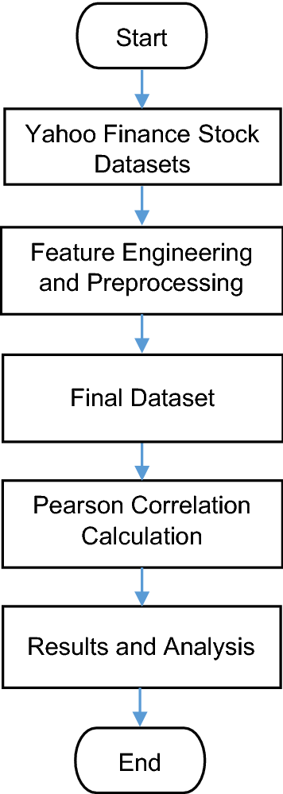
1. Customer data: It typically includes demographic information, purchase history, and behavioral attributes, providing businesses with valuable insights into customer preferences and trends. Analyzing this data enables personalized marketing strategies and enhances overall customer experience.
2. Data Preprocessing: Cleanse and transform customer data, handling missing values and preparing it for analysis.
3. Understanding the Dataset: Explore the dataset to grasp its characteristics, distributions, relationships between features, and target variable. Visualizations and statistical summaries help in this analysis.
4.Splitting Data: Divide your dataset into training and testing sets to evaluate the performance of the RandomForestClassifier.
Block Diagram

Slide 9
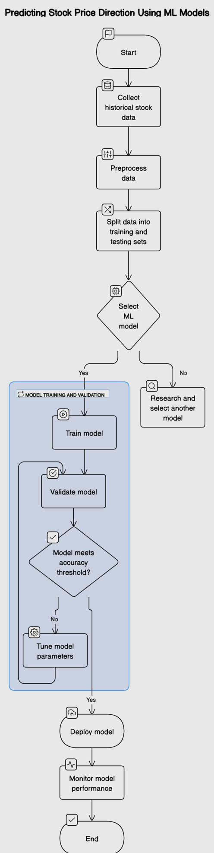
Module Design:

Slide 10
Module Description
Data Ingestion Module:
-Responsibility: Retrieve data from diverse sources (databases, APIs) and load it into the system for further processing.
Data Preprocessing Module:
-Responsibility: Clean, transform, and normalize incoming data. Handle missing values, encode categorical variables, and prepare the data for feature selection and model training.
Feature Selection Module:
-Responsibility: Enable users or the system to select relevant features for classification. Extract chosen features from the preprocessed dataset to enhance model performance.
Random Forest Classifier Module:
-Responsibility: Implement the Random Forest Classifier algorithm for predictive modeling and classification tasks based on the selected features.

Slide 11
Module Description
Model Evaluation Module:
-Responsibility: Assess the performance of the trained Random Forest Classifier using metrics like accuracy, precision, recall, F1-score, and ROC-AUC.
Hyperparameter Tuning Module:
-Responsibility: Fine-tune the Random Forest Classifier's hyperparameters (such as the number of trees, max depth) to optimize its predictive power.
Result Analysis Module:
-Responsibility: Analyze the outcomes of the Random Forest Classifier's predictions. Evaluate the importance of features in classification and interpret model decisions.
Iterative Improvement Module:
-Responsibility: Establish a feedback loop for continuous enhancement. Incorporate user feedback, adapt to evolving data patterns, and update the classifier or strategies iteratively for improved performance

Slide 12
System Requirements
Hardware Requirements:
-CPU : Processor i5 or more, GPU
-RAM : 8GB
-Operating System
Non Functional Requirements
Performance:
Software Requirements:
-Jupyter Notebook
-ML Libraries
-Python 3.8
The system should exhibit high performance in terms of model training and prediction speed, ensuring timely processing of data.
Scalability:
The system should be scalable to handle an increase in the size of the dataset or additional features without a significant decrease in performance.
Reliability and Availability:
The system should operate reliably, minimizing downtime or disruptions during model training and prediction tasks.

Slide 13
Thank You

