Slide 1
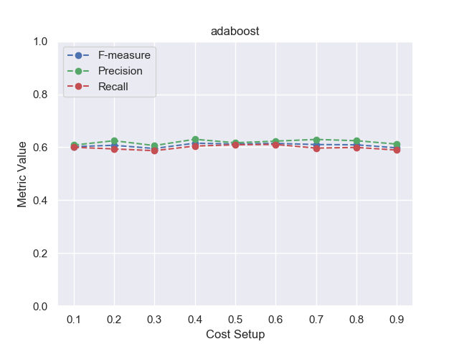
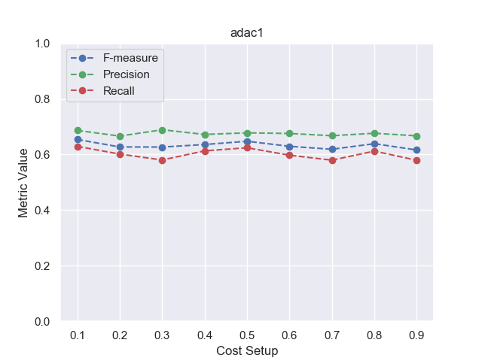
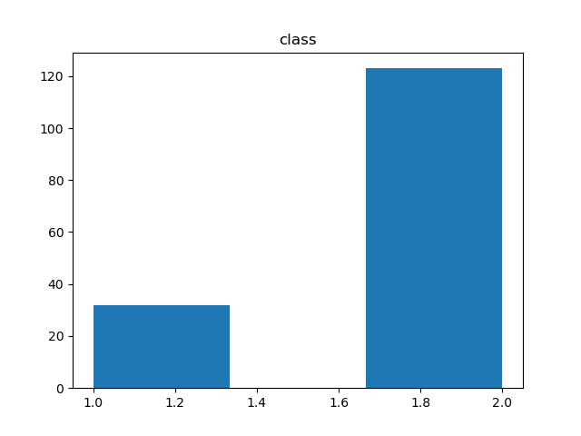
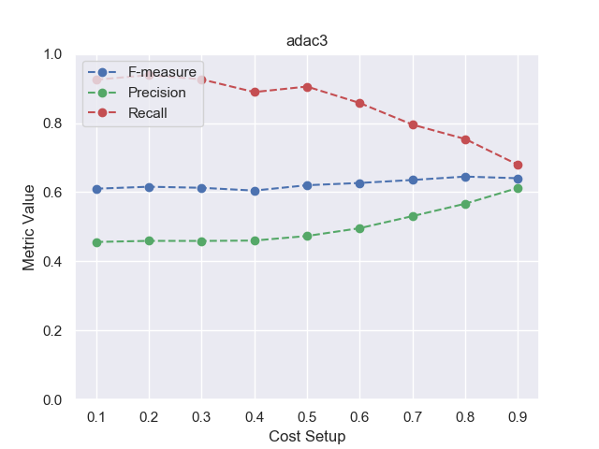
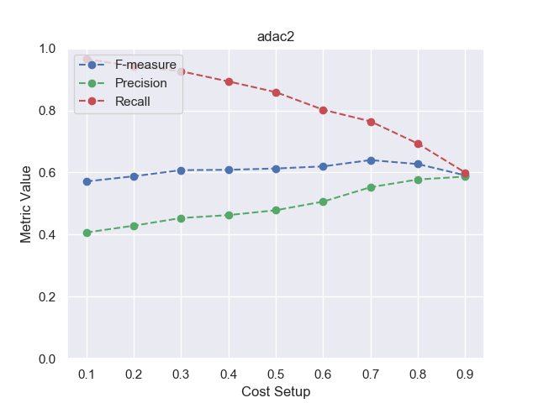
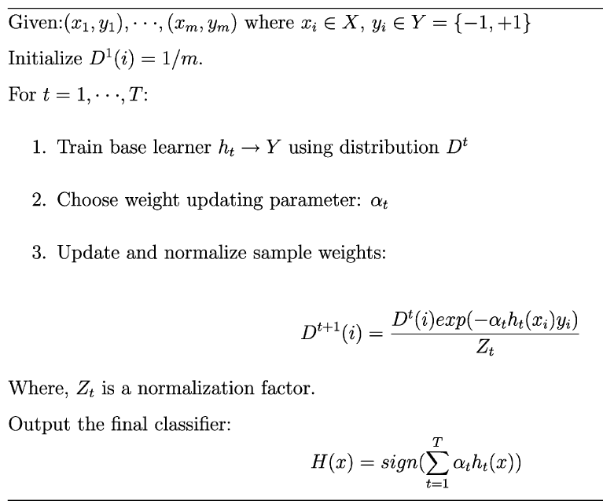
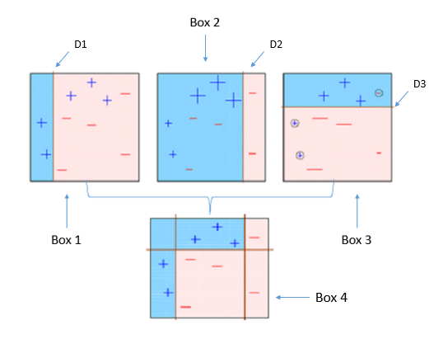
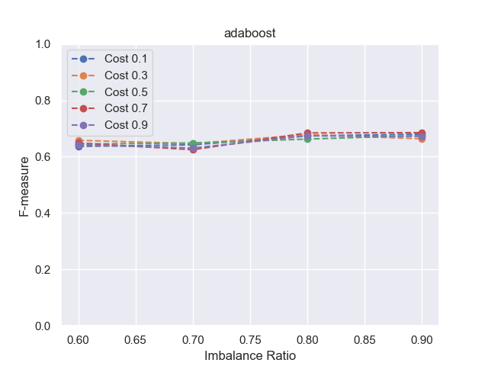
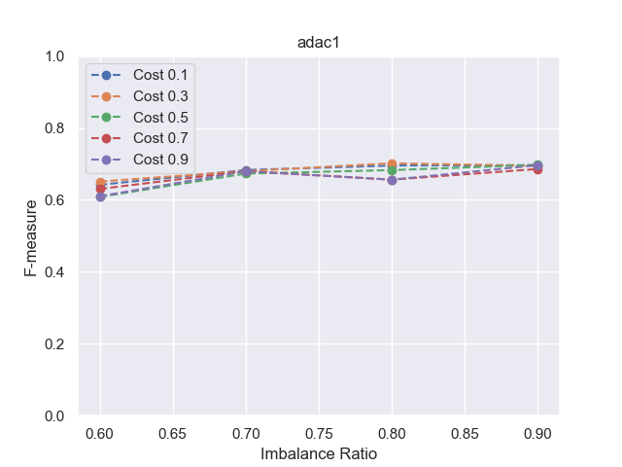
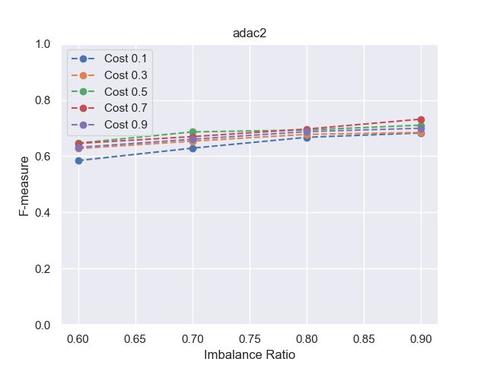
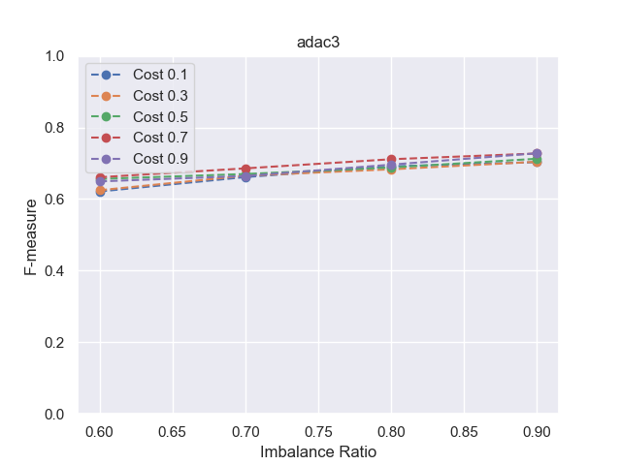
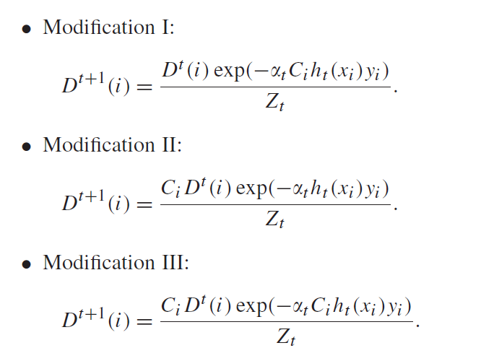
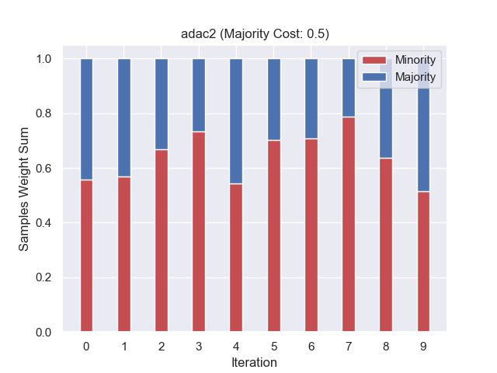
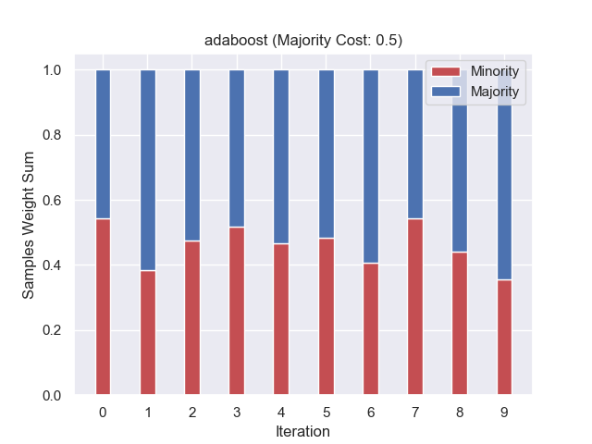


Cost-sensitive boosting for classification of imbalanced data
Project 12
Omar Arab Oghli, Hussain Kanafani, Muaid Mughrabi
omar.araboghli@outlook.com, hussainkanafani@gmail.com, mydo.mughrabi@gmail.com
1. Data Imbalance Problem
4. Results regarding Costs
Imbalanced class distribution: having many more instances of one class than the other
Conventional Classification Algorithms e.g. decision tree fails!
Standard classifiers are designed to generalize from balanced training data
Traditional evaluation measures like accuracy are misleading as they focus on average performance
Except AdaC1, the other algorithms are able to achieve higher recall values than precision values with the recall line lying above the F-measure line and the precision line below the F-measure line in most setups. AdaC1 cannot always obtain higher recall values than precision values
AdaC2 and AdaC3 are sensitive to cost setup
Imbalanced Distribution
2. AdaBoost
Sequential ensemble algorithm based on n weighted weak learners
5. Results regarding Imbalance Ratios
AdaBoost and AdaC1 don’t show any performance variation regarding the imbalance ratio
AdaC2 and AdaC3 yield better performance with more balanced datasets
Image Source 1
3. AdaC1 - AdaC2 - AdaC3
Each sample is associated with a cost item: the higher the value, the higher the importance of correctly identifying this sample
There are three ways to introduce cost items into the weight update formula of AdaBoost: inside the exponent, outside the exponent, and both inside and outside the exponent
6. Algorithmic Behavior
Weight updating strategy of AdaC2 weighs each sample by its associated cost item directly. This enables a standard classification learning algorithm that optimizes error rate to optimize cost error rate according to the translation theorem
Sources:
https://towardsdatascience.com/understanding-adaboost-2f94f22d5bfe
https://sci2s.ugr.es/keel/pdf/algorithm/articulo/2007%20-%20PR%20-%20Sun%20-%20Cost-Sensitive%20boosting.pdf
cost-sensitive-boosting repository:
https://gitlab.com/omar.araboghli/cost-sensitive-boosting.git

