Slide 1
Project 12: Cost-Sensitive Boosting for Classification of Imbalanced Data
Arab oghli, Omar || Kanafani, Hussain || Mughrabi, Muaid
Mentor: Prof. Dr. Eirini Ntoutsi

Slide 2
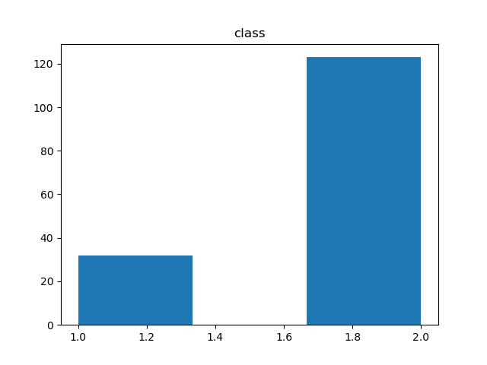
The Class Imbalance Problem
Conventional Classification Algorithms e.g. decision tree, KNN, and SVM.
Imbalanced class distribution: having many more instances of some classes than others
Applications: Fraud detection, Disease detection.
Standard classifiers are designed to generalize from balanced training data. (here: the focus will be on majority)
Hepatitits Dataset of UCI Machine Learning Database

Slide 3
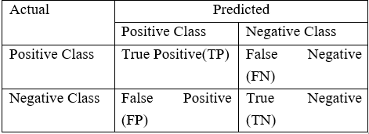

The Class Imbalance Problem
Case: positive class( 2%), negative class( 98%)
The promise of accuracy improvement is trivial in the context of the class imbalance problem, where accuracy is less meaningful
https://www.analyticsvidhya.com/blog/2017/03/imbalanced-classification-problem/

Slide 4
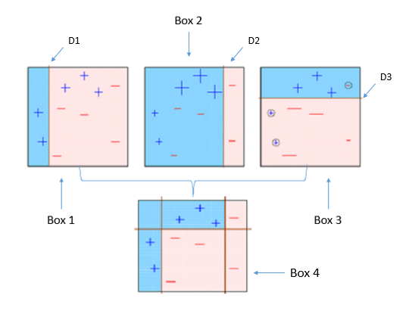

The Class Imbalance Problem
AdaBoost: Sequential ensemble algorithm based on n learners where each learner depends on results of the previous learner. But still biased against majority.
Weighting Strategy
Problem with imbalanced data:
Prevalent class
https://towardsdatascience.com/understanding-adaboost-2f94f22d5bfe

Slide 5
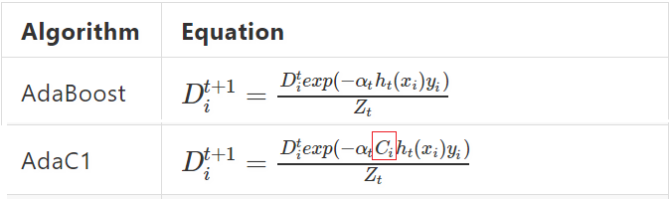
Cost-Sensitive Boosting for Class Imbalance
Improvement idea: Assign costs to classes (high for the minority) to take the class-membership into account.

Slide 6
In this project
We will implement a ML pipeline
We will analyse the impact of choosing the base learner
We will analyse the differences between the three adjustments (AdaC1, AdaC2, AdaC3)
We will analyse the impact of the imbalance ratio

Slide 7
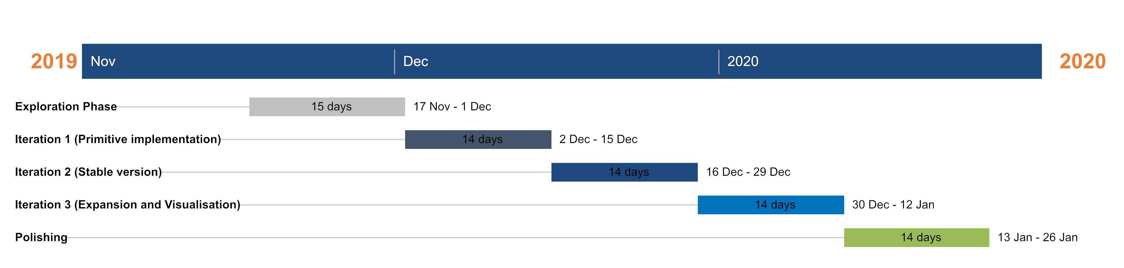
Our workplan

Slide 8
Q&As
Contact us under:
omar.araboghli@outlook.com
mydo.mughrabi@gmail.com
hussainkanafani@gmail.com

