Slide 1
Project 12: Cost-Sensitive Boosting for Classification of Imbalanced Data
Arab Oghli, Omar || Kanafani Hussain || Mughrabi, Muaid
Mentor: Prof. Dr. Eirini Ntoutsi

Slide 2
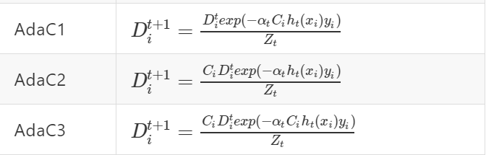
Recap
Very low number of instances of class A in comparison with the huge number of instances of class B (e.g. Fraud Detection)
Traditional evaluation measures like accuracy are misleading as they focus on average performance
Naïve idea: AdaBoost as a boosting algorithm
Better idea: AdaC1, AdaC2, and AdaC3 as cost-sensitive boosting algorithms
Assign high cost to the minority!

Slide 3
Project status
Find suitable datasets (done)
Primitive implementation (done)
ML Pipeline (done)
Reproduce paper results (in progress)
Informative visualization of results (in progress)
Experimenting with the new datasets (to do)

Slide 4
Datasets
4 Datasets (used in the paper)
Breast cancer data (Cancer) 9 attributes, 3 of which are linear and 6 are nominal 286 instances, 9 of which are with missing values 29.7% positive, 70.3% negative | Hepatitis data (Hepatitis) 10 attributes, one of which is continuously valued 155 instances 20.65% positive, 79.35% negative
Pima Indian’s diabetes database (Pima) 8 continuously valued attributes 768 instances 268 positive, 500 negative | Sick-euthyroid data (Sick) 25 attributes, 7 are continuous, 18 are boolean 3163 instances 9.26% positive, 90.74% negative

Slide 5
Data Processor
Ignore missing values
One-Hot Encoding
Test sets construction:
80% 20% 10-fold random construction

Slide 6
Implementation
Weak classifiers: Decision Tree and Neural Network
Better understand the weight changes done via the algorithm by:
Checking how the population distribution changes over the iterations
Plotting those changes in easy to read format

Slide 7


Evaluator & Visualizer
Evaluating the predictive performance (using F-measure, G-mean)
Evaluating the impact of parameters ( class costs, update factor, instance weights, and weak learner)
Visualize weights changes over the sequential execution of each algorithm
$$G−mean=\sqrt{{TP}_{rate}.{TN}_{rate}}$$

Slide 8
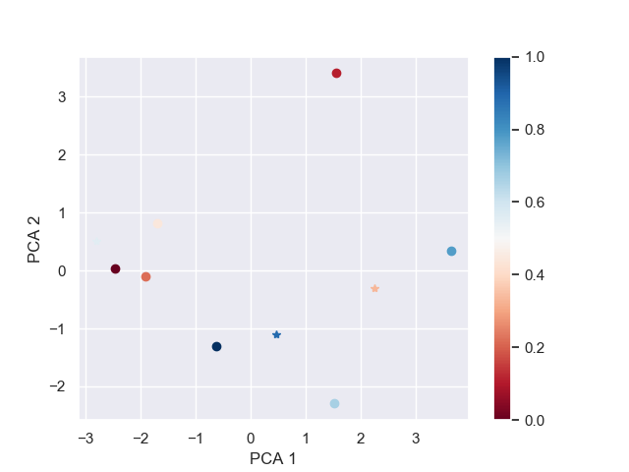
Visualisation of model in classification step
Show weights and classes in iteration(t)
Use PCA to convert from n dim (dataset features) space to 2d space.
Color coding to show instance weight for the classifier
Shape coding for classes (here circle and star)
Figure: Visualizer on Dummy Data

Slide 9
Next Steps
Stable version (connecting the parts together, tests, and bug fixing)
Evaluate the results to understand the differences between the algorithms (starting 19.01.2020)
Handle multiclass problem as mentioned in the paper (starting 19.01.2020)

Slide 10
Questions?

