Slide 1
AI-Trust Forensic Suite
Multi-Task Detection & Attribution of AI-Generated Images
with Explainable AI
Mohammed Hussain Nathani | GWID: G36308827 | DATS 6499 Capstone | GWU - Spring 2026
Instructor: Prof. Yuxiao (James) Huang

Slide 2
PROBLEM
The Rise of Synthetic Media
Generative AI models (DALL·E 3, Midjourney, Stable Diffusion) now produce images indistinguishable from real photographs
Misinformation risk is rapidly expanding across social media, journalism, and legal evidence
Existing commercial detectors (Undetectable.ai, Sightengine, Decopy.ai) return only a binary score — no explanation
They operate as black boxes: no visual evidence, no source attribution — just a number
"The problem isn't just detecting AI images — it's that current tools give you a number and nothing else."

Slide 3
MOTIVATION
Gap Analysis — What's Missing?
Feature | Undetectable.ai | Sightengine | Decopy.ai | Our Suite
Binary Detection | ✓ | ✓ | ✓ | ✓
Generator Attribution | ✗ | ✗ | ✗ | ✓
Visual Explanation (XAI) | ✗ | ✗ | ✗ | ✓
Open Source | ✗ | ✗ | ✗ | ✓

Slide 4
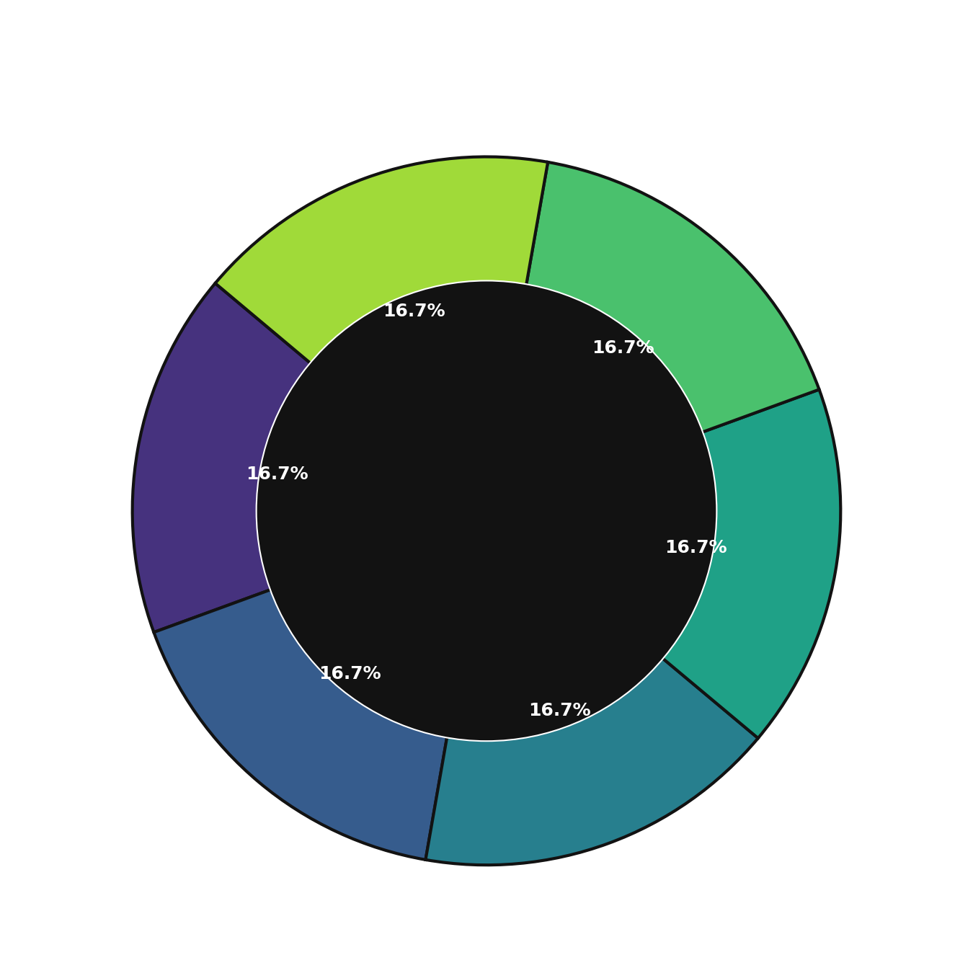
DATA
Dataset: Defactify (96,000 Images)
Real Photos
Stable Diffusion 2.1
Stable Diffusion XL
~7,500 images per class
~7,500 images per class
~7,500 images per class
Stable Diffusion 3
DALL·E 3
Midjourney
~7,500 images per class
~7,500 images per class
~7,500 images per class
Split: 42,000 Train / 9,000 Validation / 45,000 Test — Source: HuggingFace

Slide 5
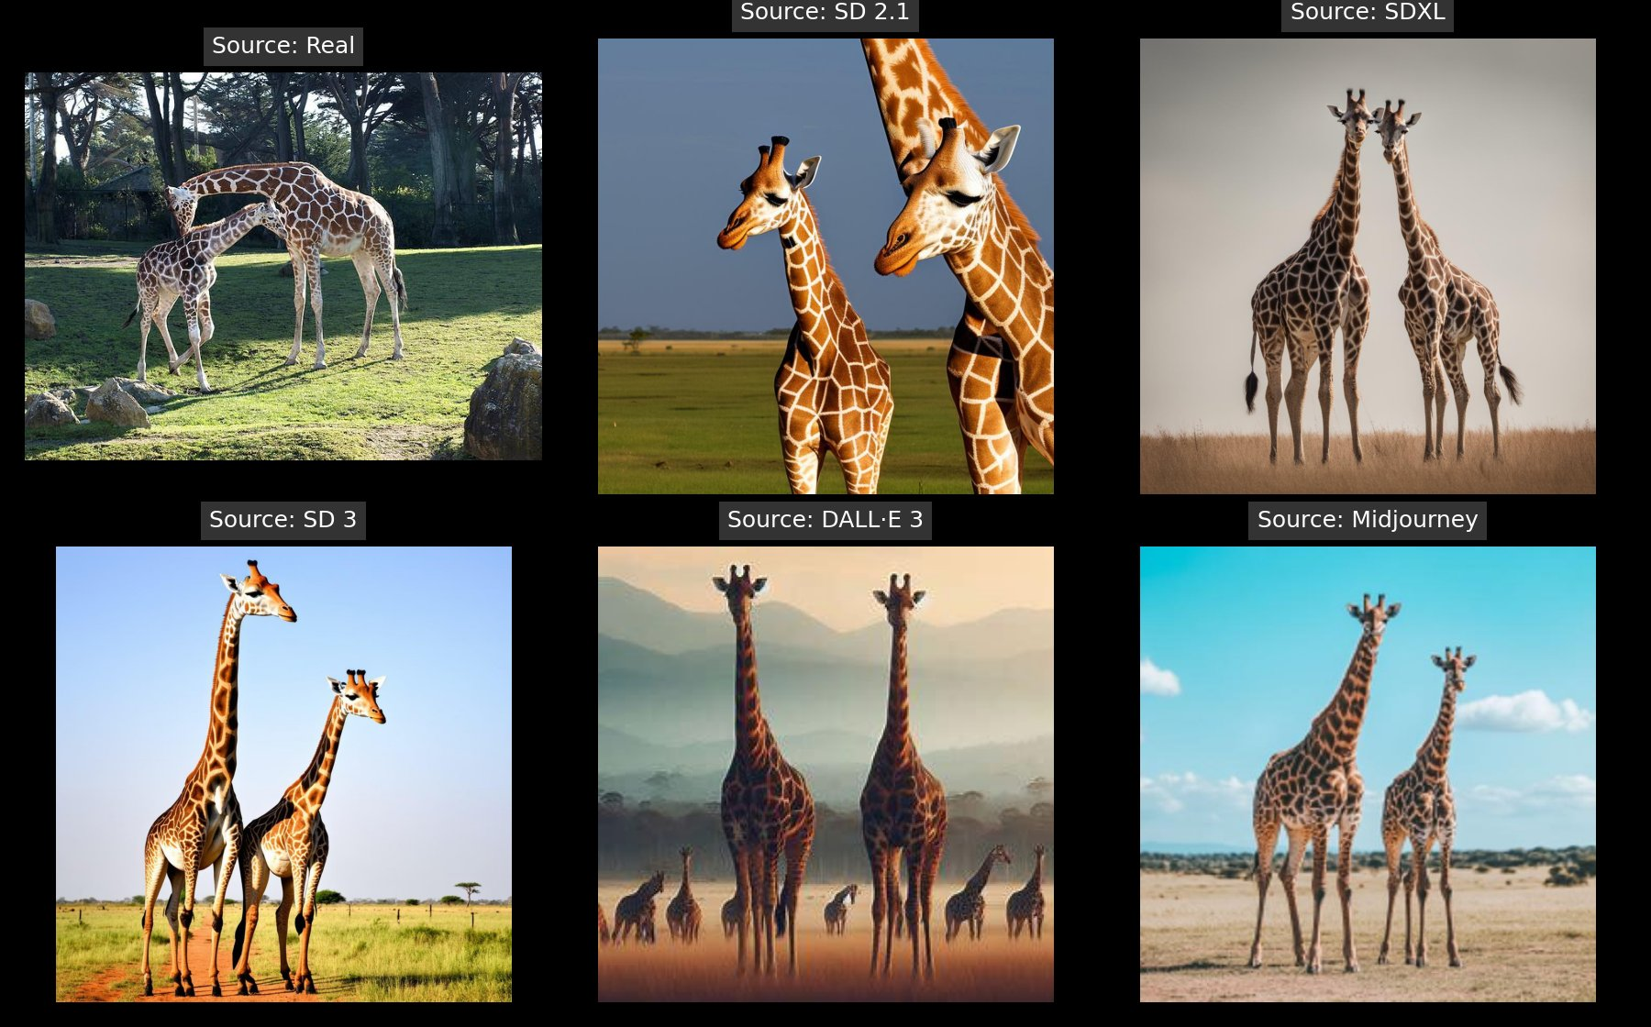
EDA — VISUAL CHALLENGE
Can You Tell What's Real?
6 images of the same subject — only 1 is a real photograph. The rest are AI-generated.
This is exactly why we need machine learning — the human eye can no longer reliably distinguish AI-generated content.

Slide 6
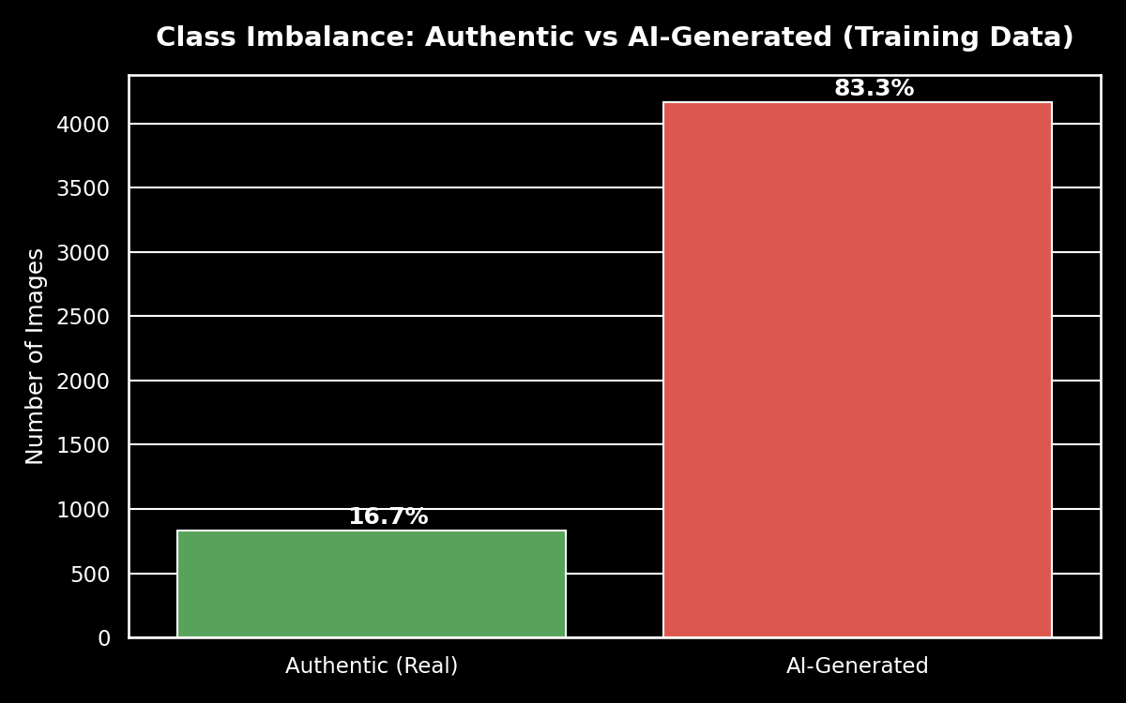
EDA
Critical Challenge: 1 : 5 Class Imbalance
16.7%
83.3%
83%
Real images
in training set
AI-Generated
images
Naive model
accuracy (shortcut)

Slide 7
METHODOLOGY
Multi-Task Vision Transformer Architecture
Input Image (224 × 224)
ViT-Base/16 Backbone
Single forward pass
feeds BOTH heads
simultaneously
ImageNet-21k pretrained | 12 Attention Layers
[CLS]
Head A
Head B
Binary Detection
Real vs AI-Generated
6-Class Attribution
Which AI Generator?

Slide 8
METHODOLOGY
Transfer Learning & Layer Freezing Strategy
L1
L2
L3
L4
L5
L6
L7
L8
L9
L10
L11
L12
❄
❄
❄
❄
❄
❄
🔥
🔥
🔥
🔥
🔥
🔥
Layers 1–6: FROZEN ❄ Generic visual features (edges, textures, shapes)
Layers 7–12: TRAINABLE 🔥 Forensic-specific features learned here
86M Parameters
in ViT-Base
Too many to train from scratch on 42k images. Freezing early layers lets us leverage ImageNet knowledge while fine-tuning only forensic-relevant features.

Slide 9
EXPERIMENT 1 — BASELINE
Baseline Results: The Model Is Biased
48.4%
86.3%
Real Recall
AI-Gen Recall
Only half of authentic
images identified correctly
Model biased toward
predicting AI
44.7%
3×
Head B Accuracy
Train/Val Loss Gap
Generator attribution
(random = 16.7%)
Severe overfitting
detected
Baseline config: 10 epochs | LR 2e-5 | 8/12 layers frozen | Unweighted loss

Slide 10
DIAGNOSIS
What Went Wrong? Three Root Causes
01
Class Imbalance Bias
Fix: Weighted CrossEntropyLoss
1:5 ratio (Real : AI) in training. Equal-weight loss lets the model take the easy shortcut of predicting 'AI' for everything.
02
Insufficient Model Capacity
Fix: Unfreeze more layers (→6)
8 of 12 layers frozen leaves only 4 layers to learn subtle generator fingerprints — not enough.
03
Overfitting
Fix: L1 + L2 Regularization + Label Smoothing
Train loss is 3× lower than validation loss. Model memorizes training images instead of learning transferable patterns.

Slide 11
EXPERIMENT 2 — TARGETED FIXES
Experiment 2: Targeted Corrections
Parameter | Run 1 Baseline | Run 2 Fixed | Justification
Class Weights (Head A) | [1.0, 1.0] | [5.0, 1.0] | Penalize Real misclassification 5× more
Frozen Layers | 8 / 12 | 6 / 12 | More capacity for generator fingerprints
Weight Decay (L2) | 0.01 | 0.05 | 5× stronger regularization
L1 Regularization | None | λ = 1e-5 | Encourage sparse, generalizable weights
Label Smoothing | None | 0.1 | Prevent overconfident predictions

Slide 12
RESULTS
Three Experiments: Progressive Improvement
Key Wins Run 2 → 3
✓
Overfitting eliminated
(3× → 0× loss gap)
✓
Real Recall lifted
from coin-flip ~48%
✓
Head B stable at 45%
(vs 16.7% random)
!
97%+ detection accuracy
on validation set

Slide 13
FINAL RESULTS — TEST SET (45,000 IMAGES)
Final Model Performance
HEAD A — Binary Detection
HEAD B — Generator Attribution
53.4%
82.7%
0.78
Generator | Recall
Real | 51.2%
SD 2.1 | 42.1%
SDXL | 43.9%
SD 3 | 42.6%
DALL·E 3 | 50.4%
Midjourney | 40.8%
Real Recall
AI-Gen Recall
Weighted F1
Overall Attribution Accuracy: ~45% (Random baseline = 16.7%) / 2.7× better than chance

Slide 14
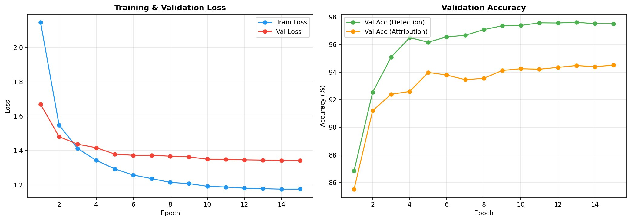
FINAL MODEL — TRAINING CURVES
Final Training Curves
97%+
94.5%
~0×
Val Detection Accuracy
Val Attribution Accuracy
Overfitting Eliminated

Slide 15
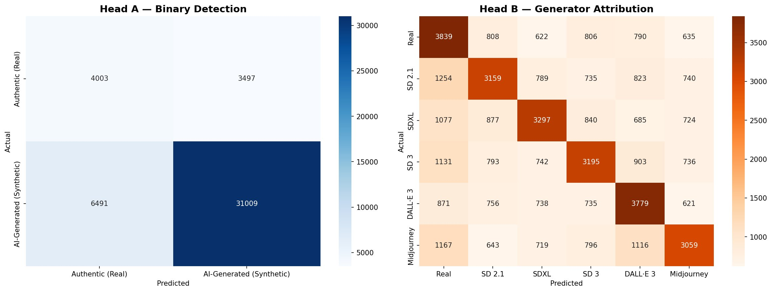
FINAL MODEL — CONFUSION MATRICES (TEST SET: 45,000 IMAGES)
Final Confusion Matrices
53.4% Real Recall (Head A)
82.7% AI-Gen Recall (Head A)
0.78 Weighted F1 (Head A)
~45% Attribution Accuracy (Head B)

Slide 16
HONEST ANALYSIS
Known Limitations & Why They Exist
Real Recall caps around 53%
Root cause: 1:5 class imbalance — model has 5× more synthetic examples. SMOTE on raw pixels creates ghosting artifacts. Weighted loss is the correct DL-native fix.
SD 2.1 / SDXL / SD 3 Confusion (Head B)
All three share the same UNet diffusion backbone architecture. They produce statistically similar noise patterns — even Corvi et al. (2023) struggle with this in forensic literature.
DALL·E 3 and Midjourney are easier to attribute
DALL·E 3 uses an autoregressive architecture (different fingerprint); Midjourney uses proprietary training data (unique distribution). Both have more distinguishable forensic signatures.
These are not implementation failures — they are documented characteristics of the forensic problem domain.

Slide 17
EXPLAINABLE AI
XAI: Where Does the Model Look?
WHERE
WHAT
Attention Rollout
Gradient-Based Saliency Maps
Aggregates attention weights across all 12 ViT layers. Produces a spatial heatmap showing which image regions most influenced the prediction, often highlights unnatural textures, impossible reflections, and deformed hands.
Computes pixel-level gradients with respect to the predicted class. Shows exactly which pixels had the highest impact on the decision, drills down to sub-region level. Complementary to Attention Rollout.
Shows broad forensic regions
Shows specific pixels
Key differentiator: No commercial detector gives visual proof of its reasoning. We show WHERE and WHY - not just IF.

Slide 18
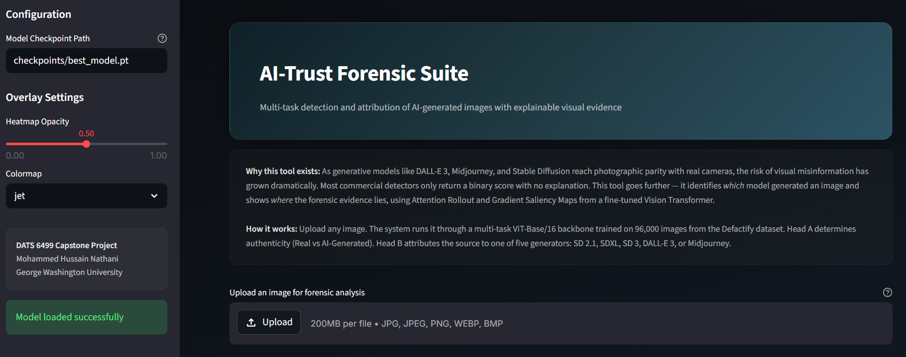
LIVE DEMO
AI-Trust Forensic Suite: Live Dashboard
Interactive Web Application: https://datscapstoneproject.streamlit.app/

Slide 19
CONCLUSION
Key Takeaways & Future Directions
Takeaways
Future Work
End-to-end multi-task forensic system that detects AND attributes AI-generated images in a single forward pass
Iterative, data-driven improvement, diagnosed bias, applied targeted fixes (weighted loss, L1/L2, layer unfreezing)
Integrated Explainable AI (Attention Rollout + Saliency Maps) to bridge the Forensic Transparency Gap
Production-ready interactive dashboard for non-technical users, fully open-source
ViT-Large / DINOv2 backbone
Extend to video forensics
Adversarial robustness testing
REST API browser extension
Continuous learning for new generators (Flux, Imagen 3)
Thank You - Questions?
G36308827 | DATS 6499 | GWU Spring 2026

