Slide 1



Time Series Analysis of Gold ETF Prices
Using Base Models, ARMA, ARIMA, and Box-Jenkins Models
Submitted by:
Name: Mohammed Hussain Nathani
GWID: G36308827
Course: DATS_6313_10

Slide 2


Project Overview
Goal: Forecast Gold ETF Close Prices, aiming to uncover temporal patterns and develop predictive models for future price forecasting
Dataset: 12 financial indicators (gold, silver, oil, GDP, CPI, etc.)
Methods: Base Models, MLR, Holt-Winters, ARMA, ARIMA, Box-Jenkins

Slide 3
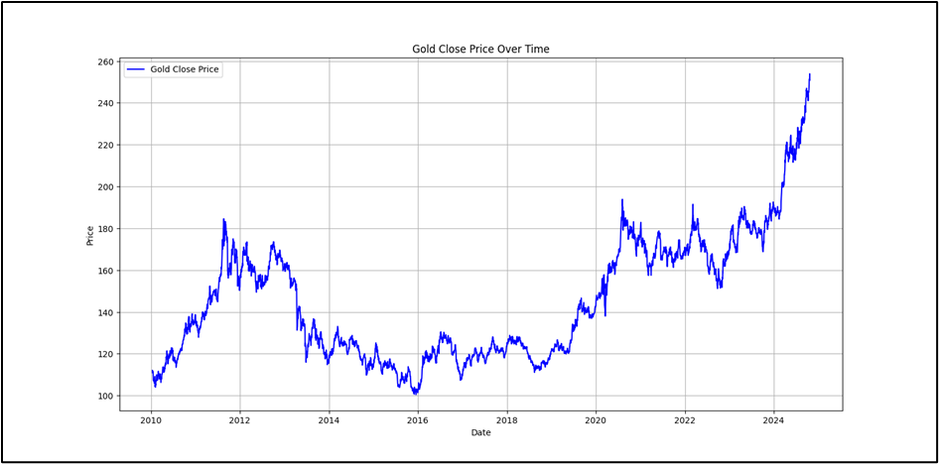
Data Summary + Trends
Line chart of gold close price
Mention: non-stationary pattern, visual trends

Slide 4
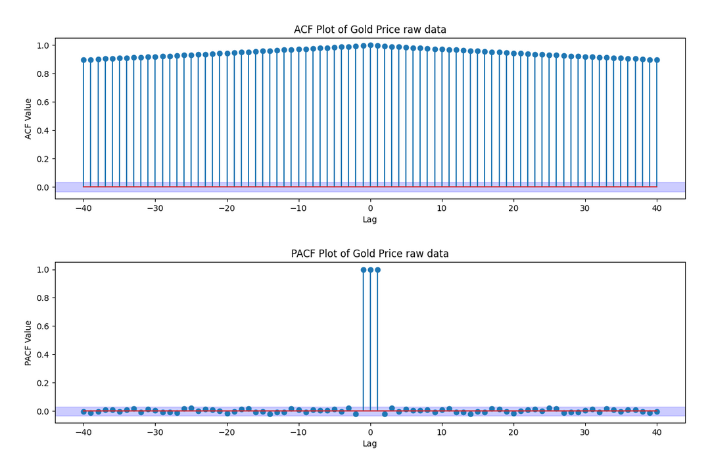
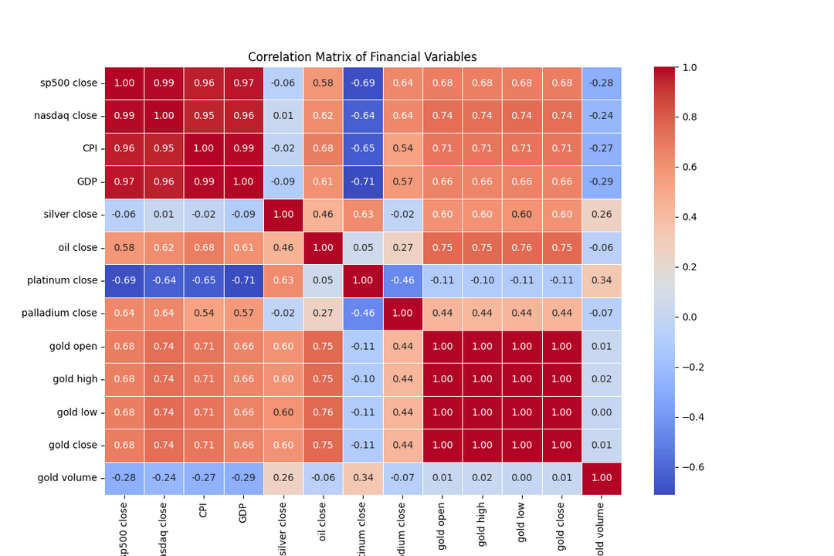
ACF/PACF and Correlation Insights
Heatmap: feature relationships
ACF: Decays slowly. PACF: Cut-Off

Slide 5
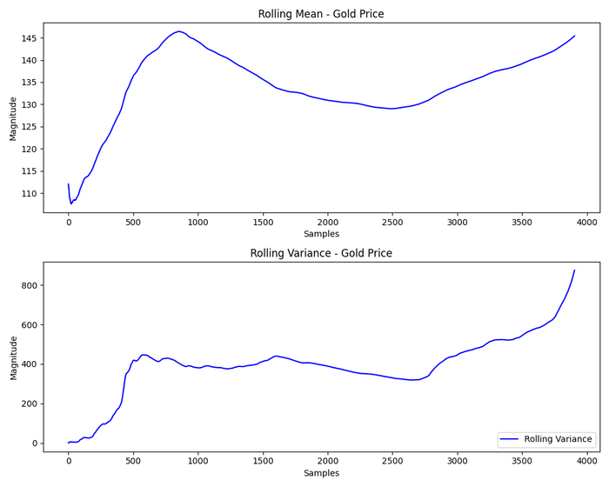
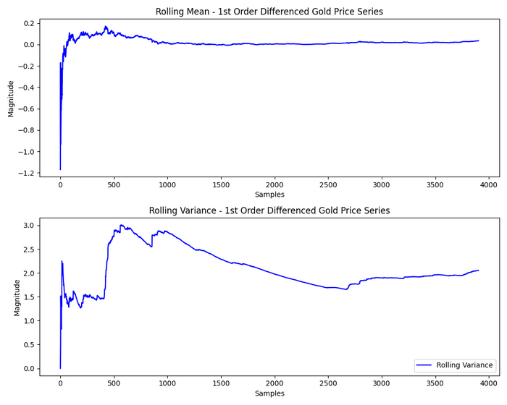
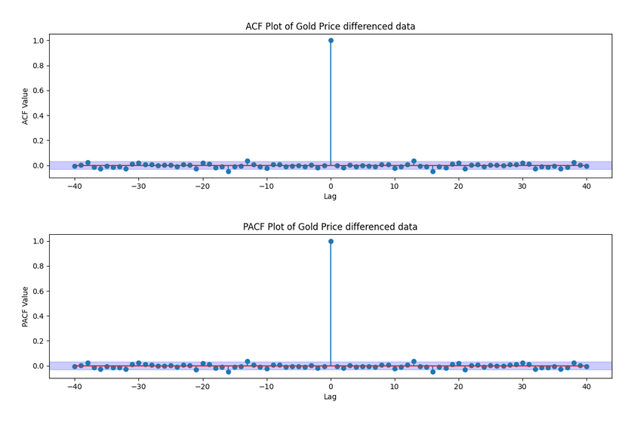
Stationarity Checks
The Gold Close data was non-stationary. 1st order differencing performed.

Slide 6
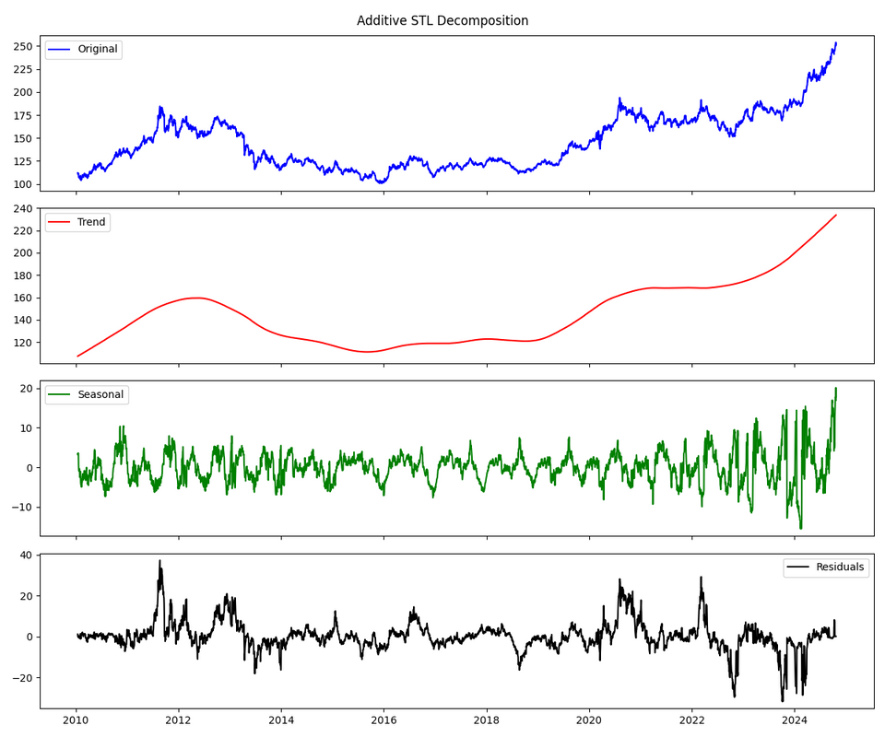
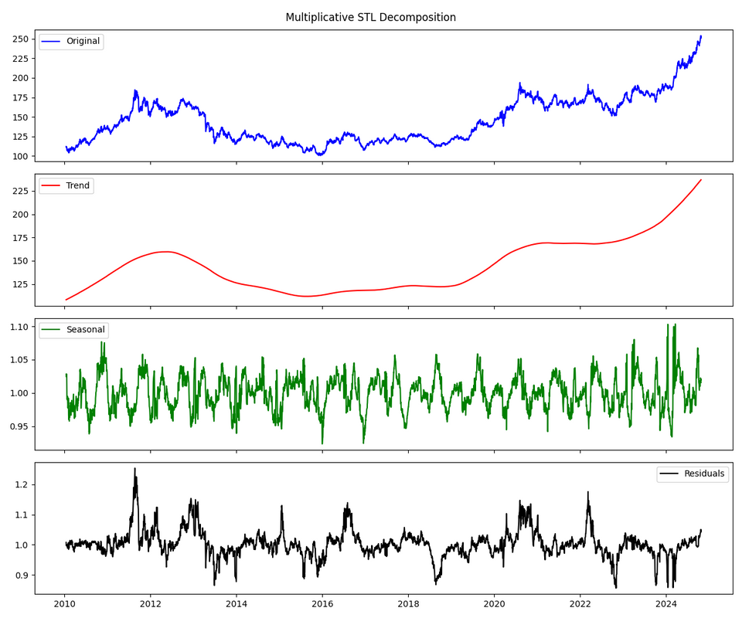
Decomposition Analysis
Additive vs Multiplicative STL plots
Strong trend, weak seasonality
Additive Decomposition:
Strength of Trend: 0.9406
Strength of Seasonality: 0.0580
Multiplicative Decomposition:
Strength of Trend: 1.0000
Strength of Seasonality: 0.1202

Slide 7
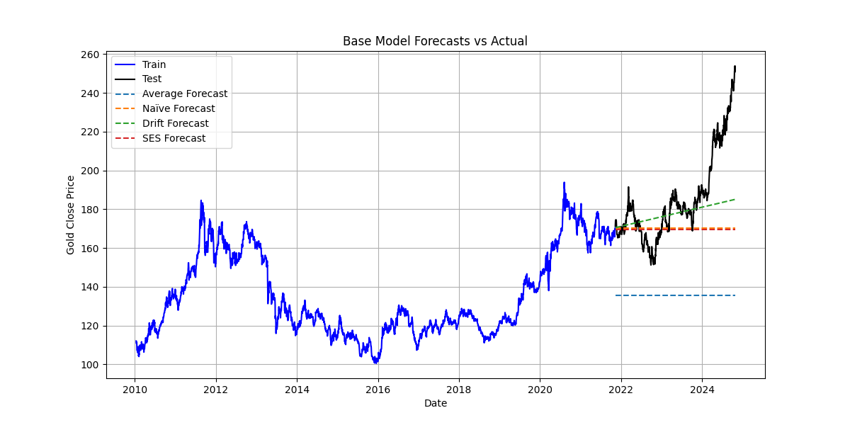
Base Forecasting Models
Average Model : RMSE = 54.5309, MAE = 49.7513
Naïve Model : RMSE = 26.7726, MAE = 18.3628
Drift Model : RMSE = 20.5011, MAE = 13.6719
SES Model : RMSE = 27.3327, MAE = 18.8494

Slide 8
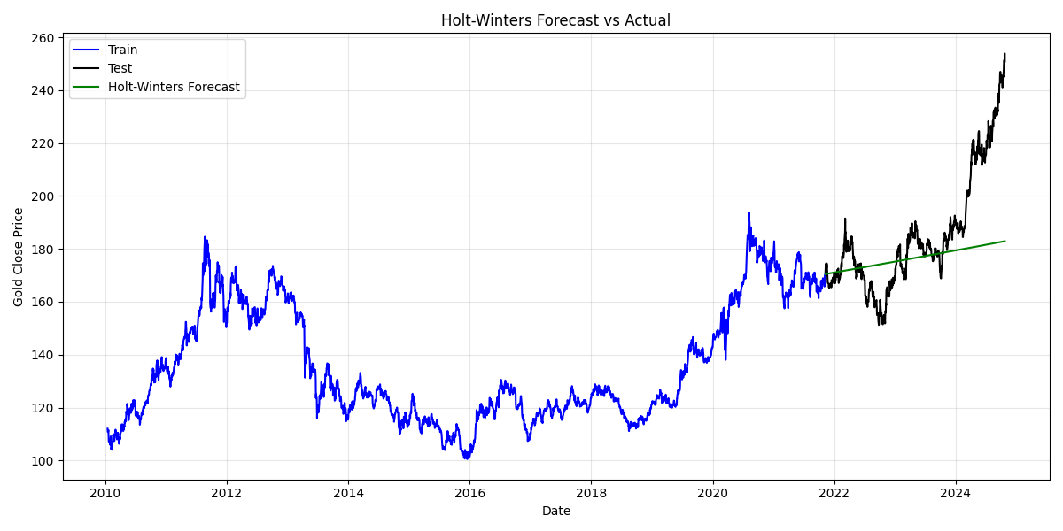
Holt-Winters Forecasting Model
Mean Absolute Error (MAE): 14.2446
Mean Squared Error (MSE): 455.7504
Root Mean Squared Error (RMSE): 21.3483

Slide 9
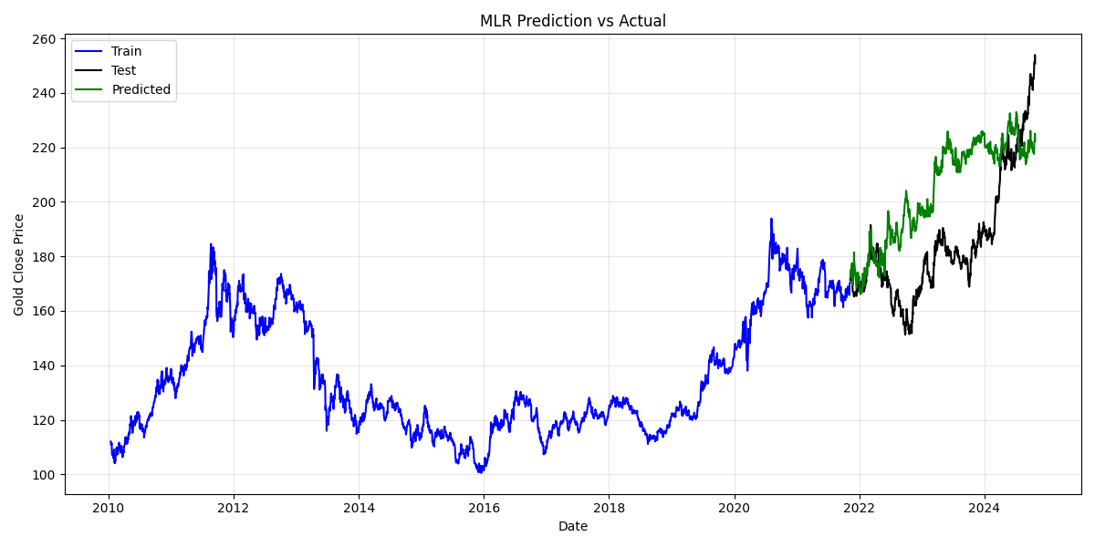
Multiple Linear Regression Model
Backward elimination
Good performance, but residuals are autocorrelated

Slide 10
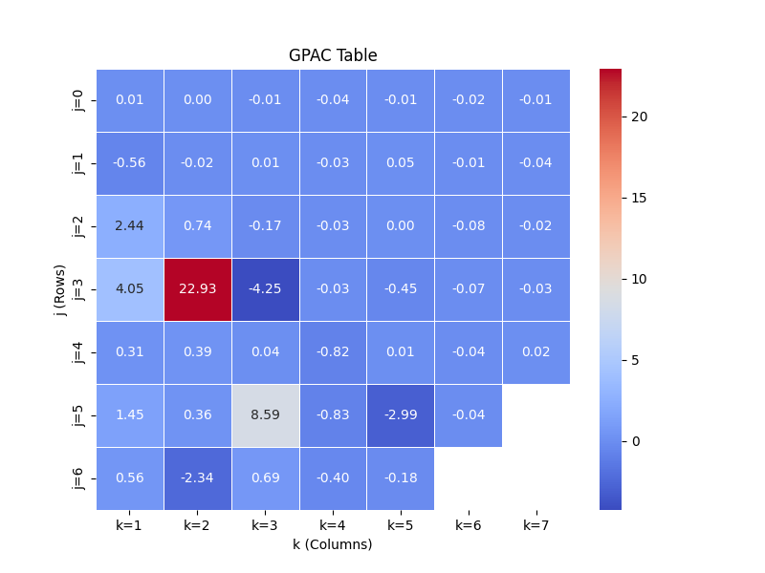
GPAC Table
GPAC Table does not show any particular order

Slide 11
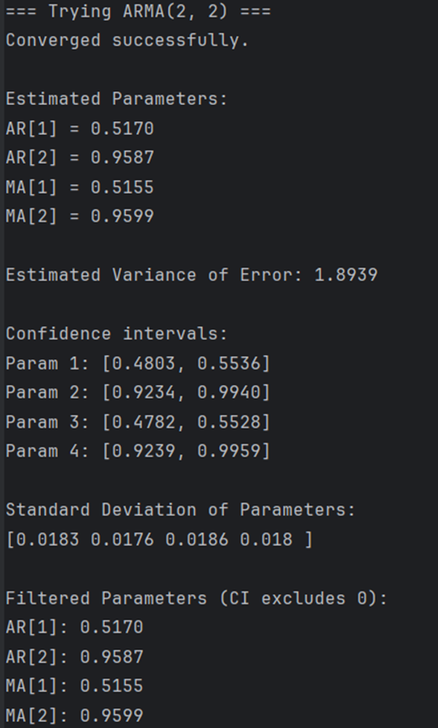
ARMA Modeling
Best ARMA(2,2)
Estimated Parameters: AR[1] = 0.5170, AR[2] = 0.9587, MA[1] = 0.5155, MA[2] = 0.9599
Residual Q-Test: Q = 36736.3448 → Residuals show autocorrelation

Slide 12
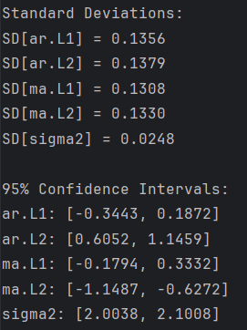
ARIMA Modeling
Best ARIMA(2,1,2)
Estimated Parameters: [AR]1 = -0.0786, [AR]2 = 0.8756 MA[1] = 0.0769, MA[2] = -0.8880
Residual Q-Test: Q = 19.3887 < Q_critical = 62.83 → White

Slide 13
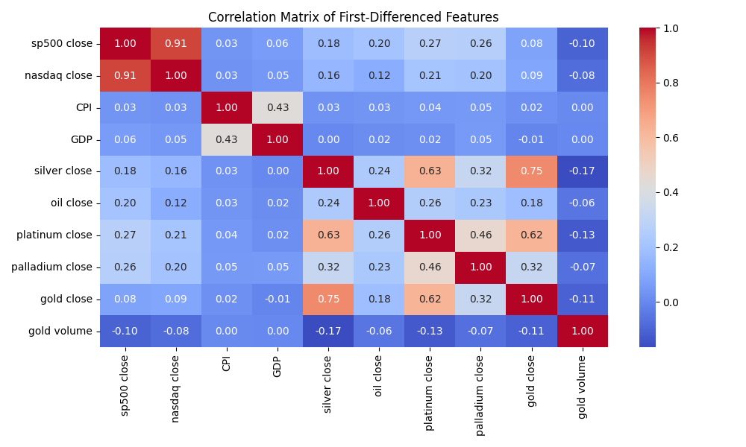
Box-Jenkins Modeling
Input Feature Selection: silver close

Slide 14

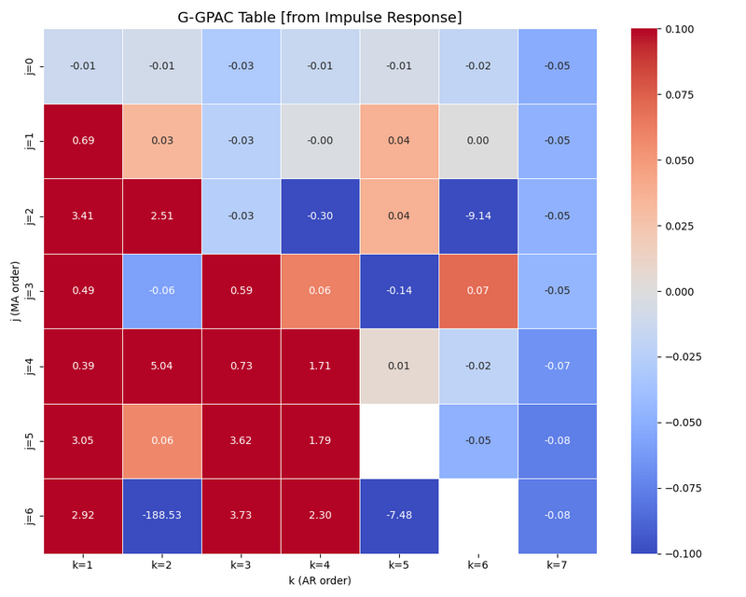
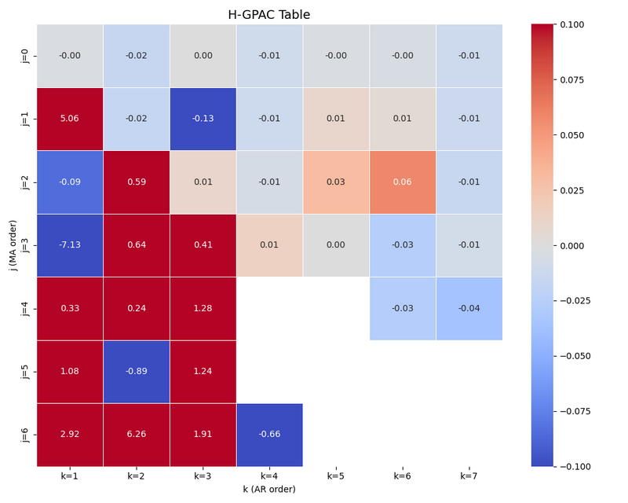
Box-Jenkins Modeling
Impulse Response, G-GPAC, H-GPAC

Slide 15
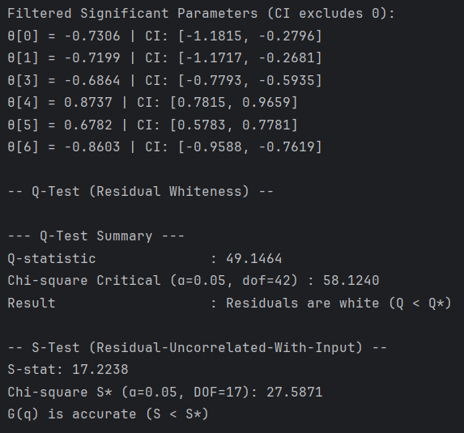
Box-Jenkins Modeling
Selected Order: (2,2,2,2) → Filtered Parameters Order: (2,1,2,1)
Residual diagnostics passed Q and S tests

Slide 16
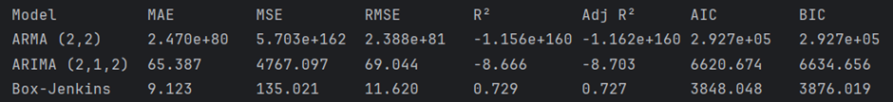
Final Forecast Comparison
Best: Box-Jenkins (lowest error)

Slide 17
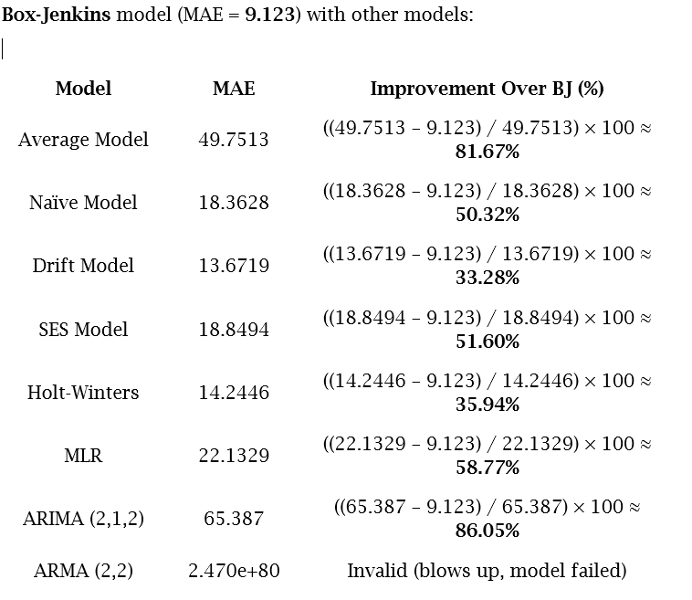
Final Forecast Comparison

Slide 18
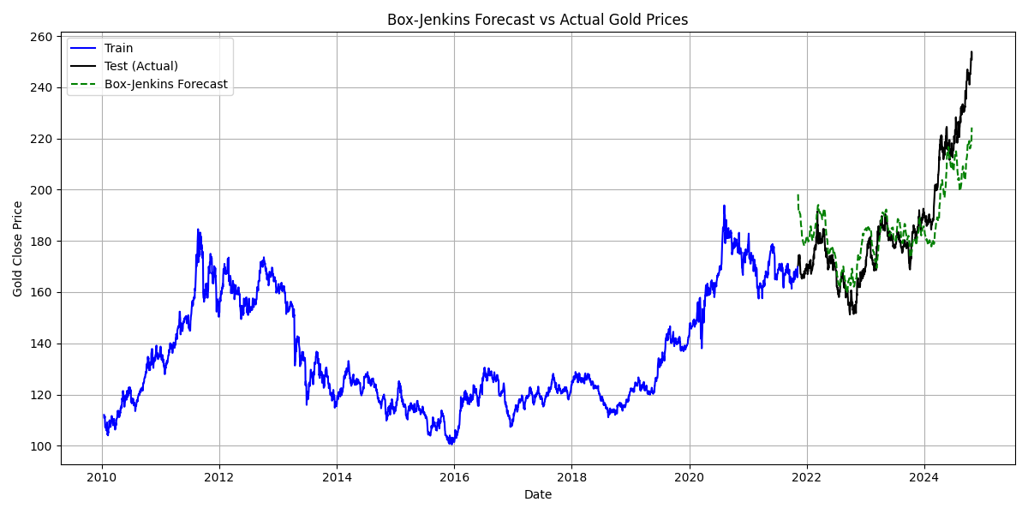
Final Forecast Plot
Forecast vs Actual for Box-Jenkins
Forecasts closely follow actual gold price trends
Short-term fluctuations not always captured
No major divergence from test values

Slide 19
Conclusion
Complete modeling pipeline: EDA → Modeling → Forecasting
Box-Jenkins (2,1,2,1) with silver input delivered best performance
Passed Q-test & S-test → residuals are white and independent
Accurate multi-step forecasts using custom-built function
“Gold prices can be reliably forecast using diagnostic-driven time series models — with improved accuracy when leveraging exogenous financial indicators like silver prices.”

Slide 20

Thank You
✨ "From trends to forecasts — mastering gold with models that shine."

