Slide 1
Digital Image Processing project
Lossy image compression using dct technique

Slide 2
Discrete Cosine Transform, and the JPEG format
• The JPEG (Joint Photographic Experts Group) compression technique is one of the most popular image data compression methods in use.
• It is a transform (DCT) based method that involves some loss of information (hence “lossy”data compression) in proportion to the degree of compression achieved.
• It is important to remember that taking the transform of an image does not result in loss of information. The complete information still exists, but is simply presented in another form (i.e. spatial frequency). The data file size is the same, or even larger than the original (e.g. real integerÆcomplex float). •Loss of information takes place when some of the transform coefficients are discarded

Slide 3

Pre-Compression concepts
Once you get sense of this , you will hitting the Ground running
DCT Expression
Tpq = $\sqrt{\frac{2}{M}}\cos{\frac{π\left(2q+1\right)p}{2M} , 1≤p≤M−1 , 0≤q≤M−1}$

Slide 4
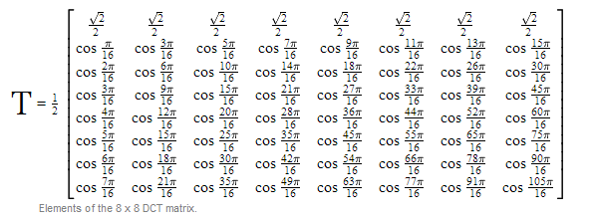
Pre-Compression concepts
A Convenient Matrix Representation Form for DFT Calculations

Slide 5
Processing Diagram
Image in Time Domain
Image in Frequency Domain
Processing on each 8x8 block on The Transferred signal
Back to Time Domain
DCT
IDCT

Slide 6
The Operations behind JPEG/DCT
For an MxM matrix A, TxA is an MxM matrix whose columns contain the 1D DCT of the columns of A. The 2D DCT of A is given as: B = T x A x T’
First generate the transform matrix T , Apply T across the image in 8x8 blocks ,then At this point you now have the DCT of all of the 8x8 blocks in the image.
Compression at this point is achieved by setting some of the DCT coefficients in each block to zero.
In this case this can be accomplished by generating an 8x8 binary mask array in which the positions of the coefficients are represented by 1 if the coefficients are to be retained, and by 0 if they are to be discarded
Upon examination of the DCT of one of the blocks it is observed that the DC coefficient is located in the upper left, with spatial frequency increasing down and to the right. Thus, the mask array elements will have values of 1 in the upper left region

Slide 7
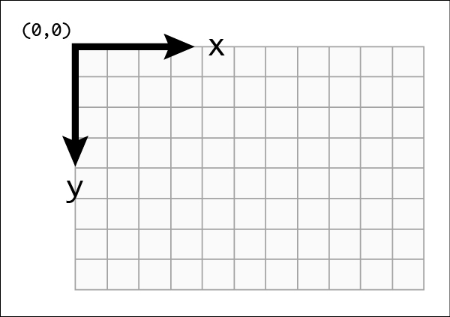
The Operations behind JPEG/DCT
Mask =
Please Note That , the computer starts the Origin ( 0 , 0 ) at the Upper Right corner !
1 1 1 1 0 0 0 0 1 1 1 0 0 0 0 0 1 1 0 0 0 0 0 0 1 0 0 0 0 0 0 0 0 0 0 0 0 0 0 0 0 0 0 0 0 0 0 0 0 0 0 0 0 0 0 0 0 0 0 0 0 0 0 0

Slide 8
The Operations behind JPEG/DCT
At the mask matrix , frequencies starts at the upper left ( smallest frequency ) and increases to down right ( largest frequency at the most right bottom )
So one’s are keeping the upper left matrix values which represents low Frequencies and zero’s are to discard the High Frequencies
Why Choosing saving low Frequencies ?! - as the fact that the human eye can only sense the low frequencies , so we can Sacrifice the High Frequencies in seek of compressoin .
Finally , we Back to the time domain where T is a real orthonormal matrix so its inverse is equal to its transpose. Thus the inverse 2D DCT is: A = T’x B x T

Slide 9
I hope That was useful for all of you !
Thanks
Khaled Mansour
Sayed gad EL-mawla
Muhammed Abd El-halim Elgamal
Hussam EL-Dien Salah Muhammed

