Slide 1
Transportation Rental Services

Slide 2
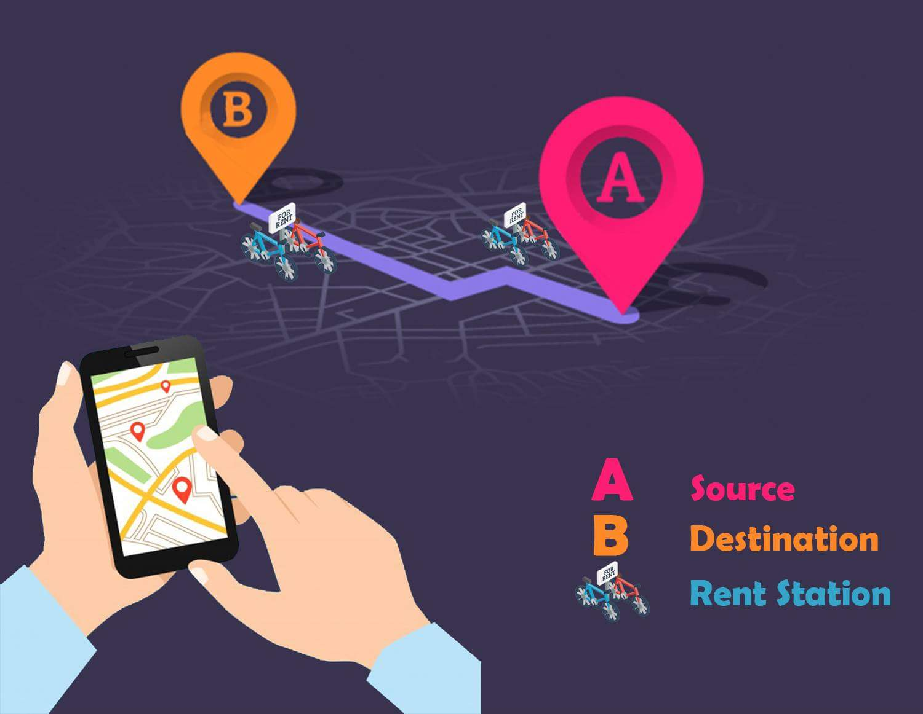
Introduction

Slide 3



Problem Definition
Lack of knowledge of rental of transportation
device (bicycle, Private car)
Technological solution for rental services ( wench , heavy car)
Exploitation and high cost

Slide 4


Objectives
Trying easy people’s life by providing the following:
Match making service between people and Stores to facilitate getting the nearest available and transportation services
Provide a way of navigation that will facilitate reaching available trucks, winches and bicycle

Slide 5

Stakeholders
User/citizen
Stores and Car Owner
Administrators

Slide 6
Functional Requirements
User
Request service
Cancel request
Activate payment
Rate service
Recharge quota
Show requests
Show active rides
Show ride history

Slide 7
Functional Requirements
Owner
Accept request
Cancel request
Add , remove and edit service
Show notifications
Show history
Start rental
Terminate rental
Show requests
Show active rides
Rate user
Change store status
Edit store location
Edit store name
Calculate estimated amount

Slide 8
Functional Requirements
Admin
View Users
Update Users (Activate , verify)
Soft delete
Active soft delete

Slide 9
Use Case Diagram

Slide 10
Non - Functional Requirements

Slide 11
Non - Functional Requirements

Slide 12
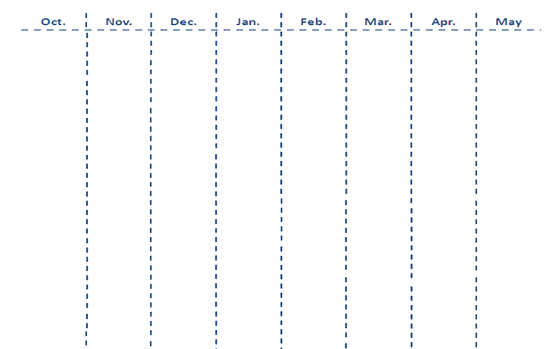
Time Plan
Analysis
Design
Implementation
All Group
Testing
Documentation

