Slide 1
Transportation Rental Services

Slide 2

Project idea
- Transportation Rental Services is an application developed for android mobile phones. The initial idea behind this project is to provide you transportation at any time and to any place , this app will get you where you need to be.

Slide 3
Problem significance
The main aim for any customer who wants either to rent a car, bicycle or even a truck for transporting what he needs is being able to rent at any time and in any place
Our application will solve that problem as for renting a car or bicycle the customer will have to go to the company’s place to take the car or the bicycle but for the truck, the application will know the location of the customer and send the truck to that location

Slide 4


the previous solutions
Uber
Uber is a ridesharing app for fast, reliable rides in minutes – day or night. There’s no need to park or wait for a taxi or bus.
Careem
Careem is car booking app for a safe, reliable and affordable ride

Slide 5
Advantages & Disadvantages
Advantages:
Cover large scope of area.
People trust them.
Easy to use Application.
High quality service.
Price of service is fair.
Credit card payment.
Disadvantages:
Transportation by car only.
Sometime has problems in serves (Late response and Accept then cancel request).

Slide 6
System arch

Slide 7
Stakeholders
We have 3 stakeholders:
● Normal Users , Android application users who use service
● Store & Car Owner , Android application users who provide service
● Administration , mange our app

Slide 8
Functional Requirements
User.
Request service.
Cancel request.
Activate payment.
Rate service.
Recharge quota.
Show requests.
Show active rides.
Show ride history

Slide 9
Functional Requirements
Owner.
Accept request.
Cancel request.
Add service , remove service , edit service .
Show notifications
Show history
Start rental
Terminate rental.
Show requests.
Show active rides.
Rate user.
Change store status
Edit store location.
Edit store name.
Calculate estimated amount .

Slide 10
FUNCTIONAL REQUIREMENTS
Admin.
View users
Update user (activate, verify)
Soft delete
Activate soft deleted user

Slide 11
Non-Functional Requirements
Usability
Reliability
Supportability
Performance

Slide 12
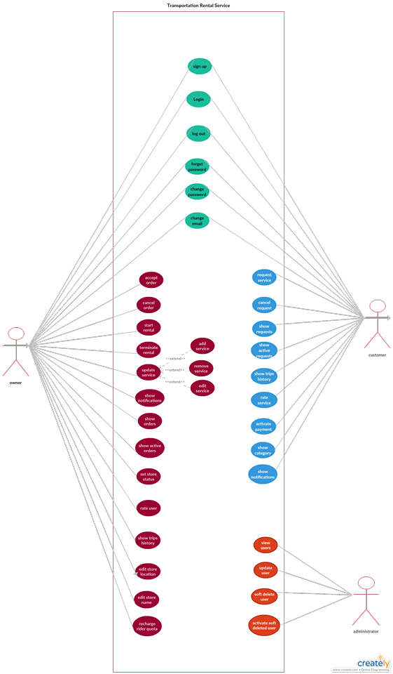
Use-case Diagram

Slide 13
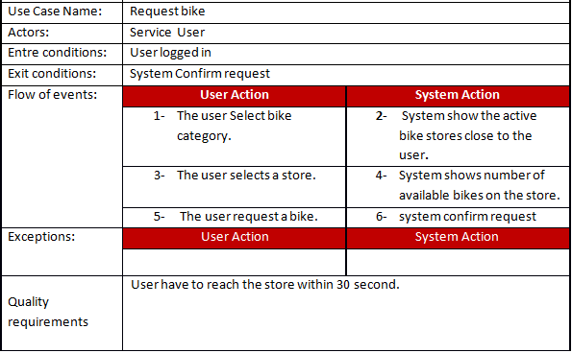
Sample Use-cases

Slide 14
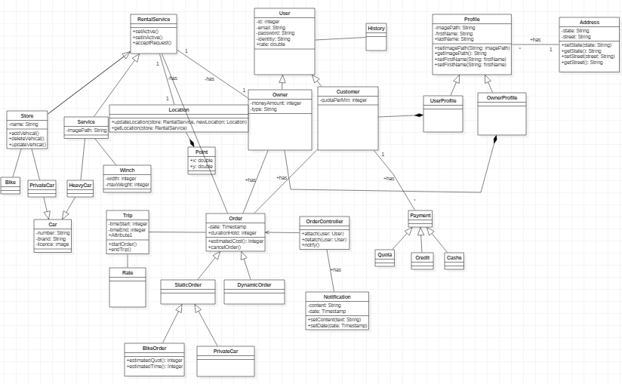
Class Diagram

Slide 15
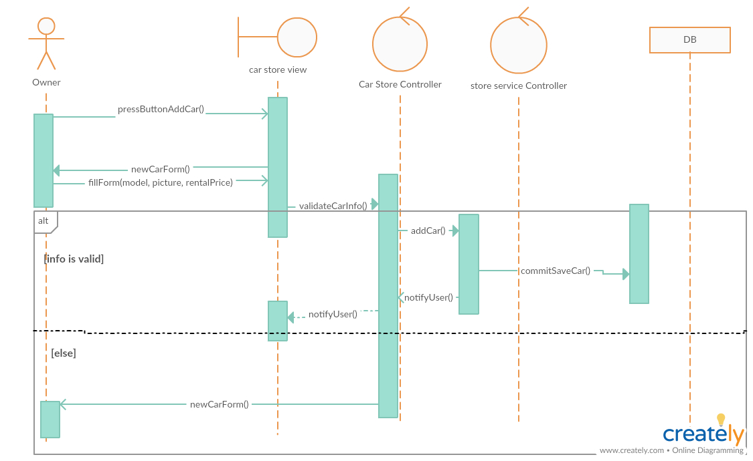
Sequence Diagram

Slide 16
ERD

Slide 17
Draft of screenshots

Slide 18
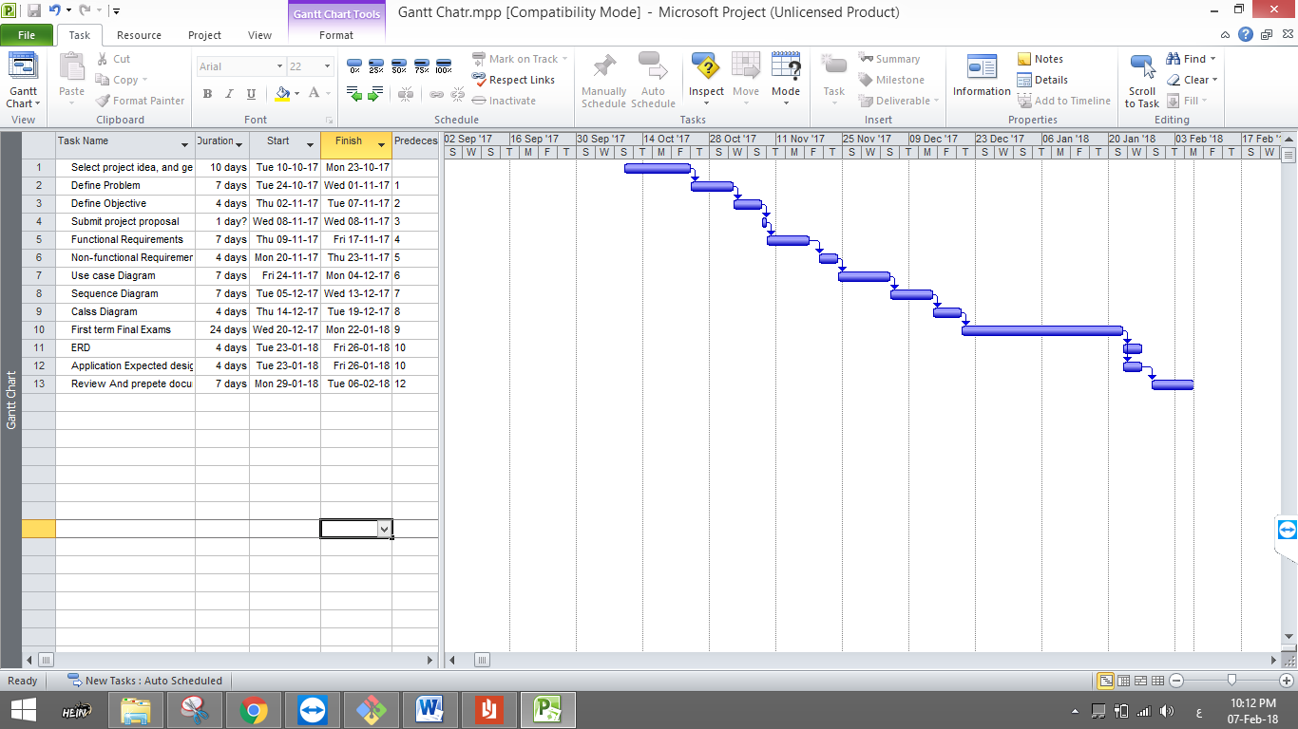
Time plan

Slide 19
Conclusion
Khaled Mohamed | 20140108
Sayed Ashraf | 20140146
Hossam Khaled | 20140099
Omar Adel | 20140185

