Slide 1
Package
APPLICATION DEVELOPMENT FOR MOBILE AND UBIQUITOUS COMPUTING
TECHNISCHE UNIVERSITÄt Dresden
Hussam Altaleb
&
Ahmed Mahmoud
supervised BY: dR. –ING. tHOMAS sPRINGER

Slide 2






Traditional Shipping
DHL, HERMES, …..

Slide 3
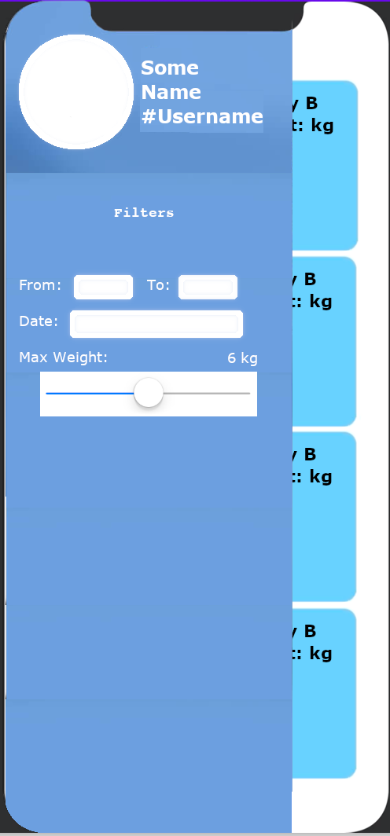
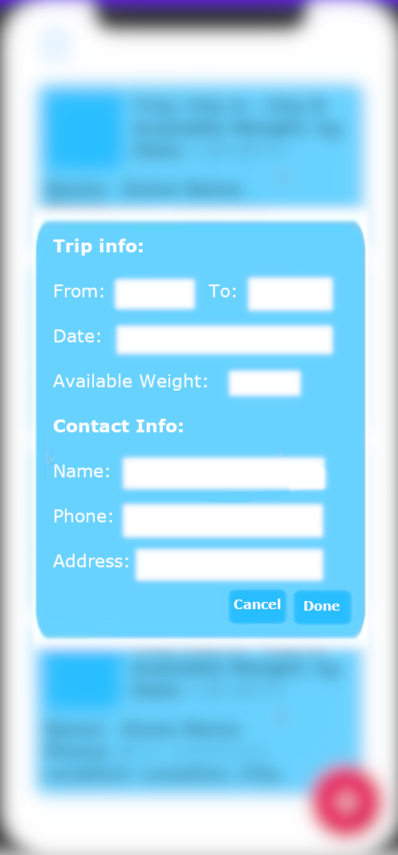
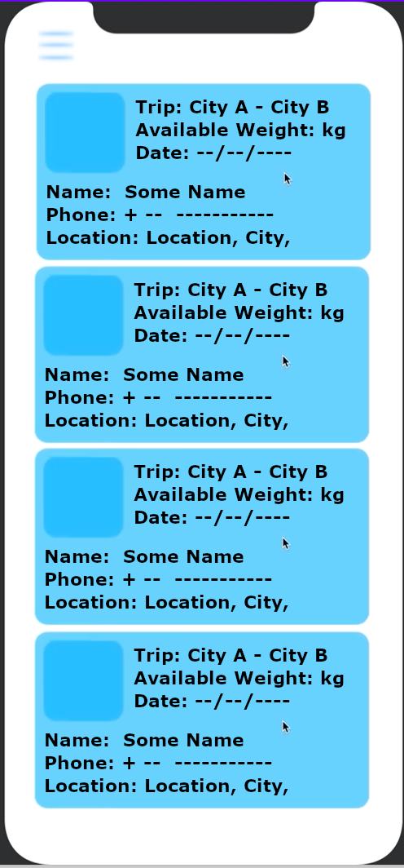
How Package solves the problem ?
Created trips automatically shows up in the main lobby screen (real-time).
Trips show up sorted according to the location of the user (nearest travellers show first).
User can filter the showing results according to:
Place of departure
Destination
Trip date
Max weight offered by the traveller to carry
User creates a trip specifying trip info:
From (place of departure).
To (destination).
Date (trip date).
Available Weight (weight available in the travel luggage).
Contact info such as name, phone and address for communication (can be copied from user profile).

Slide 4
Challenges
Power consumption.
Data handling.
User interface responsiveness.
Network integration.

Slide 5
Adaptivity
Location Based Search
Offline usage in case of network outage
Real time update

Slide 6
Location Based Search
Learn about location from the context.
Use that information to provide suggestions of journeys or queries where the current location is the origin of the journey.
Keep location queries to a minimum to save power.

Slide 7
Offline usage in case of network outage
Results of user queries are stored temporarily on the user device.
Those results can be used as a cache:
Save Bandwidth
They also can be used when user is offline:
Offline usage
Must denote somehow that user is offline, and when they are back online

Slide 8
Real time updates
Scenario:
User X searches for journeys from A to B then user Y posts a journey from A to B.
User X must be notified of the new posted journey.
To be implemented using a Model-View-Controller (MVC) in the logic tier.

Slide 9
Architecture (Tiers) and Technologies
Data Tier
Data Store
Django ORM to SQL
Handling database queries in Python OO manner allowing for flexible logic development
MVC
Community Driven
Logic Tier (Middleware)
Interfacing (and decoupling) end tiers
Django REST framework
Efficiently handle and serialize Django data
MVC
Community Driven
Presentation Tier
User Interface
React Native
Cross Platform
JavaScript
Live reload
Community Driven

Slide 10
Work Plan: Tasks
Hussam
Data modeling
Data interfacing
MVC
Others as needed!
Ahmed
User interface
Consuming REST API inside the application
Others as needed!

Slide 11
Work Plan: Milestones (tentative!)
By the second presentation deadline:
Implement MVC’s and adaptation concepts and their underlying infrastructure
By final presentation deadline:
Finalize the application and implement unit tests for it

