Slide 1


Application Development
Pitch: Package Appliaction
Hussam Altaleb
Ahmed Mahmoud

Slide 2

Package: Shipment Broker
Want to send some documents abroad?
Do you have a shipment that would cost a fortune to ship with traditional courier mail?
You like to travel and want to make some money? Why not use your extra space and ship stuff!

Slide 3

Send Documents & Shipments
Find a traveler to your destination on Package and let them take your document or shipment there.
Money saved and hopefully got to know a new friend!

Slide 4
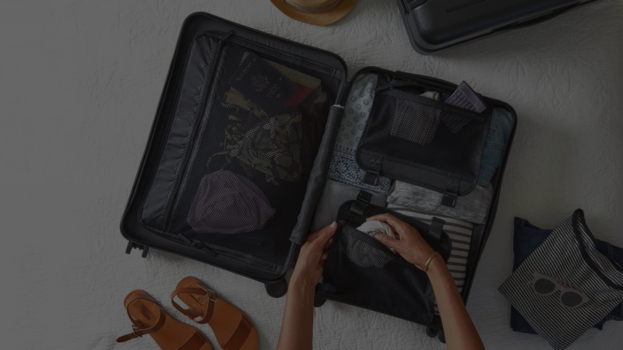
Travelling Light?
Use your extra space to help others on Package and hopefully earn some money and friends!

Slide 5

Smart lookup of journeys
Intuitive interface for adding filters of journeys, such that they can be used in combination with your location to show you the most relevant journeys! Keeping in mind minimizing power consumption by computing location conservatively.
Real time update
You will be kept updated without the need to constantly refresh the app.

Slide 6
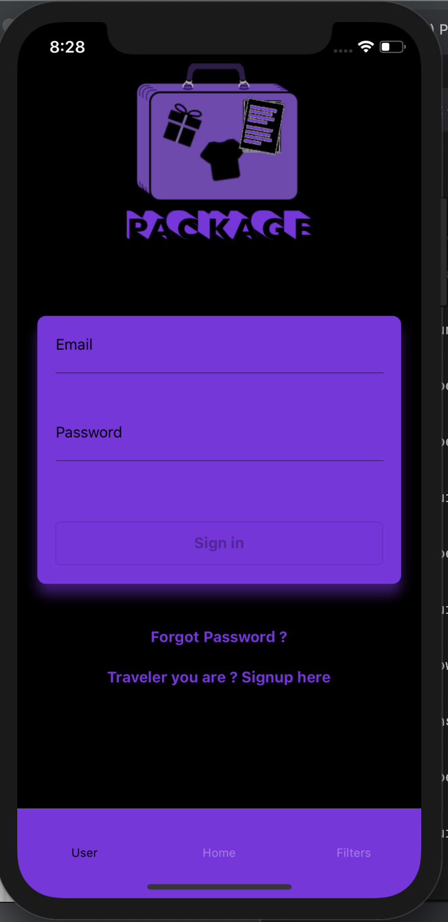
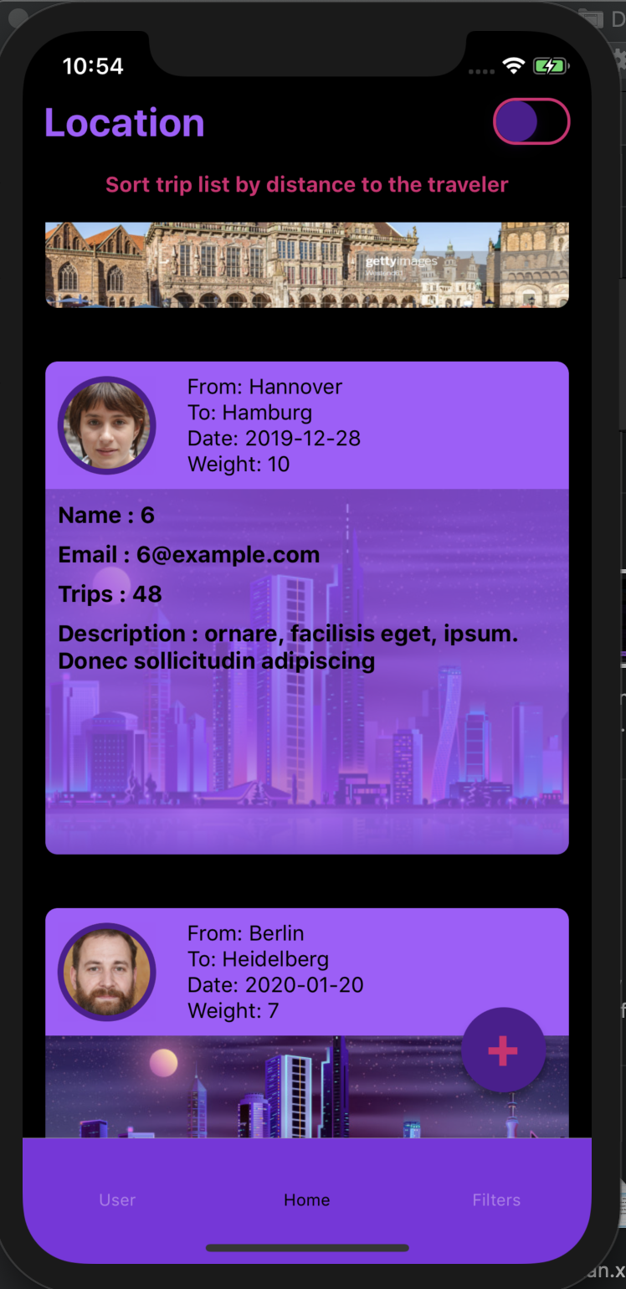
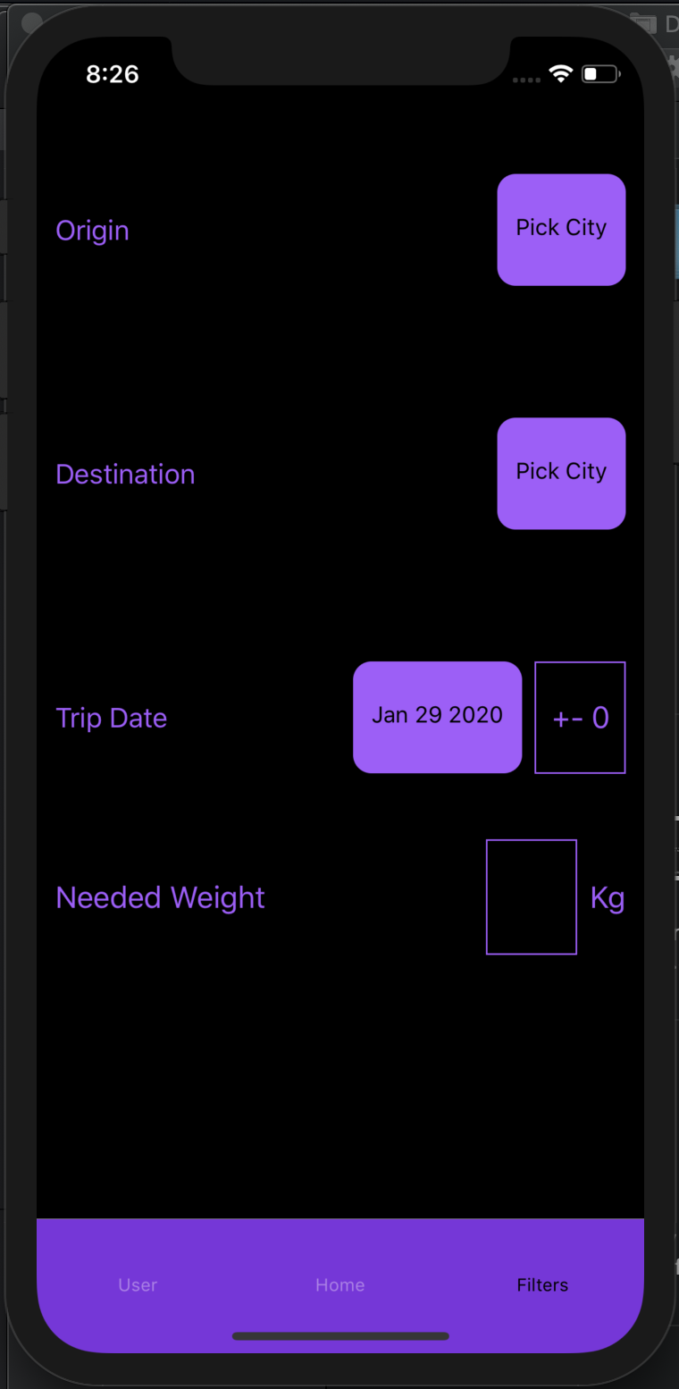
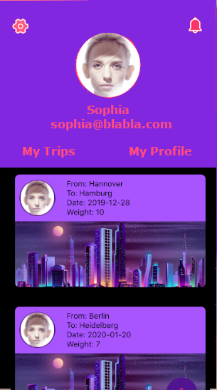
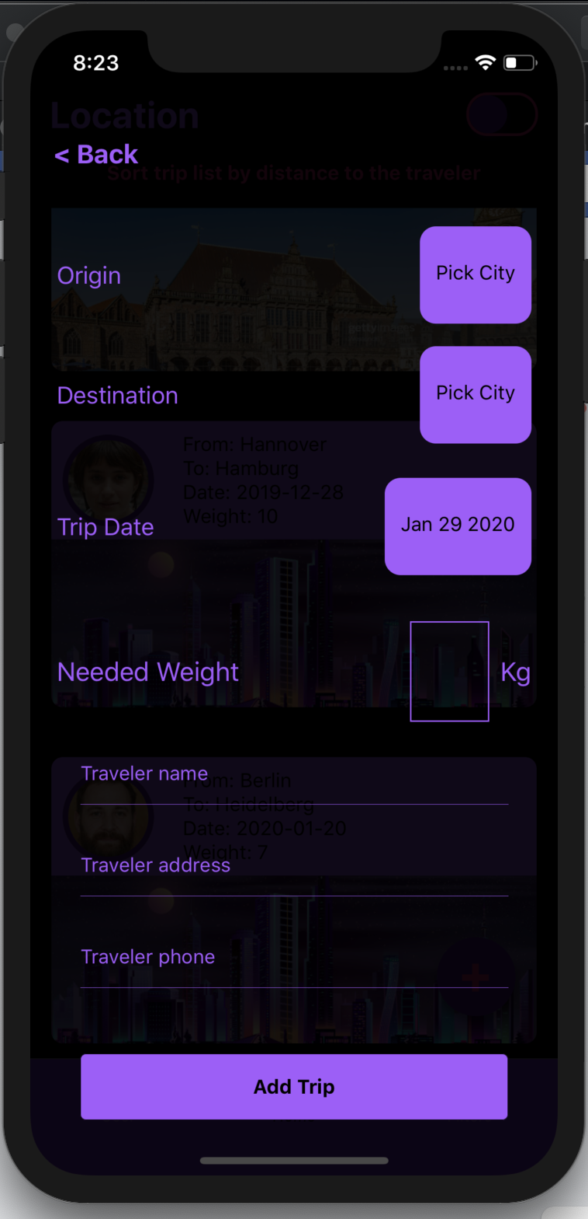
Registered user
Guest user
My trips is the list of trips created by user to keep track of
Only registered users can add new trips for the other to view real-time
A list of all the trips carried out by other users with their contact information for further arrangements
The user can update profile information through this tap (still under development)
Filters adapts the list of trips to user specific requirements
By default the trips are sorted according to creation date but if capturing the user’s location is permitted, the trips are resorted to show travelers nearer to the user first

Slide 7
Teamwork!
Hussam and Ahmed, co-founders of Package, decided on the app idea and the problem to be solved, to later Ahemd develop the app features, components and screens while Hussam developed its models, services and interfaces.

