Slide 1



Edumate – Assisting Teachers
Project Guide: Prof. Rohini Nair Group No.: C9
Group Members | Roll Number
Rushabh Gandhi | 1911012
Kritarth Jain | 1911020
Nayan Mandliya | 1911027
Hussein Motiwala | 1911031

Slide 2
Outline
Problem Definition
Scope
Motivation to build the project
Uniqueness of the project
Literature Review
Proposed System Model
Features Implemented
Implementation details
UML Diagrams
Hardware and Software Requirements
2

Slide 3
Problem Statement
A teacher encounters a variety of challenges in addition to teaching, including:-
Maintaining accurate attendance records of students.
Allocation, collection and grading of student assignments.
Ensuring the originality of the work submitted by students.
Monitoring quizzes to prevent cheating and ensure a fair evaluation and many more….
3

Slide 4
Scope
Ensuring accurate attendance using face detection and class photos.
Online quizzes with built-in cheating detection.
Ensuring originality and academic integrity using plagiarism while grading submitted assignments.
Individual and group peer grading, enhancing student engagement and collaboration.
Central hub for announcements, schedules, reference materials and assignments.
4

Slide 5
Motivation to build the project
Assisting the teachers in various activities like attendance, collecting assignments, grading etc. which are time consuming.
No existing efficient and integrated system
Students have to move from one platform to other to do different things.
Building a solution that can assist the teachers and students both in various aspects of their work
5

Slide 6


Uniqueness of the project
Features | Google Classroom | Learning Management Systems (LMS) | Edumate
Smart attendance - Mark attendance through group photo |  | Present but prone to bogus attendances
Cheating detection during online quizzes
Plagiarism checking for assignments
Peer review of assignments
Project tracking
6

Slide 7

Literature Survey
7

Slide 8
Paper title | Author | Publishing Year | Algorithm (s) used | Publication
Standalone Application and Chromium Browser Extension-based System for Online Examination Cheating Detection | Samadhi Kariyawasam, Anjana Lakshan, Anuranaga Liyanage, Kaveesha Gimhana | 2022 | K-nearest neighbor (KNN), Convolution Neural Network (CNN) | IEEE(Link to paper)
IBAtS - Image Based Attendance System: A Low Cost Solution to Record Student Attendance in a Classroom | Setia Budi, Oscar Karnalim, Erico D. Handoyo, Sulaeman Santoso, Hapnes Toba, Huyen Nguyen, Vishv Malhotra | 2018 | Haar Cascade Face detection, Non detected face selection. | IEEE (Link to paper)
Mobile Attendance using Near Field Communication and One-Time Password | John Jacob, Kavya Jha, Paarth Kotak, Shubha Puthran | 2015 | One time password, Bluetooth, NFC | IEEE(Link to paper)
8

Slide 9
Paper title | Author | Publishing Year | Algorithm (s) used | Publication
Effective Learning through Peer Assessment using Peergrade tool | Dr. Deepak Sharma, Dr. Manish Potey | 2018 | Job allocation | IEEE(Link to paper)
Document Similarity Based on Concept Tree Distance | Praveen Lakkaraju, Susan Gauch, Micro Speretta | 2018 | Vector Space Classifier | ACM(Link to paper)
9

Slide 10

Proposed system model

Slide 11
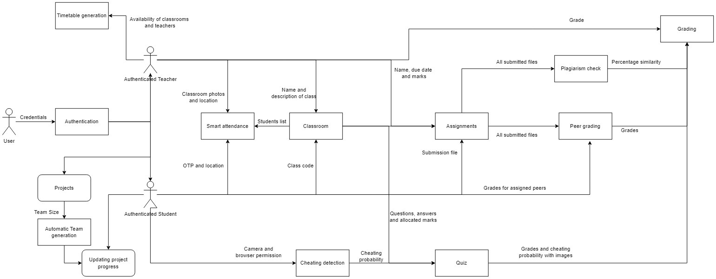
System Design
Link To the diagram

Slide 12
Features Implemented
Execution of Smart Attendance system.
Implementation of quiz with cheating detection.
Assignment submission and grading with similarity checking.
Peer-grading and project Tracking.
Implementation of announcement module and schedule generation.
Progressive Web App and project tracking
Research paper approved for publishing in IJRESM
12

Slide 13
Implementation
Link To GitHub Repository

Slide 14
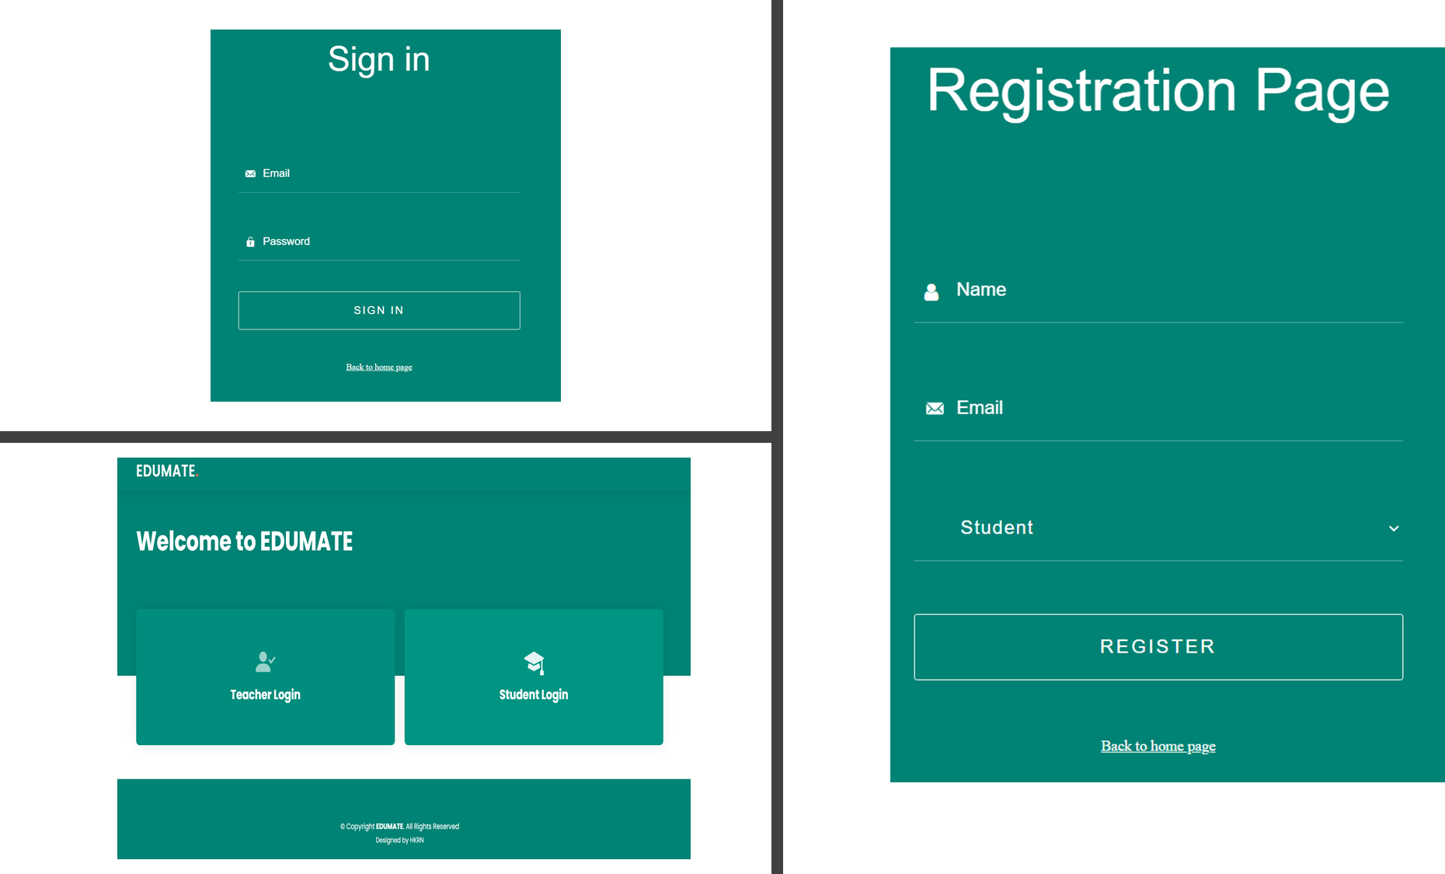
14

Slide 15
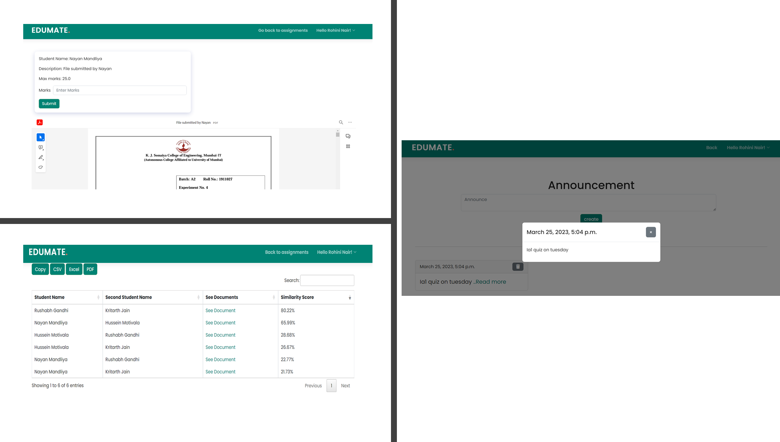
15

Slide 16
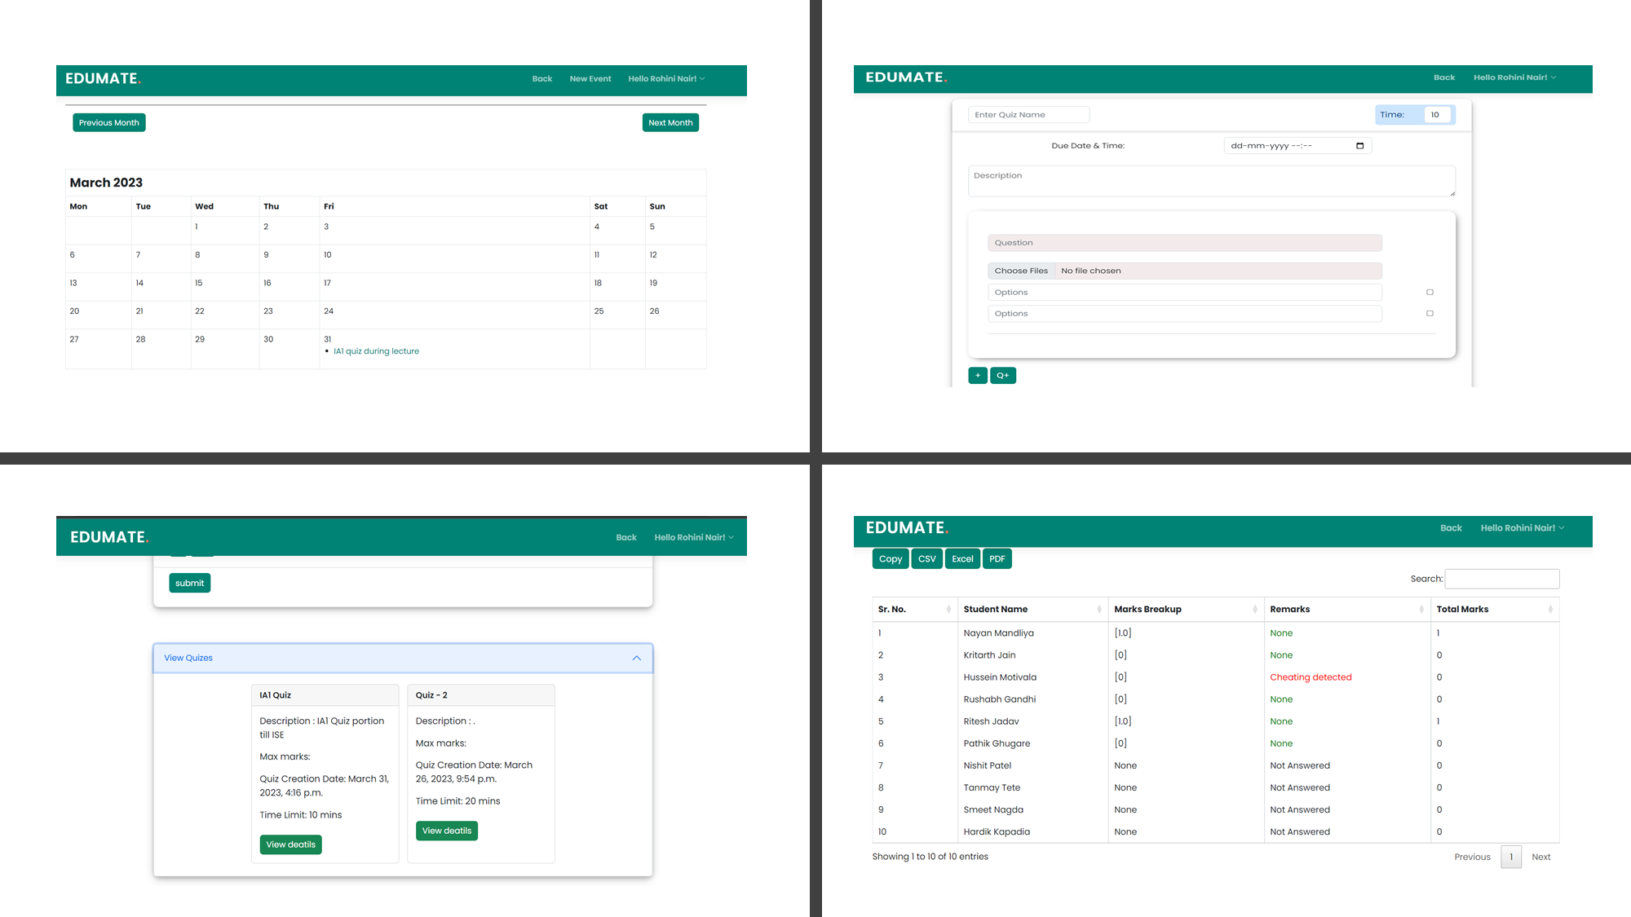
16

Slide 17
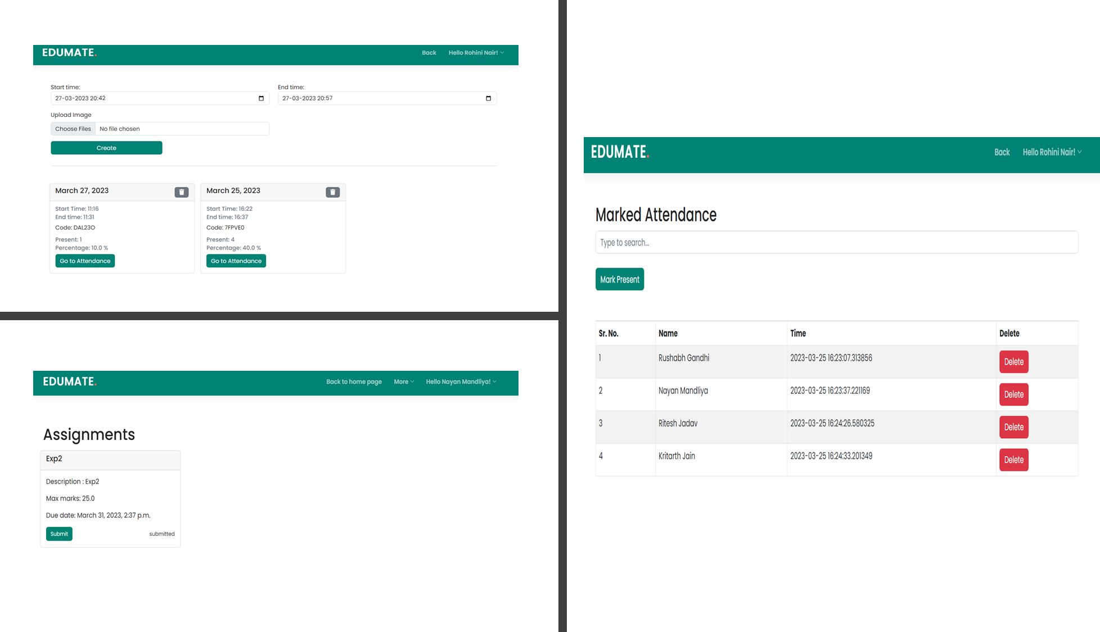
17

Slide 18
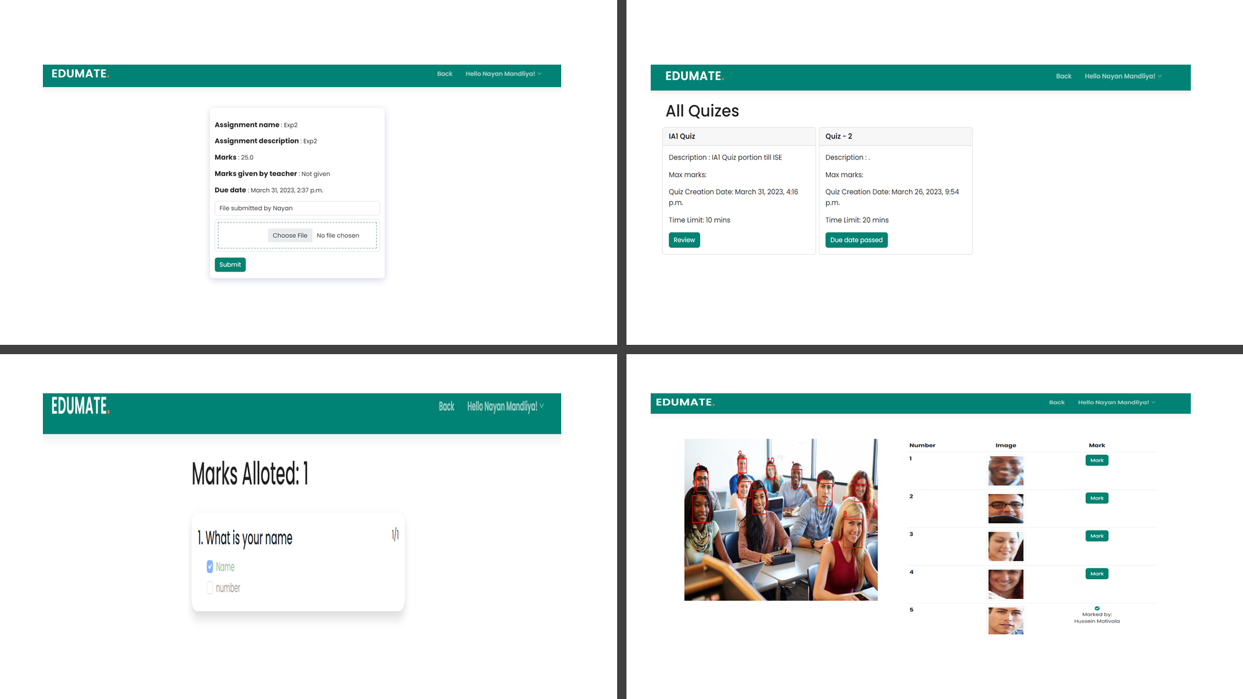
18

Slide 19
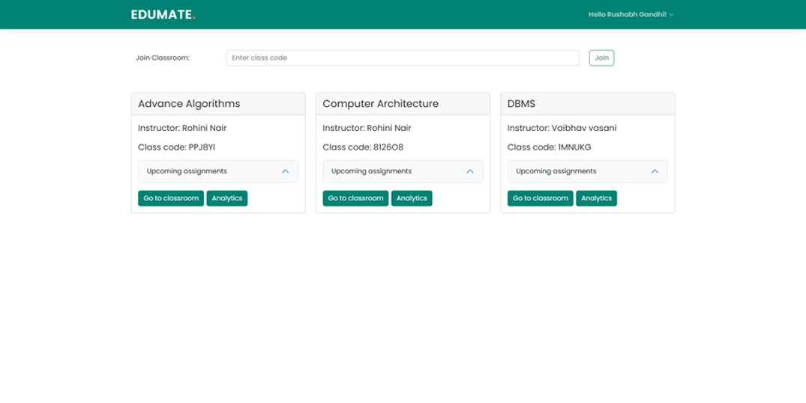
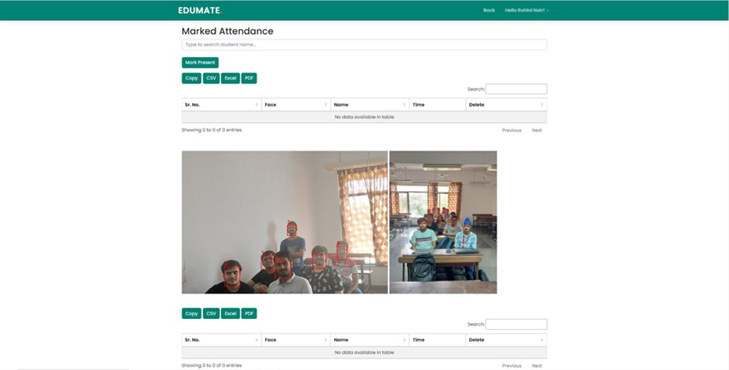
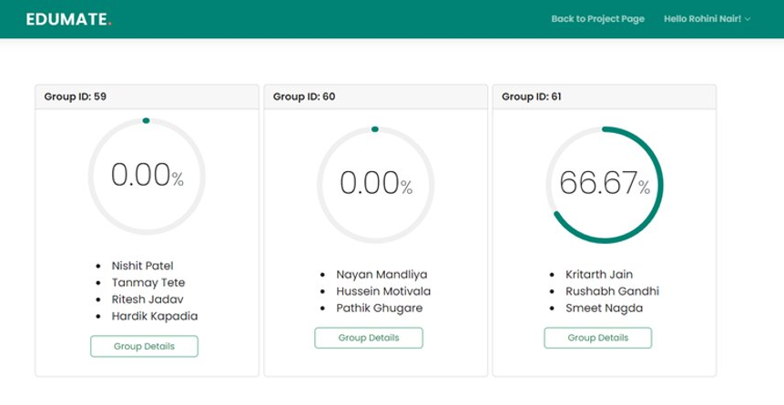
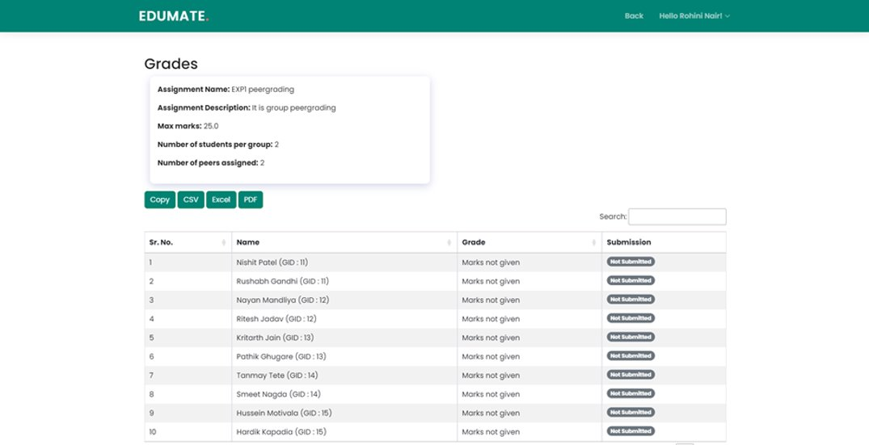
19

Slide 20
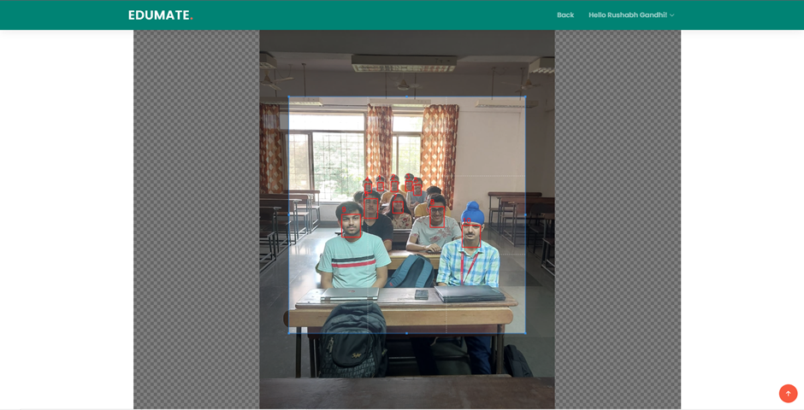
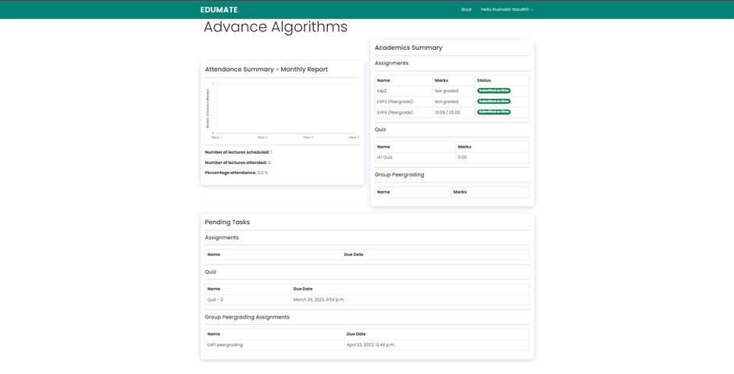
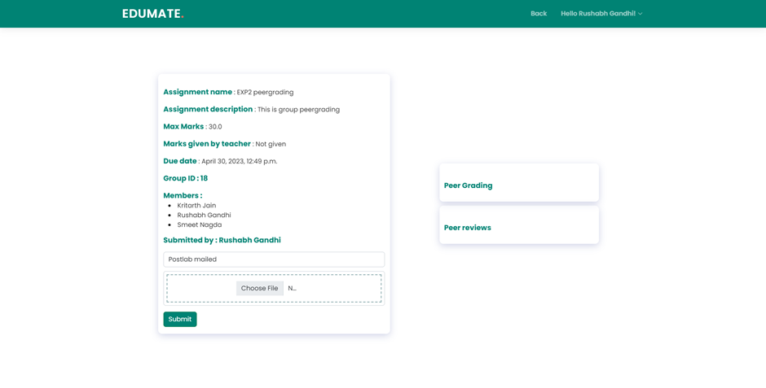
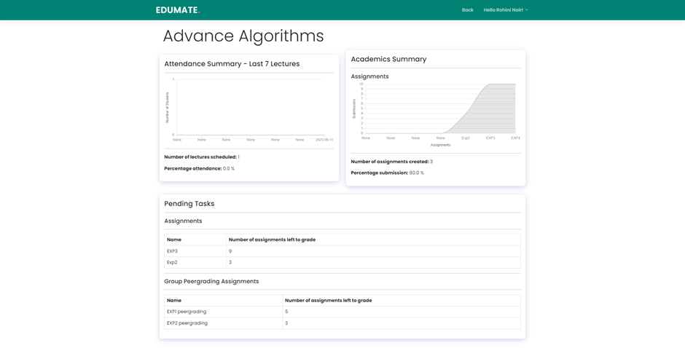
20

Slide 21
UML Diagrams
21
21

Slide 22
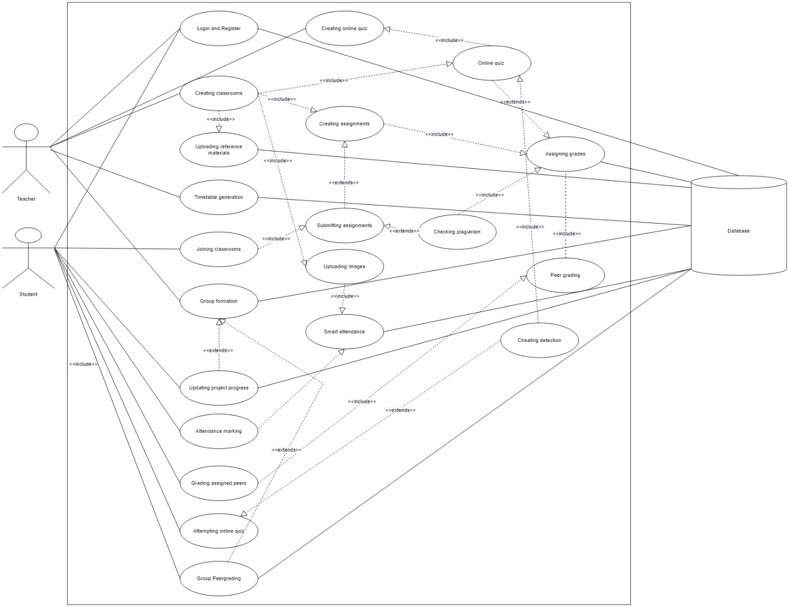
Use Case Diagram
Link To the diagram
22

Slide 23
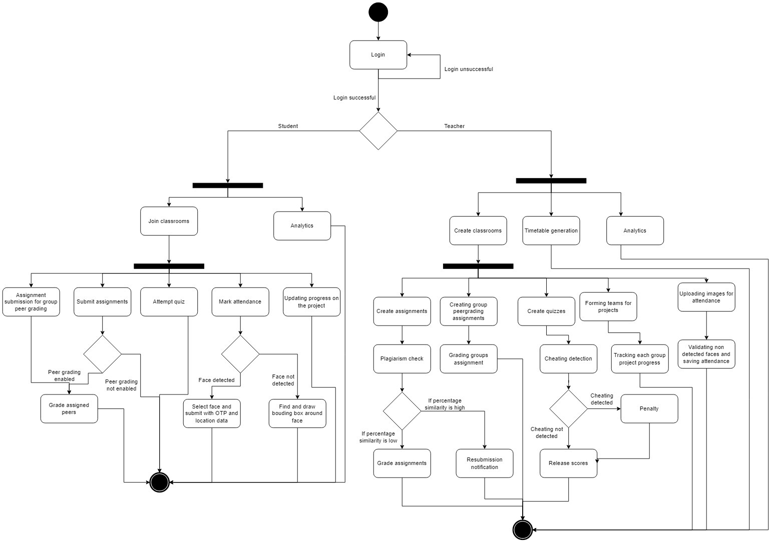
Activity diagram
Link To the diagram
23

Slide 24
Hardware & Software Requirements
Hardware
Software
Camera/Webcam
2GB Ram
I3 2nd Gen/AMD 2nd gen or similar
Operating Environment
VS Code
MYSQL
Postman
Django
Github
Javascript
Python
Web Browser
PCs running Windows operating system​
Macs running OS X Panther (v10.3)​
IPads running IPadOS 13.0 or later.​
Android-based Tablets running on (v4.2) jelly bean​
24

Slide 25

Thank You!

