Slide 1

Smart Attendance System
By
1911024 – Sneha Kothi
1911027 – Nayan Mandliya
1911031 – Hussein Motiwala

Slide 2
Problem Definition:
Decreasing complexity and time consumption of manual attendance system.
Maintaining the attendance record with day to day activities is a challenging task.
The conventional method of calling the name of each student is time-consuming and there is always a chance of proxy attendance.
The following system is based on face recognition to maintain the attendance record of students.

Slide 3
What is our project about:
The student attendance record is one of the most important things in any institutions.
Computers can detect a person's face using a digital image or video. It may be done by comparing the image captured in the real time with the database image.
The facial characters obtained from a real time image is to be compared with the facial characters of the database image stored.
The automated attendance management system gives a facility to the faculties to reduce the burden in taking attendance. This system takes the attendance automatically using face recognition.

Slide 4
What is our project about ?
Our project is a mixture of traditional technique for marking attendance of student and the new modern ideation.
The traditional way requires a student to speak the word “Present sir/ma’am”, and this is done for each and every student.
Now our project uses machine learning, deep learning and image processing to capture a students facial area and eventually marks his/her attendance without any waste of “present” time.

Slide 5
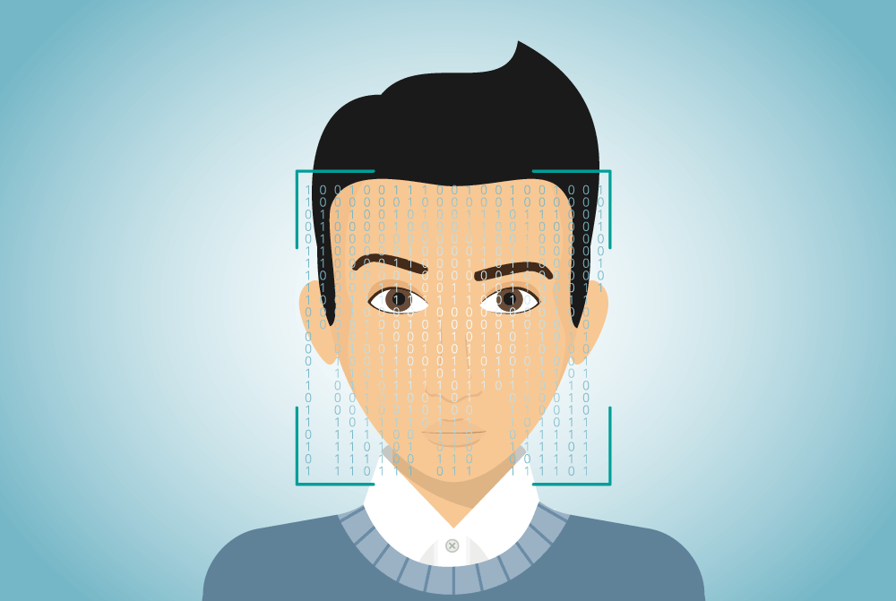
Flow of the project:
Creating dataset consisting of student images.
Extracting Facial features and embedding Images.
Training our Machine learning model on our dataset.
Recognizing the student and marking his attendance.

Slide 6
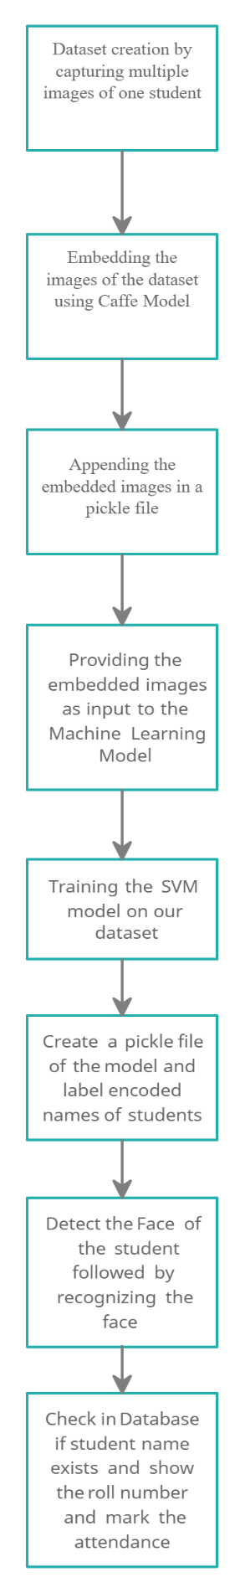
Flow Diagram:

Slide 7
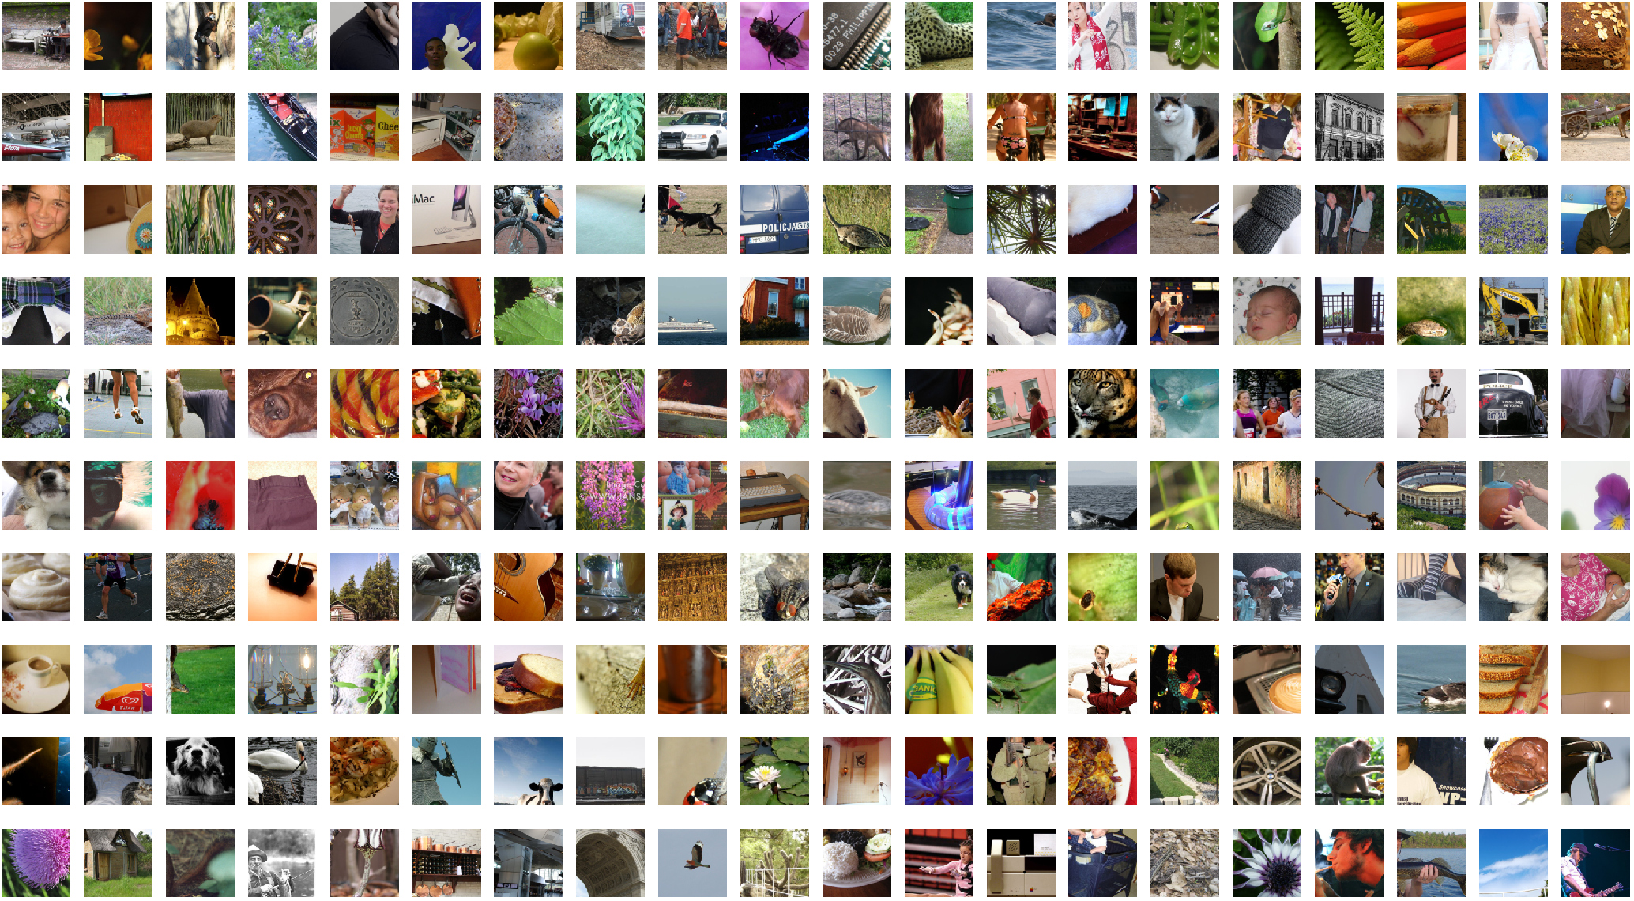
Dataset Creation:
Access webcam and take image of the student.
Resize the frame and detect the face using Haarcascade frontal face algorithm.
Convert the image to Gray scale.
Store the image.
This process will repeat till we get desired
number of images.

Slide 8
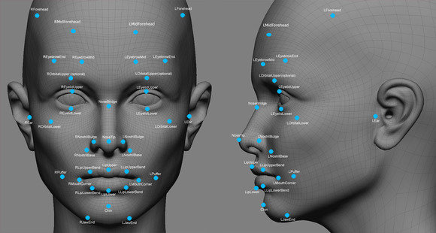
Extracting Features:
We capture the users images from the webcam and save it to create the dataset.
Now for detecting and mainly recognizing a particular person we need to extract features from its facial area.
The detection part is essential for correctly recognizing a person. This part is done by the caffe model.
After the person’s face has been detected the image is sent to a deep neural network from pytorch library which extracts
the features from the provided image and
embeds them in a pickle file.

Slide 9
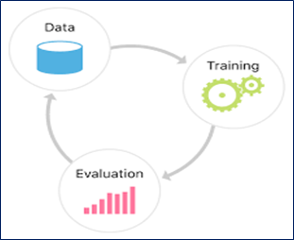
Training Model:
Now after the image features are extracted and embedded in the pickle file we then use these features on our custom dataset to train the Support vector machine (SVC).
Now we also need to create labels for a particular group of images belonging to a particular person. This is done using label encoders.
We label encode the names of the students as label for images corresponding to a particular student.
Fit SVC model on the embeddings and labels.
Create a separate file for the encoded labels and the
trained SVC model.

Slide 10

Recognizing Student and marking Attendance :
Load the recognizer pickle file and label encoded file.
Access the webcam and take users image through live feed.
Resize image and pass it to caffe model for face detection.
Pass the captured image to pytorch model for extracting features and embedding them.
Pass the embeddings to the Trained SVM model for predictions.
Predict the class(Identity the student).
Check for the name of student in database and print its roll number and mark attendance.

Slide 11
Work Distribution:
Name | Dataset Creation | Feature Extraction | Training ML Model | Updating Database
Sneha Kothi |  | X | X | X
Nayan Mandliya | X | X |  | X
Hussein Motiwala | X |  | X | X

Slide 12
What we have done till now?
We have created a custom dataset using our own images captured through our webcam.
Then we preprocessed the images by resizing them to fixed dimension and converting each image to blob.
Now the caffe model detects the facial part in the image and extracts it and sends the to deep neural network for feature extraction.
(Debugging):
The deep learning model extracts features from the images and then creates a recognizer file which is sent to SVC for classification purpose.
Finally the person switches webcam and the model recognizes the person and marks his/her attendance in the database.

Slide 13
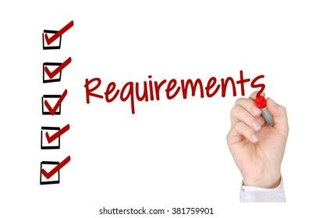
Requirements:
Microsoft Word: For Documentation purposes
Jupyter notebook: Programming purpose (Python)
Chrome Browser, webcam: Testing
Creatly : Block Diagram
Open-cv: Image processing
Pytorch: Deep neural network.
Caffe model: Face detection.

Slide 14

DEMO

