Slide 1
Runway Detection and Localization in Aerial Images Using Deep Learning
Authors:-
Javeria Akbar, Muhammad Shahzad, Muhammad Imran Malik, Adnan Ul-Hasan,
Fasial Shafait
Hussein.A.Motiwala - 1911031

Slide 2
Need for such a System
Solution which the paper proposes
Landing is the most difficult phase of the flight for any airborne platform. Due to lack of efficient systems, there have been numerous landing accidents resulting in the damage of onboard hardware.
Vision based systems provides low cost solution to detect landing sites by providing rich visual information.
Detection and localization of runways in aerial images with untidy terrains which would consequently help aerial platforms especially Unmanned Aerial Vehicles (commonly referred to as Drones) to detect landing targets (i.e., runways) to aid automatic landing

Slide 3
Traditional Techniques used for Runway Detection
Template based approaches use a model of the object to be detected in the query image. This model is stored in an image called a template. This template is compared with the query image on pixel by pixel basis to find matches. Template based methods are not too common and mostly they are used alongside other feature based techniques.
Feature Based Approaches(hand-craft): These approaches use features of runway like intensity edges, high contrast corners, texture primitives and other similar image components. Feature based approaches can be further divided into two more categories; one that uses geometric shape of the runway for detection, and the other that uses machine learning based approaches

Slide 4
Runway Detection
Land consists of multiple areas like runways, roads, forests, buildings, seas, mountains, deserts and many more. There should be a classification process to find whether a runway exists in the image or not. We have used CNN model for classification purpose.
Dataset: For binary classification, land areas other than runway like roads, forests, mountains, deserts etc. would have been treated as one class which would have been a less suitable approach. So, a remote sensing dataset [1] with multiple classes has been used for this purpose. This dataset is the largest available dataset, which is variant enough to apply CNN models and consists of satellite images downloaded from google earth, collected by experts. There are 45 classes with each class containing 700 images.
Feature Extraction: CNN classification models VGG16 [2], Resnet50, Resnet152 [3] and Densenet161 [4] trained on Image Net dataset have been used to extract features from images. For each classification model, input images have been resized to 224x224 and the only preprocessing performed is mean normalization(In image processing, normalization is a process that changes the range of pixel intensity values). Keras models with backend as TensorFlow have been used for feature extraction

Slide 5
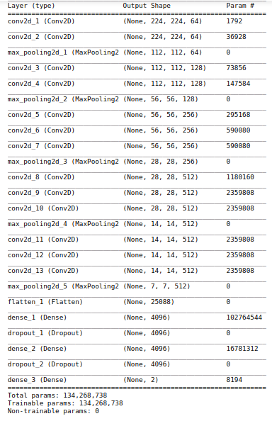
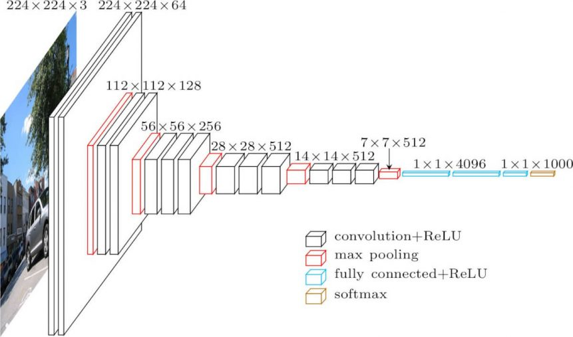
VGG16

Slide 6
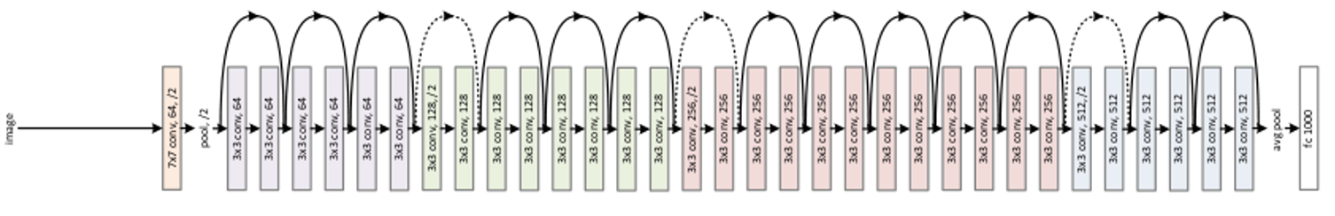
Resnet50
ResNet50 is a variant of ResNet model which has 48 Convolution layers along with 1 MaxPool and 1 Average Pool layer.

Slide 7
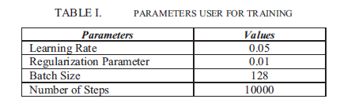
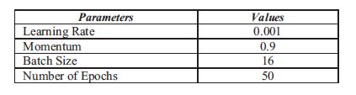
Classifier & Training: After extracting features, a softmax classifier has been trained on these features It works as follows: Weight matrix is initialized using random values based on normal distribution and biases are initialized to zero. Inputs (extracted features) are multiplied with weight matrices and biases are added. Training labels are first converted into one hot encoding sequence (representation of labels as binary vectors). Then loss is calculated by computing cross-entropy and taking average of it across all training examples. The minimum loss is found using gradient descent optimizer
Fine-tuning: ResNet50 has been selected as the best model based on results presented in Results section. Keras based implementation of Resnet50 trained on ImageNet has been used for finetuning. Softmax classifier of Resnet model has been replaced with a customized softmax classifier. For finetuning, input images have been resized into 224x224 and have been randomly divided into 80% training data, 10% validation and 10% test data. Parameters have been finetuned manually based on validation accuracy.

Slide 8


Runway Localization
Runway detection is used for only finding out that whether runway exists in the image or not. To find the exact location of the runway in the image, the runway has been localized using both line detection algorithms and deep learning CNN models. Same dataset which has been used for classification purpose has been used here for localization purpose. But here only one class of that dataset that is runway is used. The purpose is to localize only runway in the image.
Line Detection Techniques: As the runway structure is composed of straight lines, line detection algorithms can be employed to localize the runway in the image. Simple Hough transform, probabilistic Hough transform and LSD (line segment detector) based approaches have been used for localizing runway in this section
Hough Transform (HT): In this approach, firstly runway images from the selected dataset have been converted into grayscale images. It can be clearly seen from Figure that gray values of runway area are much different than those of background. Then Canny edge detection has been applied to extract edges. Distance between two detected line is calculated by the following formula.
Then Hough transform has been applied on edge image with accuracy of 1 and different accuracy and threshold parameters. It returns lines in parametric form (, ). This parametric form has been used to get endpoints of returned
lines as follows:

Slide 9

Line Segment Detector (LSD): In this approach, firstly runway images from the selected dataset have been converted into grayscale images. After detecting all line segments in the image, their lengths have been calculated. It is known that runways are elongated structures and they have long boundaries, so some threshold has been set and lines are filtered based on their length. That is, those lines are selected which have length greater than some threshold. LSD algorithm returns the two endpoints (x1, y1), (x2, y2) of a line segment so the length of a line segment cab be calculated as follows:
CNN: The objective is to localize the runway such that the runway can be extracted with its boundaries. Bounding boxes give us subset of the image which includes the required object. We still cannot extract the exact object as it is. To extract the object with its boundaries, a segmentation algorithm is needed. In segmentation, each pixel is assigned to a class. For each pixel, it is decided that whether it belongs to a particular class or not, so it can also be called as pixel level classification. A pixel wise mask for the required object is generated and the model learns by finding the difference between the predicted and the ground truth mask. Mask R-CNN is which is a pretrained model on the coco(Common objects in context) dataset has been used as a segmentation algorithm.

Slide 10
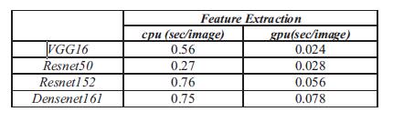
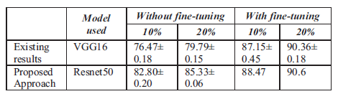
Results
Runway Detection
Feature Extraction: According to graph, Resnet50 and Resnet152 have almost same performance based on their accuracies. But as shown in Table Resnet50 is faster so it has been chosen for finetuning
Finetuning: CNN model Resnet50 has been finetuned on selected dataset. Model has been initialized with pretrained weights of ImageNet dataset. Validation accuracy on training ratio of 80% has been reported to be 97.33% and test accuracy on training ratio of 80% has been reported to be 96.63%. To evaluate the model on target class runway, precision and recall has been calculated for class runway. For training ratio of 80%, precision and recall has been calculated as 94.44 % and 97.14% respectively.

Slide 11
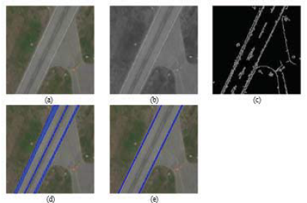


Runway Localization
Hough Transform: For evaluation purpose, 460 images with different properties have been selected from 700 runway images of selected dataset. Whether runway has been successfully localized or not, it has been evaluated by inspection. Runway is considered successfully localized if two detected lines are almost same as the real two boundaries of the runway. All such images have been manually counted, and accuracy has been reported. Table VII shows accuracy results for simple Hough transform based approach and Table VIII shows accuracy results for probabilistic Hough transform based approach
Hough Transform results
Probabilistic Hough Transform results

Slide 12
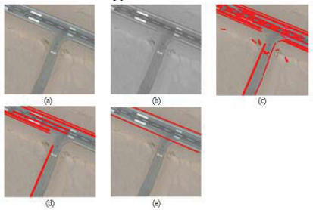
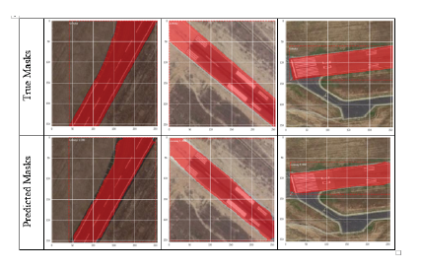

Line Segment Detector: OpenCV based implementation of LSD has been used with default parameterization as it showed satisfying results except for number of bins. Number of bins have been selected based on the dataset used. Same set of images have been used as in above method and runway has been correctly localized in almost 76.5% of the total images
CNN: Both selected dataset and novel customized dataset has been used for experiments. In both cases, weights have been initialized with pre-trained weights of coco dataset for finetuning.

Slide 13
Conclusion
This paper presents a method to perform the runway detection using aerial images acquired from onboard vision sensor. The work presented in this paper is the initial step in UAV landing that includes the detection and localization of runways.
This research has been conducted to find an accurate runway detection model. Previous research has been mostly based on non-machine learning based methods with lot of assumptions about position of runway in the image. Use of deep learning in runway detection allows to detect runways without explicitly extract hand crafted features. The proposed runway detection model has been validated on two datasets including a custom-made runway detection dataset and a public remote sensing dataset for aerial image classification which shows that this model can detect any shape of runway with the appropriate training data.
This research includes two modules, first land has been classified to find out if there exists a runway or not, then runway detection model has been applied to extract runway from image. Combination of these two approaches increase accuracy. With right hardware, this can be implemented in landing of UAVs. After successful extraction of runway, this extracted runway can be used to align UAV with the runway. The proposed runway detection model achieved reasonable IOU of 0.8 which validates its efficacy.

Slide 14
References
[1] G. Cheng, J. Han, X. Lu. "Remote sensing image scene classification: Benchmark and state of the art." Proceedings of the IEEE, vol. 105, issue 10, 2017.
Dataset - http://www.escience.cn/people/JunweiHan/NWPU-RESISC45.html
[2] - VGG16 is a convolutional neural network model proposed by K. Simonyan and A. Zisserman from the University of Oxford in the paper “Very Deep Convolutional Networks for Large-Scale Image Recognition”.(92.7% top-5 test accuracy in ImageNet)
[3] - Resnet152
[4] - Densenet161 G. Huang, Z. Liu, L. von der Maaten, K. Q. Weinberger, "Densely connected convolutional networks" Proceedings of the IEEE conference on computer vision and pattern recognition, 2017, pp. 4700-4708.

Slide 15
Implementation
I will be performing the runway detection part of the paper
Will be using same dataset mentioned in the paper as it a large one with ~31k images.
Will use Resnet50 specified in the paper.
And if possible will also try to implement localization part

Slide 16
Thank You

Slide 17
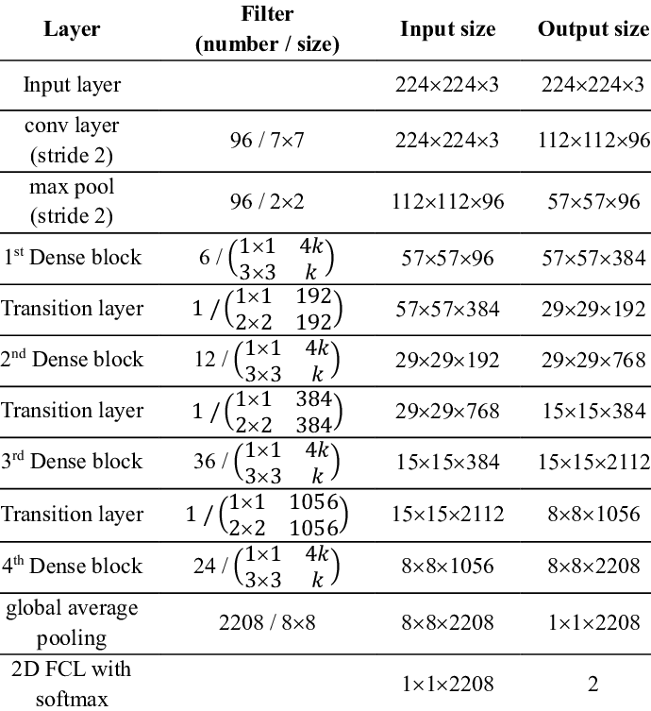
Densenet161

