Slide 1
Stock Market Analysis using Supervised Machine Learning -Kunal Pahwa -Neha Agrawal
Roll No : - 1911027 Name : - Nayan Mandliya

Slide 2

Introduction :
Stock market or share market is one of the most complicated and sophisticated way to do business.
Prediction of share values is a very complex task.
Hence some computational work needs to be done.
This paper proposes to use machine learning algorithm to predict the future stock price for exchange by using open source libraries and preexisting algorithms to help make this unpredictable format of business a little more predictable.

Slide 3

Stock/Share Market:
One of the oldest platforms where normal person would trade stocks, make investments and earn some money.
Prices and liquidity is highly unpredictable.

Slide 4
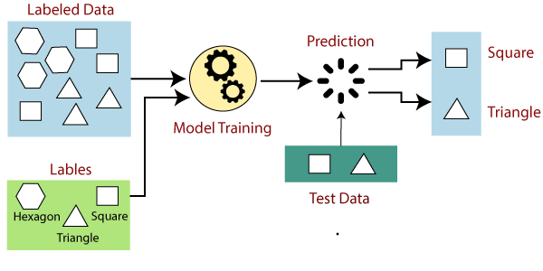
Supervised Machine Learning:
It is a learning in which we teach or train the machine using data which is well labeled that means some data is already tagged with the correct answer.
After that, the machine is provided with a new set of examples(data) so that supervised learning algorithm analyses the training data(set of training examples) and produces a correct outcome from labeled data.
Advantage:
Helps to optimize performance criteria with the help of experience.
Disadvantage:
Training for supervised learning needs a lot of computation time.

Slide 5

EXISTING Method:
A human brain is very capable of extending the graph a few coordinates by just simple looking at it for a few minutes.
If we crowd compute i.e. make a group of people try to extend the graph by a fixed amount of time (say a week), then accuracy of results will be much more.
Hence true value of the stocks can be efficiently predicted using method of crowd computing.
It is a time consuming activity.

Slide 6
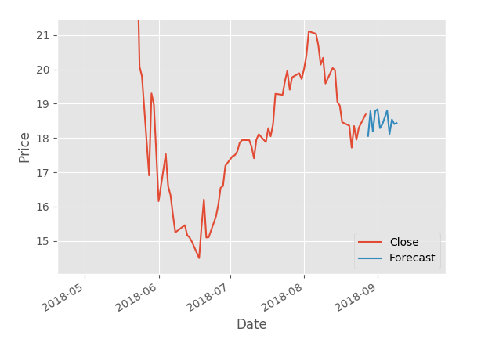
PROPOSED METHOD:
In statistics, there is a way where we look at the values and attributes of a problem in a graphs and identify the dependents and independent variables and try to establish or identify an existing relationship amongst them.
This technique is known as linear regression.
In machine learning we have adapted the same algorithm where we use the features to train the classifier which then predicts the value of the label(stock price) with certain accuracy which can be checked while training and testing of the classifier.
The accuracy of your classifier is directly proportional to the amount of data provided to the classifier and the attributes selected.

Slide 7


PREDICTION MODEL:
- : DATA ANALYSIS STAGE : -
In this stage, we shall look at the raw data available to us and study it in-order to identify suitable attributes for the prediction of our selected label.
Closing price of the stock will be the label(Value to be predicted).
Set of features which will be used to predict stock prices:
Adj. Close: This is an important source of information as this decides market opening price for the next day and volume expectancy for the day.
HL_PCT: We use percentage change as this helps us reduce the number of features but retain the net information involved.
PCT_change: We do the same treatment with Open and Close as High and Low.
Adj. Volume: This is a very important decision parameter as the volume traded has the most direct impact on future stock price than any other feature.

Slide 8
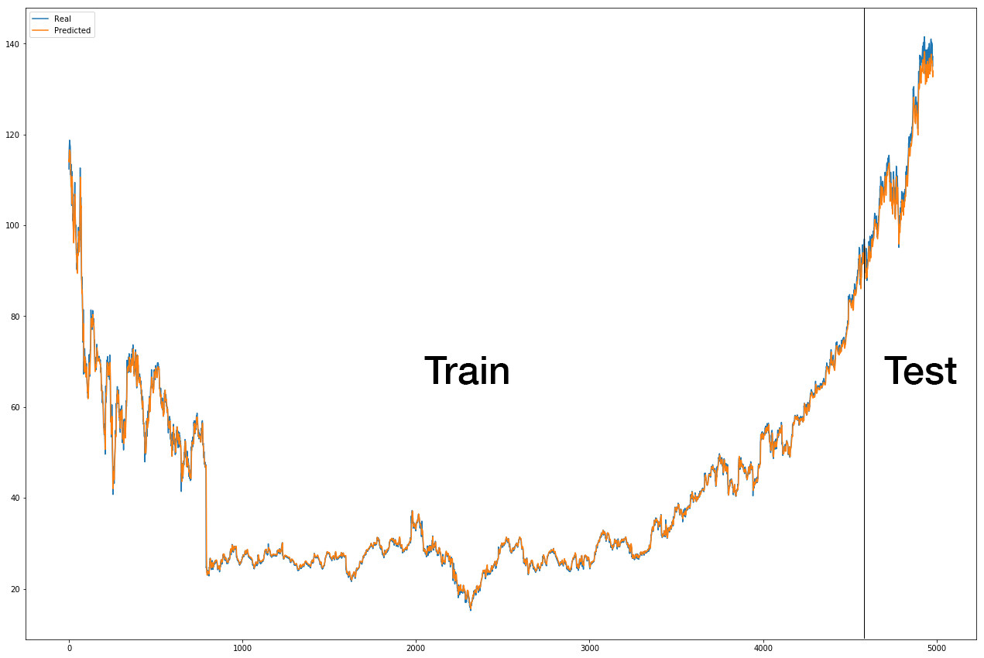

PREDICTION MODEL:
- : TRAINING AND TESTING STAGE : -
At this stage we shall be using what we extracted from our data and implement in our machine learning model.
We will be using our model, train it with the features and label which we extracted and then test them with the same data.
First we shall preprocess the data:
Dataframe format is converted to Numpy array format.
All NaN data values removed before feeding it to the classifier.
The data is scaled such that for any value X, X $∈\left[−1, 1\right].$
The data is split into test data and train data.
Now the data is ready for us to input in a classifier.

Slide 9
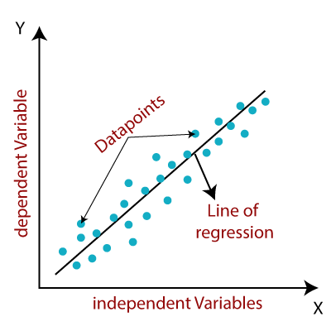
PREDICTION MODEL:
This paper describes to use the simplest machine learning model i.e. Linear Regression
This model is chosen because of its simplicity and it serves purpose just right.
Linear regression is a very commonly used technique for data analysis and forecasting.
Here in our case, the regressor sees the features and simply looks at its label and remembers it.
Then it moves on and learns what pattern is being followed by the
features to produce their respective label.
For testing in supervised machine learning, we input some combination of
features into the trained regressor and cross check the output of the regressor
with the actual label.

Slide 10
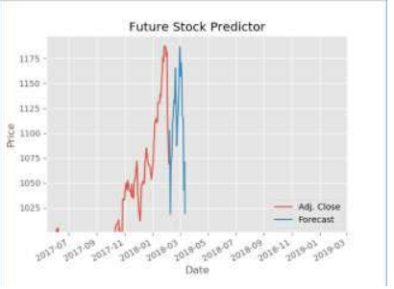

PREDICTION MODEL:
- : RESULTS : -
Once the model is ready, we use the model to obtain the desired results in any form we want.
In our case, we shall be plotting a graph(between date and close
price of the stock) as our result.
The key component of every result is the accuracy it delivers.
There are some standard methods to calculate accuracy in
machine learning, some are as follows:
$R^{2}$ value of the model.
Adjusted $R^{2}$ value
RMSE Value
And many more

Slide 11

CONCLUSION:
Machine learning is a very powerful tool and it has some great application.
Machine learning is very much dependent on data.
This paper completely describes fundamentals of stock market.
This paper delivers a smooth insight of how to implement supervised machine learning project.
This paper proposes a method to predict the stock prices.
Machine learning have found tremendous application and has evolved further into deep learning and neural networks.

Slide 12
REFERENCES:
“Linear Regression”, 1997-1998, Yale University http://www.stat.yale.edu/Courses/1997-98/101/linreg.htm
Agarwal (July 14, 2017). "Introduction to the Stock Market". Intelligent Economist. Retrieved December 18, 2017.
Jason Brownlee, March 2016, “Linear Regression for machine learning”, Machine learning mastery, viewed on December 2018, https://machinelearningmastery.com/linear-regression-for-machinelearning/
Fiess, N.M. and MacDonald, R., 2002. Towards the fundamentals of technical analysis: analysing the information content of High, Low and Close prices. Economic Modelling, 19(3), pp.353-374.
Hurwitz, E. and Marwala, T., 2012. Common mistakes when applying computational intelligence and machine learning to stock market modelling. arXiv preprint arXiv:1208.4429.

Slide 13

IMPLEMENTATION Strategy:
Importing dataset from quandl.
Preprocessing on dataset to extract features that machine learning model will require.
Using a linear regression model to predict stock prices.
Showing the results using graph.

Slide 14


