Slide 1
Introduction To Python
Hussein El Amouri

Slide 2
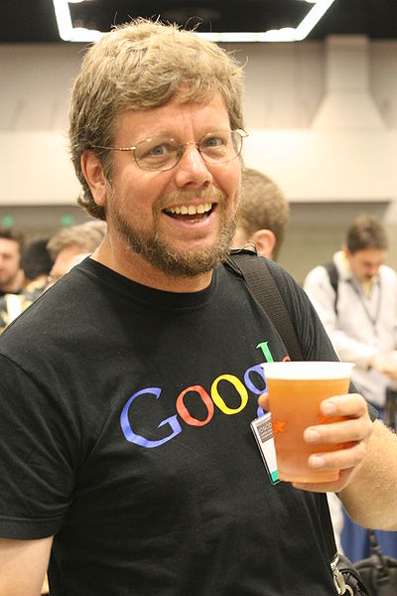
What is Python?
“Python is an experiment in how much freedom programmers need. Too much freedom and nobody can read another's code; too little and expressive-ness is endangered.”
- Guido van Rossum

Slide 3
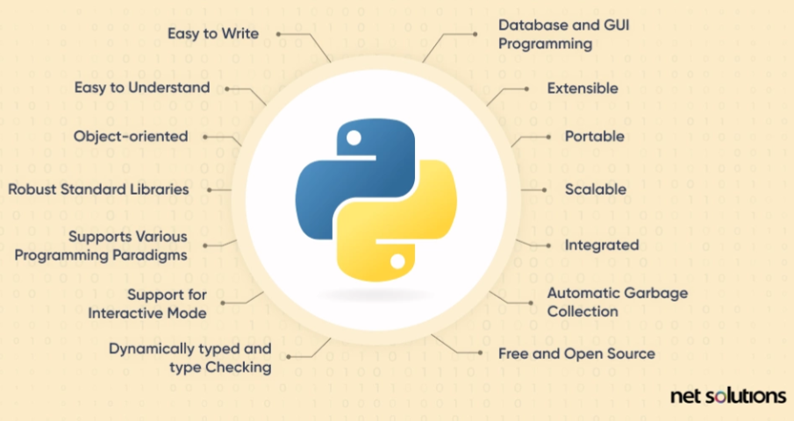
Why Python?
It’s easy to learn
Full-Featured
Strong Libraries

Slide 4
Python
High-level
Human-readable and strong abstraction from machine language
Interpreted language
Line by Line is interpreted into machine language
Dynamically typed
No need to define data types

Slide 5
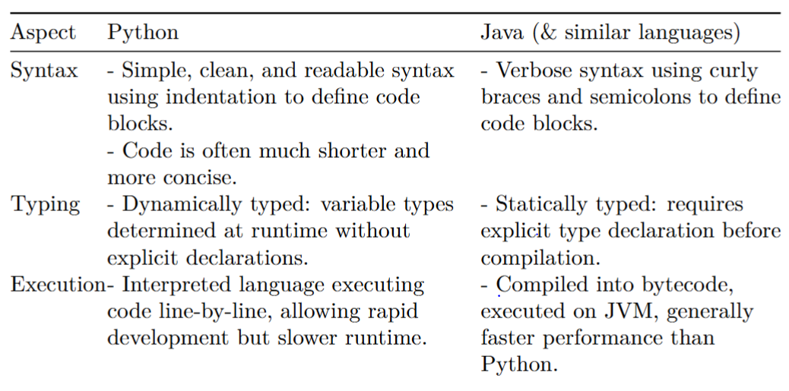
Python vs Java (& Similar languages)

Slide 6
Python Installation
Refer to: 02_Setup_Python.pdf in Python Installation and Basics
Following document:
1.2.1. Installing Python (latest stable release - 3.9 or 3.10)
1.2.2. Installing and setting up VS Code as Python IDE (GoogleColab and Jupyter NoteBook)
We will be using Vscode

Slide 7
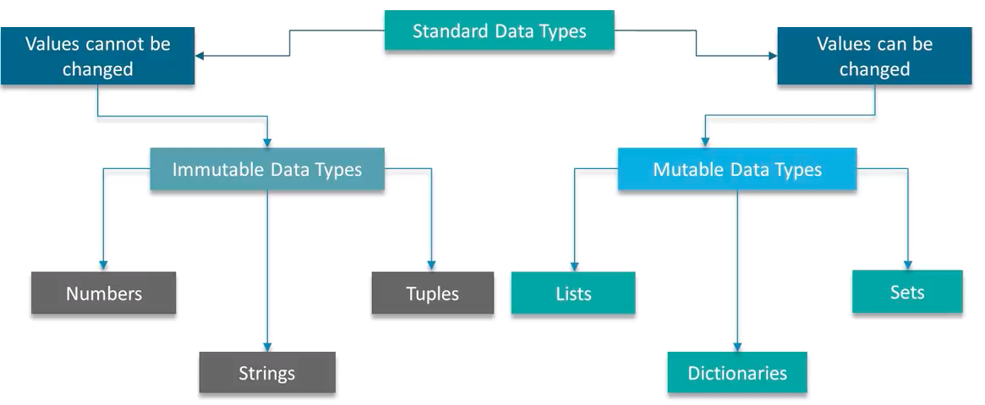
Python Data Types

Slide 8
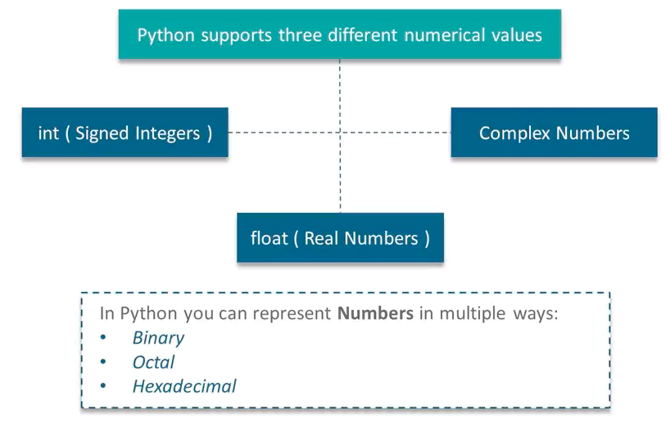
Numerical Data Types

Slide 9
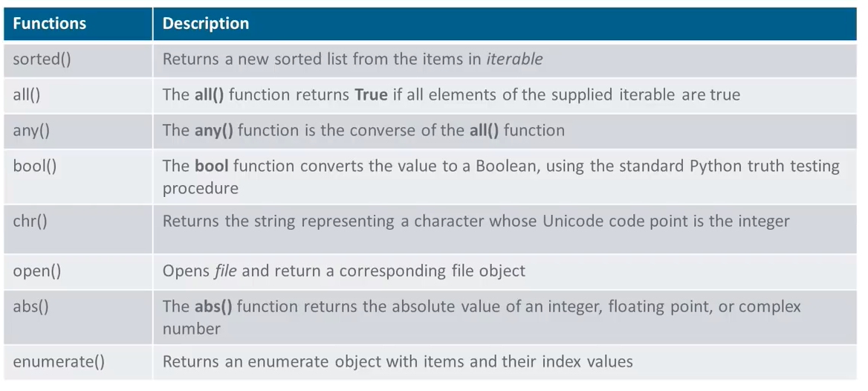
Built-in functions

Slide 10
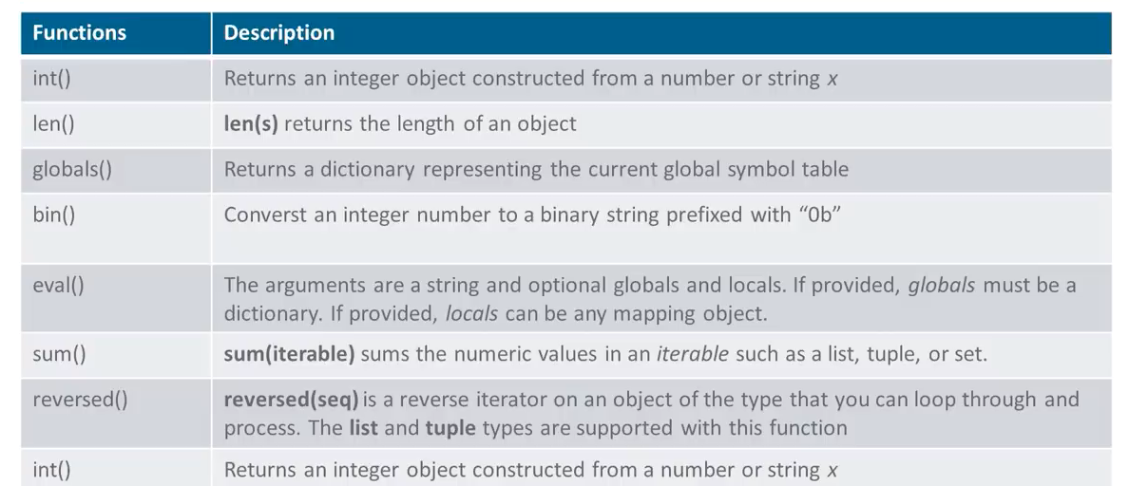
Built-in functions

Slide 11
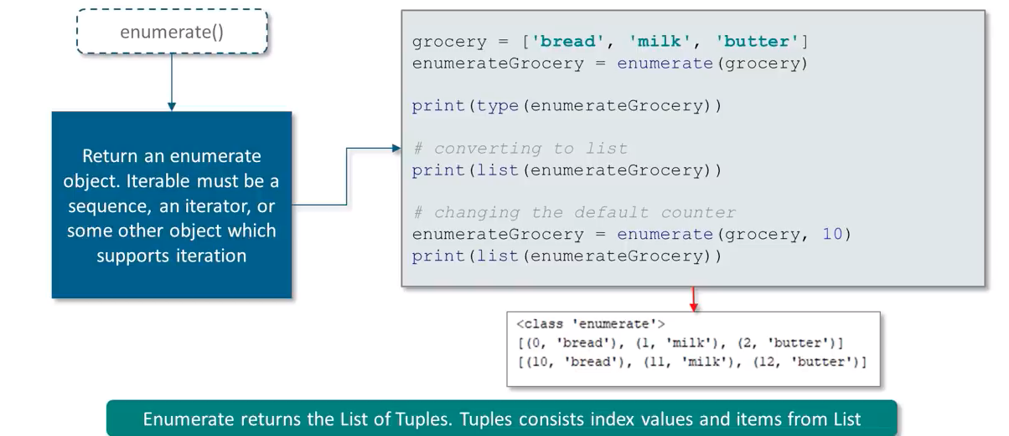
Enumerate Function

Slide 12
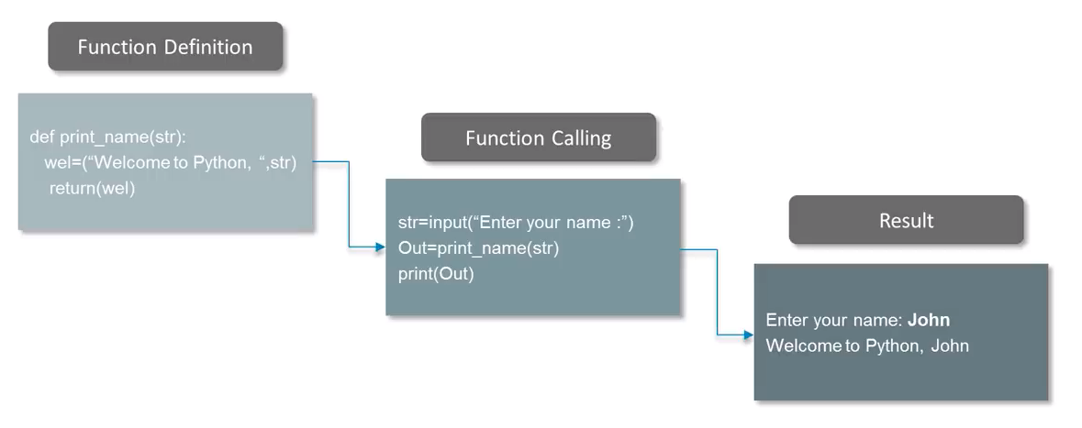
Functions

