Slide 1
INNOVATION RADAR
“Automated” Signal-to-Opportunity Engine
Turning raw public-procurement signals into structured, ranked business opportunities — powered by LLM-driven extraction, validation, and scoring.
Team members:
Hussein Abuamamr
Max Huberland
Sooyoung Lee
Prepared for the Orange Business Team

Slide 2
The Technical Signal Processing Pipeline
Five automated stages take a raw market signal to a scored, structured opportunity
01
02
03
04
05
Ingestion
Persistence
Theme Discovery
Opportunity Synthesis & Scoring
Radar
TED scanner pulls contracts via targeted CPV codes
NEWSAPI calls by domain
→
Clean metadata cached into relational SQLite tables
→
LLM batches text to extract top 5 trending themes by domain
→
Deep LLM pass builds the enterprise opportunity matrix
→
Display of opportunity spaces with prioritization
Innovation Radar
02

Slide 3
Layer 1 — Ingestion & Data Harvesting
Harvesting high-value public-sector signals
NEWSAPI
Pre-filtering up to 500 signals by domain
Domains
Sustainability
Cybersecurity
Connectivity
Cloud
Smart industries
Customer Experience
Employee Experience
TED EUROPA API
Post-filtering down to 10% linked to domains with LLM
Innovation Radar
03

Slide 4
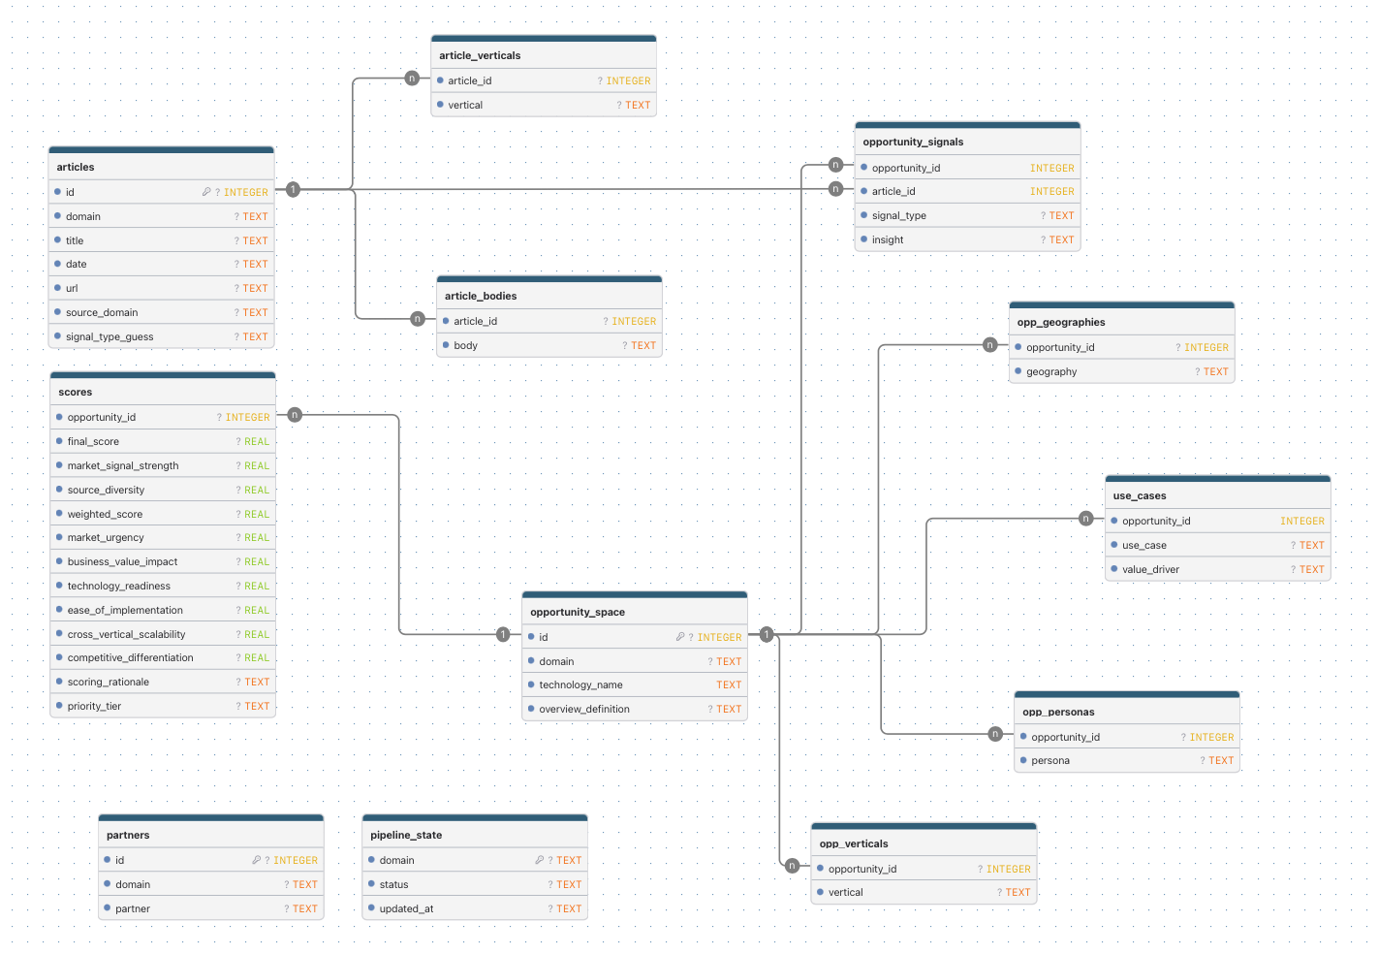
Layer 2 — Relational Persistence
Innovation Radar
04

Slide 5
Layer 3 — Theme Extraction & Validation
A resilient pipeline that extracts up to 5 trending themes by domain without letting the AI break the system
Raw Articles
(one extraction by domain)
→
Extract & Repair
(Gemini API)
→
Validated Schema
(Pydantic)
1
2
3
Strict Schema Enforcement
Self-Healing Layer
Hallucination Auditing
Gemini's native JSON schema mode forces structured, machine-readable output every time.
A JSON repair & normalization utility patches malformed output and standardizes loose model field names.
RapidFuzz token matching (fuzz.WRatio) re-links AI-generated themes back to real article IDs — catching fabricated sources.
Innovation Radar
05

Slide 6
Layer 4 — Strategic Opportunity Mapping
Scaling context to a 16,384-token window to turn themes into commercial insight
Valid Theme IDs
+ Verified Docs
→
Deep Content Input
(max 16k tokens)
→
Enterprise Matrix
Generation
The matrix maps each theme across four commercial dimensions:
1
Use Cases
2
Value Drivers
Concrete ways the technology gets applied in the real world
The business outcomes and ROI levers behind each use case
3
Target Audience
4
Geography
Buyer personas, industry verticals mapped by function
Operational zones and regional demand concentration
Innovation Radar
06

Slide 7
Layer 5 — Advanced Scoring & Storage
A mathematical, multi-dimensional framework for ranking opportunities
Market Signal
Strength
Source
Diversity
Strategic potential
Final
Score
How loud or frequent is the demand?
Are multiple buyers asking, or just one?
Combination of 6 LLM scores
Blended metric ranking what to pursue first
40%
20%
40%
Signal Classification
Diverse text phrases are mapped into three clean, searchable corporate categories:
Market_urgency (20%)
Business_value_impact (20%)
Technology_readiness (15%)
Ease_of_implementation (15%)
Cross_vertical_scalability (15%)
Competitive_differentiation (15%)
regulation
buying_signals
market_trends
Innovation Radar
07

Slide 8
Next steps..
Source
Diversity
Dashboard adapted to each persona
More signals
Paid LLM
Merging with orange internal data
Automation
Linking partners
08
Innovation Radar

