Slide 1
Drug Review Sentiment Classification
Karim Alhusaini
CSC 7810

Slide 2
Content
Intro: Natural Language Processing
Dataset Overview
Literature Review
Proposed Methodology
Results
BERT Model
Application
Conclusion & Further Study

Slide 3
Natural Language Processing (NLP)
AI tools that help machines understand human languages and derive meaning from text and speech
Text classification
Sentiment Analysis
Speech recognition
Text/Speech generation
Translation
Auto-correct
Applications

Slide 4


Sentiment Analysis
Classify text or speech into pre-defined sentiments: Positive, negative, neutral, ..etc
Machine Learning Algorithm
Feature Extractor
Label
Features
“Really works fast and without any side effects”
Positive (Score*: 0.98)
“This was the worst experience I had in my life”
Negative (Score: 0.005)
Score based on Sigmoid function

Slide 5
The Dataset
Patient reviews on specific drugs along with related conditions and a patient rating reflecting overall patient satisfaction.
Data was obtained by crawling online pharmaceutical review sites
Source: druglib.com & drugs.com
Retrieved from UCI Machine Learning Repository
121,573 reviews total, 60:20:20 split
Median review length: 112 words
2 sentiments (classes): Positive & Negative
Small class imbalance: 60% Positive, 40% Negative
Imbalance solved using two methods:
Applied class weight multipliers: ((1/class) * total) / 2
Oversampling from under-represented class to get 50:50 distribution

Slide 6
Literature Review
Law et al. (2009) – Sentiment Classification of Online Reviews using Supervised Machine Learning Approaches
Carley et al. (2018) – Aspect Level Sentiment Classification with Attention-over-Attention Neural Network
Rao et al. (2018) - LSTM with sentence representations for document-level sentiment classification
Munikar et al. (2019) - Fine-grained Sentiment Classification using BERT
Lian et al. (2018) - Domain Adapted Word Embeddings for Improved Sentiment Classification
Chen et al. (2019) - A Text Sentiment Classification Modeling Method Based on Coordinated CNN-LSTM-Attention Model

Slide 7
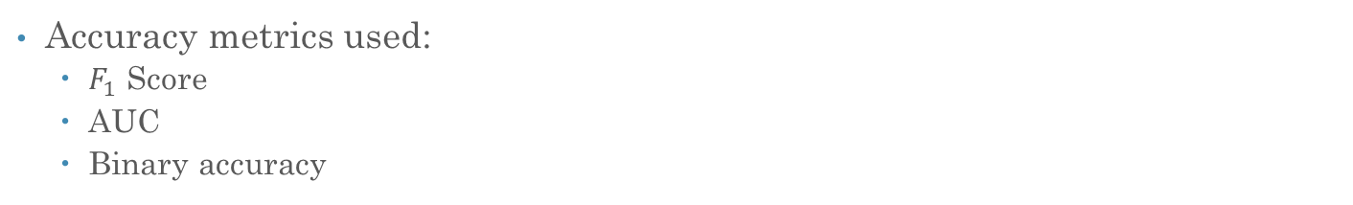
Methodology
Data Preparation
Pre-Processing & Feature Engineering
Embeddings
Machine Learning
Deep Learning
BERT Transformer
Dataset
- Naïve Bayes
- Support Vector Machine
- Logistic Regression
- Gradient Boosting Classifier
- XGBoost
Bidirectional LSTM
CNN with LSTM
Pooled GRU
HAN
BERT Base
ELECTRA Base
Project done using Python – Colab Pro
Accuracy metrics used:
$F_{1}$ Score
AUC
Binary accuracy

Slide 8
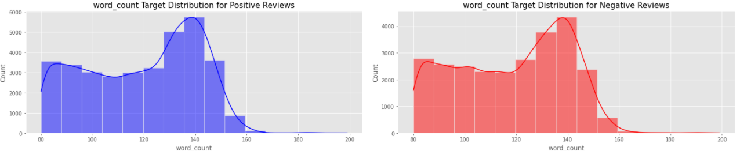
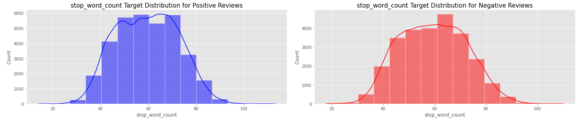
Methodology: Data Preparation
Merge .csv files from source
Remove unnecessary columns
Perform EDA

Slide 9
Methodology: Pre-processing
Apply spelling checking using Python PySpelling
Only minimal correction so to not over correct
Remove HTML text and tags
&#039;
&quot;
Remove URL strings
Using NLTK in Python:
Remove punctuation
Remove stop words
Apply lemmatization - takes sentence into account
Did not apply stemming – stems one word at a time

Slide 10
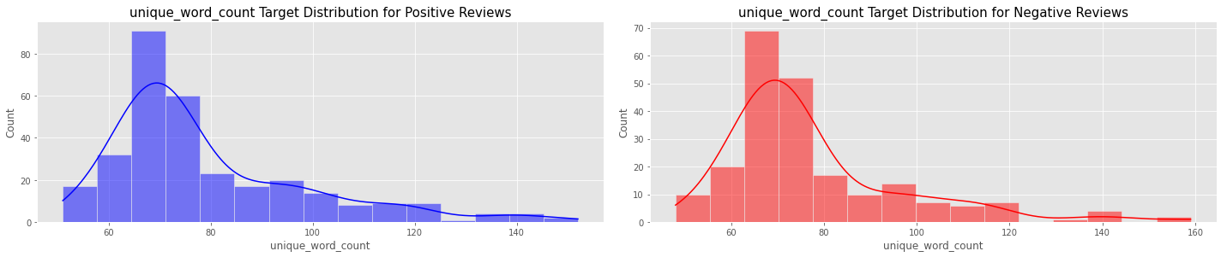
Methodology: Pre-processing
Before pre-processing
“This medication has literally saved my life!! I was severely depressed and had horrible anxiety and almost committed suicide. The first week on this drug was awful and I was very sick....then a miracle happened. After only a couple of weeks I suddenly realised that I felt 'normal', my thoughts were clear and organised, I was able to laugh, focus, I didn&#039 t feel like crying anymore, my fun-loving personality was shining through once more and I became a better version of me. Everyone has noticed and commented, I am now a great person to be around. I am able to work and eat and sleep and function like a normal young woman and it&#039 s all thanks to this amazing drug. It really has given me my life back.” 128 words
After pre-processing
“medic liter save life sever depress horribl anxieti almost commit suicid first week drug aw sick miracl happen coupl week suddenli realis felt normal thought clear organis abl laugh focu feel like cri anymor fun love person shine becam better version everyon notic comment great person around abl work eat sleep function like normal young woman thank amaz drug realli given life back” 63 words

Slide 11
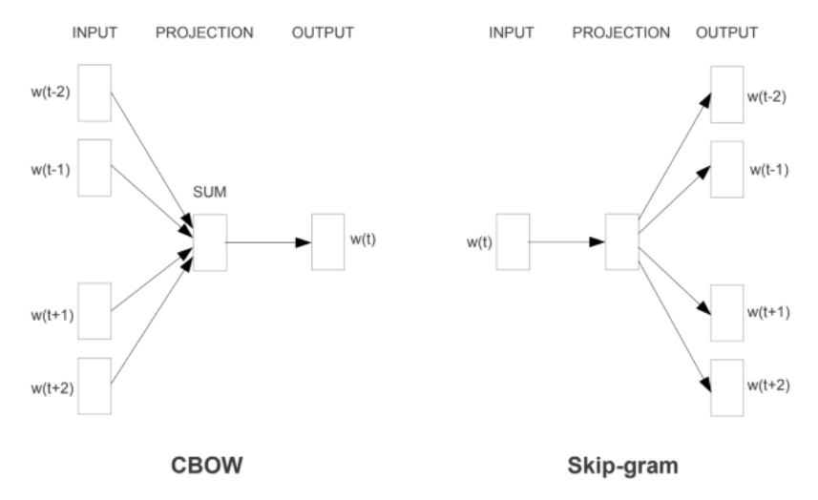
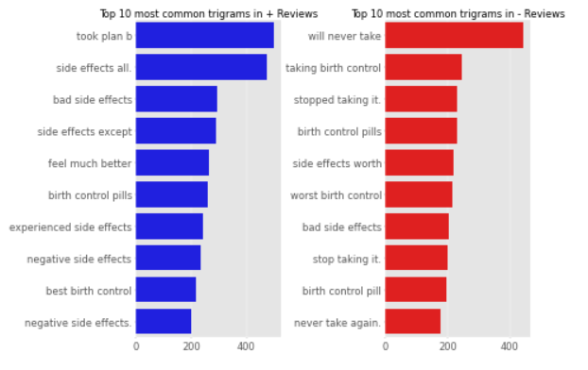
Methodology: Tokenization & Vectorization
Tokenize vocabulary then use TF-IDF to assign weights
Continuous Bag of Words (CBOW): predicts a word given the neighboring context, faster than skip-gram
Continuous Skip-Gram: predicts the context (or neighbors) of a word, given the word itself, slower than CBOW but more accurate

Slide 12
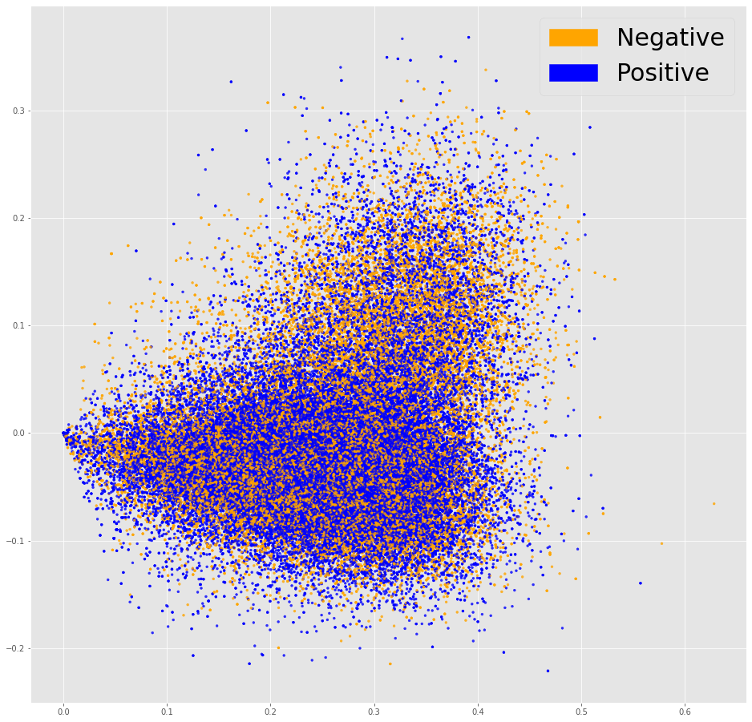
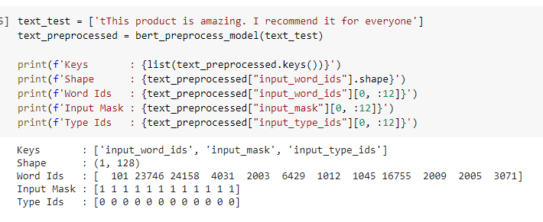
Vectorization Chart
TF-IDF weight visualization using t-SNE

Slide 13
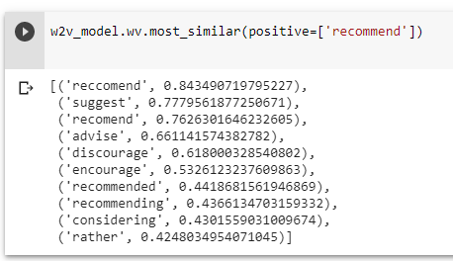
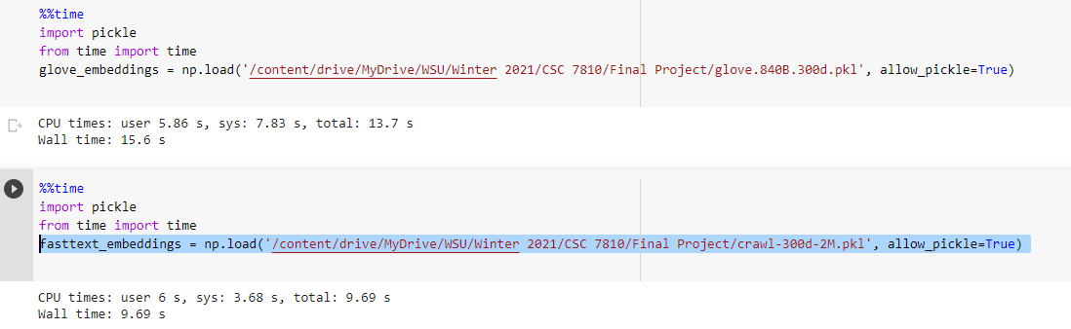
Word Embeddings
Learned representation for text where words that have the same meaning have a similar representation.
Applied word embeddings:
Word2vec
GloVe: 2.2-million-word vocab, 300d vectors, trained on Common Crawl (840B tokens) using continuous skip-gram model (78% voacb coverage)
fastText: 2-million-word vocab, 300d vectors, trained on Common Crawl (600B tokens) using continuous skip-gram model (77% voacb coverage)
Notes:
I did not use word2vec because while it’s the original model, fasttext is similar but more accurate because it includes word frequencies. GloVe and FastText and more granular
Word2Vec takes texts as training data for a neural network. The resulting embedding captures whether words appear in similar contexts.
GloVe focuses on words co-occurrences over the whole corpus. Its embeddings relate to the probabilities that two words appear together.
FastText improves on Word2Vec by taking word parts into account, too. This trick enables training of embeddings on smaller datasets and generalization to unknown words.

Slide 14
Results
Machine Learning models
Using vocab tokenization and TF-IDF weight assignment
Model | Accuracy | Precision | Recall | F1-Score | AUC
Naïve Bayes | 0.82 | 0.84 | 0.83 | 0.83 | 0.80
Support Vector Machine | 0.80 | 0.82 | 0.80 | 0.80 | 0.77
Logistic Regression | 0.90 | 0.90 | 0.90 | 0.90 | 0.89
Gradient Boost Classifier | 0.78 | 0.79 | 0.78 | 0.78 | 0.75
XGBoost | 0.78 | 0.78 | 0.78 | 0.78 | 0.75
Notes:
Accuracy: the percentage of texts that were categorized with the correct tag.
Precision: the percentage of examples the classifier got right out of the total number of examples that it predicted for a given tag.
Recall: the percentage of examples the classifier predicted for a given tag out of the total number of examples it should have predicted for that given tag.
F1 Score: the harmonic mean of precision and recall.

Slide 15
Results
Model | Accuracy | Precision | Recall | F1-Score | AUC
Bi-directional LSTM | 0.91 | 0.90 | 0.90 | 0.90 | 0.91
CNN with LSTM | 0.93 | 0.93 | 0.93 | 0.93 | 0.93
Pooled GRU | 0.91 | 0.89 | 0.88 | 0.89 | 0.90
HAN | 0.93 | 0.92 | 0.91 | 0.92 | 0.91
Inherent embeddings
Model | Accuracy | Precision | Recall | F1-Score | AUC
Bi-directional LSTM | 0.92 | 0.92 | 0.92 | 0.92 | 0.92
CNN with LSTM | 0.88 | 0.89 | 0.89 | 0.89 | 0.89
Pooled GRU | 0.90 | 0.87 | 0.88 | 0.88 | 0.89
HAN | 0.91 | 0.89 | 0.90 | 0.90 | 0.91
GloVe
Model | Accuracy | Precision | Recall | F1-Score | AUC
Bi-directional LSTM | 0.85 | 0.86 | 0.86 | 0.86 | 0.85
CNN with LSTM | 0.84 | 0.86 | 0.86 | 0.86 | 0.85
Pooled GRU | 0.89 | 0.90 | 0.88 | 0.89 | 0.88
HAN | 0.91 | 0.89 | 0.90 | 0.90 | 0.91
fastText
Adam optimizer, binary cross-entropy loss
Notes:
LSTM is a type of RNN. RNN are basically neural networks that loop through the hidden layers.
LSTM solves the problem of vanishing gradient where gradient changes become very small and it becomes harder to train.
It adds gates in the network which decides which weights should be carried forward, which to update, and which to forget
Bi-direction LSTM basically goes both ways of the text so left to right
Pooled GRU is similar to LSTM, but instead of LSTM, it’s more binary, either reset or move forward
Good source: https://medium.com/@mrunal68/text-sentiments-classification-with-cnn-and-lstm-f92652bc29fd

Slide 16
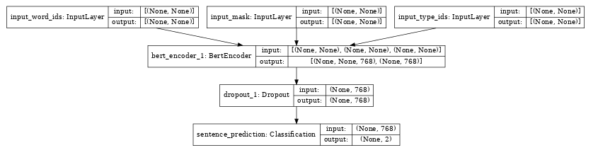
BERT Models
BERT: Bidirectional Encoder Representations from Transformers
Language representation model in which every output element is connected to every input element
Unlike other language models, it can read text input sequentially in both directions at the same time
Trained on 3.3 million words
Variations:
BERT
SmallBERT
ALBERT
ELECTRA
Notes:
BERT, which stands for Bidirectional Encoder Representations from Transformers, is based on Transformers, a deep learning model in which every output element is connected to every input element, and the weightings between them are dynamically calculated based upon their connection. (In NLP, this process is called attention.)
Historically, language models could only read text input sequentially -- either left-to-right or right-to-left -- but couldn't do both at the same time. BERT is different because it is designed to read in both directions at once. This capability, enabled by the introduction of Transformers, is known as bidirectionality.

Slide 17
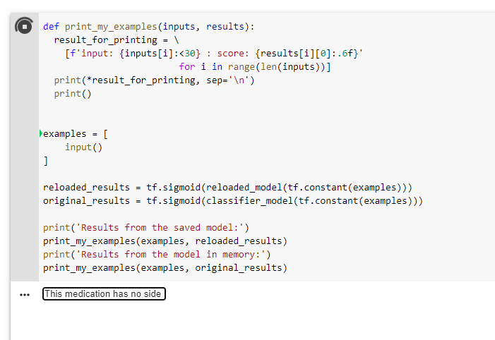
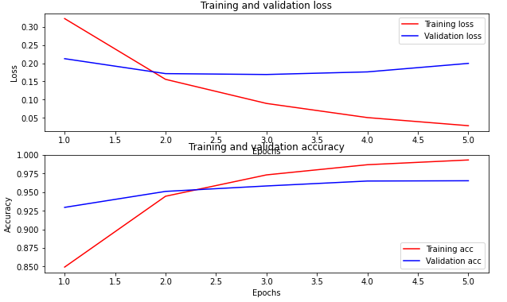
Results & Application
Input as tensor
Minimal text pre-processing
Using Sigmoid activation
Model | Accuracy | Precision | Recall | F1-Score | AUC
BERT (Base) – 12 Layers | 0.94 | 0.93 | 0.94 | 0.94 | 0.93
ELECTRA (BASE) – 12 Layers | 0.96 | 0.95 | 0.96 | 0.96 | 0.94

Slide 18
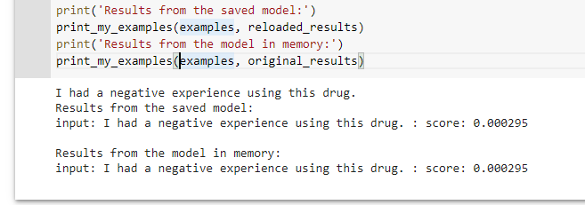
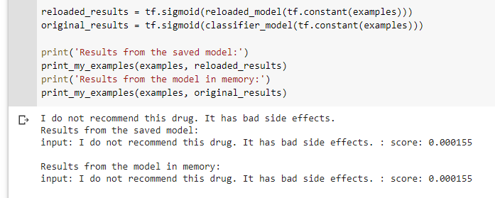
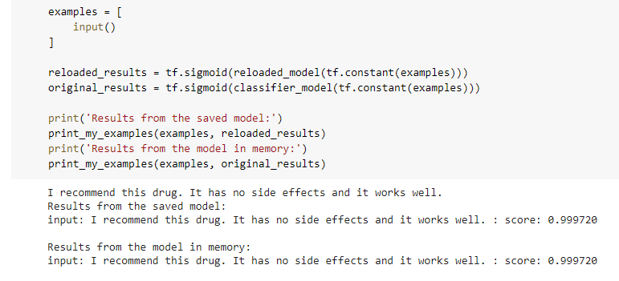
Results & Application

Slide 19
Conclusion & Further Study
Simple Machine Learning models, such as, log reg worked well on pre-processed data
Full BERT based model produced best results
Using ELECTRA variation was more efficient (8 hrs vs 13.5 hrs)
It could be fine-tuned to run faster and produce higher accuracy
For further study:
Incorporate drug names and medical conditions
Incorporate more ratings (classes)
Potentially 1 – 5 or 1 – 10 scale
Use more computing power (TPU) to train Full BERT model

Slide 20
References
Law et al. (2009) – Sentiment Classification of Online Reviews using Supervised Machine Learning Approaches
Carley et al. (2018) – Aspect Level Sentiment Classification with Attention-over-Attention Neural Network
Rao et al. (2018) - LSTM with sentence representations for document-level sentiment classification
Munikar et al. (2019) - Fine-grained Sentiment Classification using BERT
Lian et al. (2018) - Domain Adapted Word Embeddings for Improved Sentiment Classification
Chen et al. (2019) - A Text Sentiment Classification Modeling Method Based on Coordinated CNN-LSTM-Attention Model

Slide 21
Thank you

Slide 22
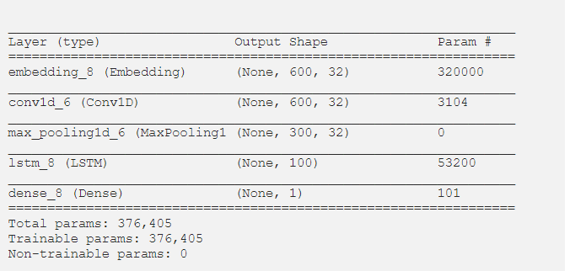
Appendix
CNN with LSTM Model Details

Slide 23
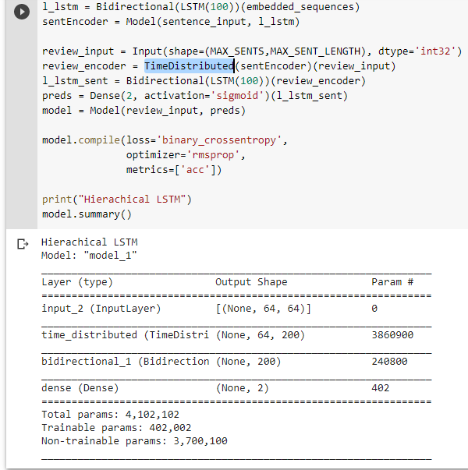
Appendix
HAN Model Details

Slide 24
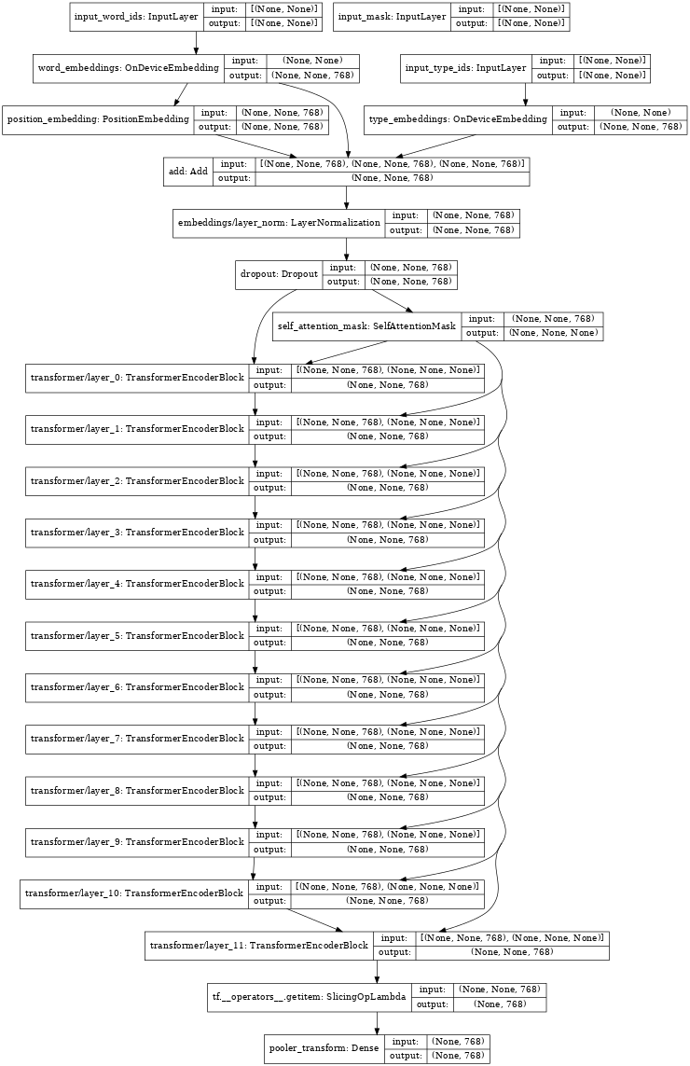
Appendix
BERT Encoder Layer

