Slide 1
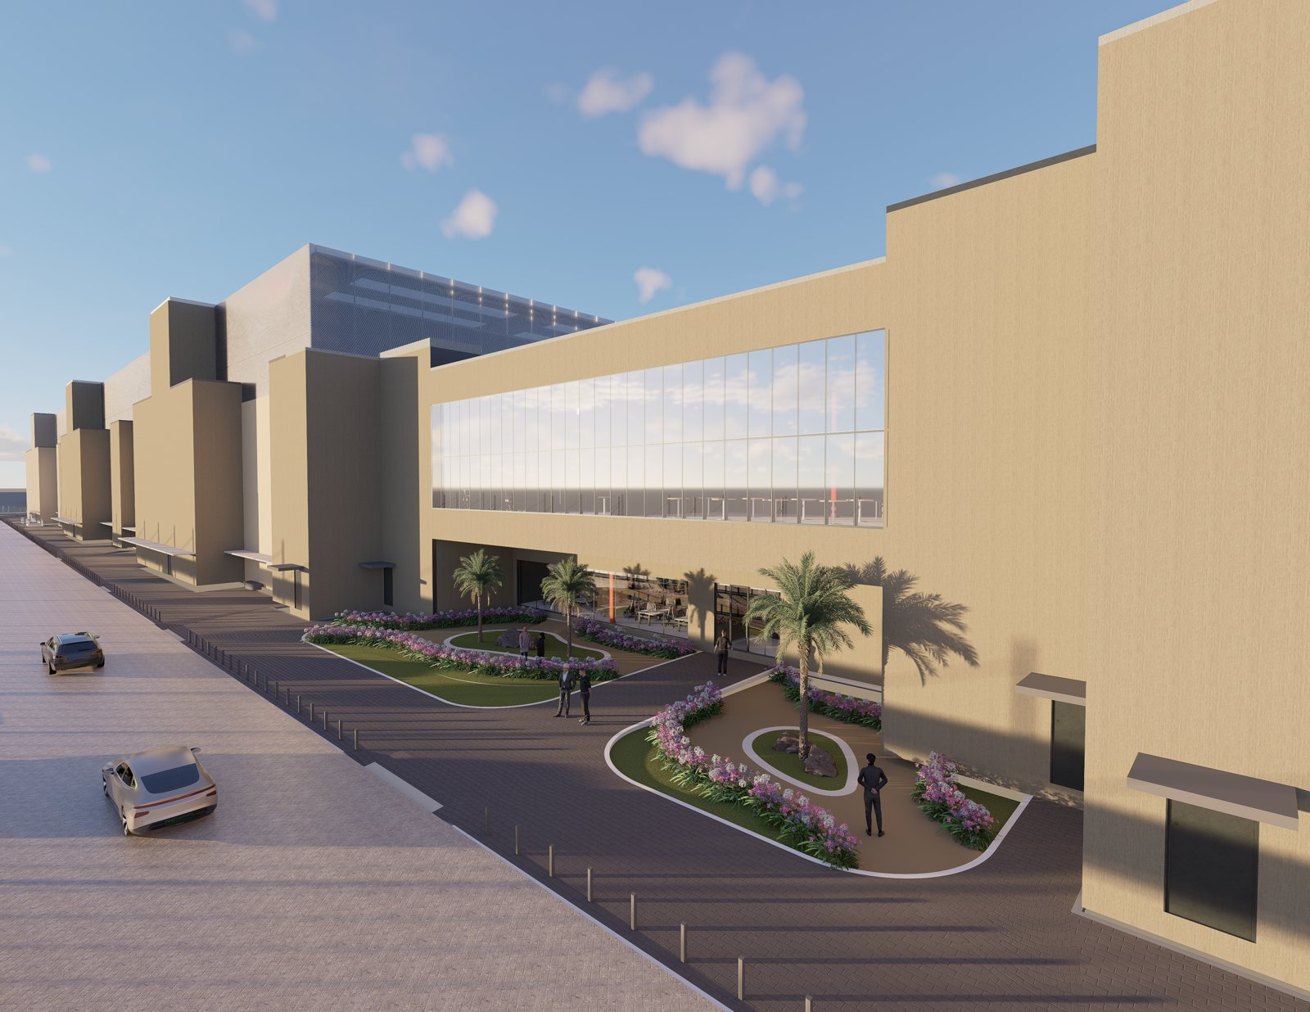

FINAL ASSESSMENT
FROM PROGRAMME TO NARRATIVE
A Visual Communication Strategy for a Large-Scale Data Centre Development
AI-First Multimedia Designer — Hussein Masri

Slide 2
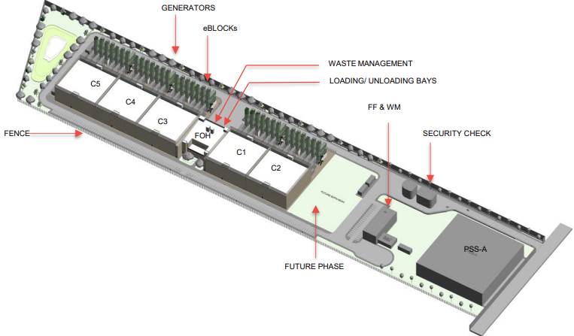
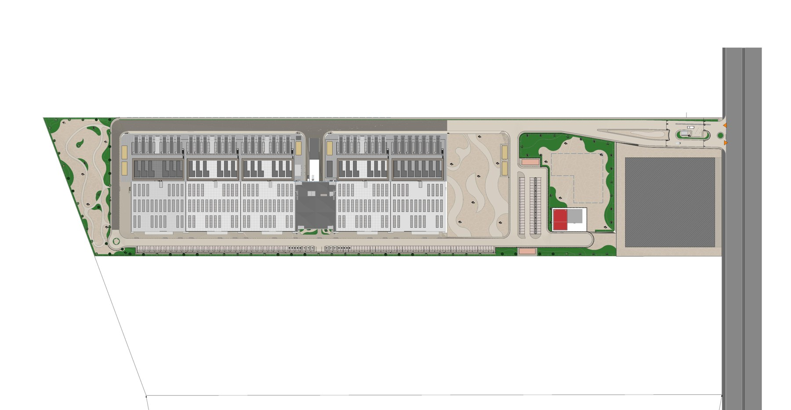
01 — VISUAL NARRATIVE & SEQUENCING
A 60-Second Executive Journey: Vision to Operations
Scale → Complexity → Delivery → Outcome, told across three acts, each anchored to a real project asset, not a generic template.
SEQUENCE MAP — EACH ACT ANCHORED TO A REAL ASSET
PHASE 1
PHASE 2-3
T&C / HANDOVER
ACT I
ACT II
ACT III
Site to Structure
Structure to System
System to Service
Labelled site model resolves into shell & core — C1-C3, FOH.
Resolved masterplan — data hall fit-out tracked building by building.
Completed render — the journey ends Ready-for-Service, not on construction.
HOW PROGRAMME DATA IS CARRIED — 78-MONTH DELIVERY BAR
PHASE 1 — SHELL & CORE C1-C3, FOH
PHASE 2 — SHELL & CORE C4-C5 + FIT-OUT
PHASE 3 — FIT-OUT C3-C5 + T&C
GC MOBILISED
POWER ON
C1/C2 RFS
T&C & HANDOVER
Transitions match-cut on shared geometry — the site outline in Act I becomes the shell footprint in Act II, the footprint becomes the finished form in Act III.
Hussein Masri

Slide 3
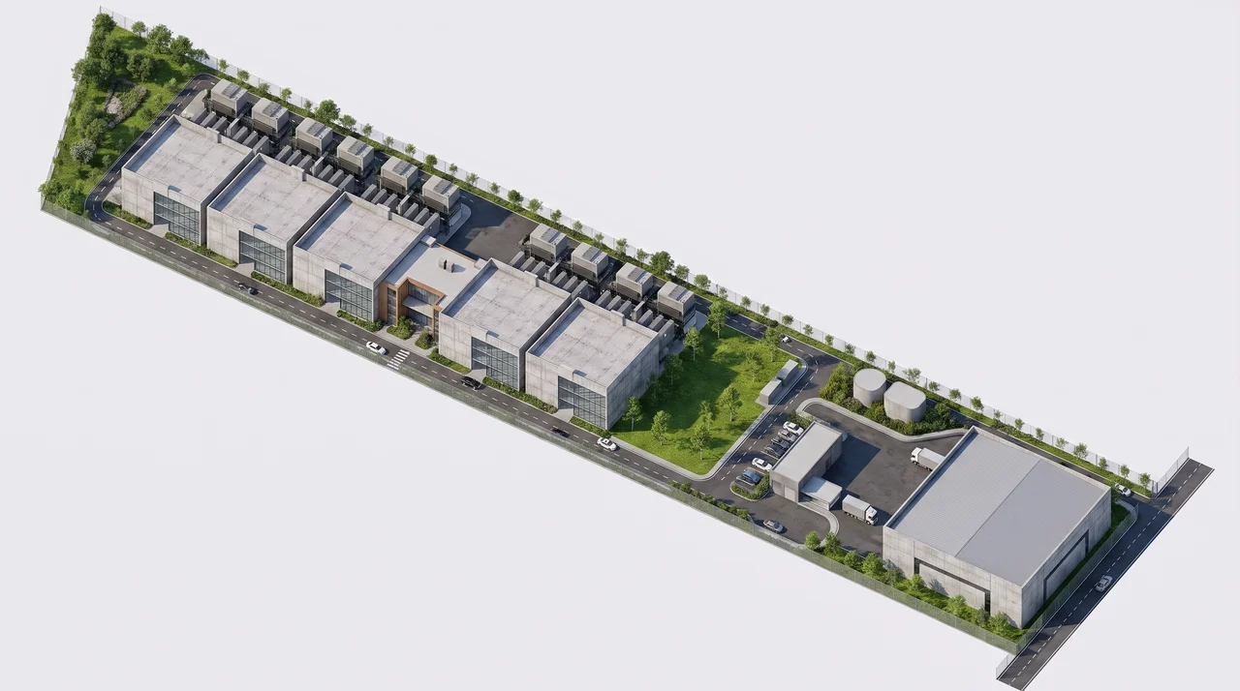
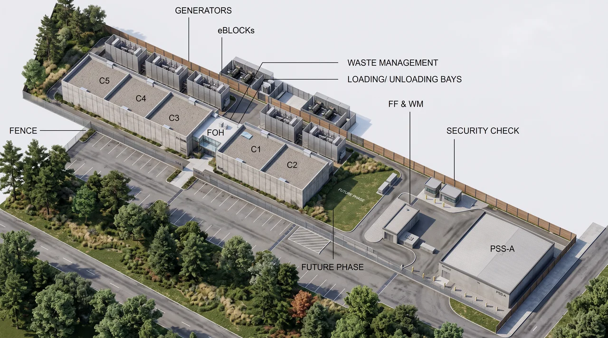
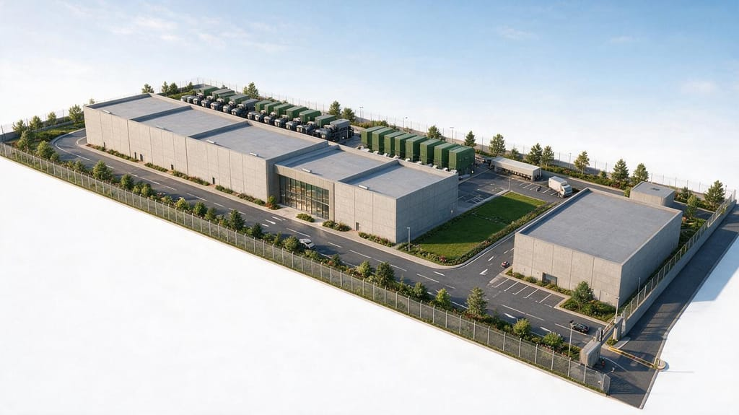
01 — VISUAL NARRATIVE & SEQUENCING
A 60-Second Executive Journey: Vision to Operations

Slide 4
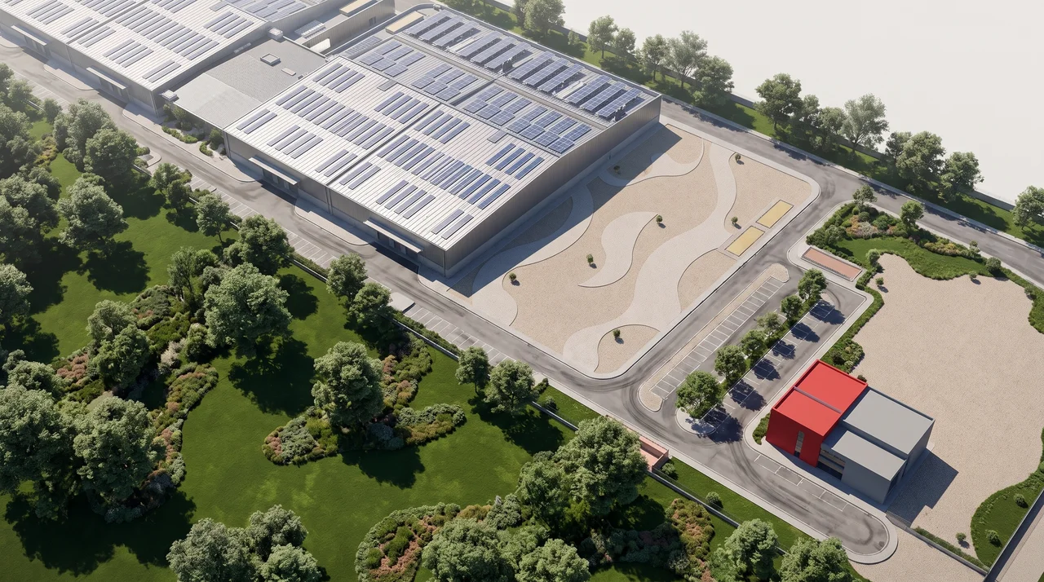
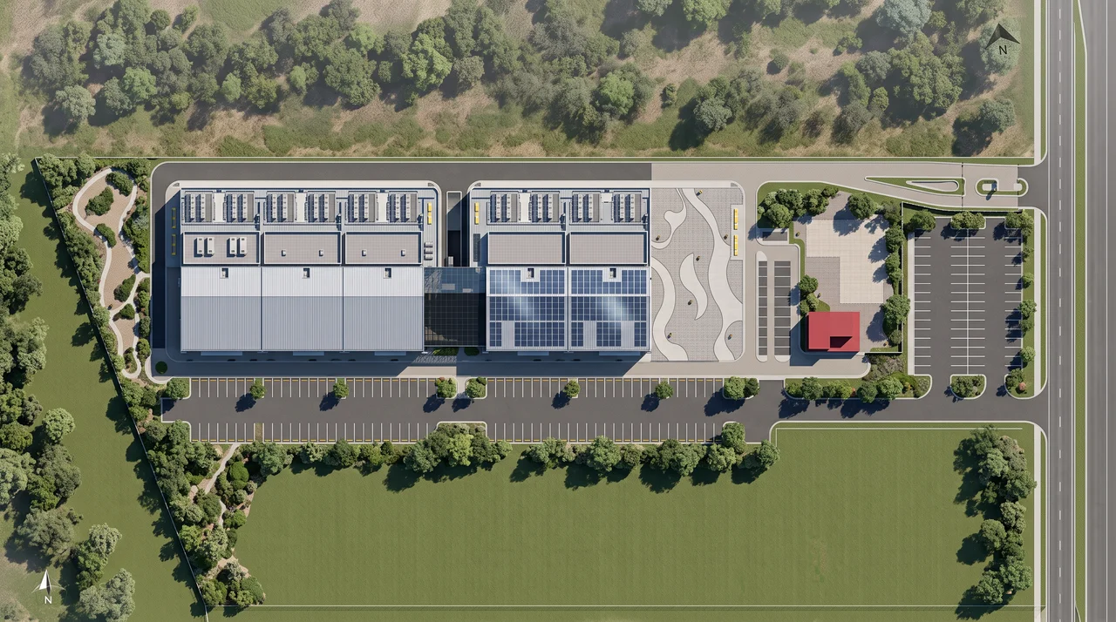
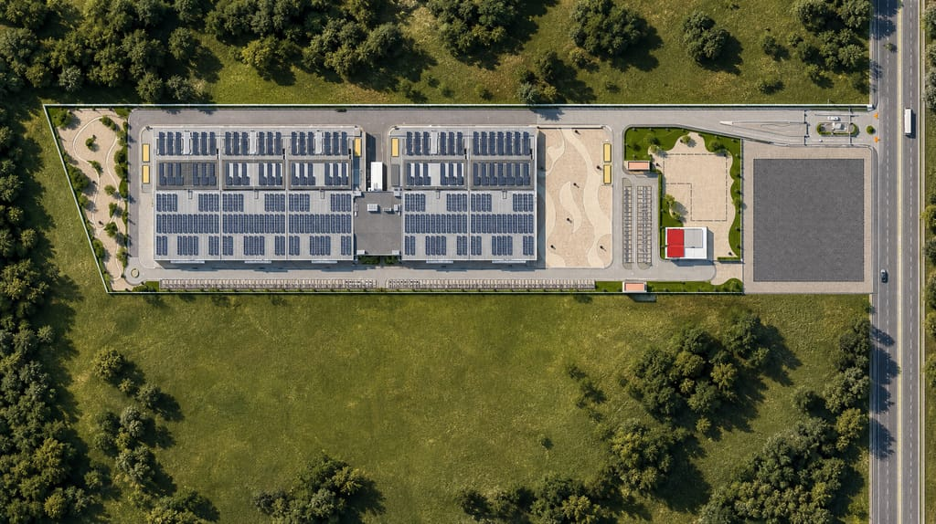
01 — VISUAL NARRATIVE & SEQUENCING
A 60-Second Executive Journey: Vision to Operations

Slide 5


01 — VISUAL NARRATIVE & SEQUENCING
A 60-Second Executive Journey: Vision to Operations

Slide 6





02 — CONTENT DEVELOPMENT METHODOLOGY
Five Steps: Source Material to Executive Story
The same sequence for any project — only the inputs change.
01
Source Review & Audit
Catalogue every input and flag gaps before any creative decision is made.
02
Information Triage
Separate what an executive audience must retain from supporting technical detail.
03
Visual Approach per Stage
Assign a treatment per programme phase plan, render, or iconography.
04
Executive Translation
"RIBA Stage 4 sign-off" → "Design Finalised"; "T&C & H/O" → "Ready for Operations."
SOURCE MATERIAL
This is what gets audited in Step 01 before a single frame is designed.
05
Accuracy & Consistency Check
One source-of-truth document; technical lead sign-off before production.
Hussein Masri

Slide 7

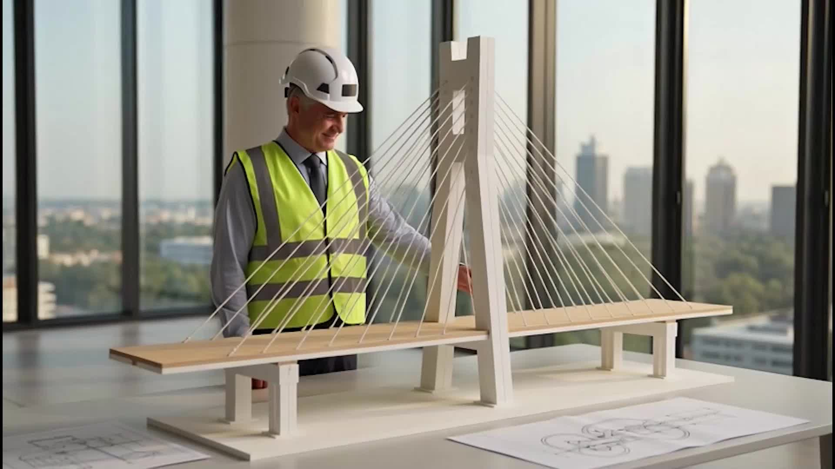
03 — AI WORKFLOW
Brief to Completion, Anchored to Real Assets
AI extends the real site model and renders — it never replaces them.
TOOLS BY STAGE
Ideation & scripting
ChatGPT, Claude
Image generation
Midjourney, Adobe Firefly, Higgsfield
Video generation
Kling, Google Flow, Higgsfield
Post-production
Adobe Creative Cloud applications
PROMPT DEVELOPMENT
QUALITY ASSURANCE
Anchored to the real render via image-to-image reference — not a blank description. Keeps output geometry and materiality consistent with the actual design.
Every generated frame is checked against the programme and site plan for factual accuracy — building count, phase order, milestone sequence — before a brand and technical-lead sign-off.
DELIVERY WORKFLOW — BRIEF TO COMPLETION
BRIEF & SOURCE AUDIT
→
STORYBOARD
→
ASSET GENERATION
→
QA (TECH + BRAND)
→
FINAL DELIVERY
PROVEN EXECUTION — FRAMES FROM THE DELIVERED WSP FILM (ASSIGNMENT 1)
Typical duration: 5-7 working days from brief to final delivery, depending on programme complexity.
Hussein Masri

Slide 8




04 — SCALABILITY
One Methodology, Applied Across Every Project
Standardised where it should be; flexible where the project demands it.
Reusable Story Template
Standardised Milestone Language
A fixed act structure (Site → Structure → System → Service) with swappable content for a new project, same narrative skeleton.
One icon and terminology set for Power On, RFS, T&C & Handover consistent across every project type, not reinvented per brief.
Templatised AI Pipeline
Shared Brand & QA Governance
Reusable prompt structures and reference-anchoring workflow cut per-project production time without cutting quality.
Same sign-off gate and visual system on every output connects directly to the AI Creative Lab model proposed in Assignment 1.
The goal is not a one-off film — it is a repeatable system that turns any project's programme and design assets into an executive-ready visual story, at consistent quality and speed.
Hussein Masri

Slide 9
THANK YOU

