Slide 1


FQDs, FQTNs, and Taxonomies in Database Governance
By: Mohab Hussein, Gabriel Zamora, Ilya Yahoshchankau, Md Ismail Hossain, Ranjan Bhattarai

Slide 2






Introduction & Key Concepts
Taxonomy
Fully Qualified Domain (FQD)
Fully Qualified Table Name (FQTN)
in relational databases, its the organized structure of Schemas, tables, columns, keys, and the such.
A domain is a named, reusable data type that can include rules about what values are allowed. It explains the type of data something should be, kind of like a class in java.
A fully qualified table name includes a database, schema, and object name.

Slide 3
The ANSI Standard: CREATE DOMAIN
CREATE DOMAIN creates a new domain. A domain is essentially a data type with optional constraints (restrictions on the allowed set of values).
Domains can have CHECK conditions and DEFAULT values, and you can indicate whether the data type permits NULL values or not.
These conditions and values are inherited by any column defined on the domain.
Domains are useful for abstracting common constraints on fields into a single location for maintenance.
For example, several tables might contain email address columns, all requiring the same CHECK constraint to verify the address syntax. Define a domain rather than setting up each table's constraint individually.

Slide 4
The T-SQL Method: CREATE TYPE
Creates an alias data type... in the current database in SQL Server
The implementation of an alias data type is based on a Database Engine native system type.
CREATE TYPE is a format that allows an organization to create their own data type in a database that can be used to accomplish a specific task.
This makes the database easier to understand and reduces errors, because everyone will use the same standard data type when storing the same type of information.
For example, if an organization wants a reserve phoneNumber or employeeID, they can create a custom data type called phoneNumber/employeeID.

Slide 5


DOMAIN vs. TYPE: The Key Difference
The Limitation of CREATE TYPE (T-SQL)
The Advantage of CREATE DOMAIN (ANSI)
All the CREATE DATATYPE statement does is create an alias to a datatype... and because it does not allow a CHECK expression, it offers no value for data integrity
This guarantees that definition of the domain appears in only one place, only once in schema, and can be altered or validated with certainty.
Note: The CREATE DOMAIN statement (which is part of the ANSI SQL standard) is not supported in SQL Server.
Note: The CREATE TYPE statement (for defining user-defined data types) is not part of the ANSI SQL standard.

Slide 6
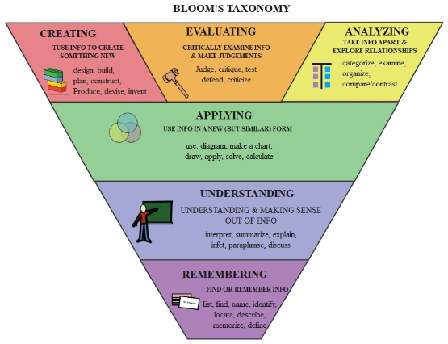
What is a Data Taxonomy?
•
Taxonomy in SQL is basically the same in english, which is the classification system used, but in relational databases, its the organized structure of Schemas, tables, columns, keys, and the such.
•
Data taxonomy is a system of organizing information that helps companies to sort, group and level data so that anyone can easily understand its meaning and what the data is used for.
•
This system ensures data is used and stored in the same way, so that data doesn't mix-up and remains error free across the organization.

Slide 7






Benefits of FQDs in a Taxonomy
Data Consistency
Reusability
Governance
when database has multiple schema, each one might have a similar column, like customerID, so when using a FQD, it makes sure each schema uses the same exact format. This system ensures less risk of data inconsistencies and errors.
You can reuse it anywhere, even within different schemas... that improve efficiency and reduce the need of repeated data typing which saves time too.
By the rules of FQD’s, you can attach rules and constraints to it that apply everywhere its being used... so that data remains accurate, safe and used correctly

Slide 8
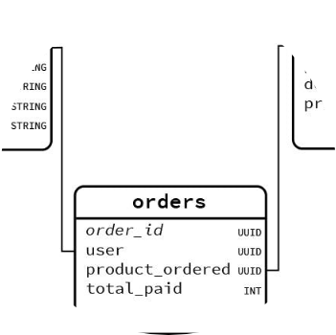
What are Fully Qualified Table Names?
Definition
A Fully Qualified Table Name (FQTN) is a complete name of a table that includes DatabaseName , SchemaName and TableName.
Example
In our previous databases, in example northwinds, one could be Northwinds.Sales.Customer, it has the [database].[schema].[table]
Purpose
Qualified table in SQL references help avoid ambiguity by explicitly stating the project, dataset, and table.

Slide 9


Importance: Clarity & Integrity
Clarity
Referential Integrity
using something like SELECT FROM Customer, the query wont know what customer it means, so you use Sales.Customer so it knows where to choose, or better yet, northwinds.Sales.Customer
FQTN helps to avoid confusion when different tables have the same name.
It means that the relationships between tables remain valid, it makes sure that it connects the correct tables and not tables that are named after other tables or share the same name.
Eliminates Ambiguity: By specifying project, dataset, and table, you avoid accidental queries on identically named tables in other datasets.

Slide 10
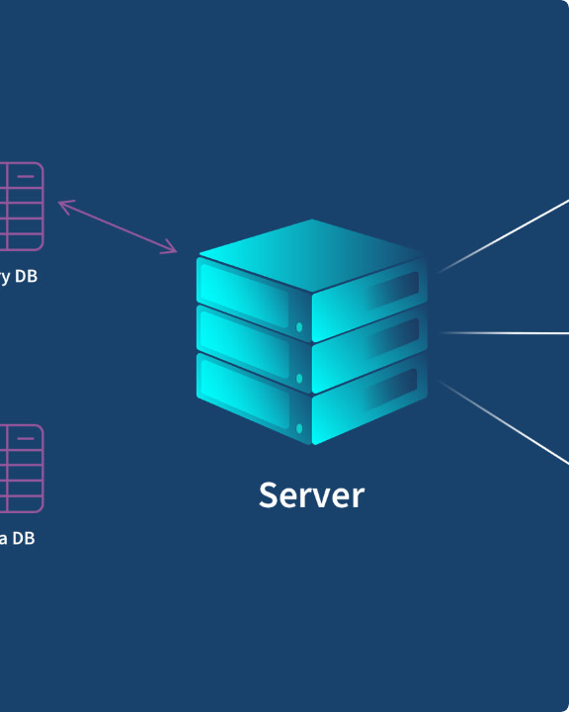
Importance: Scalability
•
Scalability: As the database grows or you use more databases, when you consistently use FQTN’s, your SQL becomes readable and know where everything is from.
•
Heterogeneous Environments: Heterogeneous database environment means different types of databases used in an organization. This level of specificity is critical for accurate queries... or working in environments with shared or complex data structures.
•
Supports Cross-Project Queries: Qualified references enable joining or comparing tables from various projects.

