Slide 1
CSTD02
Links : External , Internal , Self : Named Anchor , MailTo
Tables : Nested Tables
Forms :

Slide 2

Image map
<area shape=“poly” coords=“” href=“”/>
X,y
X,y
X,y

Slide 3
Links : External
External
Index.html
With External Links :
You Have To Write Full URL : Including http://www
Contact.html
Use tag : <a href=“URL for Target Resource ” target=“_self|_blank”
title=“” name=“”/>

Slide 4
internal
C:/iti/resources/ : absolute path : don’t’ use it within paths : not recommend
Relative :
Step in
Foldername/
Staff/
iti
1- from index to contact.html
Index.html
staff
<a href=“contat.html”> Open Contact</a>
Instr.html
Step in :
Foldername/
2- from index to instr.html
<a href=“staff/instr.html”> Open instr</a>
Stepout : ../
Students
Contact.html
3- from instr.html to index.html
students.html
<a href=“../index.html”> Open index</a>
4- from instr.html to student.html
<a href=“../stduents/students.html”> Open index</a>

Slide 5
Named Anchor : Self Link
ChapterOne
<a href=“#chone”>Choone</a>
Step One : Give Name For Target Location : using a with attribute name
<a name=“chone”/>
Chapter One Details :
Top

Slide 6
<body link=“” alink=“” vlink=“”>

Slide 7
Mailto Links :
Nagat|Alaa : Two Members
Nadia
Send Email:
To:Alaa@alaa.com
Cc:Nadia
Bcc:Nasr
Subject:
Body:
Open default mail server o your machine :
To: outlook
<a href=“mailto:alaa@alaa.com?cc=nadia&bcc=nasr&subject=&body=”>Send Mail</a>
Query String : Pairs Key Value
First separator : ? Any other separator : &

Slide 8
Table : organize data within page
Table data : td
Table Row : tr
<table>
<tr>
<td>
ID | Name
100 | Ahmed
200 | Mohamed
table
Table : Contains Set of Trs
And Trs Contains Set OF Td

Slide 9
Table
Thead
Tbody
Tfoot

Slide 10
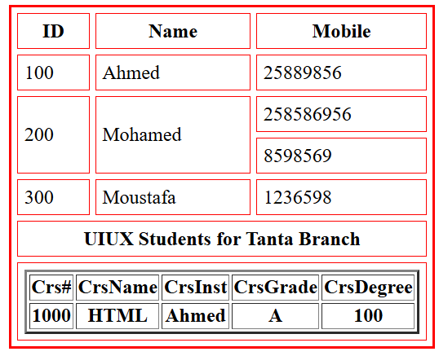

Slide 11
Tags :table , tr , td , th , caption , thead , tbody , tfoot
<table
width
height
boder
bordercolor
align=“left|center|right”
bgcolor=“color”
background=“”
cellspacing
cellpadding=>
<tr , td , th align=“left|center|right”
valing=“top|middle|bottom”
bgcolor=“color”
background=“”
>

Slide 12
User createdtable
table
expected
ID | Name
100 | Ahmed
<table>
<tr>
<td>ID</td>
<td>Name</td>
</tr>
<tr>
<td>100</td>
<td>Ahmed</td>
</tr>
</table>
ID Name
100 Ahmed
Actual
Default Style For Table:
1- Borderless :
2- width : according data
Height: default : height of data
3- aligned by default inside page : left

Slide 13
Table
=> thead
<Tr>
</tr>
=> tbody
=>tfoot

Slide 14
Header
links
footer

Slide 15
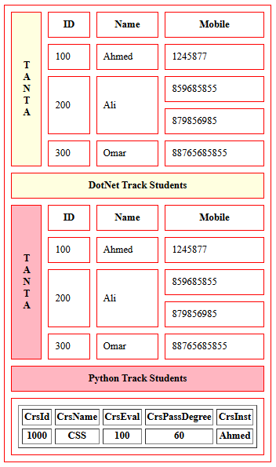

Slide 16
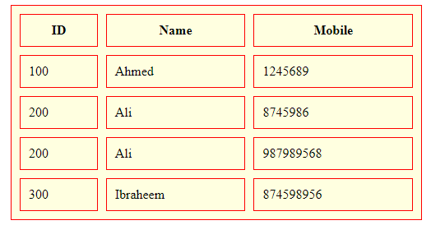
Merging For Cells
Colspan = “number”
Rowspan=“number”
Used only with td or th
Never use it with table or tr
200
Ali
Nested tables :
Create table within td or th

Slide 17
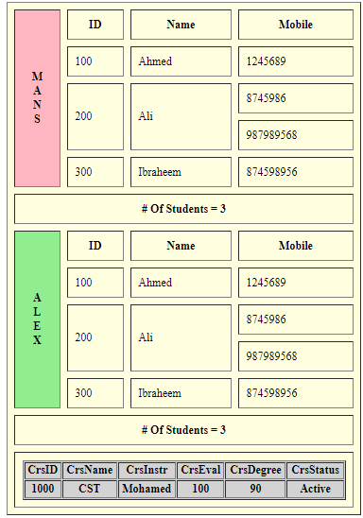

Slide 18
Forms : Collect Data From User in Organized Way : Send Data To Specific URL
Send data using query string :
No protection for data : Address Bar inside browser
Passwords : shown :
Faster than post
2048 character
Use tag form :
<form method=“get|post” action=“URL : Send Data To This URL”>
<!– Write Controls to Collect Data -->
<input type=“text”
=“password”
=“radio” | checkbox | file | hidden | submit | reset />
<Select => selection menu | selection list
textarea : use to insert data in multi line format
</form>

Slide 19
Forms : Login Form
<form action=“server.html”>
Username <input type=“text” name=“un”/><br>
Usepass <input type=“password” name=“pass”/><br>
<input type=“submit” value=“Login”/>
<input type=“reset” value=“Cancel”/>
</form>
userName
nasr
….
Un=nasr
userPass
Pass=123
Login
Cancel
Take data from controls : send data to action url using method value
Server.html

Slide 20
Registeration Form
UserName
userpass
Gender | Male
 | Female
University
Courses
CV
Intersets
Comments
Selection menu
<select>
<option></option>
</select>
Selection List : you can select many options
<select multiple size=“4”>
<option></option>
</select>
Browse
 | Football
Text Area
<textarea cols=“” rows=“”></textarea>
OK
Cancel

