Slide 1
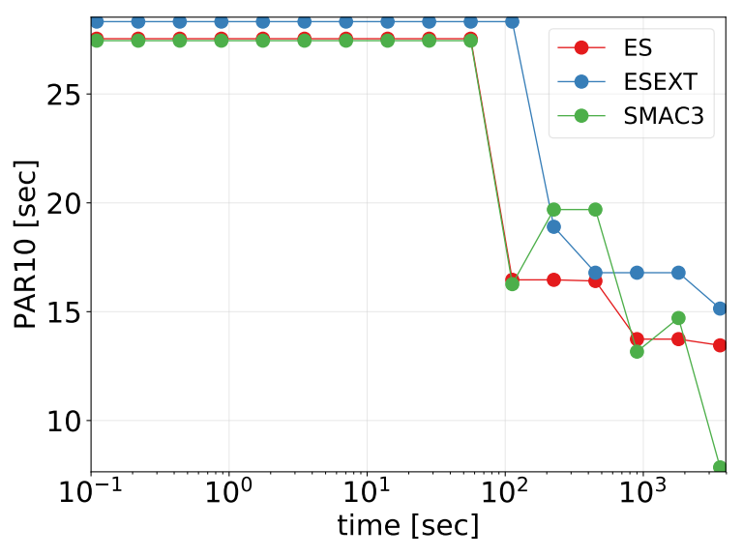
Parallel Algorithm Configuration
Saskia, Mohammed-Ali, Hussein, Francine
Motivation
In order to optimize an algorithm that highly depends on a set of parameter configurations, algorithm configuration is the common way to solve this. Since many configurations contain a lot of parameters, the computation of such an optimization can take a very long time. Here we present an approach of a parallel model-based algorithm configurator, which can run on up to 8 cores in parallel to speed up the optimization.
Our approach:
Our tool is divided into two main parts: The first part is responsible for finding a set of promising challengers. The second part then races these challlengers against each other and the current best solution in order to determine a new best solution or drop all challengers. Both parts include multiple approaches, each one with the option to be parallelized. Each approach is explained in the following.
Parallel Bayesian Optimization:
Parallel Racing:
We chose the following methods as options for finding a set of promising configurations:
- Constant Liar:
Hallucinate/lie performance values and update EPM with these. We set the liar to the minimal performance observed so far.
Choose the best configuration according to the updated fake acquistion values.
- UCB:
For each configuration, search locally for the best ten neighbours according to the acquistion funcition. Select the best neighbor based on the UCB formula.
- Expectation across fantasies:
Calculate the posterior of each configuration. Compute EPMs from the posterior with their respective acquisition functions. Sum all acquistion functions. Use the aggregate acquistion function to obtain the best challengers
These are the different racing methods we chose for our tool:
- All in parallel for a list of Instances:
Take a list of instances.
Let all configuration run on the list in parallel and select the configuration which solve the instances first.
- All in parallel for each Instance:
Run all configuration in parallel on a selected instance. Wait until they are finished and decide which one to drop. Continue with the rest on the next instance.
Experiments:

