Slide 1
Statistical modeling and Simulation system for car accidents.

Slide 2
smart cities (DELL idea)
A smart city has been defined as a city that uses information and communications technology to make its critical infrastructure, its components and public services more interactive and efficient, making citizens more aware of them.

Slide 3
Intelligent Transportation System in Smart Cities
It’s the application of sensing, analysis, control and communications technologies to ground transportation in order to improve safety, mobility and efficiency.
Intelligent transportation system includes a wide range of applications that process and share information to
1-ease Crowding
2-improve traffic management
3-increase the benefits of transportation to commercial users and the public in general.

Slide 4
main reasons ITS is needed
Some of the main reasons ITS is needed:
• Low speed, increased accident rates.
• It is not possible to build enough new roads or to meet the demand.
• Make transportation system more efficient, secure, and safer through the use of information, communications and control technologies.
• Tackle rising congestion which increases travel times and industry costs.

Slide 5
ITS advantages
ITS provides several advantages including :
1-Reduction in stops and delays at intersections
2-Speed control and improvement
3-Travel time improvement
4-Capacity management
5-Incident management

Slide 6
Our Objectives
With the help of this project, we will be able to:
Recognize key factors affecting the accident severity.
Provide some recommendations that may lead to reducing the rate and severity of accidents through our data analysis
Develop a model that can accurately predict accident severity for a given accident without any detailed information about itself like driver attributes or vehicle type in time.

Slide 7
Dataset:
We will use a dataset that talks about car accidents.
After searching and communicating with Prof Doaa, we were having a dataset and database.
This dataset was provided by Dell company technical support.
Reacting with the database was difficult, so we go through US_Accidents_May19.

Slide 8
Us Accidents May 19 dataset
Dimension= (2243939 rows × 49 columns)

Slide 9
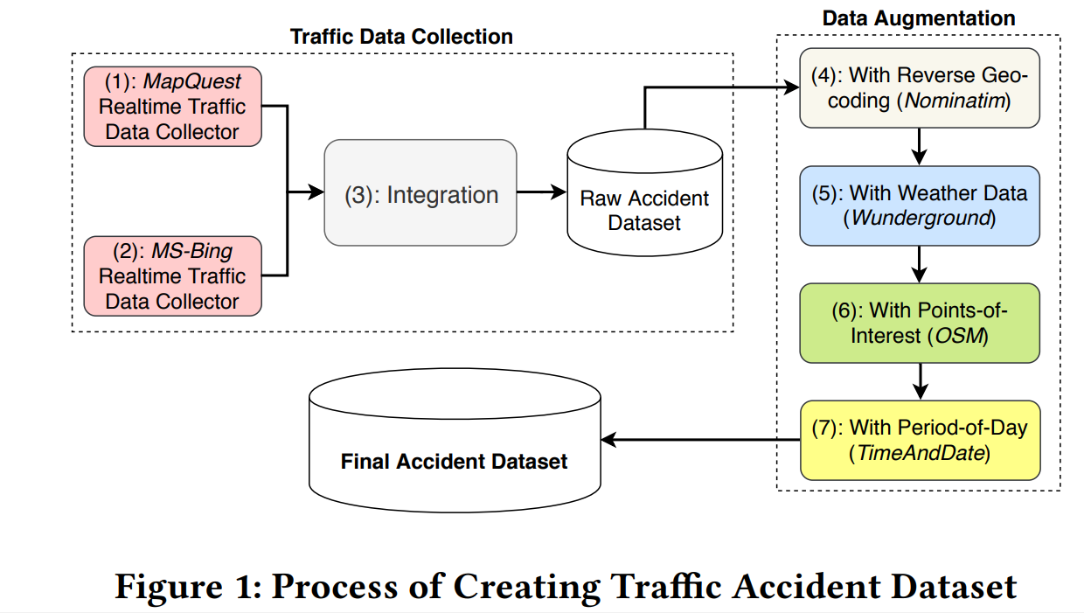
Columns:
ID: Index code of each accident in each record in each row.
Source: It is the name of the platform which the accident record was extracted from.

Slide 10
Columns:
Severity:
It represents the degree of impaction on the road due to an accident.
Label (1) represents the least impact on the road, while label (4) represents the most significant impact on the road, due to accidents.
Start_Time: It is a timestamp column, which represents the start date and time of each accident.
End_time: It is a timestamp column, which represents each accident the end date and time.
Start_lat: It is the latitude coordinate, where the accident starts.
Start_Lng: It is the longitude coordinate, where the accident starts.
End_lat: It is the latitude coordinate, where the accident ends.

Slide 11
Columns:
End_lng: It is the longitude coordinate, where the accident ends.
Distance(mi): It represents the distance in the road affected by an accident.
Description: It is a natural language that describes the accident as state name, street name, lane side, and whether there is a delay or not.
Number: It is the number of the street in the address field.
Street: It is the name of the street.
Side: It represents the lane side relative to the street.

Slide 12
Column:
City: It represents the city name.
County: It represents the county in the address field.
Country: It represents the country name.
State: It represents the state name.
ZipCode: The zip code in the address field.

Slide 13
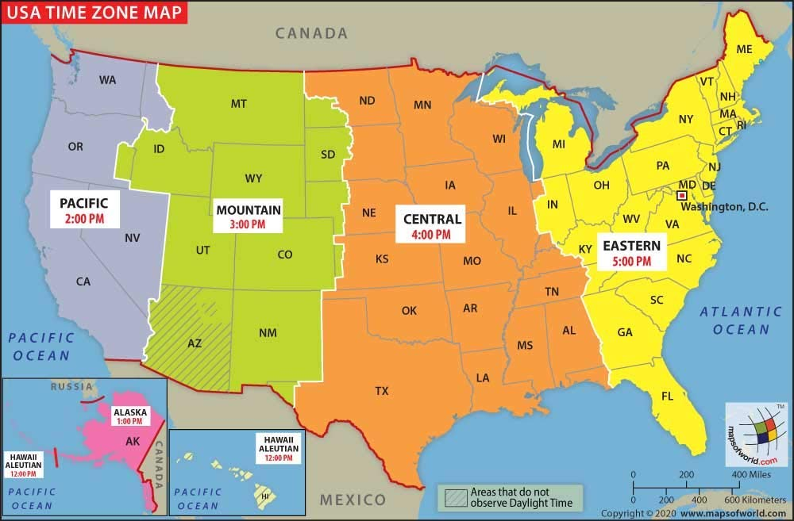
Column:
Timezone : Shows time zone based on the location of the accident(eastern, central, etc.).

Slide 14
Column:
Airport_Code : Denotes weather airport station is the closest to location of the accident.
Weather_Timestamp : Shows the time-stamp of weather observation record (in local time).

Slide 15
Column:
Temperature(F) : Shows the temperature (in Fahrenheit).
Wind_Chill(F) : Shows the temperature of the wind (in Fahrenheit).
Humidity(%) : Shows the humidity (in percentage).
Pressure(in) : Shows the air pressure (in inches).
Visibility(mi) : Shows visibility (in miles).
Wind_Direction : Shows wind direction.
Wind_Speed(mph): Shows wind speed (in miles per hour).
TMC: code provides more detailed description of the event

Slide 16

Column:
Precipitation(in) : Shows amount of any liquid or frozen water that forms in the atmosphere in inches (if any).
Weather_Condition : Shows the weather condition (rain, snow, thunderstorm, fog, etc.)

Slide 17
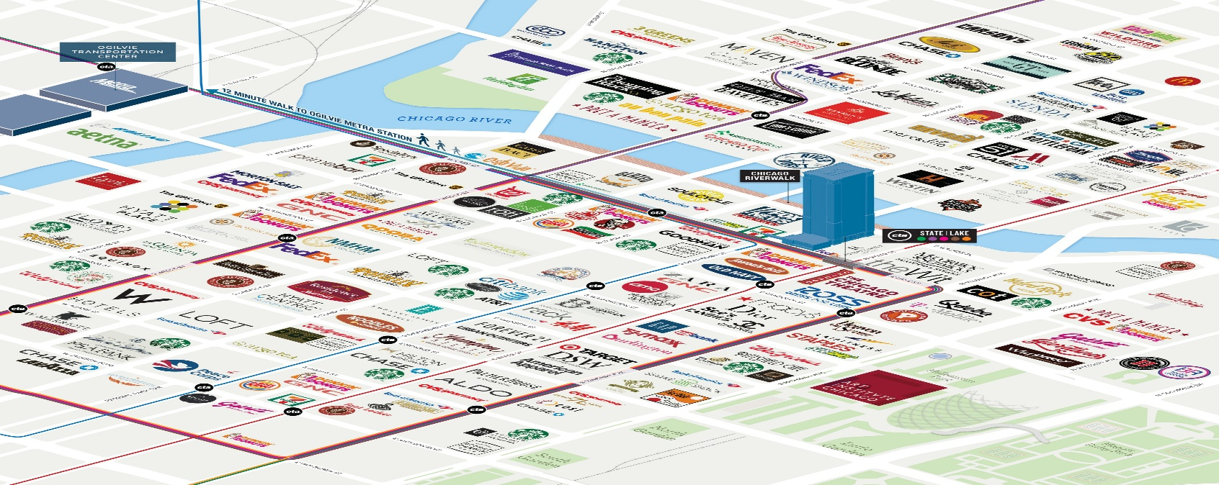
Column:
Amenity :indicates the presence of amenity or not in a nearby location.

Slide 18
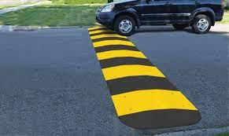
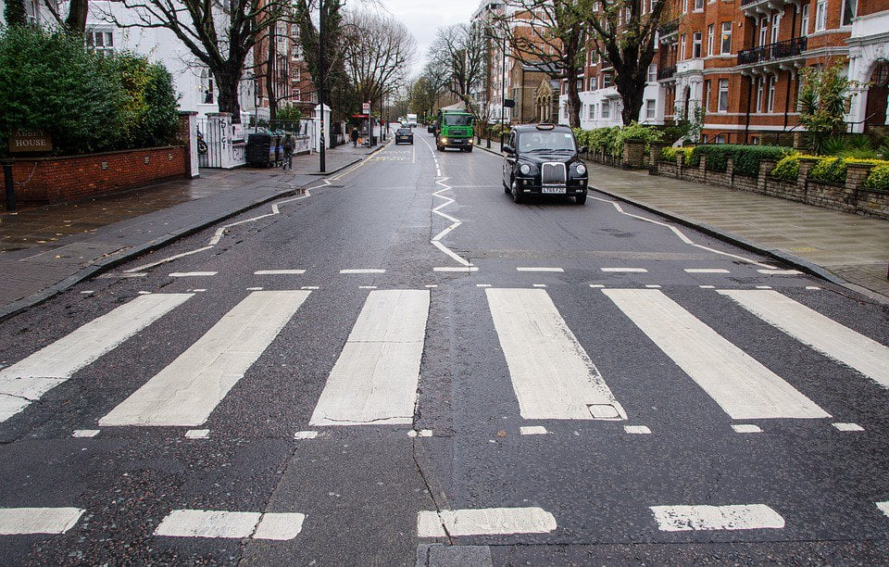
Column:
Bump : indicates the presence of speed bump in a nearby location
Crossing : indicates the presence of crossing in the nearby locatoin

Slide 19
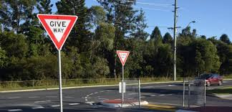
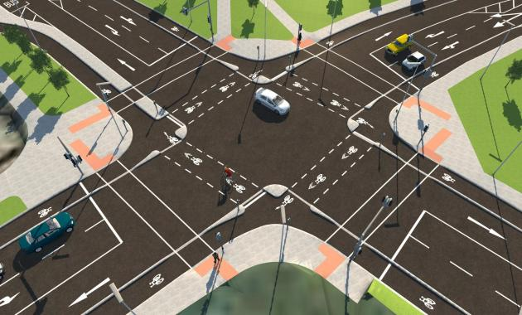
Column:
Give_Way : indicates presence of give way sign in a nearby location.
Junction : presence of junction nearby.

Slide 20

Column:
No_Exit : A POI annotation which indicates presence of no exit in a nearby location.

Slide 21
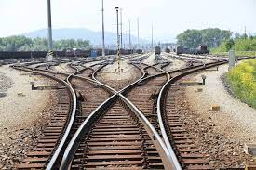
Column:
Railway : presence of nearby railway in nearby location.

Slide 22
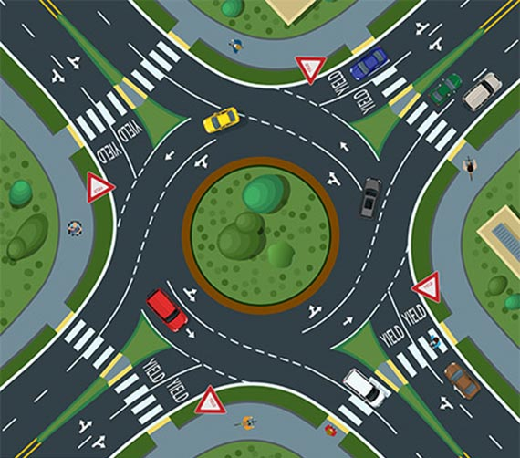
Column:
Roundabout : presence of nearby Roundabout

Slide 23
Column:
Station: presence of nearby station.
Stop : presence of stop sign.
Traffic_Calming : Any device or feature causing traffic to calm or slow.
Notes:
محطات اتوبيس أو قطار

Slide 24
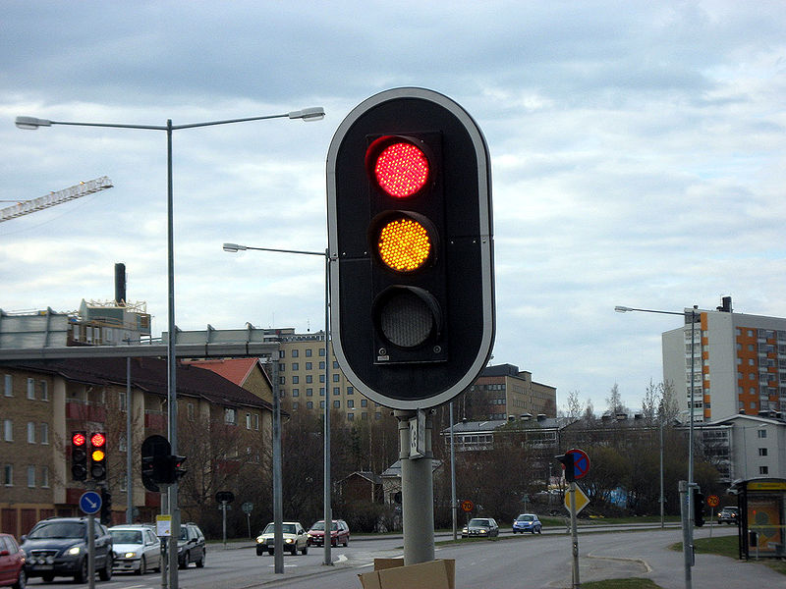
Column:
Traffic_Signal : indicates the presence of traffic lights in nearby location.

Slide 25
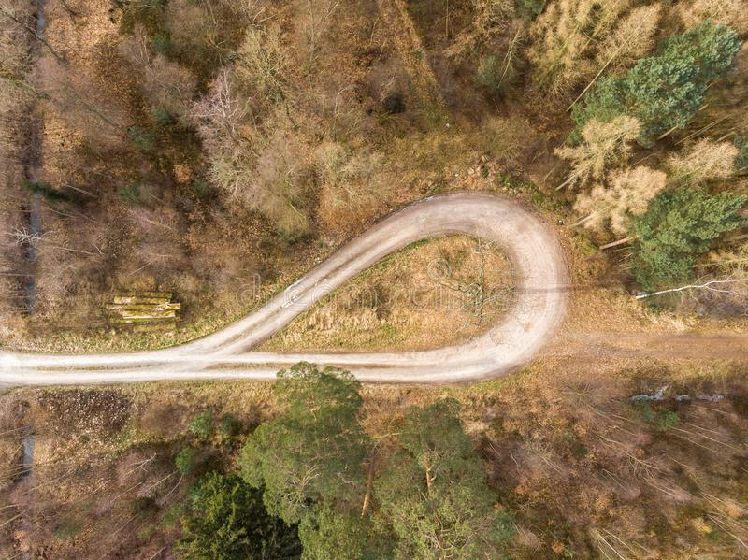
Column:
Turning_Loop : A POI annotation which indicates presence of turning_loop in a nearby location.

Slide 26
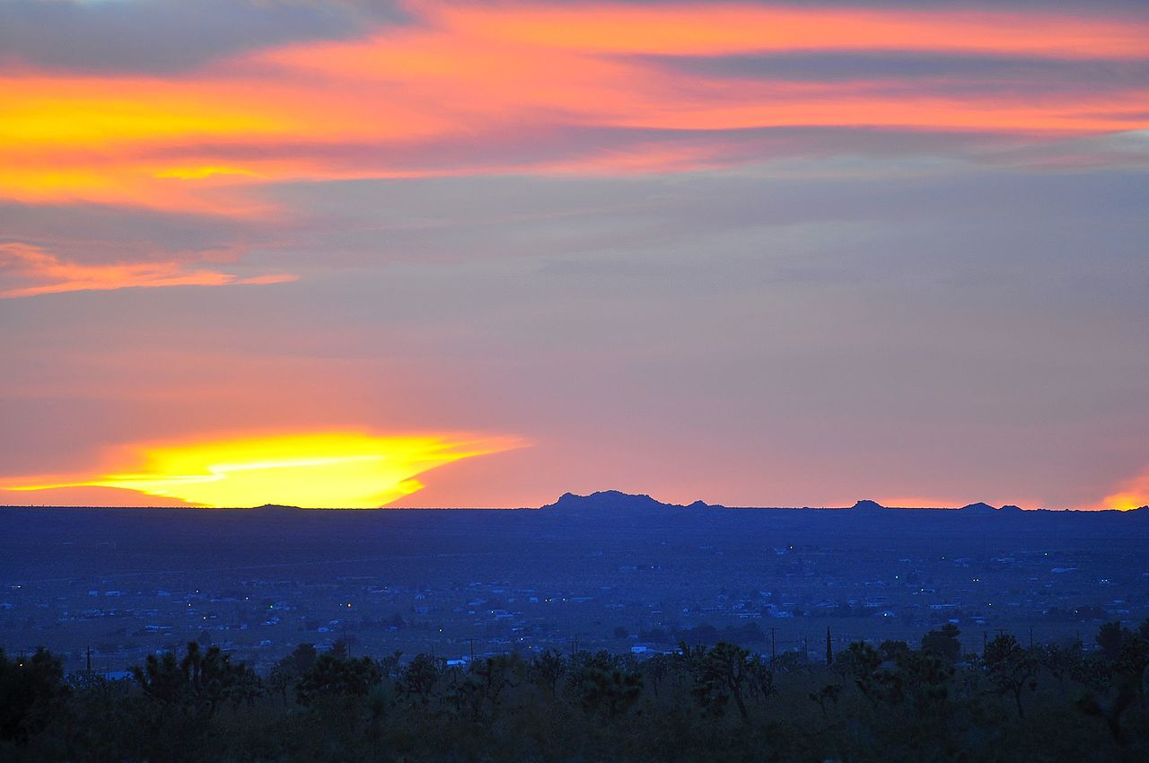
Column:
Sunrise_Sunset : Shows the period of day (i.e. day or night).
Civil_Twilight : Shows the period of day (i.e. day or night) based on civil twilight.

Slide 27
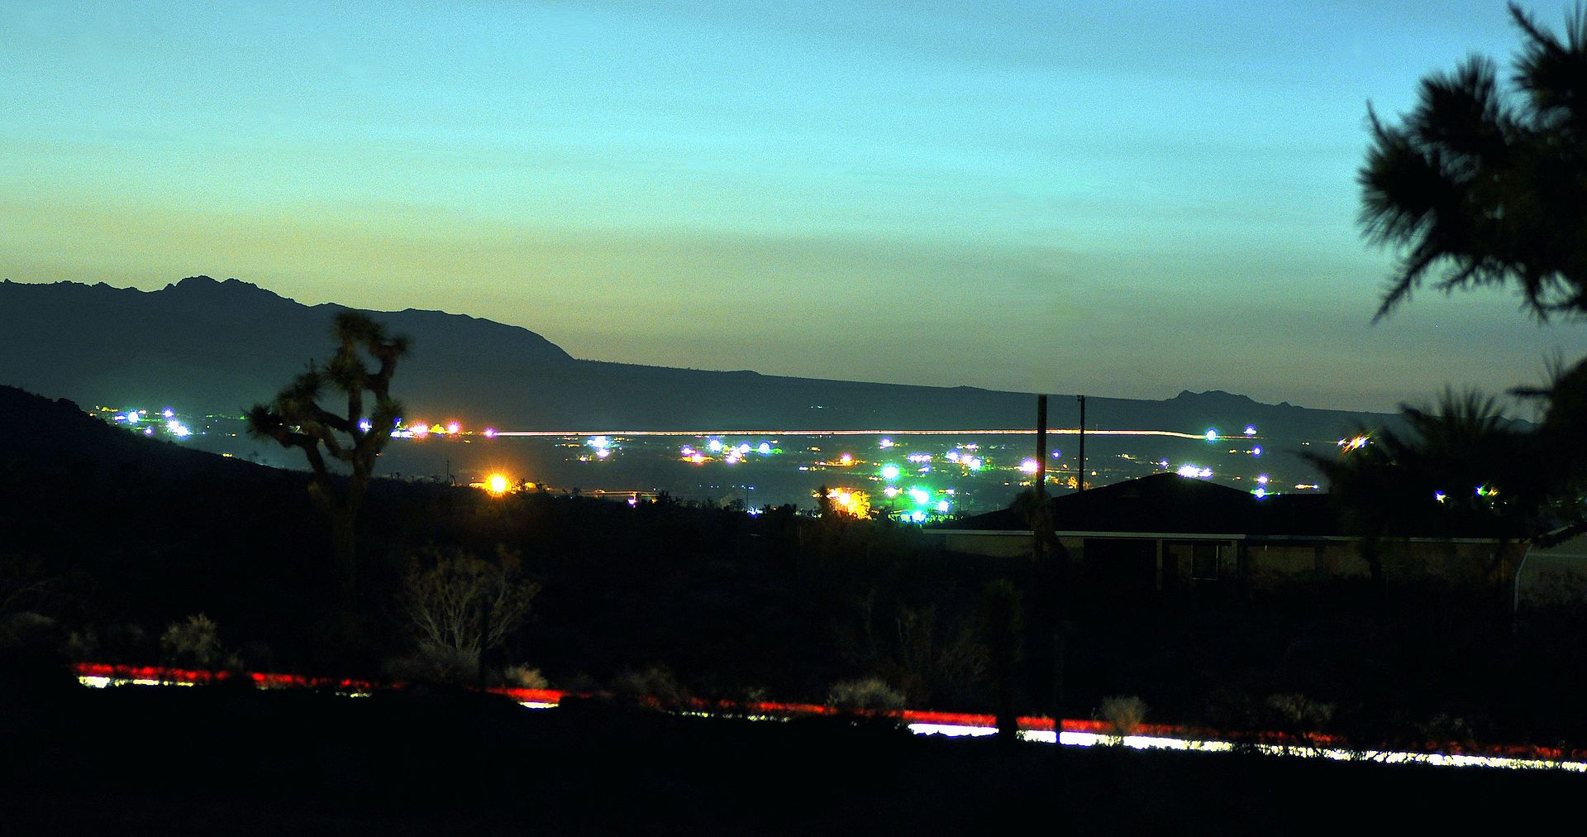
Column:
Nautical_Twilight : Shows the period of day (i.e. day or night) based on nautical twilight.

Slide 28

Column:
Astronomical_Twilight : Shows the period of day (i.e. day or night) based on astronomical twilight.

Slide 29
Data set cleaning

Slide 30
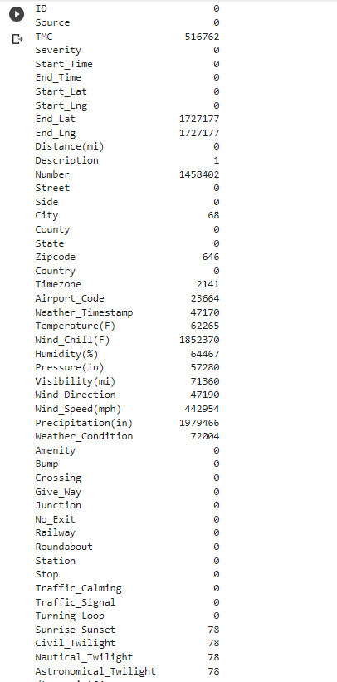
Data set missing value percentage

Slide 31
Step 1
Removing non important columns.

Slide 32
1.ID
Index code of each accident in each record in each row.
Because of this ID is Unimportant to the insights in this dataset.

Slide 33
2.Source
It is the name of the platform which the accident record was extracted from.
This not an important feature in the dataset.

Slide 34
3.Zipcode
Zip code is related to country->state->city->street.
As it will have no impact on the insights.

Slide 35
4.Airport_code
Denotes weather airport station is the closest to location of the accident.
It doesn’t have effect on the accident.

Slide 36
Step 2
Removing columns due to high present of missing value

Slide 37
1.start_Lat
Start_Lat will be removed because of its corresponding column End_Lat Has 1727177 missing value.
As 76% of the data is missed.

Slide 38
2.start_Lng
Start_Lng will be removed because of its corresponding column End_Lng Has 1727177 missing value.
As 76% of the data is missed.

Slide 39
3.End_Lat
Because of 76% of the data is missed(1727177 record)

Slide 40
4.End_Lng
Because of 76% of the data is missed(1727177 record)

Slide 41
5.Number
This column has 1458402 missing record (64% is missed)
This percent can not be in placed because it will has an negative effect on the insights.

Slide 42
6.wind_chill(H)
Wind chill has 1852370 missing record (82%).
This high percentage can not be replaced or treated.

Slide 43
7.precipitation(in)
Wind chill has 1979466 missing record (88%).
This high percentage can not be replaced or treated.

Slide 44
Step 3
Removing columns described in another columns.

Slide 45
1.Description
Explained in other columns
(Start_Time- End_Time- Street- Side-
State).
It has 1253507 different record.
shows natural language description of the accident.

Slide 46
step 4
Removing columns has only one class

Slide 47

1.Country
This column has only one class(us)

Slide 48

2.Turning_loop
This column has only one class (false)

Slide 49
Step 5
Replace nan in important column

Slide 50
Fill the missing value in the important columns.
In the numerical columns (fill by mean).
In the categorical columns (fill by mode).

Slide 51
Categorical columns filled with mode
1-City(68 NAN)
2-Timezone (2141 NAN)
3-Wind_Direction (47190 NAN)
4-weather_condition (72004 NAN)(3%)
5-Sunrise_Sunset (78 NAN)
6-Civil_twilight (78 NAN)
7-Nautical_twilight (78 NAN)
8-Astronomical_Twilight (78 NAN)
9-Weather_Timestamp(47170 NAN)

Slide 52
Numerical columns filled with mean
1-Temperature(F) (62265 NAN)
2-Humidity(%) (64467 NAN)
3-Pressure(in) (57280 NAN)
4-Visibility(mi) (71360 NAN)(3%)

Slide 53
Step 6
Drop nan from columns

Slide 54
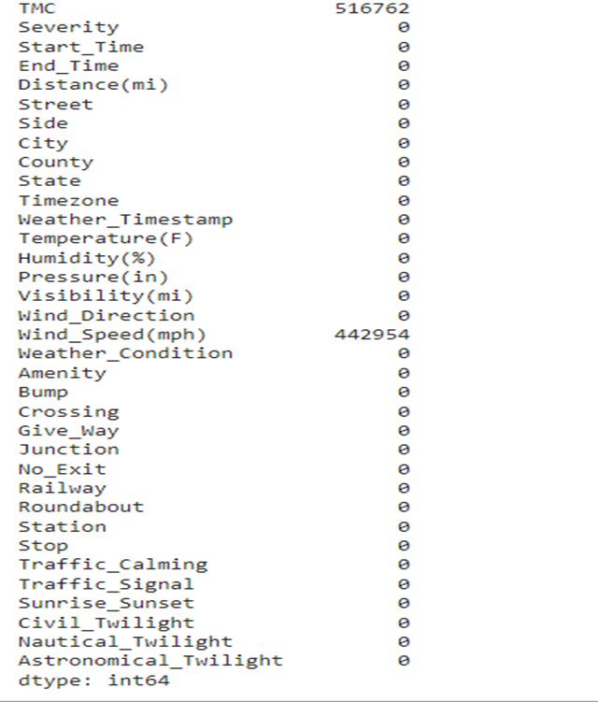
After removing columns and fill the missing value in another

Slide 55
we have an important columns it contain large percentage of missing values
TMC(516762 nan)(23%) – Wind_Speed(mph)(442954 nan)(20%)
We can not drop it or replace it with any statistical calculation
we try to apply knn imputer but this algorithms time complexity is
(O(k * n * d)),K: number of neighbors that we consider for voting ,N : number of points in the training dataset , D: data dimensionality.
Because of this we compare between these two columns according two importance(TMC-Wind_Speed(mph))
Then we drop TMC and drop NA from Wind_Speed(mph)

Slide 56
Data after cleaning

Slide 57
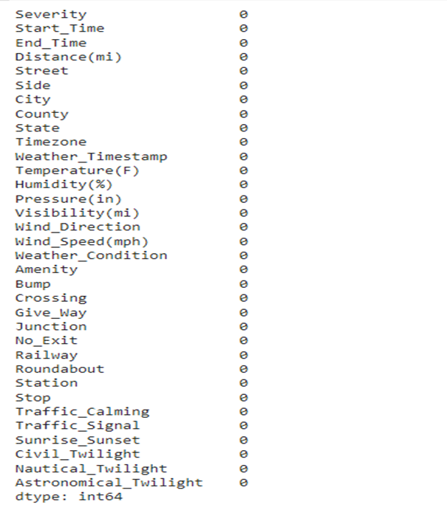
Data shape ((1800985, 34))

Slide 58
Data Visualization
We have some questions about the data and we will try to find their answers by visualizing the data.

Slide 59
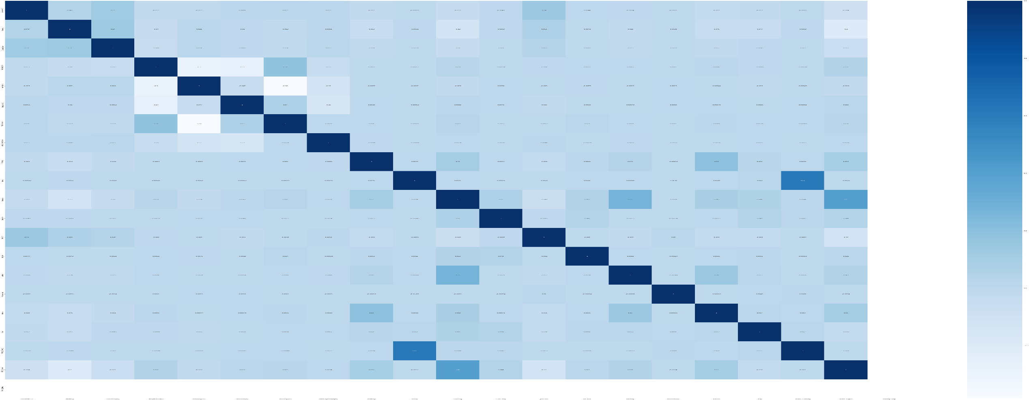
Correlation
At first we present the correlation matrix which ideates that there is no correlation between attributes

Slide 60
Traffic Attributes
It’s consist of 4 columns
(Severity ,Start_Time, End_Time, Distance(mi)

Slide 61
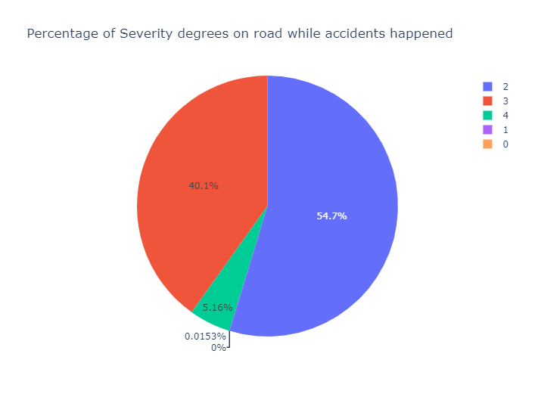
Severity
What is the most repeated Severity degree?
-Here we find that Severity with degree 3 and 2 is the most repeated by percentage 40% and 54%.

Slide 62
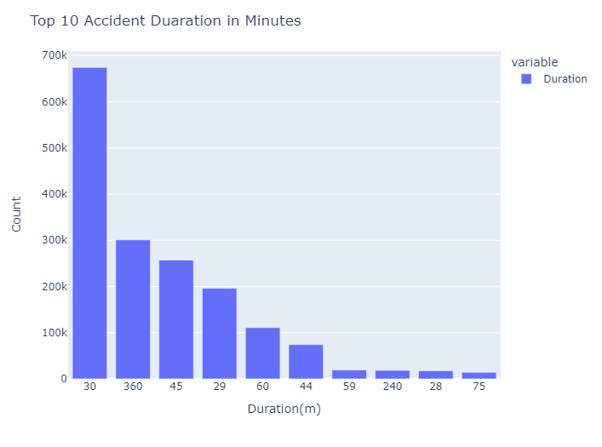
Start_Time and End _Time
What is the top 10 Accident Duration in Minutes ?
- We calculated accident duration throw start and end time
- And we found that these are the most repeated Accident Duration

Slide 63
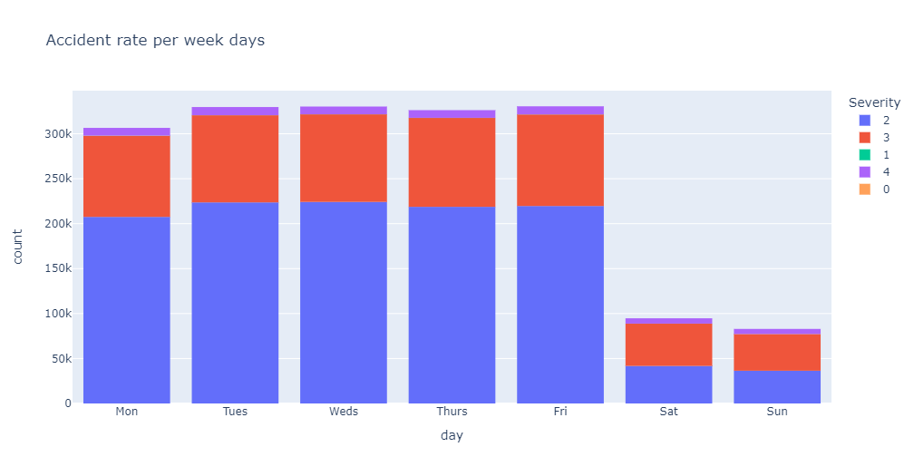
Start_Time and End _Time
- We can conclude that accident rate is higher at workdays than days off.

Slide 64
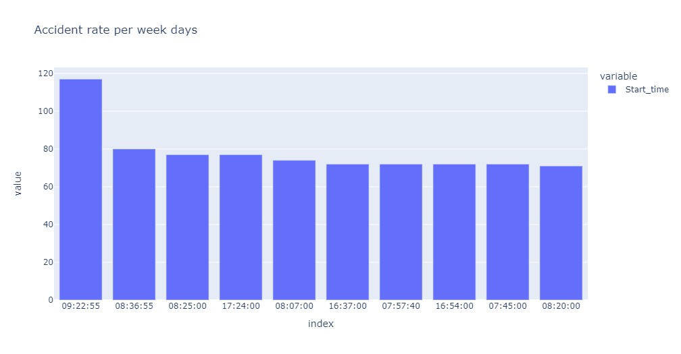
Start_Time and End _Time
-Those are the top 10 day hours per accident rate
-As known USA working hours between 9:00 And 17:00 so it was expected that most accidents rate is between them

Slide 65
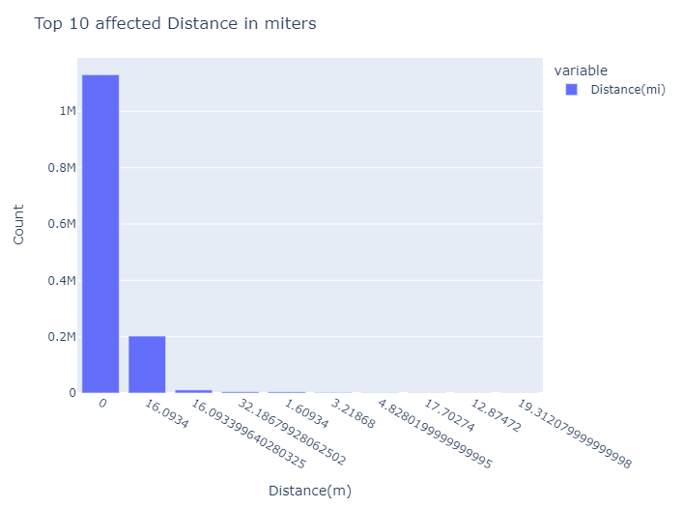
Distance(mi)
What is the top 10 affected Distance in miters?
-The most affected Distance in miters is less than 1 miter and 16 miters.

Slide 66
Address Attributes
It’s consist of 6 columns
(Street, Side, City, County, State, Timezone)

Slide 67
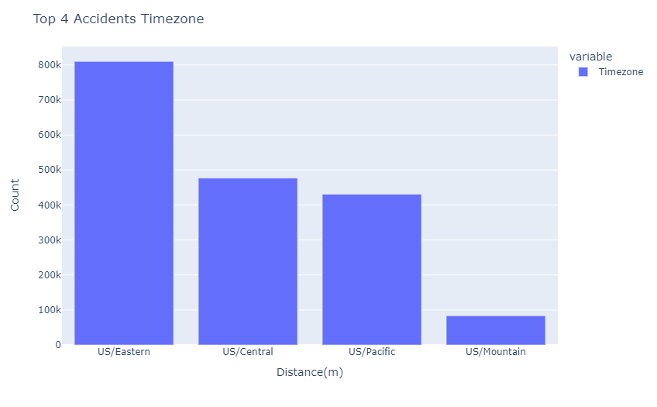
Timezone
What is the most repeated time zones?
-We found that most of accidents recorded in US/Eastern time zone

Slide 68
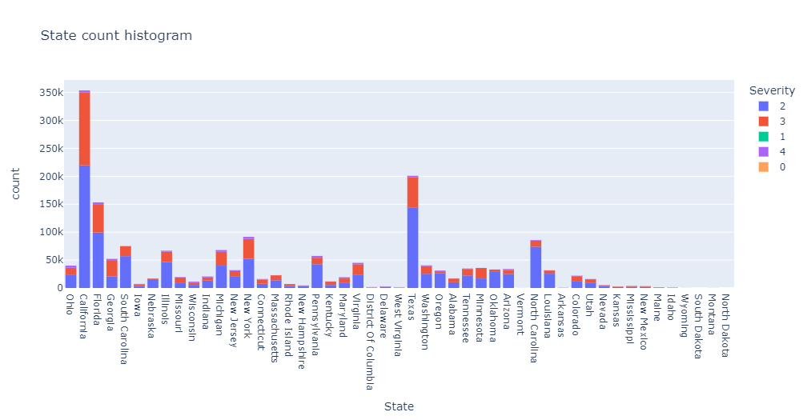
State
We can conclude from state histogram that most of accidents recorded in California state
And 2 is the highest severity degree

Slide 69
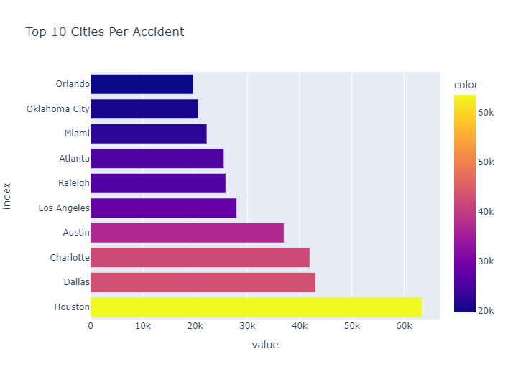
City
What is the top 10 cites per accidents?
-We found that those are the top 10 cities per accidents rate.

Slide 70
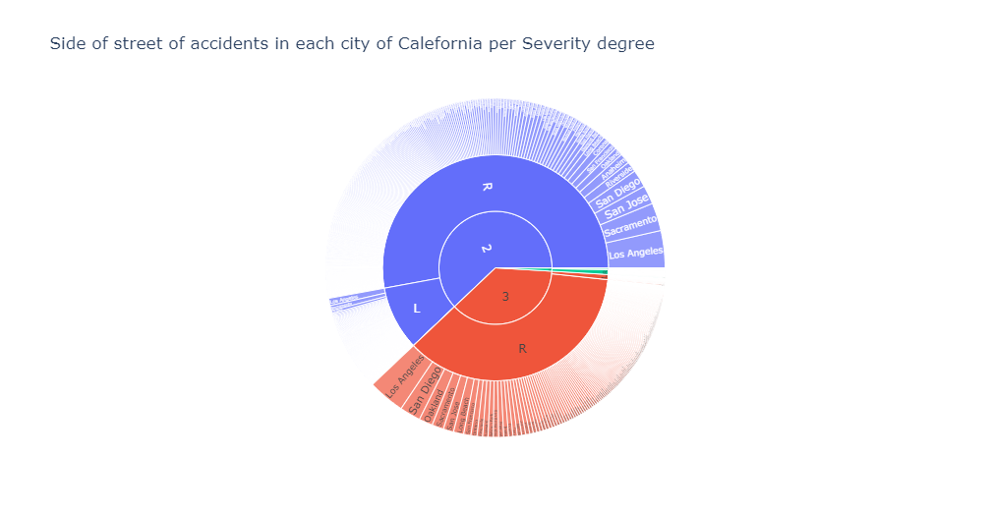
California Cities and streets
If we talk about California state, At which city, and at which street side accidents happened?
We could conclude that most of accidents happened in Los Angeles city.
We could conclude also that most accidents occur in right side of the street.

Slide 71
Weather Attributes
It’s consist of 7 columns
( Temperature(F), Humidity(%), Pressure(in), Visibility(mi), Wind_Direction, Wind_Speed(mph),Weather_Condition)

Slide 72
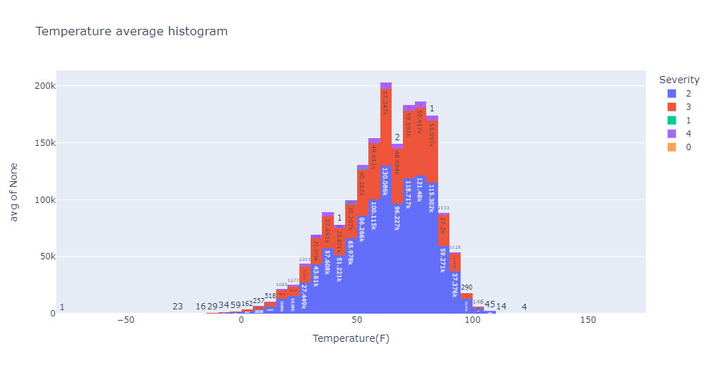
Temperature(F)
What is the range of temperature in Fahrenheit most accidents occur?
Which is the degree of severity could occur after the accident?
-As we could see in graph most accidents occur with severity third degree equal 67.347k, while severity with second degree equal 130.086.
-Most temperature is between 60-64.9 Fahrenheit.

Slide 73
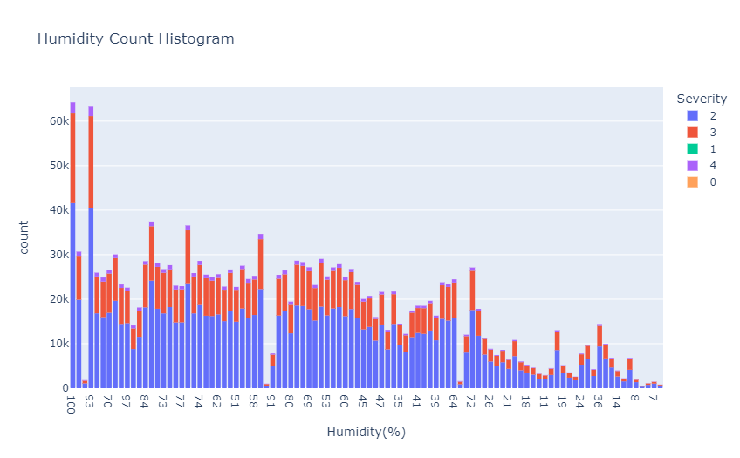
Humidity(%)
What is the highest repeated humidity percentage ?
-We found that most repeated humidity percentage is 100% which is too high because the normal humidity percentage is between 55% to 65%.

Slide 74
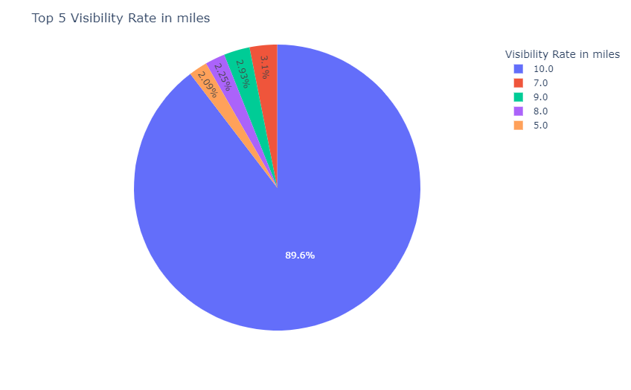
Visibility(mi)
What is the top 5 visibility rates in miles?
-We found that 10 miles is the most repeated visibility rate by 89%

Slide 75
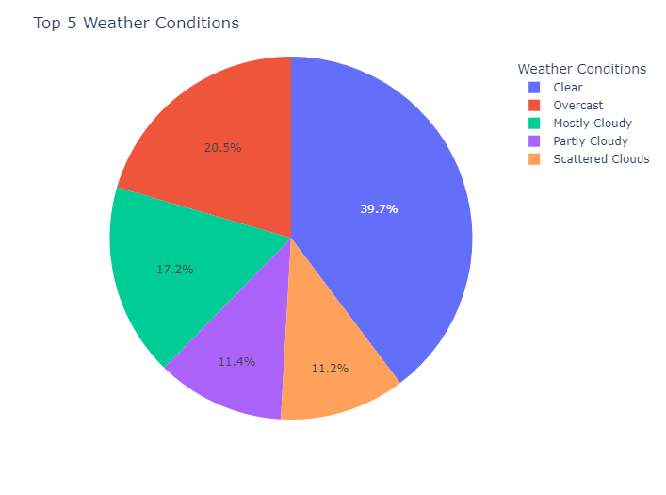
Weather_Condition
What is the top five repeated weather condition?
-We found that those five are the most repeated weather conditions.
-And clear is the most repeated weather condition by 39.7%

Slide 76
POI Attributes
It’s consist of 13 column
(Amenity, Bump, Crossing, Give_Way, Junction, No_Exit, Railway, Roundabout, Station, Stop, traffic_Calming, Traffic_signal, Turning_Loop)

Slide 77
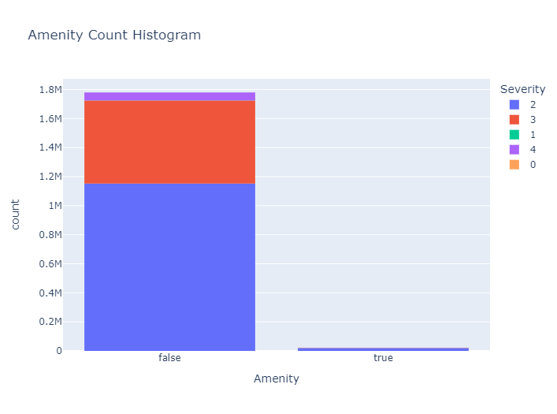
Amenity
Does the presence of amenity in a nearby location affect accident rate or severity degree?
- I seems that lake of amenity affect the accident rate and its severity.

Slide 78

Bump
Does the presence of Bump in accident location affect accident rate or severity degree?
-Most of accidents places have no bumps.
-So it seems that existence of bump reduces accidents rate.

Slide 79
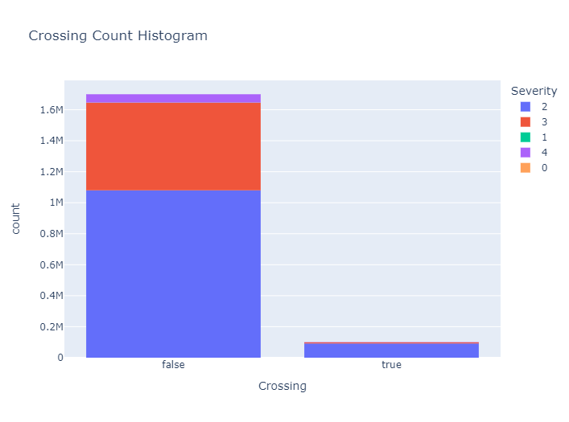
Crossing
Is the accident rate high in places where there is a crossing area?
-No

Slide 80
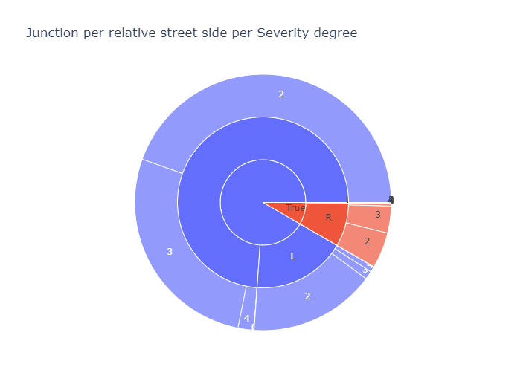
Junction
-We could conclude from this graph that most of accidents happened in places have no junction.

Slide 81

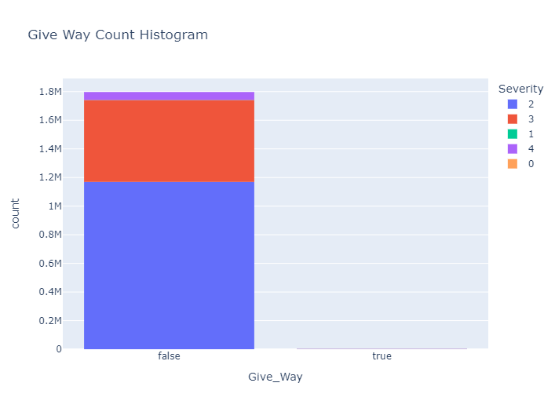

Does the presence of (give way, no exit, stop) in accident location affect accident rate or severity degree?
It seems that all accidents happened in places which haven’t (give way, no exit, stop) signs.

Slide 82
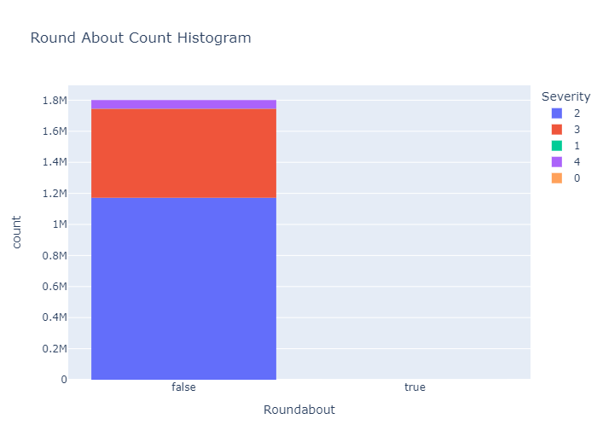
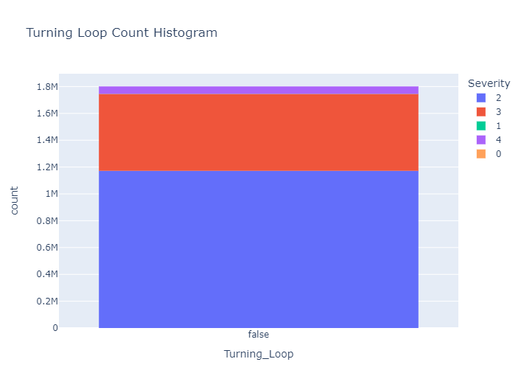
Does the presence of Roundabout or Turning Loop in a nearby location affect accident rate or severity degree?
It seems that all accidents happened in places which haven’t Round about or Turning loop in a nearby location.

Slide 83

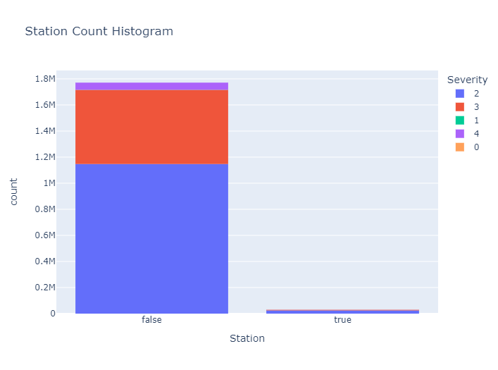
Does the presence of Railway or Station in a nearby location affect accident rate or severity degree?
It seems that all accidents happened in places which haven’t Railway or Station in a nearby location.

Slide 84
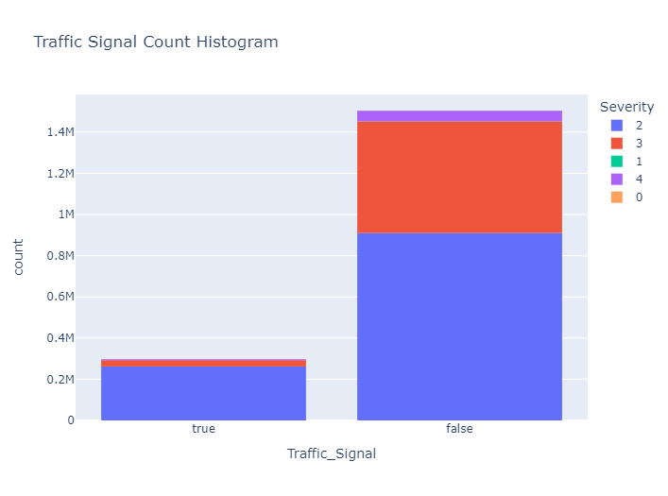
Traffic_Signal
Does the presence of Traffic signal in a nearby location affect accident rate or severity degree?
It seems that all accidents happened in places which haven’t Railway or Station in a nearby location.
But there is around 300k accident recorded nearby a traffic signal

Slide 85

Traffic_Calming
Does the presence of Any device or feature causing traffic to calm or slow in a nearby location affect accident rate or severity degree?
- Most of accidents places have no Traffic calming.
- So it seems that existence of traffic calming reduces accidents rate

Slide 86
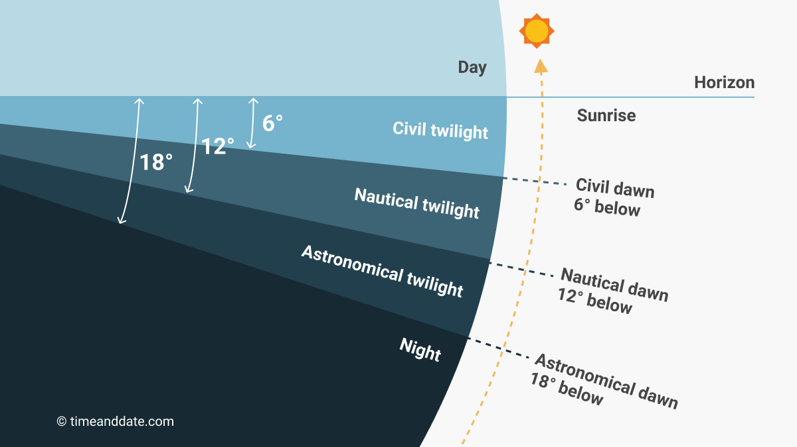
Period of Day
It’s consist of 4 column
(Sunrise_Sunset, Civil_Twilight, Nautical_Twilight, Astronomical_Twilight)

Slide 87
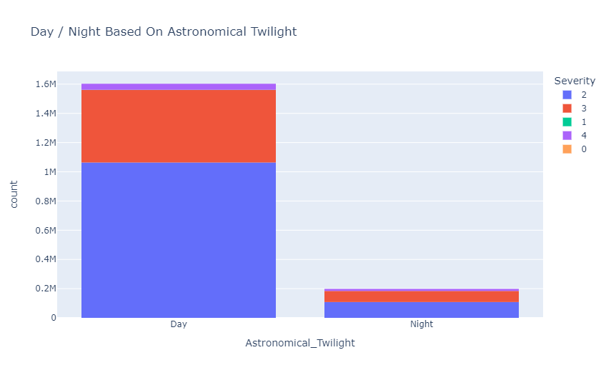
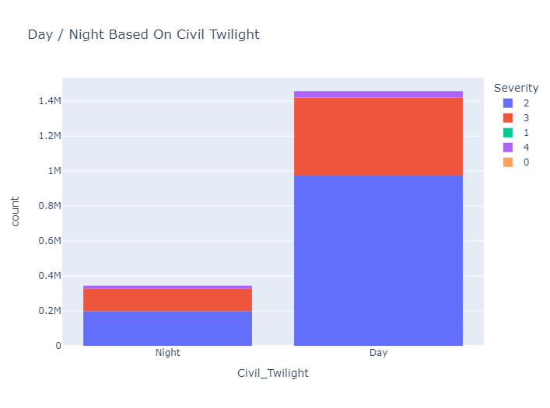
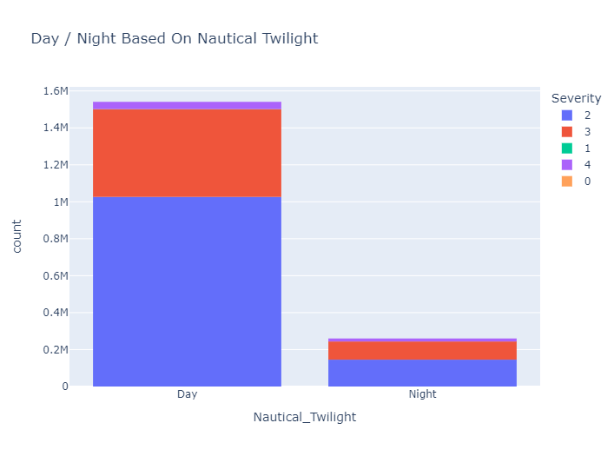
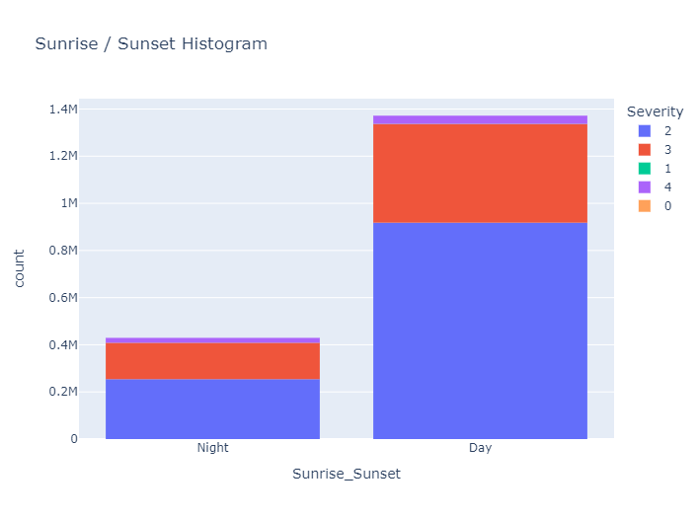
At any period of the day most accidents occur?
-We found that most of accidents(more than 1m) occur in the day light
-And accidents occur at (natural night Sunset) and(Civil twilight night )
Is higher than which at Astronomical and Nautical nights.

Slide 88
Conclusion

Slide 89
Severity
What is the most repeated Severity degree?
-Here we find that Severity with degree 3 and 2 is the most repeated by percentage 40% and 54%.

Slide 90
Important conclusion
Most accidents occur due to some problems with the driver
"Egypt's losses resulting from road accidents were estimated at 8 billion Egyptian pounds annually“ the Central Agency for Public Mobilization and Statistics
We can add our ideas to the remarkable development in the road networks in Egypt by supporting these roads with smart traffic lights.
We only lack real data to be able to implement this project on our land.

