Slide 1
16 point Radix 2 SDC FFT
by Hussien Mohamed Hussien

Slide 2
Agenda
FFT architecture
FFT equation and flow graph
Quick comparison between different architectures
Modeling phase
Architecture of the design
Results
Design phase
Verification phase
Verification plan
Results and coverage
ASIC phase
Comparison of results between Openlane flow and Adflow

Slide 3

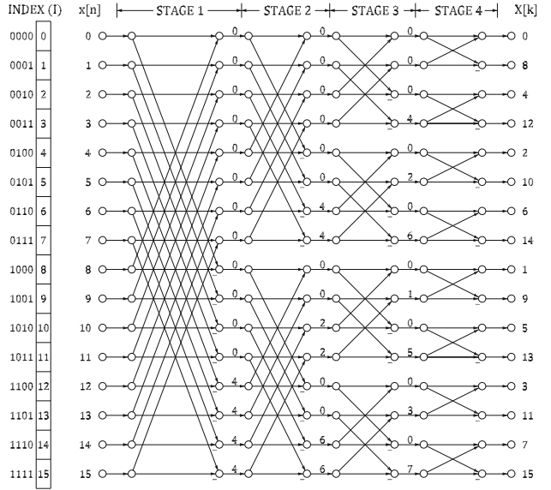
FFT architecture
FFT Transfer equation :
FFT DIT flow graph:

Slide 4
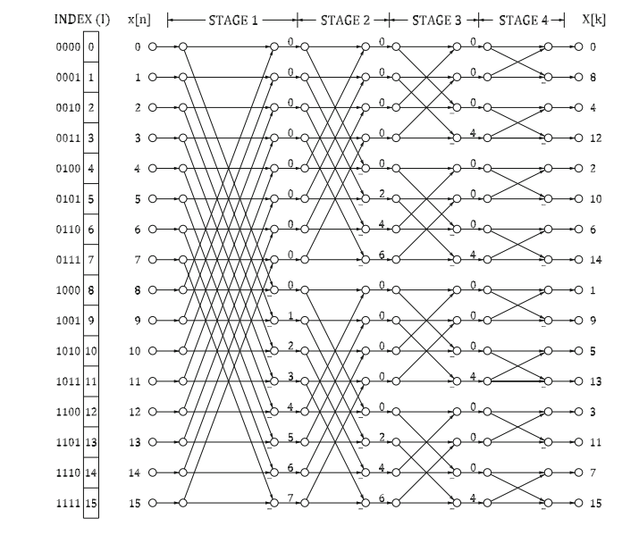
FFT architecture
FFT DIF flow graph which is the main focus:

Slide 5
FFT architecture
Quick comparison between different architectures:
Architecture | Complex Adders | Non-trivial Rotators | Data Memory | Latency (cycles) | Throughput (data/cycle) | Utilization | Expected max-fclk (qualitative) | Uses
SDF (basic) | 2N | n−2 | N−1 | N−1 | 1 | 50% | Moderate | Streaming, low-memory systems; simple FPGA/ASIC FFT cores where minimal buffer cost is critical (e.g., small embedded SDR receivers, real-time pipelines with tight memory constraints).
SDF (Deep Feedback) | N | n/2−1 | 4(N−1)/3 | N−1 | 1 | 100% | Moderate | Area-constrained designs where adders are expensive but extra memory is acceptable (ASICs/FPGA designs prioritizing adder reuse / lower arithmetic hardware). Good for low-power reuse strategies.
SDC (RI, improved) | N | n−2 | ≈3N/2 | ≈3N/2 | 1 | 100% | Moderate → Higher | Systems needing continuous utilization and simpler rotators (e.g., high-speed comms ASICs, designs where rotator complexity/power matters). Use when throughput must be energy/area-efficient, and extra latency is acceptable.
SFF (radix-2) | N | n−2 | 2N−2 | N−1 | 1 | 100% | Moderate → Higher | FPGA-friendly FFTs and OFDM front-ends where time-staging reduces per-cycle logic (good for high clock targets on FPGA fabrics, mid-to-high throughput wireless basebands).
SC (radix-2) | N | n/2−1 | ≈N | ≈N | 1 | 100% | Higher | High-performance ASICs or mmWave/radar frontends where best fclk is desired; also good for low-power designs that benefit from reduced rotator multipliers and compact memory. Balanced general-purpose FFT cores.

Slide 6
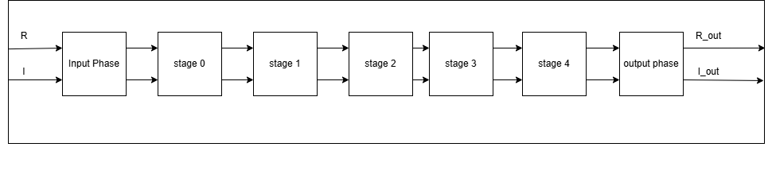
Modeling phase
Architecture of the design:
The input phase is used to reorder the input stream into real and imaginary
Stage 0 doesn’t compute ana operation but reorders the data for stage 1
Each stage from 1 to 3 computes the butterfly and rotator operation
Stage 4 has only the butterfly
Output phase is for splitting the data into real and imaginary once again
An extra block can be added to reorder the data again so it won’t be bit reversed

Slide 7
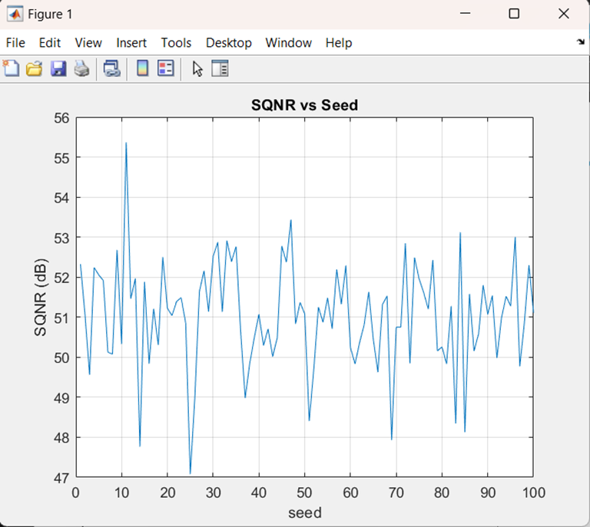
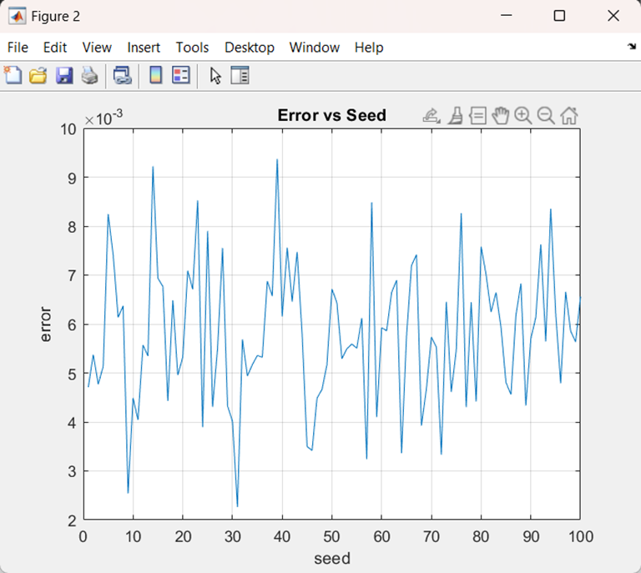
Modeling phase
Results:
Mean SQNR is 51.0521 dB and mean error is 0.0057883

Slide 8
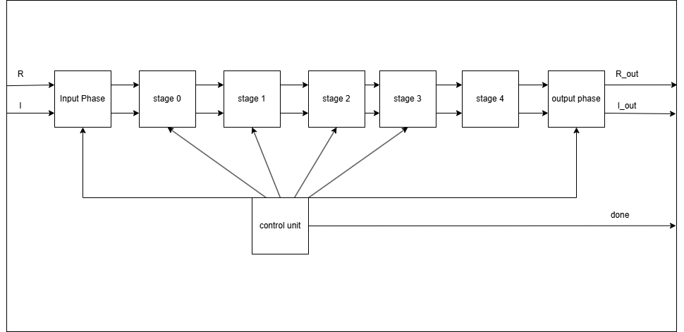
Design phase
Latency = 27 clock cycles
Block diagram :
Each stage is explained and what it does is explained here
The control unit is the one responsible to when each stage starts its operations
Done is a flag that is asserted when the first FFT result is ready (could be used for the following block but I used it for ease of debugging)

Slide 9
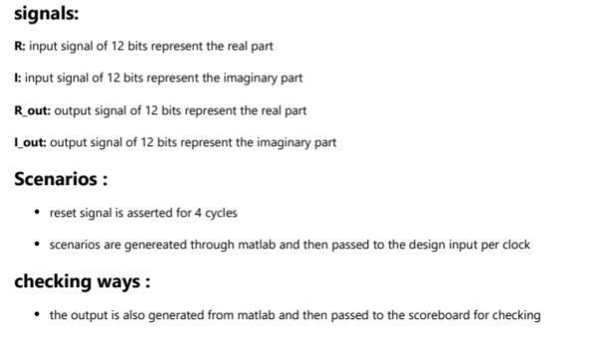
Verification phase
Verification plan:

Slide 10
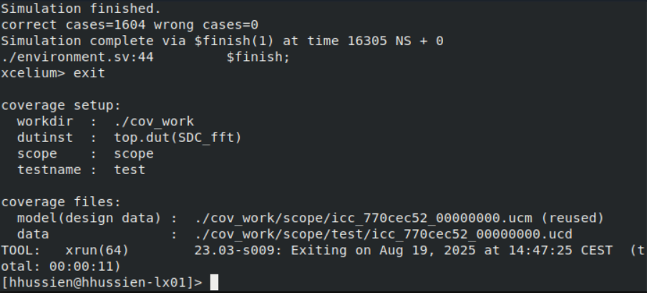
Verification phase
Results:

Slide 11
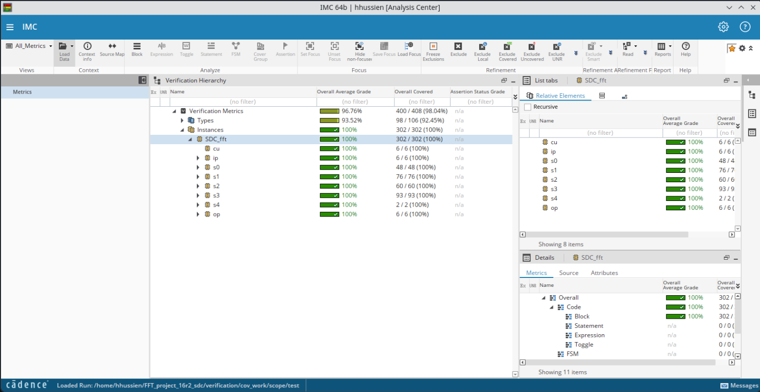
Verification phase
Coverage:

Slide 12
ASIC phase
Metric | Adflow | Openlane
Number of instances (without physical cells) | 2941 | 5089
Area used | 4285 | 4000000
Max frequency | 1 GHZ | 52 MHZ
WNS (setup) | -0.306 (this is a reg2out path which is over constrained but reg2reg has no violations) | 0 (I think there is a bug in the tool )
WNS (hold) | -0.235 (this is a in2reg path which is over constrained but reg2reg has no violations) | 0 (I think there is a bug in the tool )
Post route utilization | 85.805% (100% with fillers) | 98%
Technology used | gf22nspvlogl28hdl116f_FFG_0P88V_0P00V_0P00V_0P00V_125C | sky130
Standard cells used | HDB116SLT28 | sky130_fd_sc_hd

Slide 13
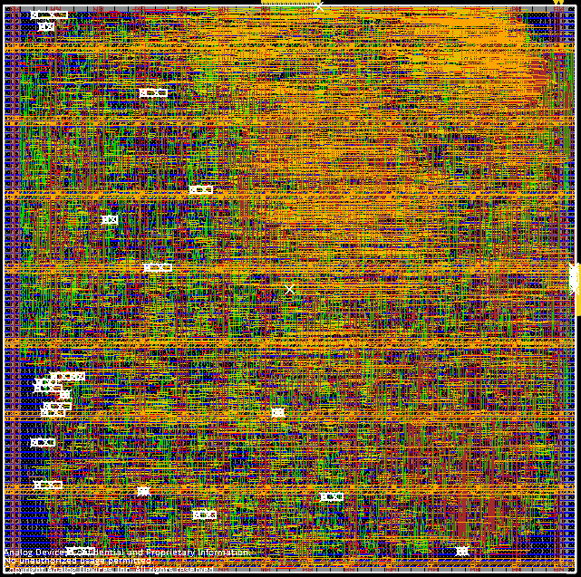
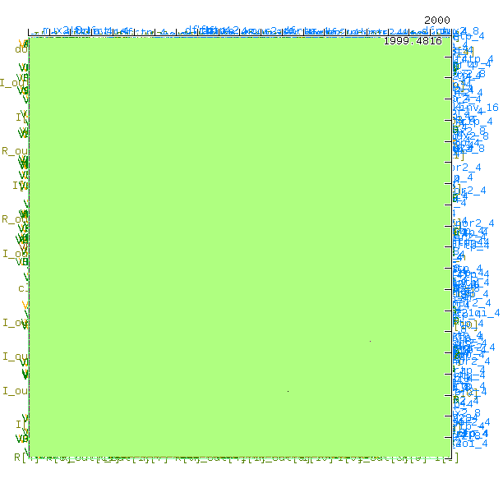
ASIC phase
Adflow PNR Image
Openlane PNR Image

Slide 14
Thank You!

