Slide 1
DATA ENGINEERING · WEEK 3
Pipelines and DuckDB
Data engineering och Agila metoder — IT Högskolan · Tue 25/8
Mikael Huss · IT Högskolan
Data Engineering och Agila metoder · Week 3
1

Slide 2
RECAP · 15 MIN
Before we start: Week 2 recap
• Git for teams branch, commit, push, pull request — you used this on your own repo.
• Code review blocking vs. non-blocking, at least one comment addressed before merge.
• The first real pipeline ingestion API + Postgres, raw and clean layers, docker-compose.
Data Engineering och Agila metoder · Week 3
2

Slide 3
Pipeline design patterns
ETL vs. ELT, batch vs. streaming, and the bronze/silver/gold naming convention you'll use for the rest of the course.
Data Engineering och Agila metoder · Week 3
3

Slide 4
PIPELINE PATTERNS
ETL vs. ELT
ETL
ELT
• Extract → Transform → Load.
• Transform happens before the data lands — outside the warehouse, in the pipeline code.
• You decide the shape of the data up front.
• Classic pattern when the destination is expensive or fragile.
• Extract → Load → Transform.
• Raw data lands first, transform happens inside the warehouse/database afterwards.
• Cheap, elastic compute (DuckDB, cloud warehouses) made this the default since ~2015.
• This is what you did Thursday: land raw, then build clean on top.
This course: ELT throughout
Data Engineering och Agila metoder · Week 3
4

Slide 5
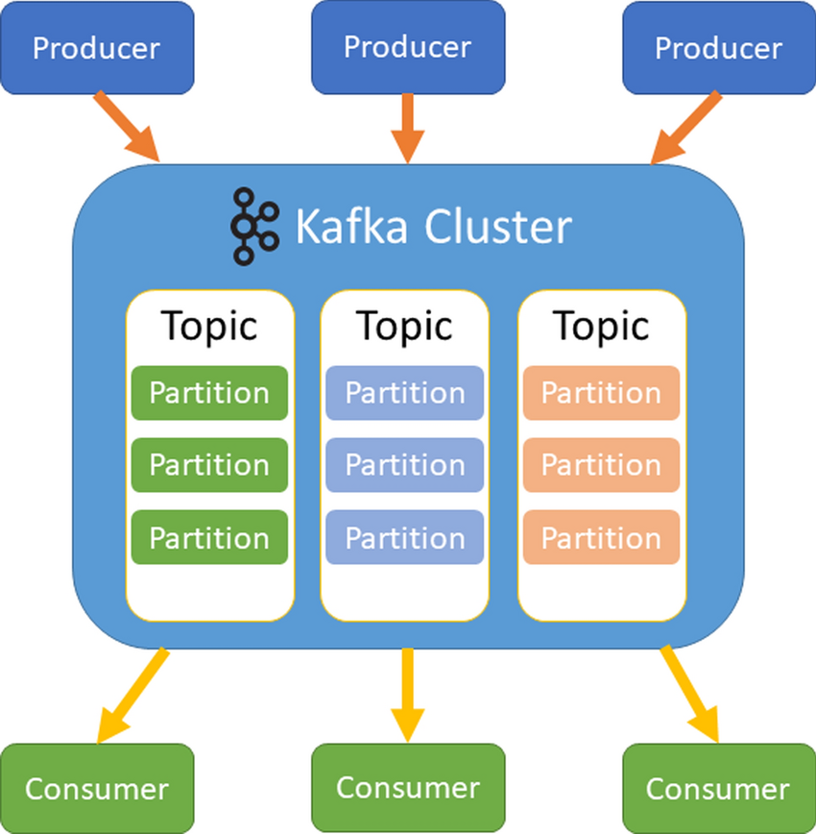
PIPELINE PATTERNS
Batch vs. streaming
• Batch process data in chunks, on a schedule (hourly, daily). Simple, debuggable, and what every pipeline in this course uses.
• Streaming process events continuously, as they arrive (Kafka, Kinesis, Flink). Lower latency, much higher operational complexity.
Data Engineering och Agila metoder · Week 3
5

Slide 6
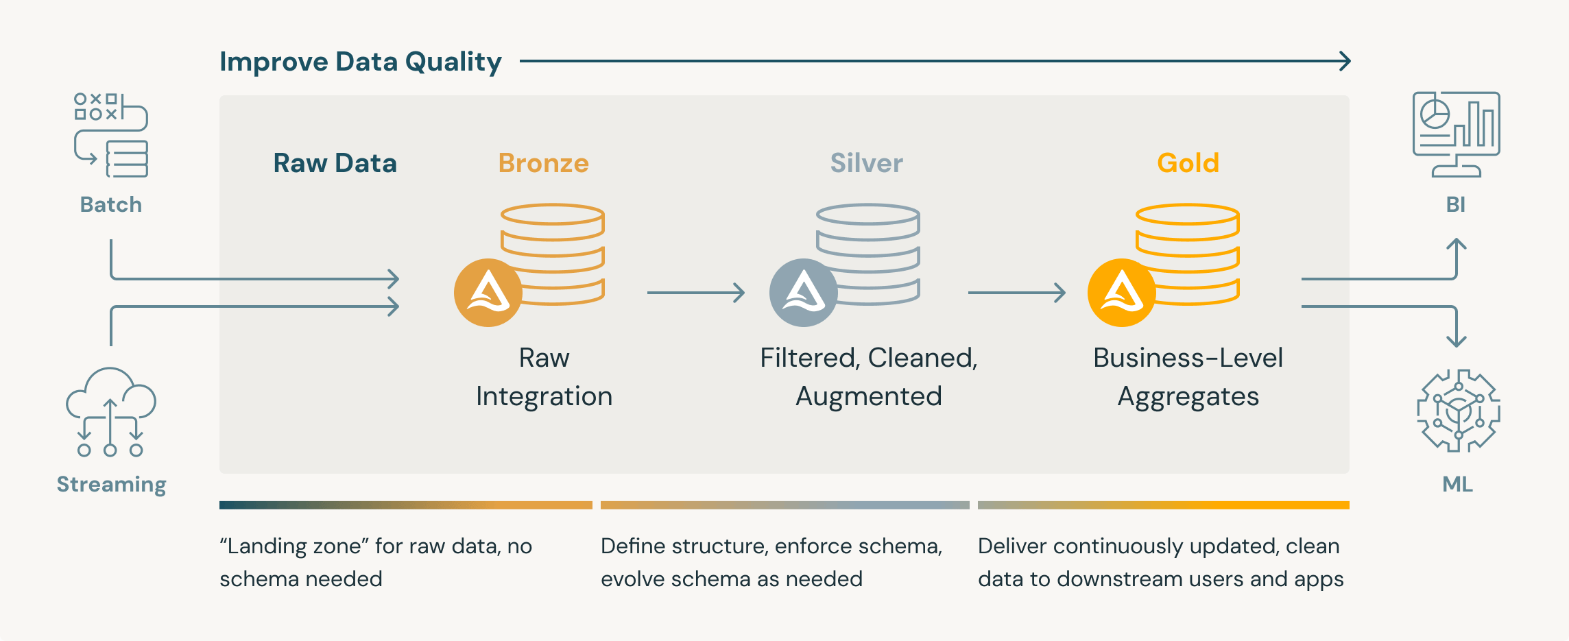
PIPELINE PATTERNS
The medallion architecture: bronze, silver, gold
Data Engineering och Agila metoder · Week 3
6

Slide 7
STORAGE
Row vs. columnar storage
Row-oriented
Column-oriented
• Stores each record together, field by field.
• Fast for reading/writing one full record (a transaction).
• Postgres, MySQL — OLTP workloads.
• Stores each column together, across all records.
• Fast for aggregating one field over millions of rows.
• DuckDB, Parquet, most warehouses — OLAP workloads.
Data Engineering och Agila metoder · Week 3
9

Slide 8
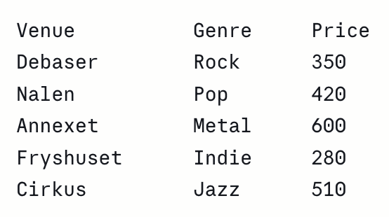
STORAGE
Concert data
Row-based storage:
Column-based storage:
[Debaser,Rock,350]
[Nalen,Pop,420]
[Annexet,Metal,600]
[Fryshuset,Indie,280]
[Cirkus,Jazz,510]
[Debaser,Nalen,Annexet,Fryshuset,Cirkus]
[Rock,Pop,Metal,Indie,Jazz] [350,420,600,280,510]
Task 1: Get all the info about the Annexet show: venue, genre, and price. How many data blocks do you have to look at to answer the question in row based storage? How many in column based?
Task 2: What’s the average price per show? How many data blocks do you have to look at in row vs column based storage, respectively?
Data Engineering och Agila metoder · Week 3
9

Slide 9
APIS & STORAGE
File formats: CSV, JSON, Parquet
Format
Shape
Good for
Watch out for
CSV
Row-oriented, text, no types.
Universal, human-readable.
No schema, slow at scale, ambiguous types.
JSON
Row-oriented, text, nested.
Matches most API responses directly.
Verbose, still no enforced schema.
Parquet
Columnar, binary, typed.
Compressed, fast for analytics, predicate pushdown.
Not human-readable; needs a reader.
The pipeline you built Thursday: JSON in from the API → bronze table in Postgres.
Data Engineering och Agila metoder · Week 3
10

Slide 10
THE DUCKDB VS POSTGRES DEMO
Meet DuckDB
• Embedded, not a server one .duckdb file, or fully in-memory — no process to start, no socket to connect to.
• Columnar OLAP engine built for aggregate queries over lots of rows, not for many small concurrent transactions.
• Reads Postgres directly the postgres extension attaches to a live Postgres database and queries it — no export step.
• Speaks Parquet natively including predicate pushdown against files in cloud storage, without downloading the whole file.
Data Engineering och Agila metoder · Week 3
11

Slide 11
THE DUCKDB VS POSTGRES DEMO
Meet DuckDB
• Embedded, not a server one .duckdb file, or fully in-memory — no process to start, no socket to connect to.
• Columnar OLAP engine built for aggregate queries over lots of rows, not for many small concurrent transactions.
• Reads Postgres directly the postgres extension attaches to a live Postgres database and queries it — no export step.
• Speaks Parquet natively including predicate pushdown against files in cloud storage, without downloading the whole file.
Data Engineering och Agila metoder · Week 3
11

Slide 12
THE DUCKDB VS POSTGRES DEMO
Mini-demo: DuckDB and local files
You can query CSV and Parquet files with SQL syntax:
query_str_csv = "SELECT * FROM 'concerts.csv' LIMIT 5";
response = duckdb.sql(query_str_csv)
Data Engineering och Agila metoder · Week 3
11

Slide 13
THE DUCKDB VS POSTGRES DEMO
DuckDB vs. Postgres — when to reach for which
Postgres
DuckDB
• System of record — the source of truth your app writes to.
• Many small, concurrent read/write transactions.
• You’ll use Postgres in your pipeline for bronze, features, predictions.
• Analysis tool — you reach for it to ask questions of the data.
• One heavy aggregate query beats many small ones.
Data Engineering och Agila metoder · Week 3
12

Slide 14

THE DUCKDB VS POSTGRES DEMO
Demo: DuckDB with Neon
Cloud Postgres database
Alternatives: Supabase, Cloud SQL (Google Cloud), Amazon RDS, Azure Database for PostgreSQL
Data Engineering och Agila metoder · Week 3
11

Slide 15
THE DUCKDB VS POSTGRES DEMO
Live demo: what actually happened
Attach a live Postgres database from DuckDB:
ATTACH 'postgresql://...' AS pg (TYPE postgres);
Three timings, same GROUP BY query, one attached table:
psql, server-side
aggregation runs inside Neon's compute; only the small grouped result crosses the network.
DuckDB via ATTACH, naive
SLOWER than psql — DuckDB pulls all 1M raw rows across the network first, then aggregates locally.
DuckDB, local copy
materialize once (CREATE TABLE ... AS SELECT * FROM pg....), then query locally — fastest of the three.
The lesson isn't "DuckDB is always faster." ATTACH is for ad hoc exploration across a live source. If you're going to hammer it with heavy analytics repeatedly, pull the data down once and work locally — which is exactly why bronze/silver/gold exists instead of everyone querying the OLTP database directly, forever.
Data Engineering och Agila metoder · Week 3
13

