Slide 1
Improved Model: SNGAN ResNet Architecture
Architecture Changes (vs Baseline)
Generator: residual upsampling blocks (512->256->128->3)
Discriminator: residual downsampling + spectral normalization
Latent dim: 100->128, embedding dim: 50->64
Minibatch stddev layer in D (mode collapse detection)
Training Changes
Loss: BCE -> Hinge loss
Optimizer: Adam(beta1=0.0, beta2=0.9)
D:G update ratio: 1:1 -> 5:1 (d_steps=5)
EMA on generator weights (decay=0.999)
100 epochs, batch size 64
Key: spectral norm only, no R1/GP/LR decay
Generator
z(128) + class_embed(64)
-> Linear -> 4x4x512
-> ResBlock (512->256, upsample 8x8)
-> ResBlock (256->128, upsample 16x16)
-> BN -> ReLU -> Conv -> Tanh (32x32x3)
Discriminator
image(3x32x32)
-> SN-Conv (3->128, downsample 16x16)
-> SN-ResBlock (128->256, downsample 8x8)
-> SN-ResBlock (256->512, downsample 4x4)
-> MinibatchStddev -> ReLU -> Linear
-> Projection conditioning with class embed
Hinge Loss:
L_D = E[max(0, 1-D(real))] + E[max(0, 1+D(fake))]
L_G = -E[D(G(z))]

Slide 2
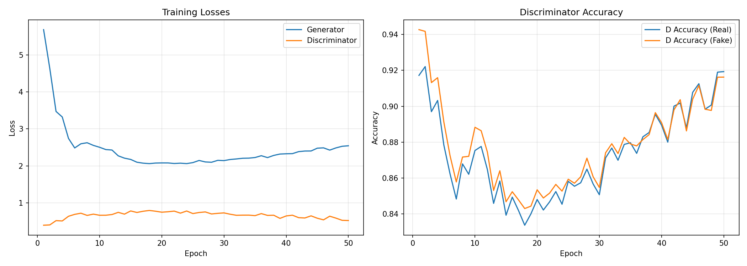
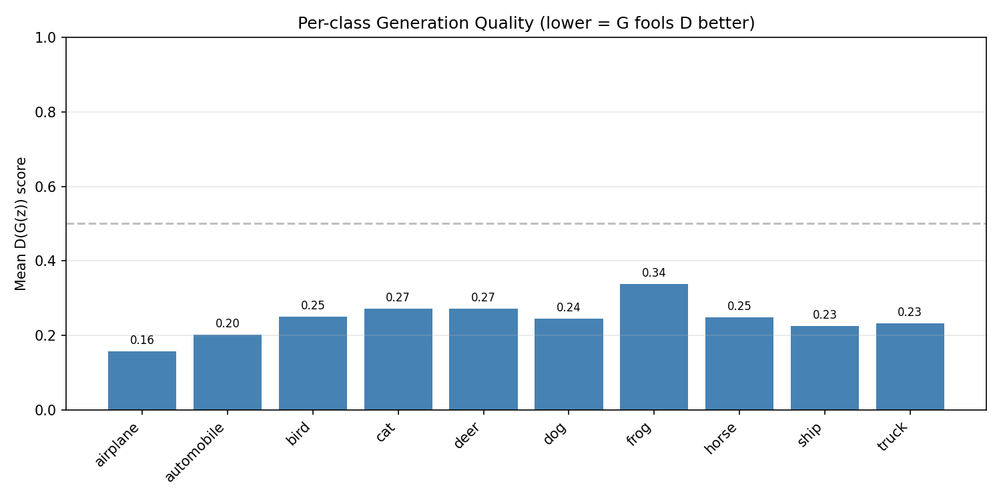
Training Results: Loss Curves & Metrics
Loss over 100 epochs:
Training Metrics
G loss: 5.69 -> 2.54 (55% reduction)
D loss: 0.39 -> 0.52 (stabilized)
D acc (real): ~92% (stable)
D acc (fake): 94% -> 92% (G slowly improving)
Evaluation Metrics
Real accuracy: 62.45%
Fake accuracy: 87.64%
Overall accuracy: 75.05%
Best class: Frog (D score 0.337)
Worst class: Airplane (D score 0.157)

Slide 3
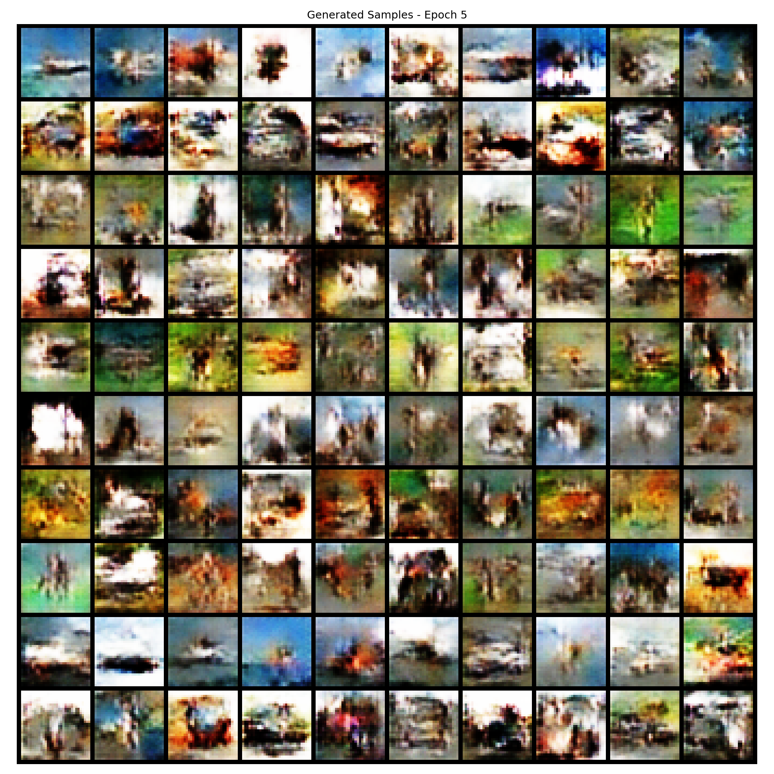
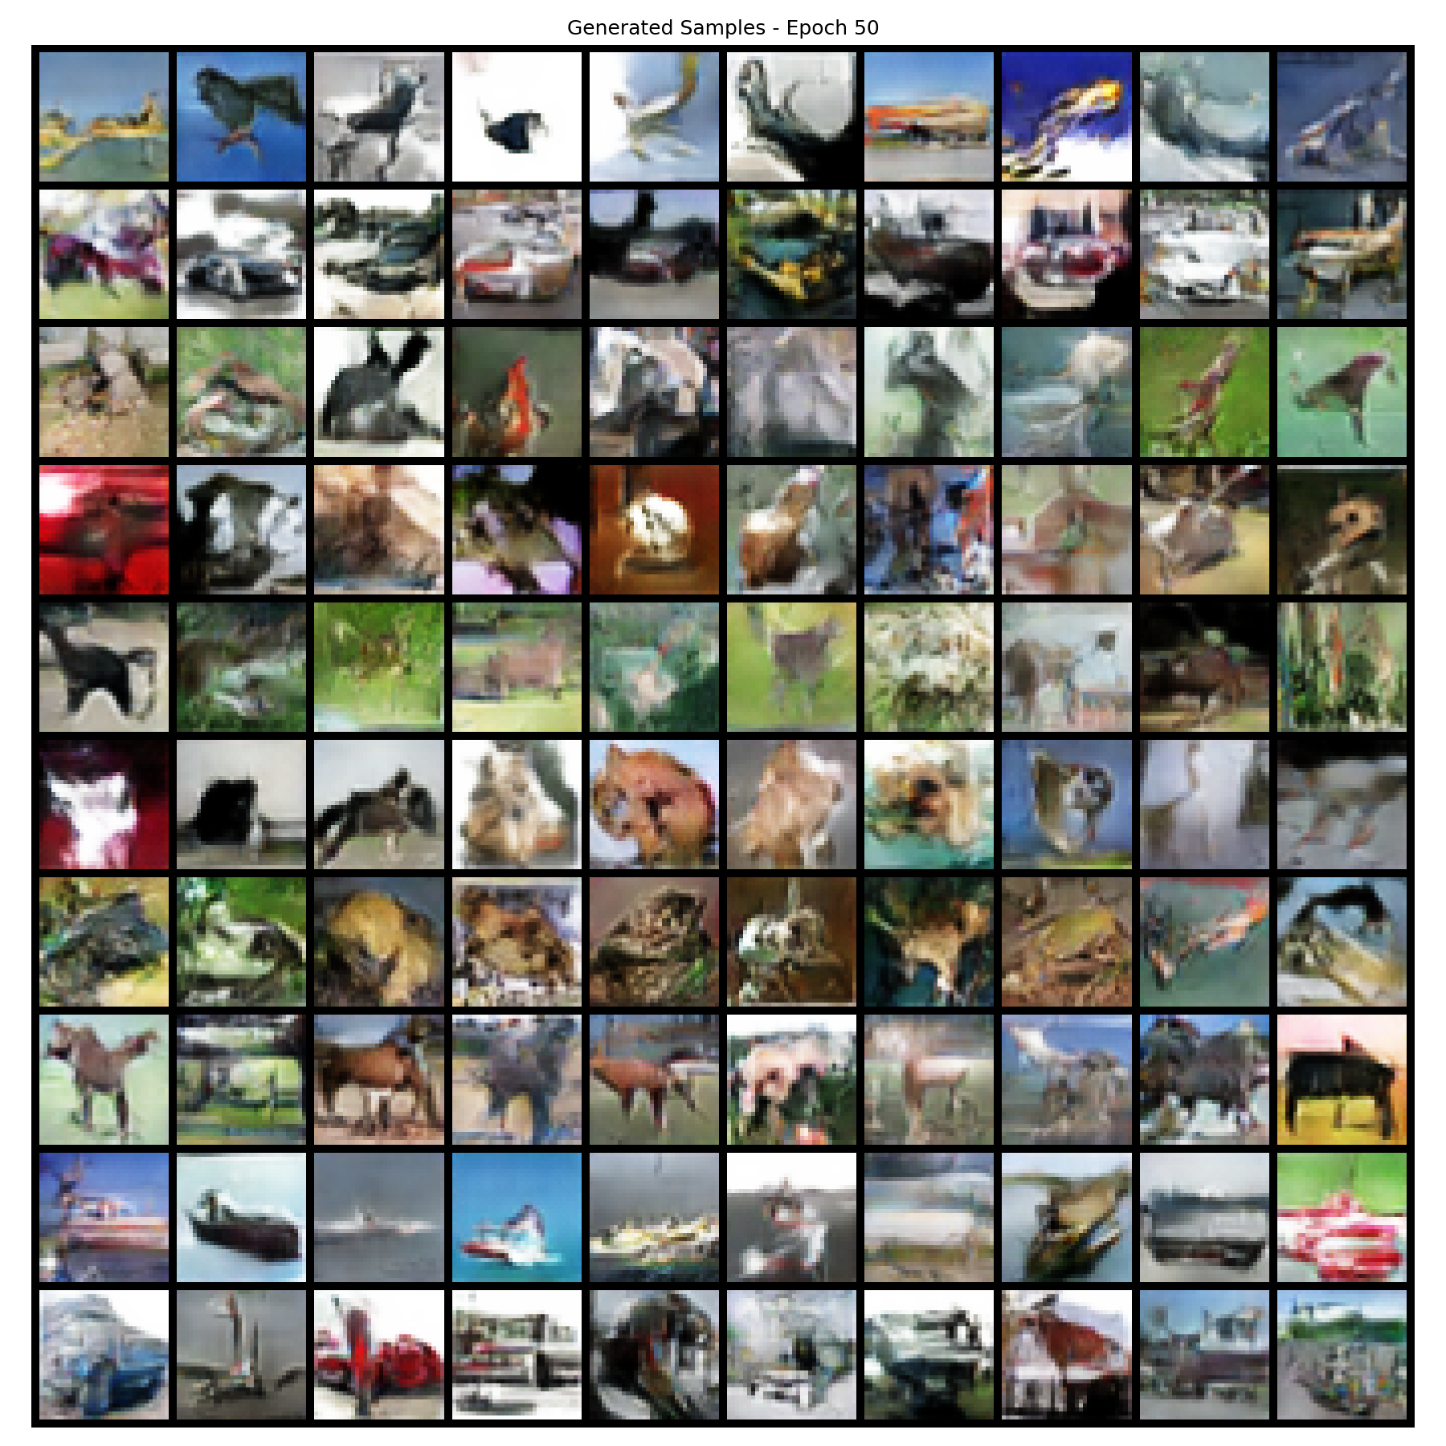
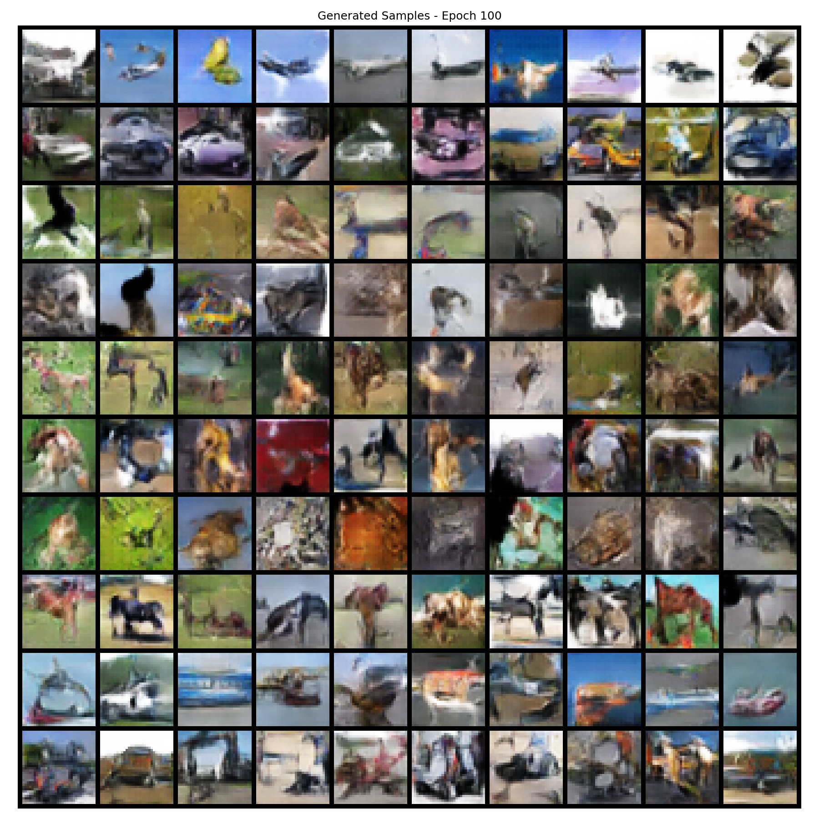
Generated Samples: Progression & Final Output
Epoch 5
Epoch 50
Epoch 100
10 rows = 10 CIFAR-10 classes | 10 columns = different random samples per class

Slide 4
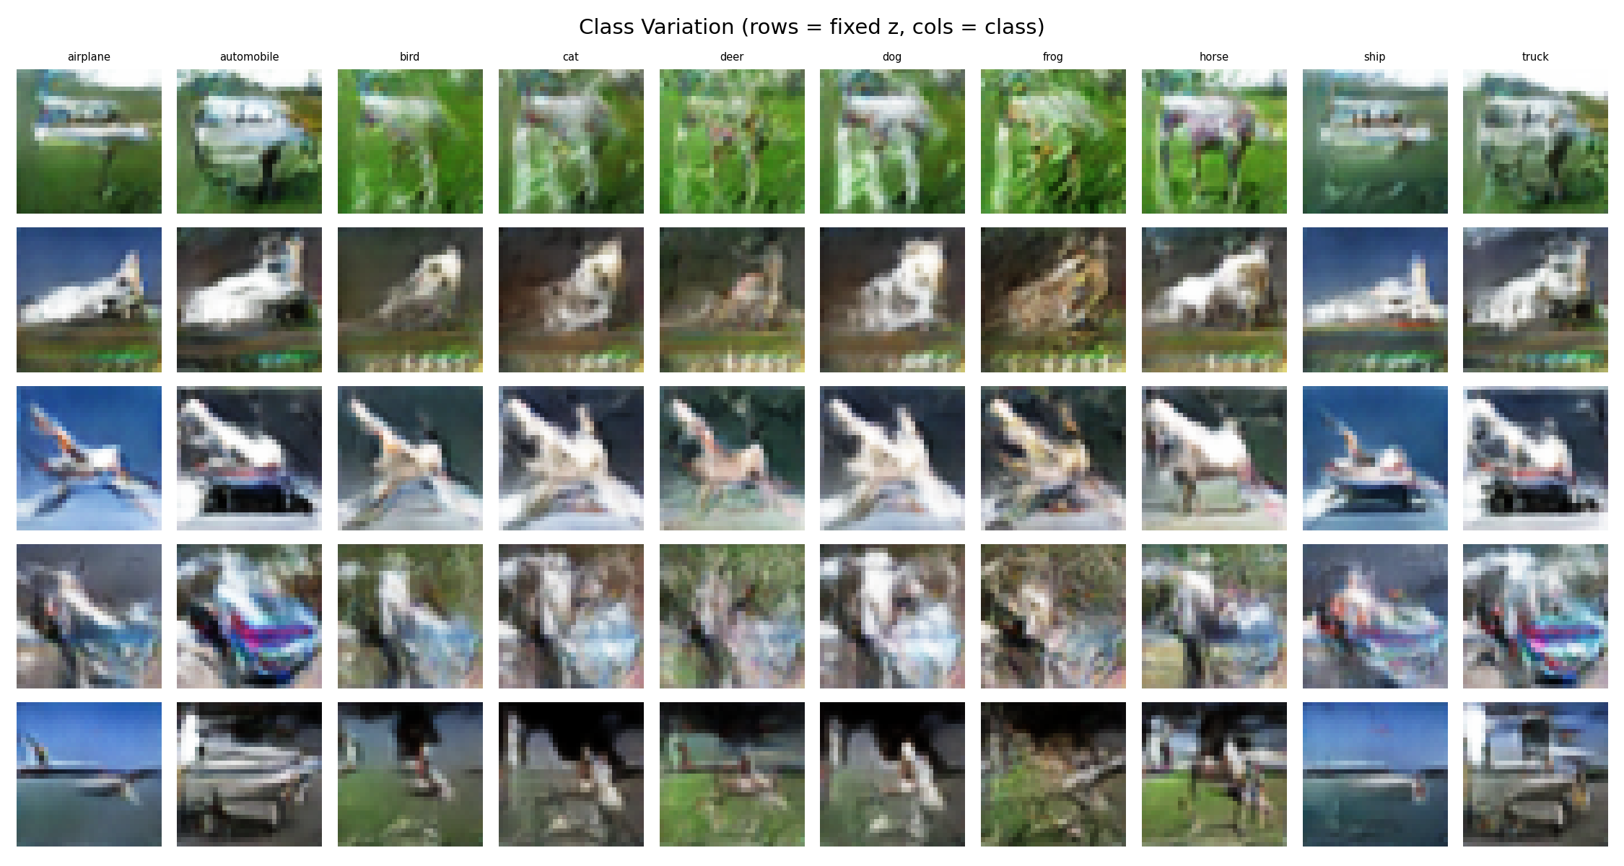
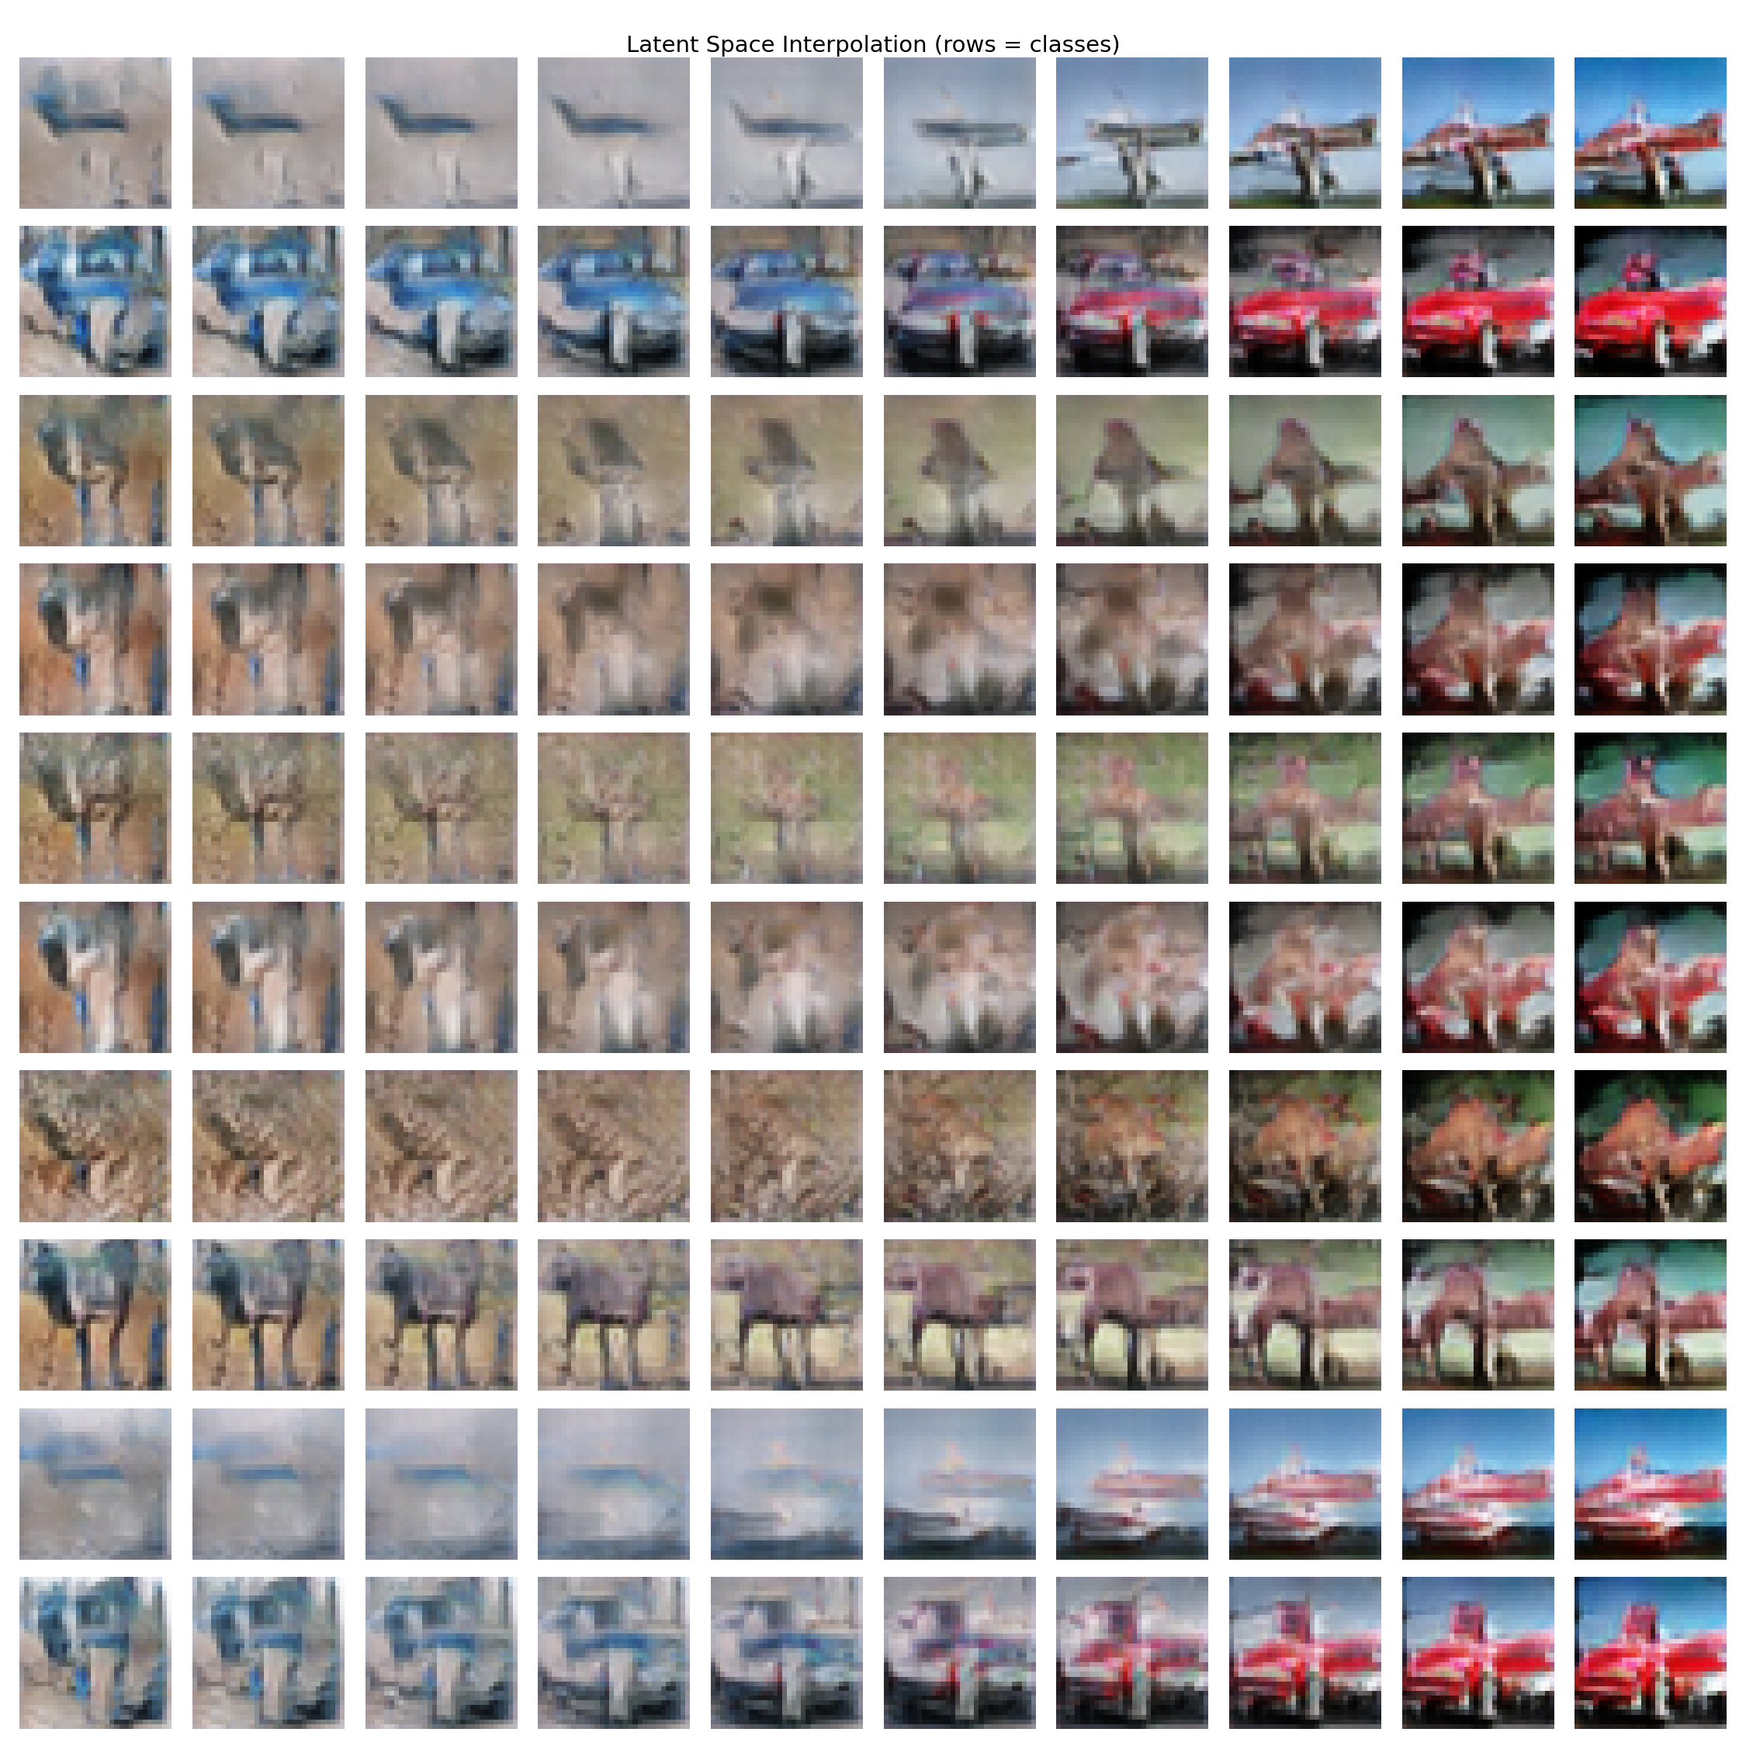
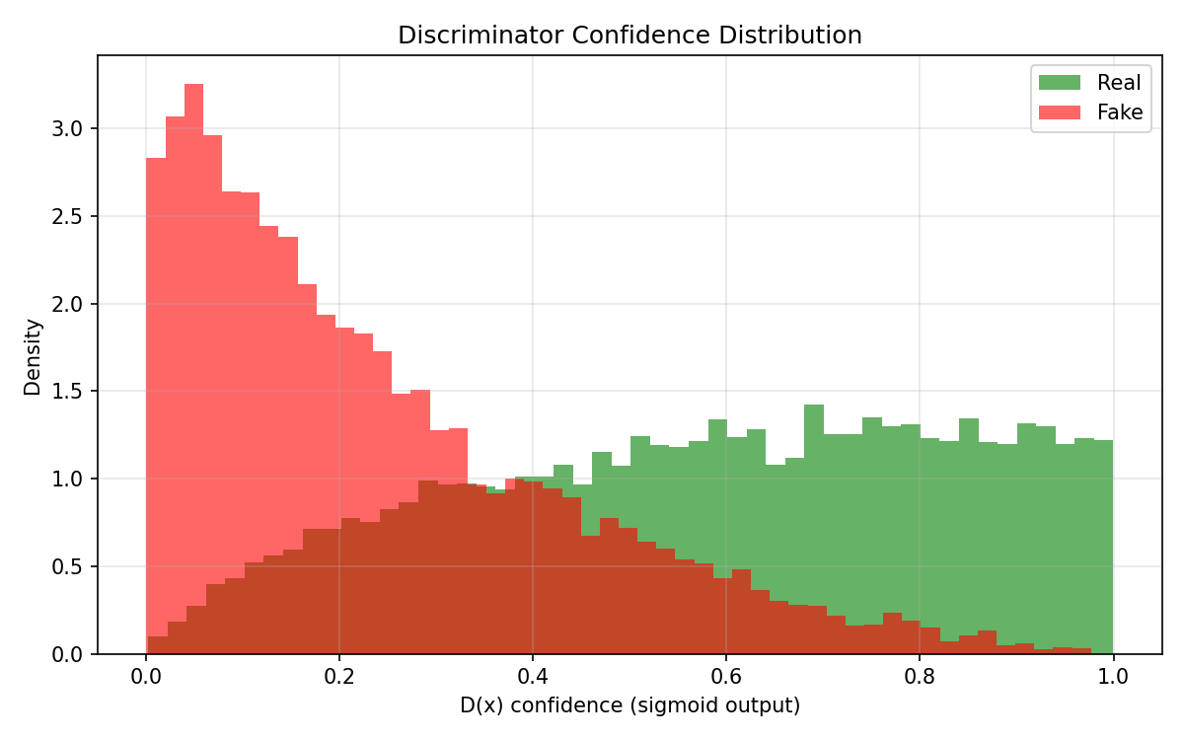
Evaluation: Class Variation & Interpolation
Same noise z across all 10 classes:
Latent space interpolation:
D confidence on real vs fake:
Observations:
Minimal class differentiation — images look similar across classes
Smooth latent interpolation — G learned a continuous manifold
D clearly separates real/fake — G quality is the bottleneck

