Slide 1
Improving Conditional DCGAN on CIFAR-10
An iterative journey through 14 architectural and training fixes
SCP-M Project | March 2026

Slide 2
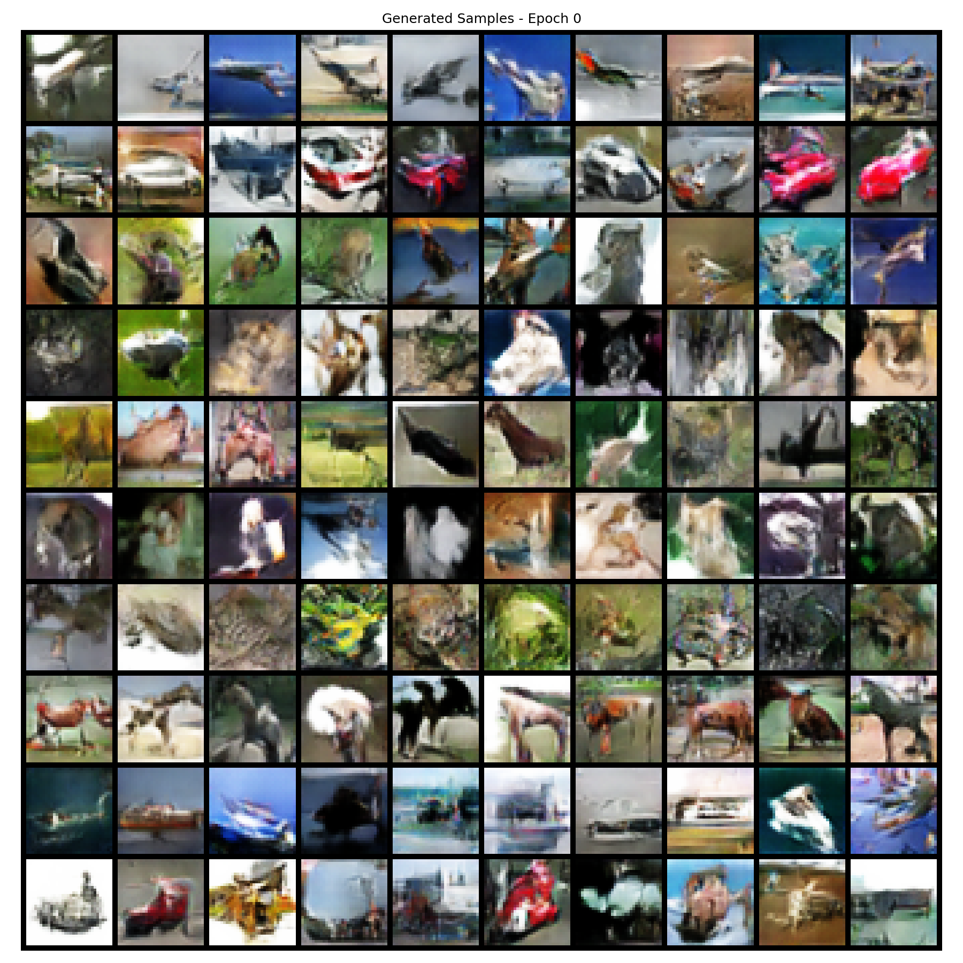
Starting Point: Baseline Conditional DCGAN
Architecture
Generator: Linear → ConvTranspose2d (256→128→64→3)
Discriminator: Strided Conv2d (64→128→256) + projection
Class conditioning: embedding concatenated to z at input only
Training
Vanilla BCE loss
Adam (lr=2e-4, β₁=0.5, β₂=0.999)
50 epochs, batch size 128
Problem: mediocre image quality, no class differentiation
Baseline samples:

Slide 3
Fix #1: WGAN-GP + Spectral Norm + Residual Architectures
What I changed
Switched from BCE to WGAN-GP loss (Wasserstein + gradient penalty)
Added spectral normalization on discriminator
Added residual connections in both G and D
Increased latent dim: 100 → 128, embed dim: 50 → 64
What I expected
More stable training gradients
Better image quality from deeper architecture
Result
Discriminator collapsed — D loss → 0, G couldn't learn
WGAN-GP + SN = double Lipschitz constraint (over-regularization)
⚠ No saved images from this run D loss went to ~0 within a few epochs. Generator received no useful gradients. Key lesson: WGAN-GP and Spectral Norm are incompatible — both constrain the Lipschitz constant of D, leading to over-regularization.

Slide 4
Fixes #2–4: Training Dynamics — TTUR, R1, LR Decay
Fix #2: TTUR + 2:1 D steps + β₂=0.9
Two-Timescale Update Rule (higher D learning rate)
D trained 2x per G step
Result: D collapse continued
Fix #3: LR decay + R1 penalty + SN init fix
Added R1 gradient penalty (γ=1.0)
Added learning rate decay schedule
Fixed spectral norm weight initialization bug
Result: D still collapsed
Fix #4: Switch to SNGAN ResNet
Full residual blocks in G and D
Dropped WGAN-GP, kept hinge loss + SN
Result: D collapse FIXED ✓ but G underfitting
Key takeaways
WGAN-GP incompatible with spectral norm
TTUR doesn't help when architecture is the bottleneck
R1 + SN = double regularization → kills D
ResNet architecture was the real fix for D collapse
Architecture after fix #4:
G: Project→4×4 → ResBlock(512→256) → ResBlock(256→128) → Conv→32×32
D: Conv→16×16 → ResBlock(128→256) → ResBlock(256→512) → Linear
Loss: Hinge loss
Regularization: Spectral norm only

Slide 5
Fixes #5–8: Removing Over-Regularization
Fix #5: Equalize LRs, strengthen R1, delay decay
Set lr_g = lr_d = 2e-4 (removed TTUR)
Increased R1 gamma, delayed LR decay start
Result: G still underfitting
Fix #6: Disable R1 penalty
SN already bounds Lipschitz → R1 is redundant
Set r1_gamma = 0.0
Result: Slight improvement ✓
Fix #7: Disable LR decay
Constant LR prevents late-stage D-G collapse
Set lr_decay_start = 1.0 (never decays)
Result: Stopped late-stage collapse ✓
Fix #8: Weight init experiments
Tried zero residual init → Tanh saturation (gray images!)
Switched to gain=0.1 init → fixed gray images
Tried weight_decay on G → killed generator
Removed weight_decay_g → G alive again
Pattern: less regularization = better
Removed WGAN-GP ✓
Removed R1 penalty ✓
Removed LR decay ✓
Removed weight decay on G ✓
Only spectral norm remains

Slide 6
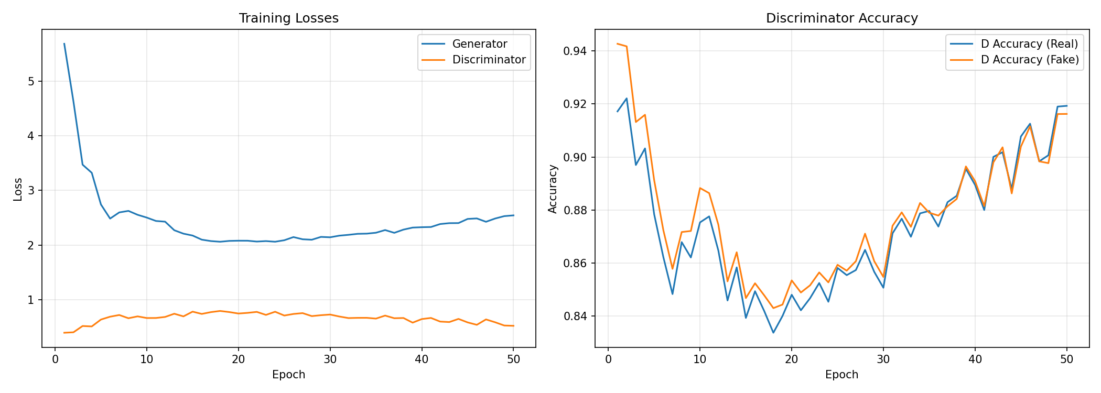
Fix #9 (Final): d_steps=5 — The Real Fix
What I changed
Set d_steps=5 (train D five times per G step)
Following SNGAN paper exactly (Miyato et al., 2018)
Fixed spectral norm initialization
Why it worked
D was undertrained → gave G poor gradients
5:1 ratio lets D develop a strong signal
G then gets meaningful gradient to follow
Final best config
SNGAN ResNet + Hinge loss
SN only (no R1, no GP, no decay)
Adam(β₁=0.0, β₂=0.9), lr=2e-4
d_steps=5, EMA decay=0.999
100 epochs, batch size 64
Final run — training curves:

Slide 7
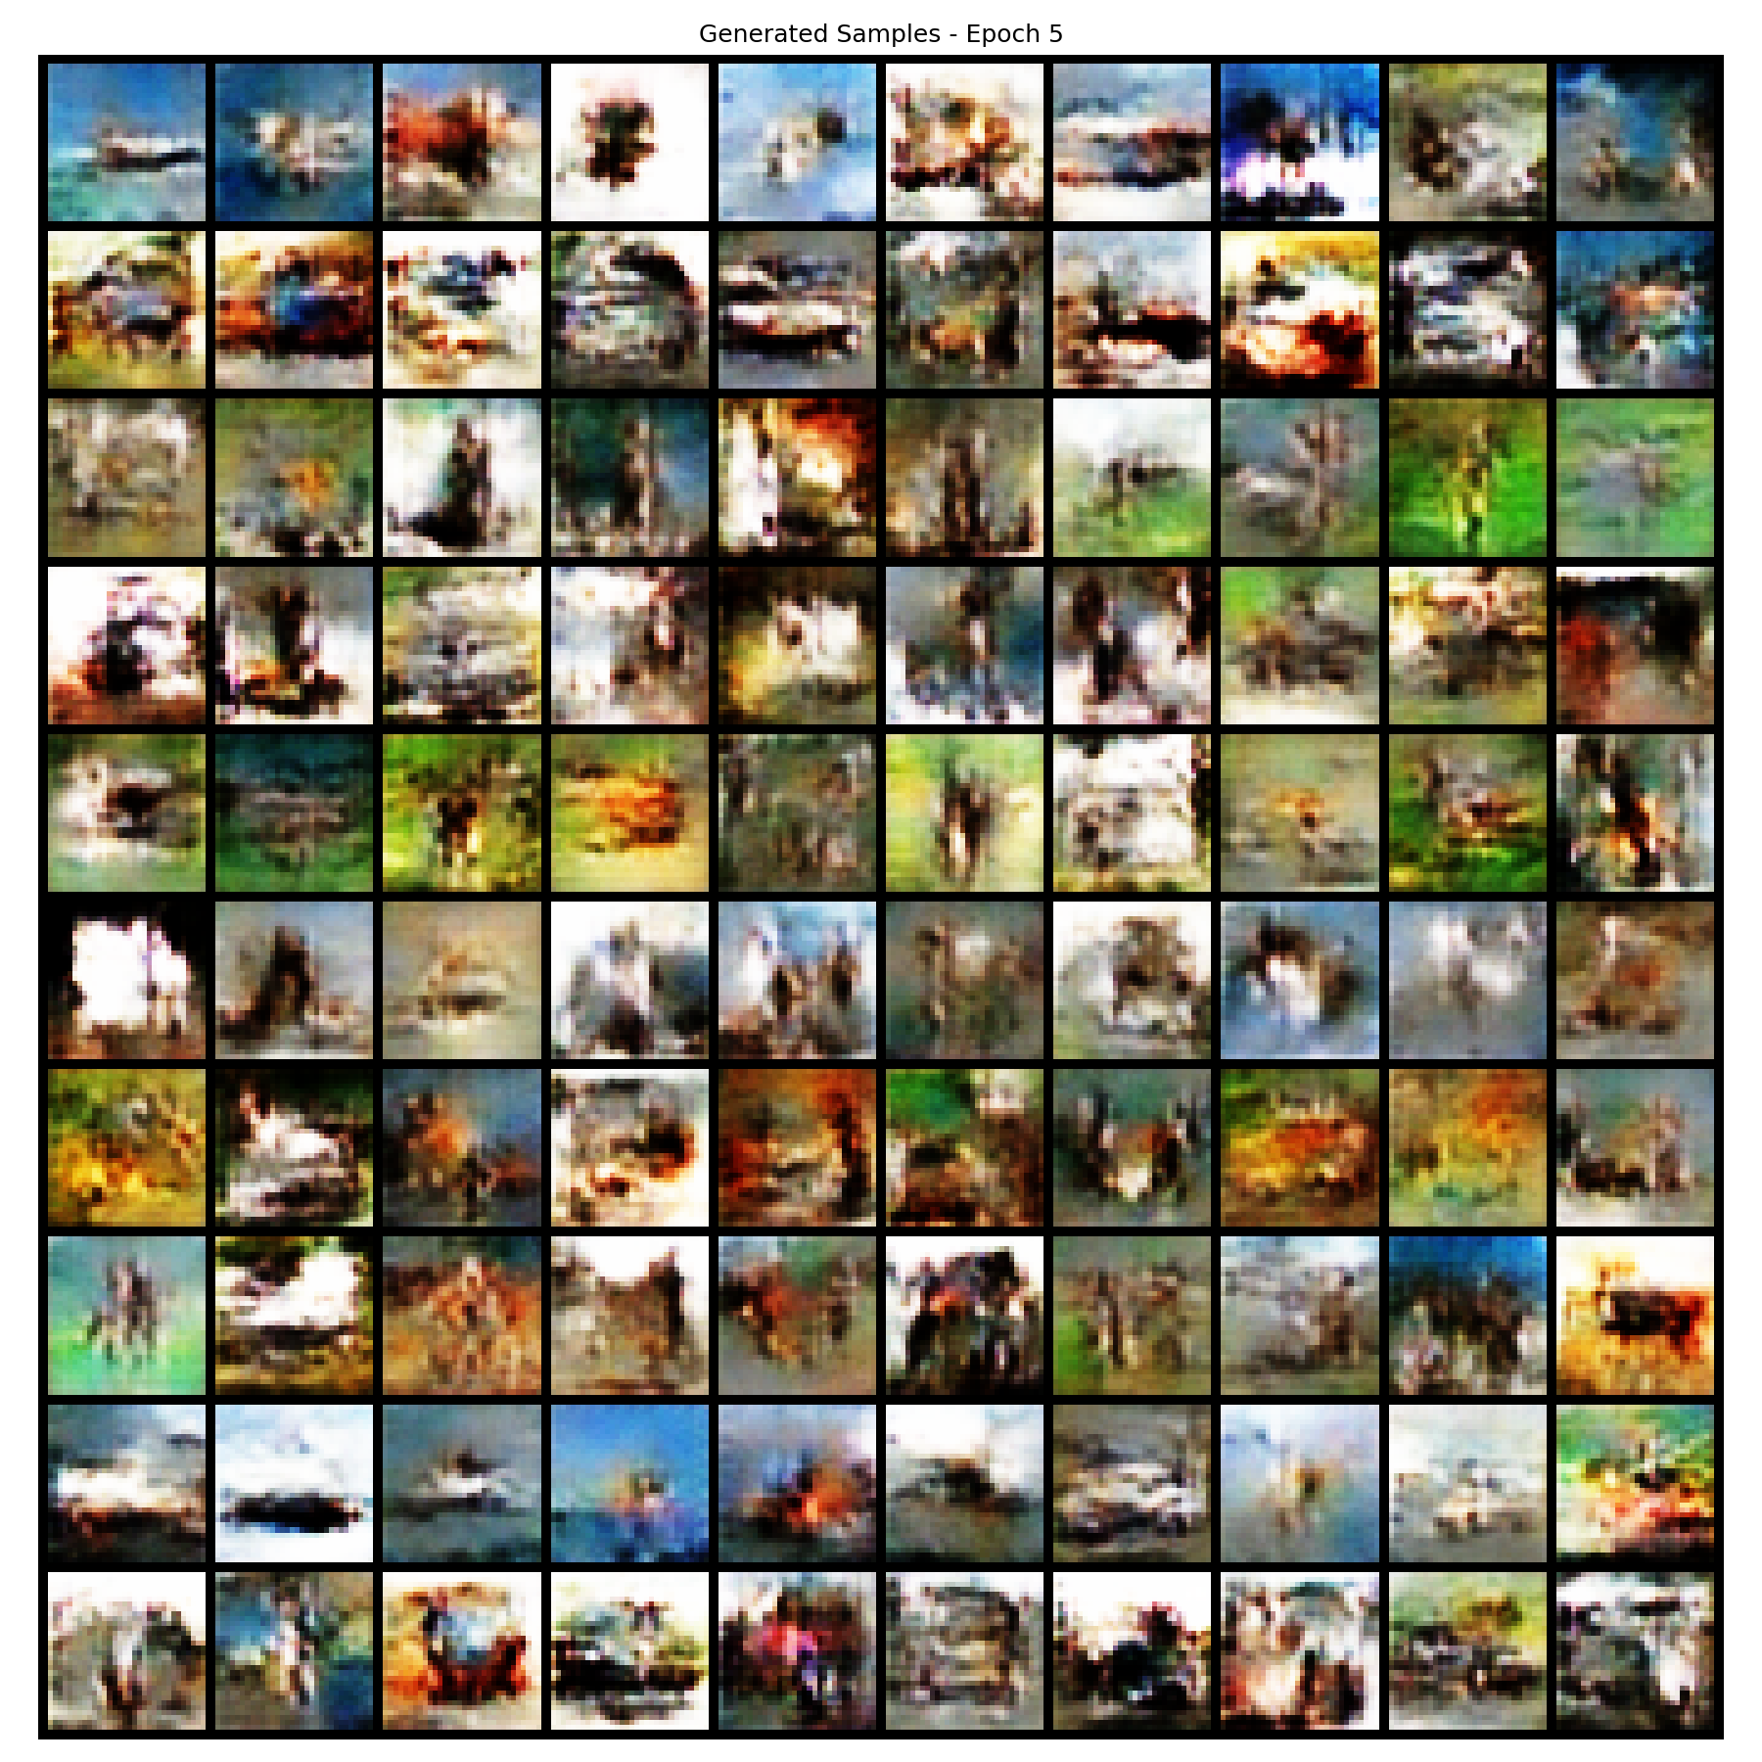
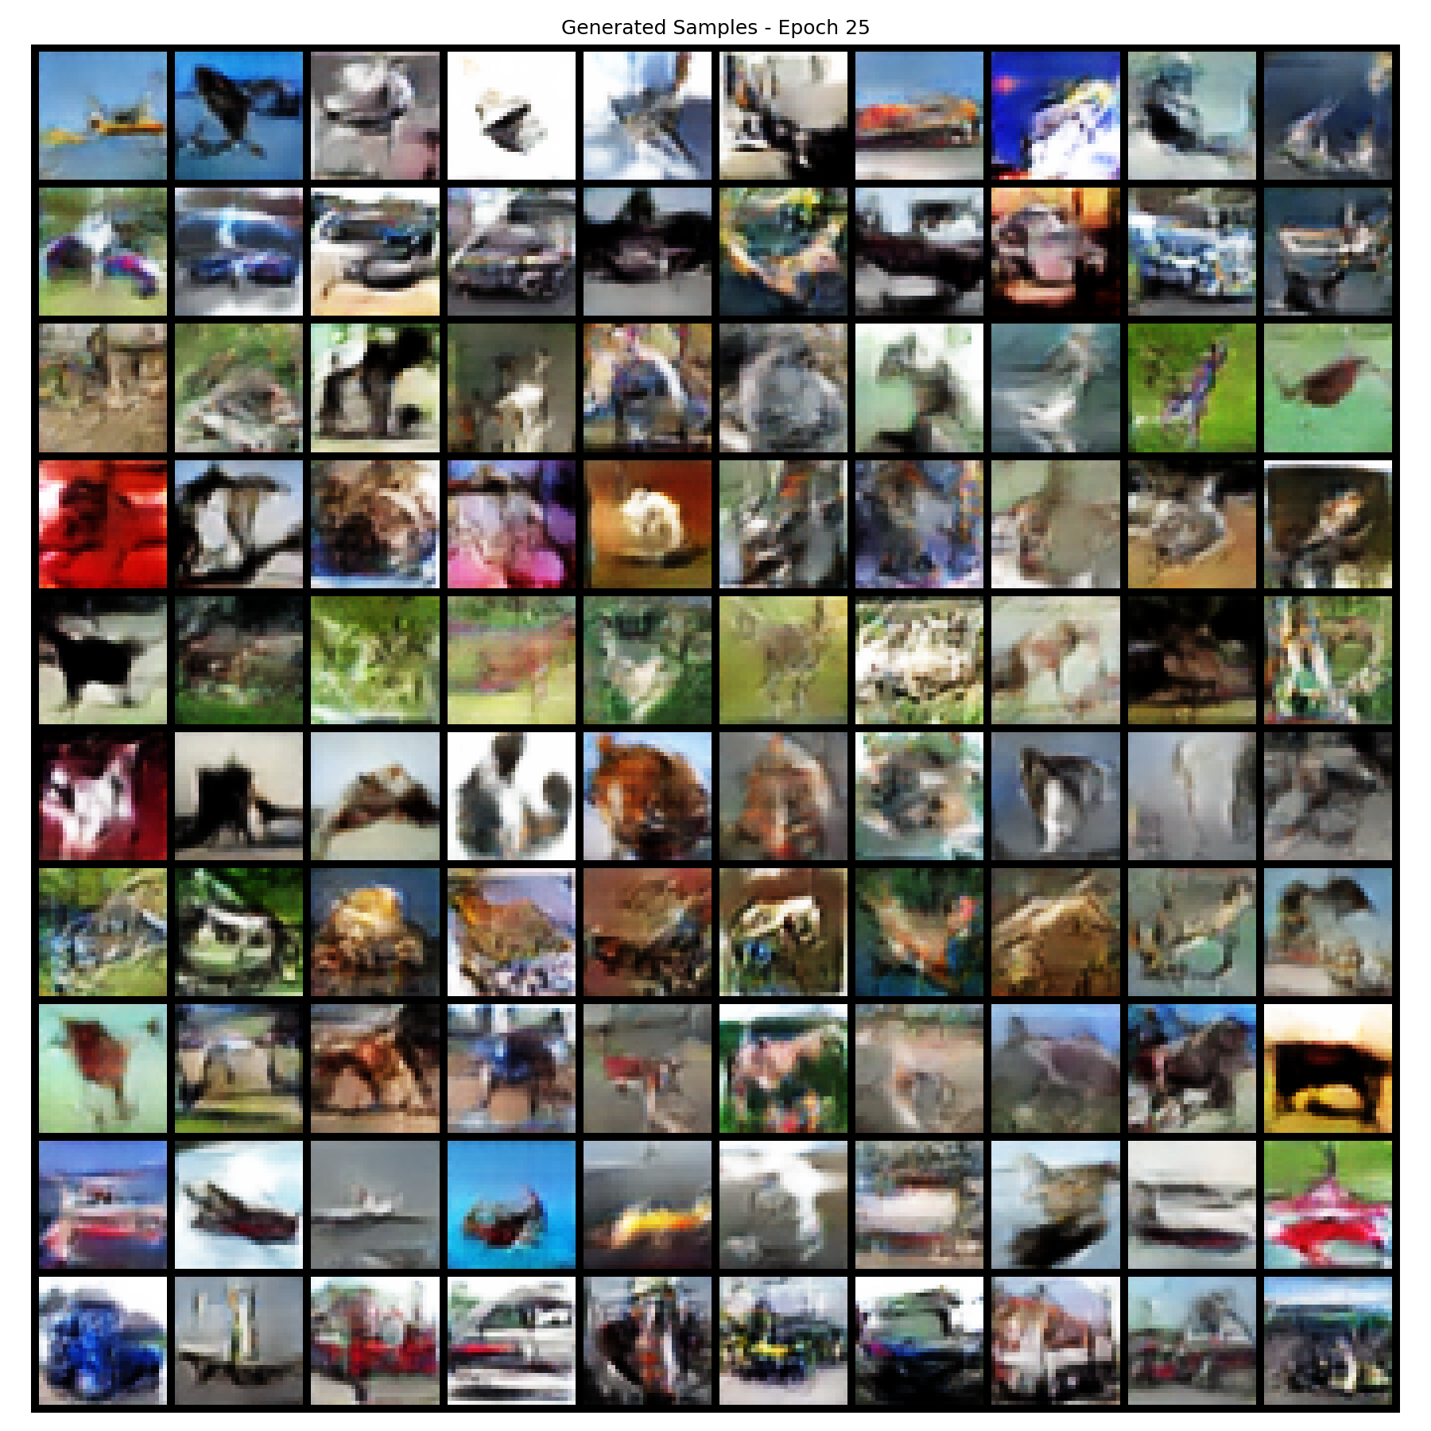
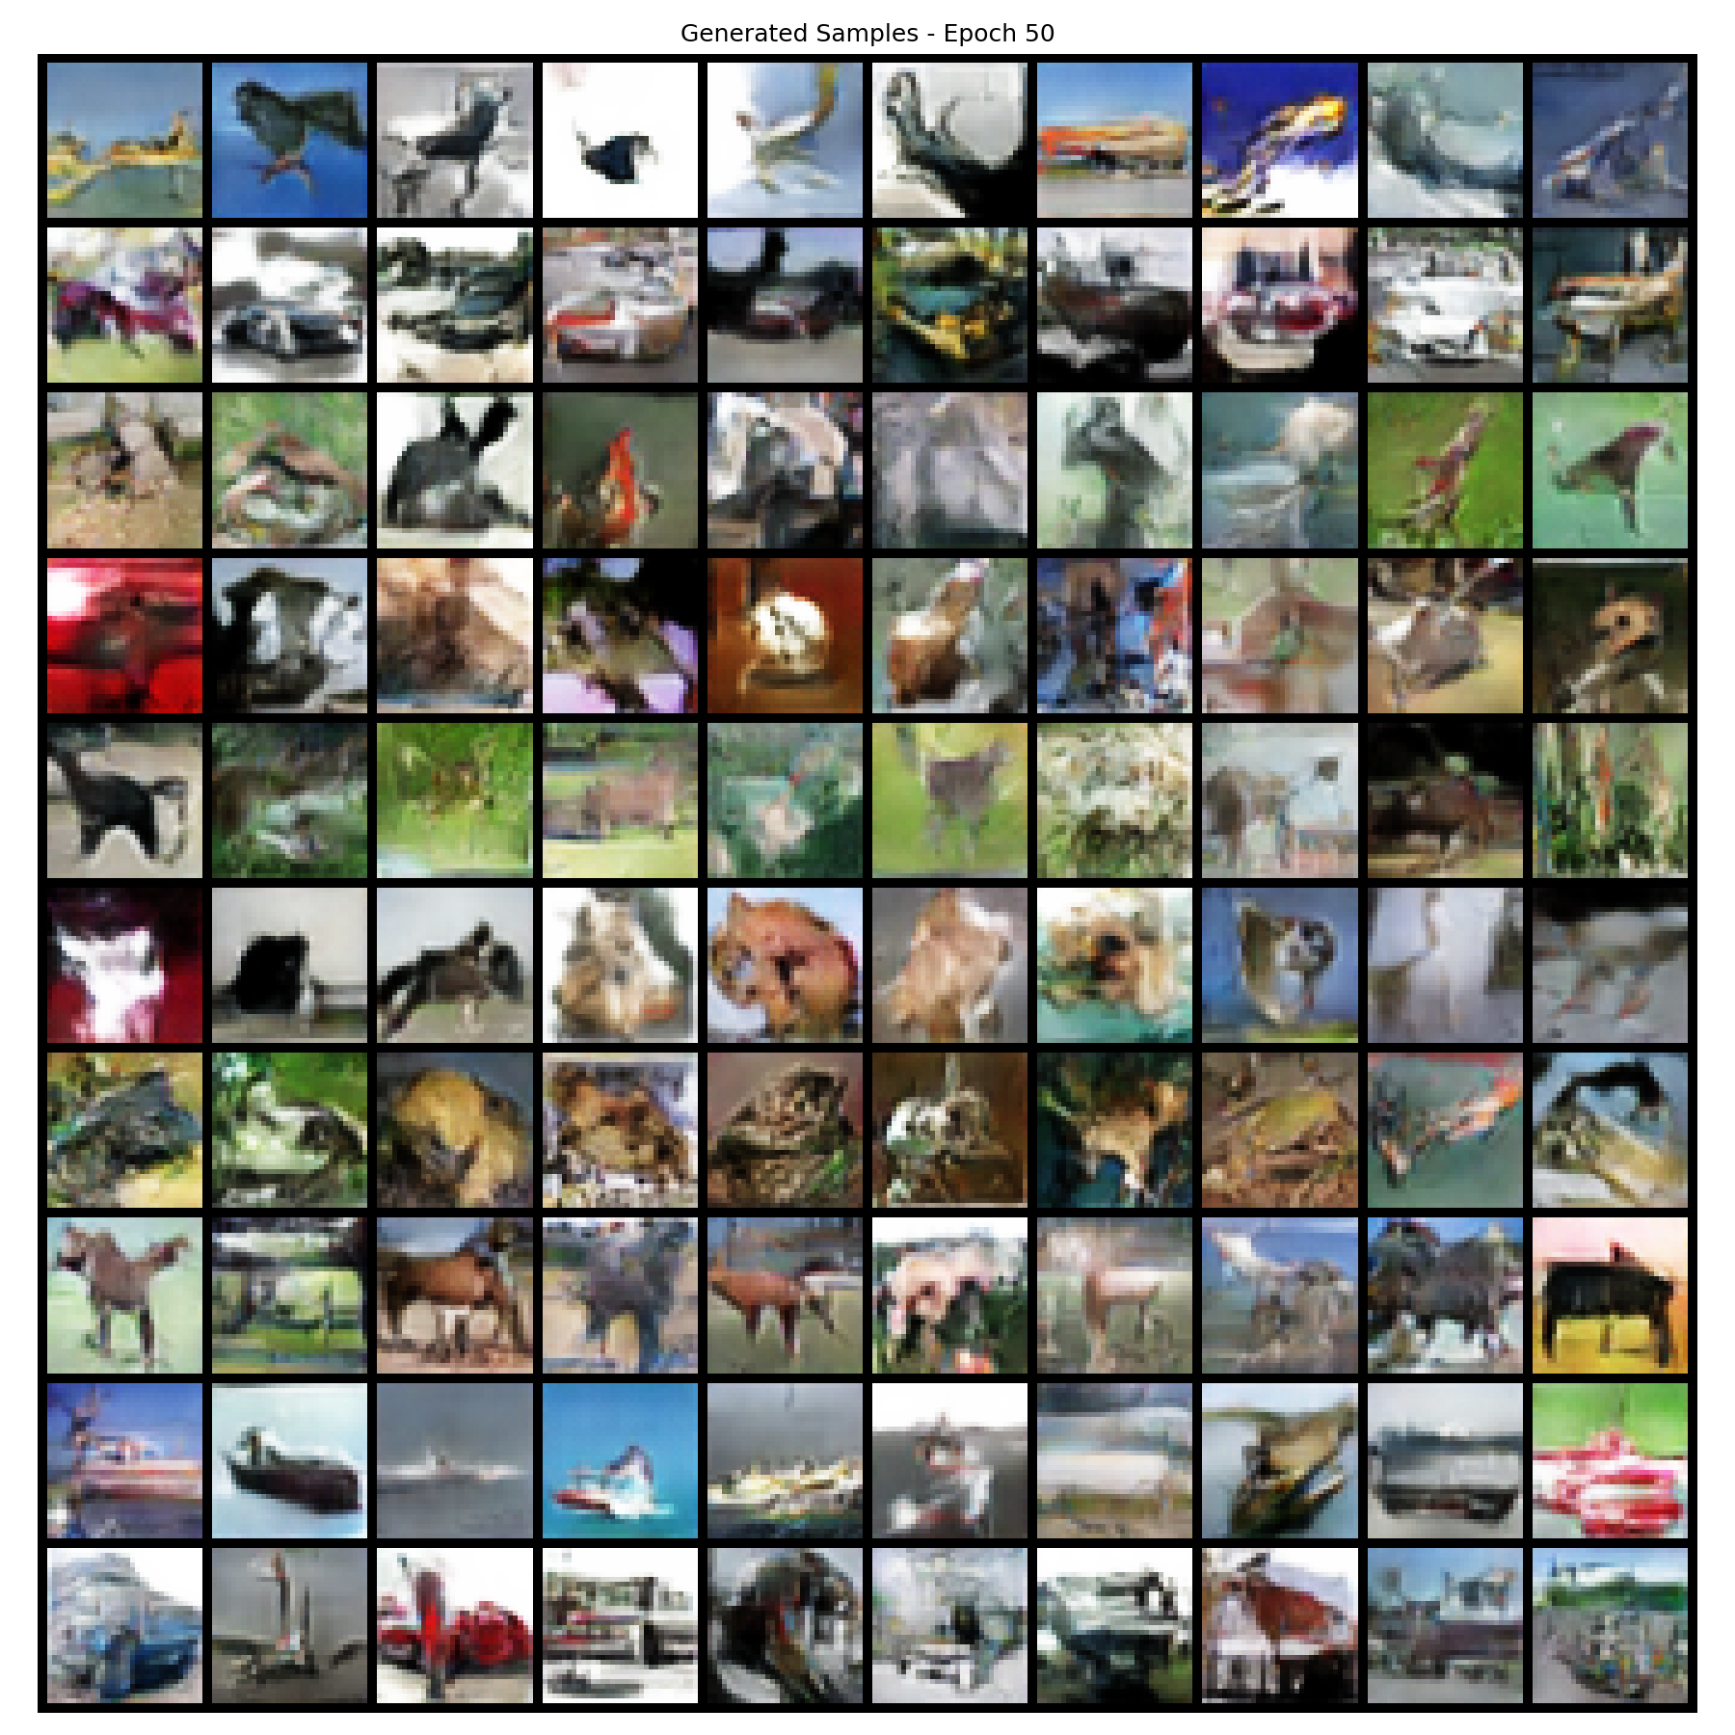
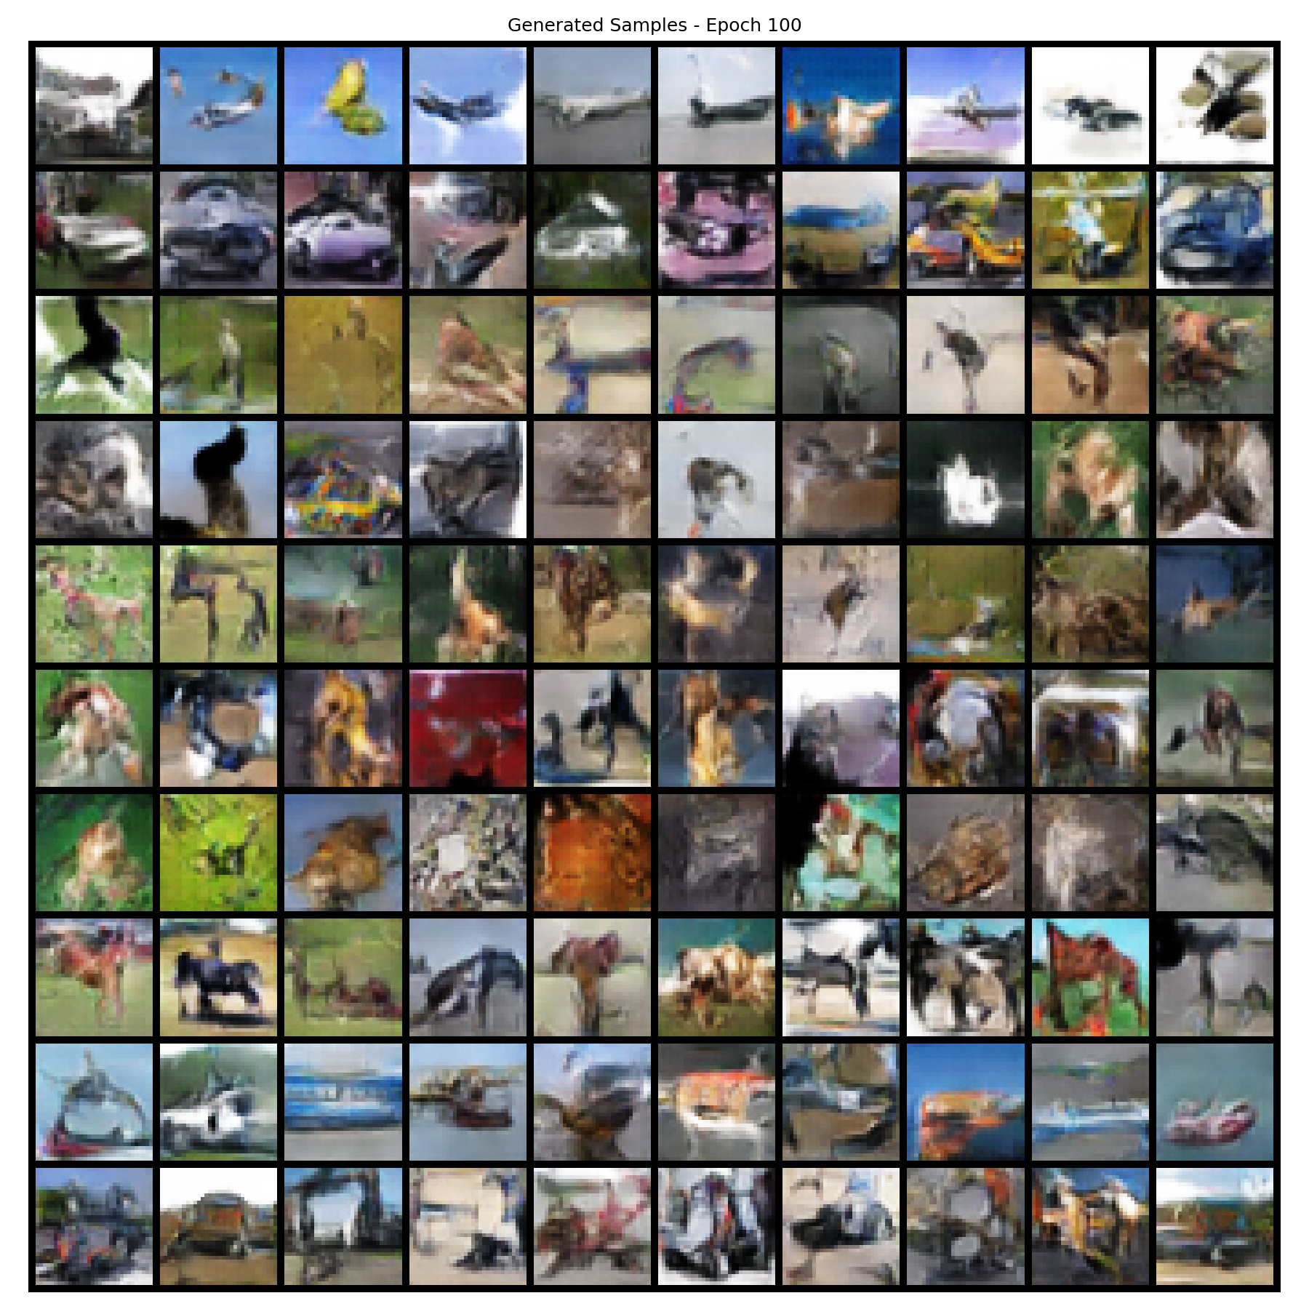
Final Run: Sample Progression Over Training
Epoch 5
Epoch 25
Epoch 50
Epoch 100
Each grid: 10 rows (one per CIFAR-10 class) × 10 samples per class

Slide 8
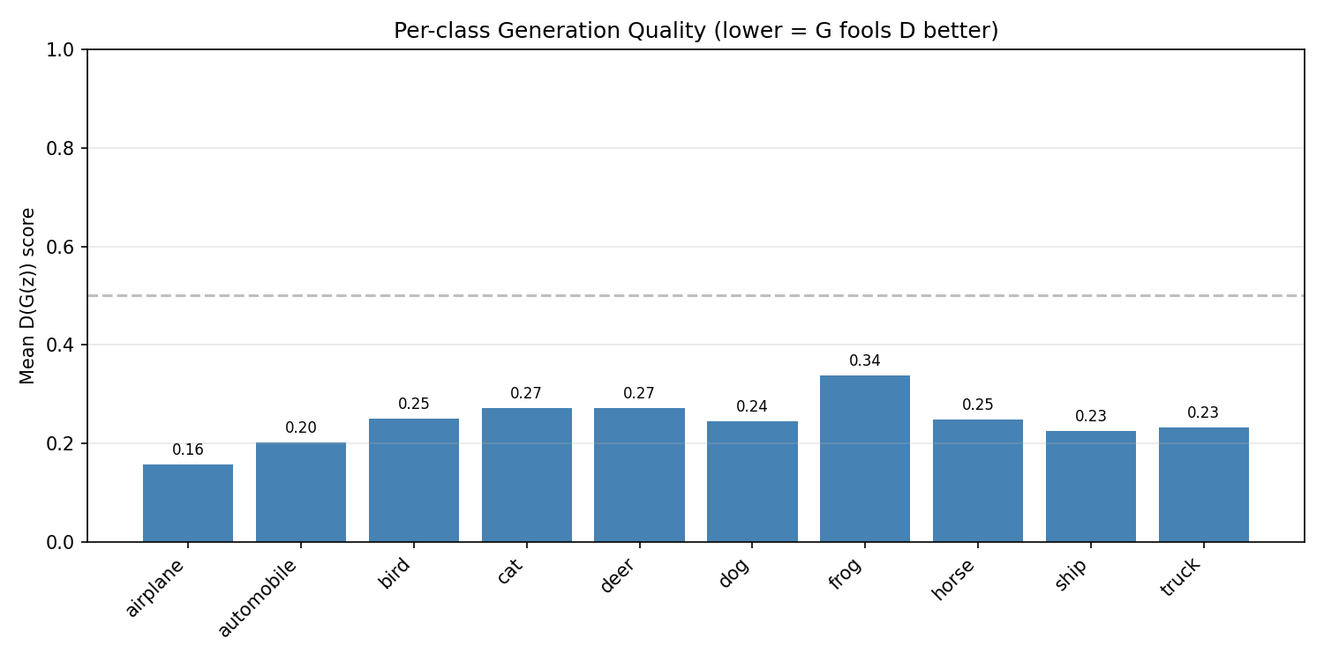
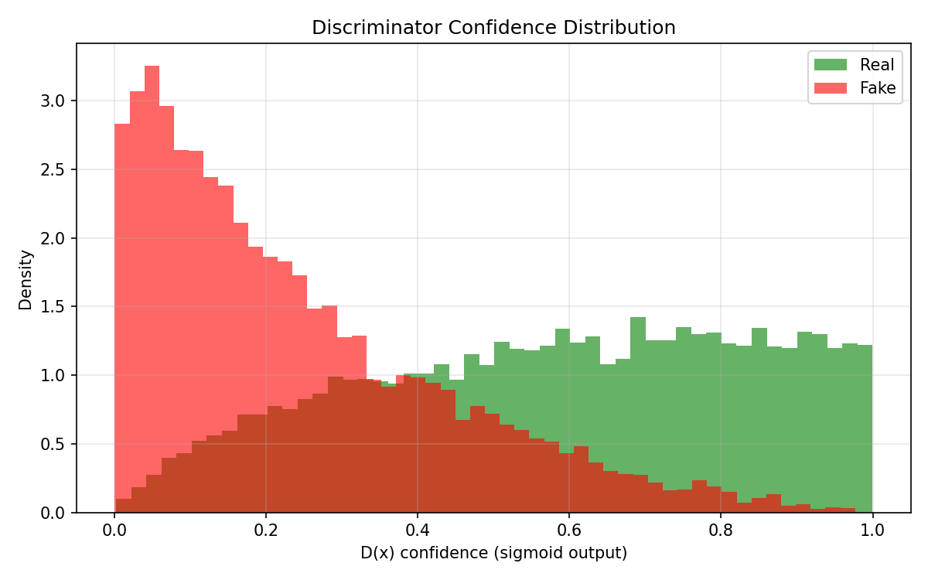
Final Results: Quantitative Evaluation
Discriminator Evaluation
Real image accuracy: 62.45%
Fake image accuracy: 87.64%
Overall accuracy: 75.05%
Training Metrics (100 epochs)
G loss: 5.69 → 2.54 (55% reduction)
D loss: 0.39 → 0.52 (stabilized)
D accuracy (real): ~92%
D accuracy (fake): ~92%
Generation quality per class:
D confidence distribution:
Best class: Frog (0.337) | Worst: Airplane (0.157)

Slide 9
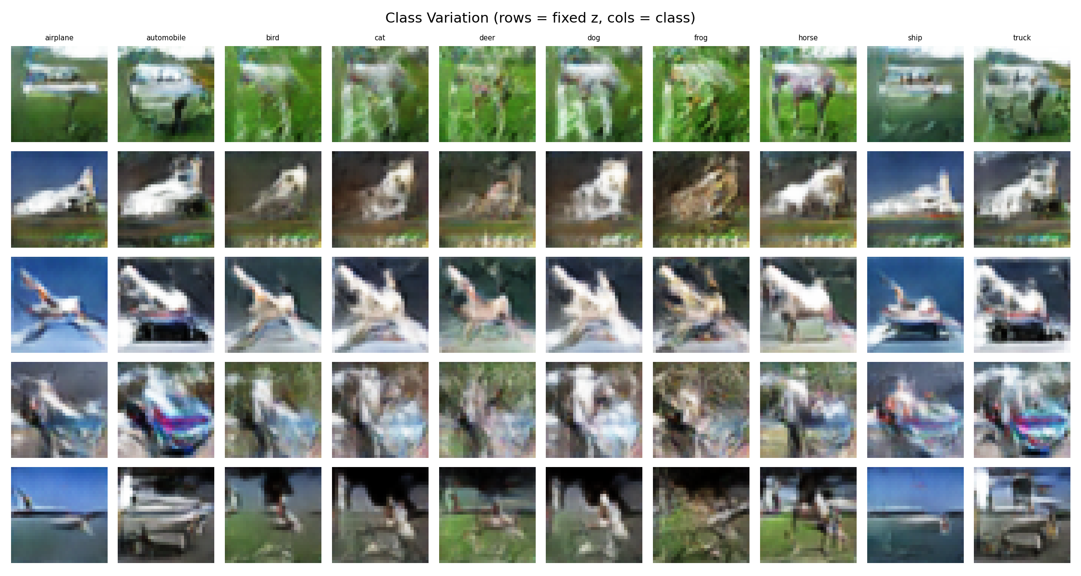
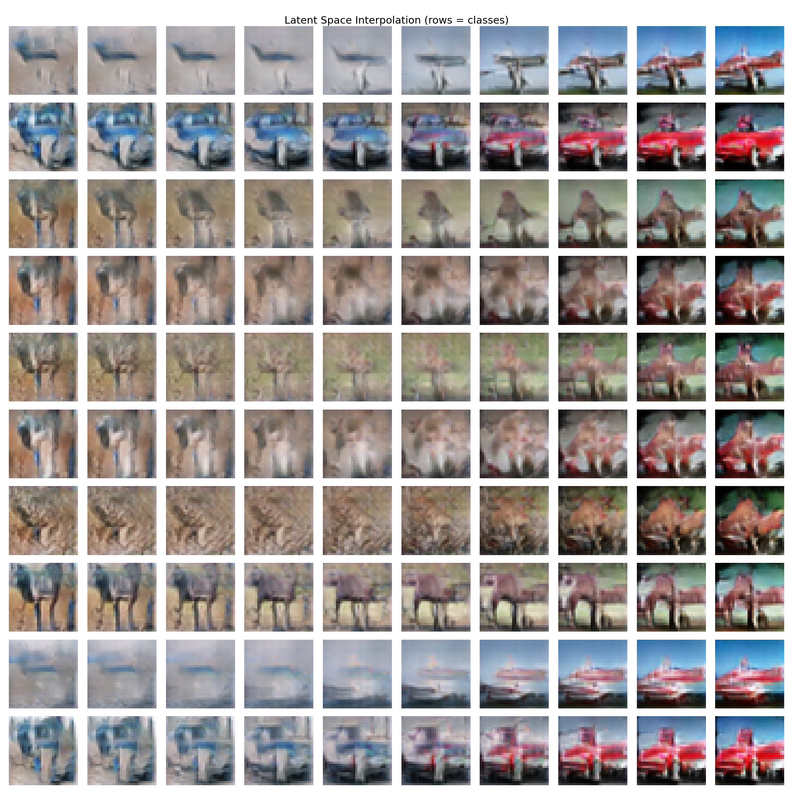
Final Results: Class Variation & Interpolation
Same z, all 10 classes:
Latent space interpolation:
Observation: minimal class differentiation visible — images look similar across classes

Slide 10
Why Results Plateau: Architectural Limitations
1. Weak Class Conditioning (Primary)
Class label injected only at input → dilutes through layers
Fix: Conditional BatchNorm at every layer (SNGAN/BigGAN)
2. No Self-Attention
Only 3×3 convolutions → no global spatial coherence
Fix: Self-attention layer at 16×16 resolution (SAGAN)
3. Shallow Final Stage
Single conv for 16×16→32×32 (most important resolution)
Fix: Full residual block for every resolution
Key insight: all 14 fixes addressed training dynamics,
none addressed model expressiveness.
FID Comparison (CIFAR-10)
Ours (baseline) ~80–120
SNGAN (+ cBN) 21.7
SAGAN (+ attention) 18.3
BigGAN 14.7
StyleGAN2-ADA 2.4
The gap is entirely architectural.
Training is stable and correct —
the generator has hit its capacity ceiling.

Slide 11
Summary of My Contribution
What I did (14 iterative fixes over 1 month)
Started with vanilla cDCGAN baseline → poor quality, no class differentiation
Tried WGAN-GP + spectral norm → D collapsed (incompatible regularization)
Tried TTUR, R1 penalty, LR decay → all caused more instability
Switched to SNGAN ResNet → fixed D collapse
Systematically removed over-regularization (R1, LR decay, weight decay)
Final fix: d_steps=5 (SNGAN paper) → best and stable result
What I found
Training is now stable and correct (no collapse, no divergence)
Visual quality plateaus: blurry blobs, minimal class differentiation
Root cause is architectural, not hyperparameter: missing Conditional BatchNorm and self-attention
Estimated FID ~80–120 vs published SNGAN FID of 21.7

