Slide 1

Hussein jalal
Rola bassam

Slide 2
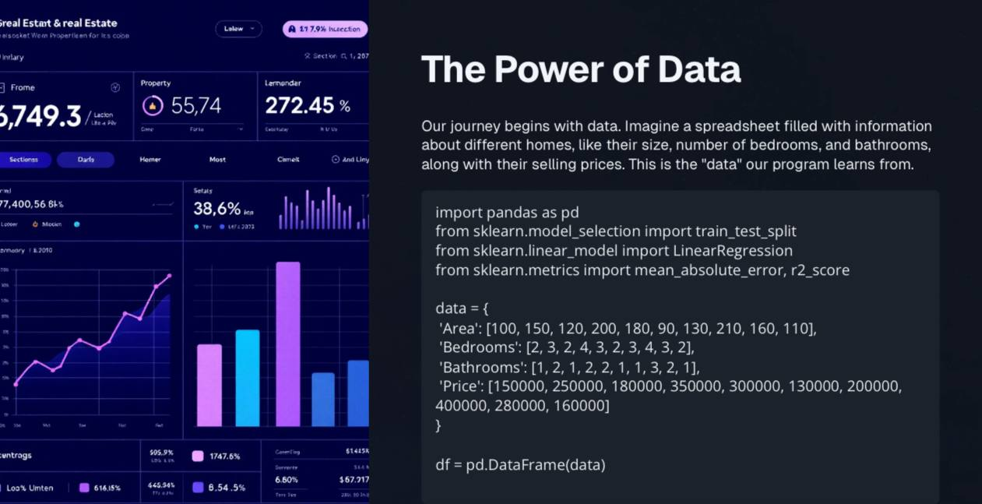

Slide 3


Slide 4


Slide 5
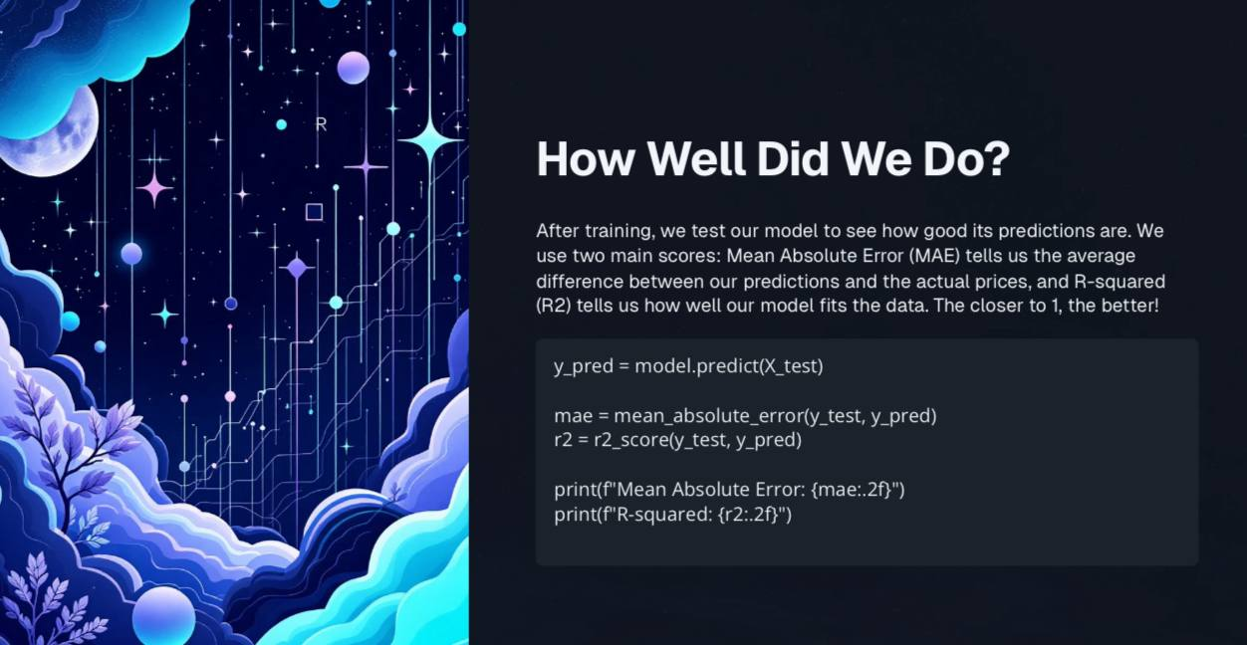

Slide 6
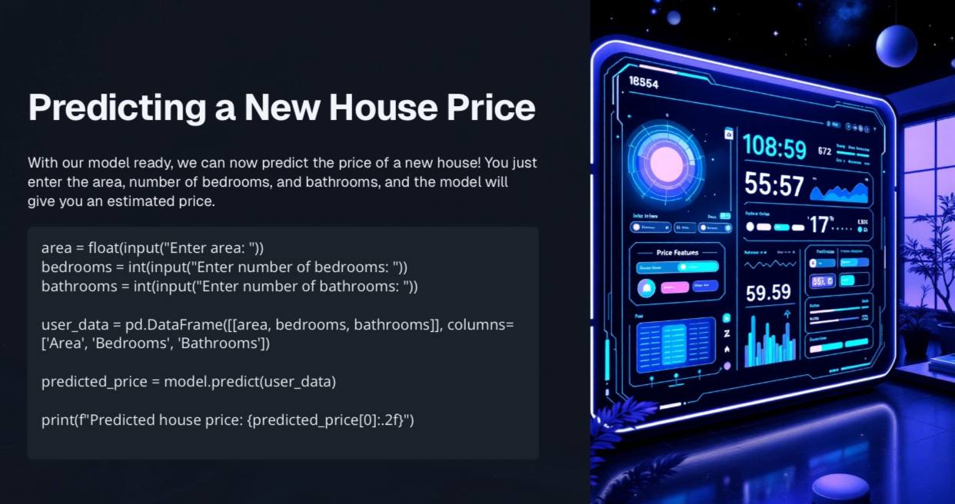

Slide 7
