Slide 1

CUI Abbottabad
Department of Computer Science
Web Technologies
Lecture -11-[CLO-2]
Javascript-Part8

Slide 2
Agenda
Events and event handlers
HTML Events
Basic syntax for event handling
Event attributes calling functions
Common HTML Events
What can JavaScript do
Mouse Events
Key board Events
Form Events
Form Validation before submission
Example programs for data validation

Slide 3
Events and event handler
An event handler is a function that responds to an event.
Assigning an event handler to an event for a DOM node is called registering an event handler.
DOM---Document Object Model

Slide 4
Html Events
An HTML event can be something the browser does, or something a user does.
Here are some examples of HTML events:
An HTML web page has finished loading
An HTML input field was changed
An HTML button was clicked
Often, when events happen, you may want to do something.
JavaScript lets you execute code when events are detected.

Slide 5
Basic syntax for Events handling
HTML allows event handler attributes, with JavaScript code, to be added to HTML elements.
With single quotes:
<some-HTML-element some-event='some JavaScript'>
With double quotes:
<some-HTML-element some-event="some JavaScript">

Slide 6
Events and event handler-example
In the following example, an onclick attribute (with code), is added to a button element:
Example
<button onclick='getElementById("demo").innerHTML=Date()'>The time is?</button>
In the example above, the JavaScript code changes the content of the element with id="demo".

Slide 7
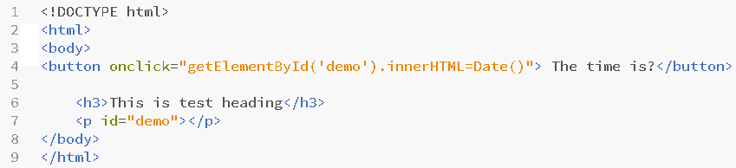
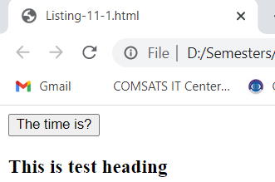
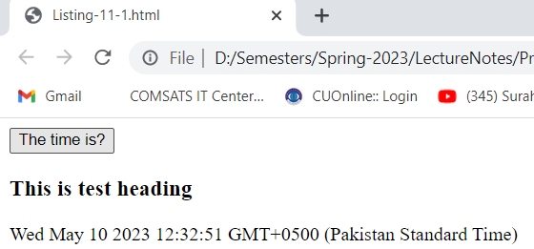
EXAmple-1-Event handling
Listing-11-1.html
When user click the button
Output-11-1.html
Output

Slide 8
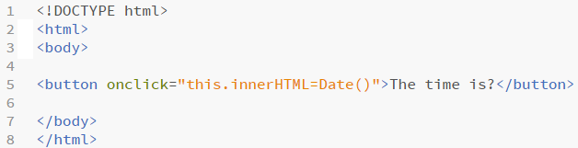
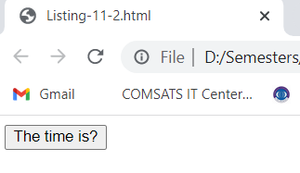
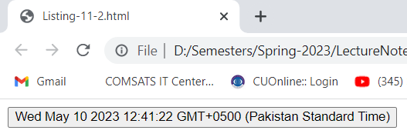
EXAmple-2-Event handling
In the following example-Listing-11-2.html, the code changes the content of its own element (using this.innerHTML):
Listing-11-2.html
Output
Output-11-2.html

Slide 9
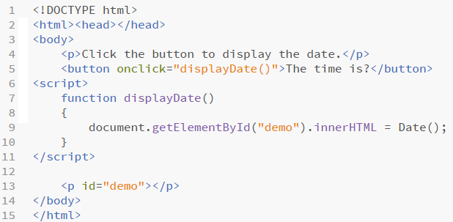
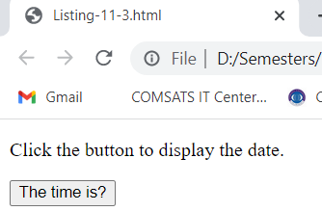
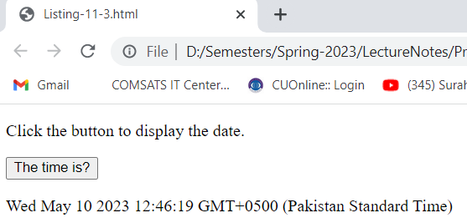
User defined function/s for event handling
JavaScript code is often several lines long. It is more common to see event attributes calling functions:
Output-Listing-11-3.html

Slide 10
Common HTML Events
Table-11.1
Event | Description | Event
onchange | An HTML element has been changed | onchange
onclick | The user clicks an HTML element | Onclick
onmouseover | The user moves the mouse over an HTML element | Onmouseover
onmouseout | The user moves the mouse away from an HTML element | Onmouseout
onkeydown | The user pushes a keyboard key | Onkeydown
onload | The browser has finished loading the page | Onload

Slide 11
What can JavaScript Do?
Event handlers can be used to handle, and verify, user input, user actions, and browser actions:
Things that should be done every time a page loads
Things that should be done when the page is closed
Action that should be performed when a user clicks a button
Content that should be verified when a user inputs data
And much more ...

Slide 12
JavaScript and event handling
Many different methods can be used to let JavaScript work with events:
HTML event attributes can execute JavaScript code directly
HTML event attributes can call JavaScript functions
You can assign your own event handler functions to HTML elements
You can prevent events from being sent or being handled
And much more ...

Slide 13
Mouse Events
Table-11.2
Event | Description | DOM
onclick | The event occurs when the user clicks on an element | 2
oncontextmenu | The event occurs when the user right-clicks on an element to open a context menu | 3
ondblclick | The event occurs when the user double-clicks on an element | 2
onmousedown | The event occurs when the user presses a mouse button over an element | 2
onmouseenter | The event occurs when the pointer is moved onto an element | 2
onmouseleave | The event occurs when the pointer is moved out of an element | 2

Slide 14
key Events
Table-11.3
Event | Description
onkeydown | The event occurs when the user is pressing a key
onkeypress | The event occurs when the user presses a key
onkeyup | The event occurs when the user releases a key

Slide 15
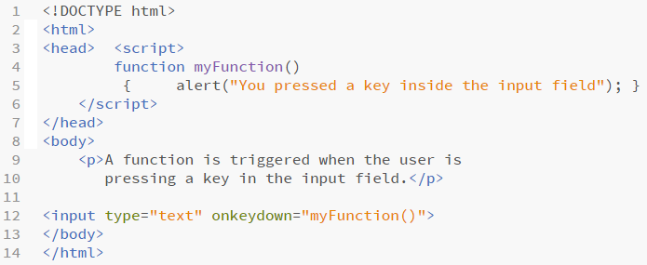
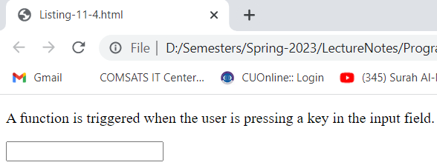
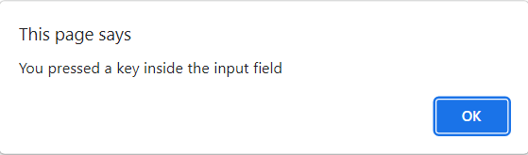
Onkeydown() event
Listing-11-4.html
Output-11.4
As user presses down any key in text input field
COMSATS University Islamabad, Abbottabad Campus

Slide 16
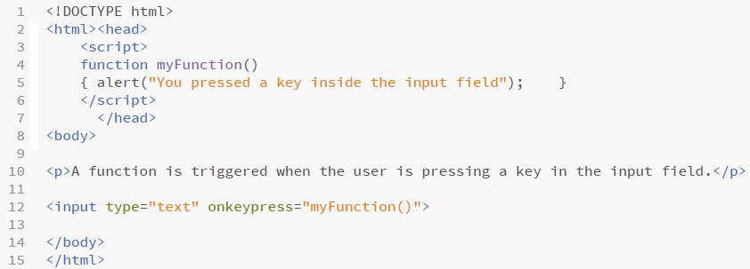
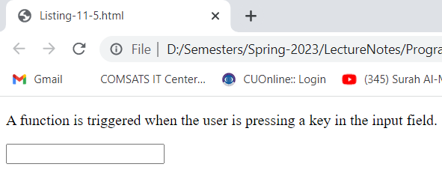
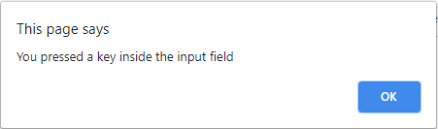
Onkeypress() event
Listing-11.5
As user presses any key in text input field
Output-11-5

Slide 17
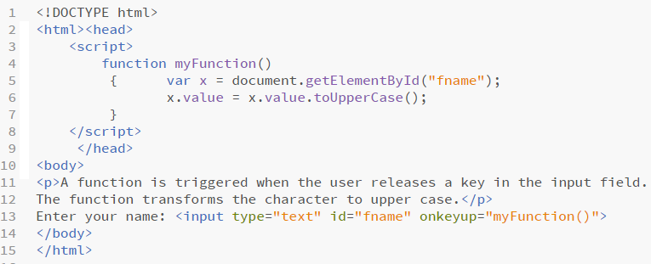
Onkeyup() event
Listing-11-6.html

Slide 18
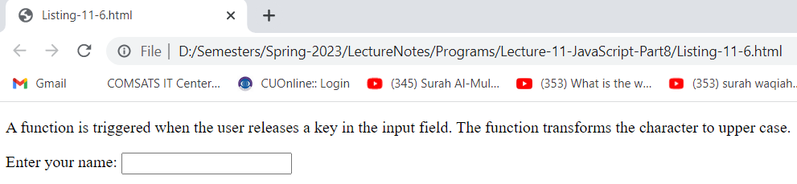
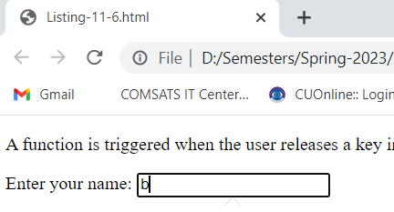
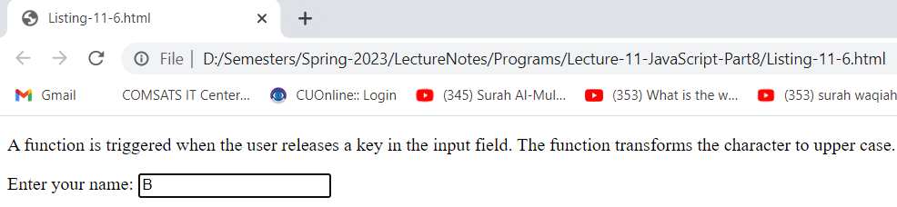
Onkeyup() event
Output-11-6.html
COMSATS University Islamabad, Abbottabad Campus

Slide 19
Form Events
Table-11.4
Event | Description
onblur | The event occurs when an element loses focus
onchange | The event occurs when the content of a form element, the selection, or the checked state have changed (for <input>, <keygen>, <select>, and <textarea>)
onfocus | The event occurs when an element gets focus
onfocusin | The event occurs when an element is about to get focus
onfocusout | The event occurs when an element is about to lose focus
oninput | The event occurs when an element gets user input
oninvalid | The event occurs when an element is invalid

Slide 20
Form Events
Table-11.4
Event | Description
Onreset | The event occurs when a form is reset
Onsearch | The event occurs when the user writes something in a search field (for <input="search">)
onselect | The event occurs after the user selects some text (for <input> and <textarea>)
onsubmit | The event occurs when a form is submitted

Slide 21
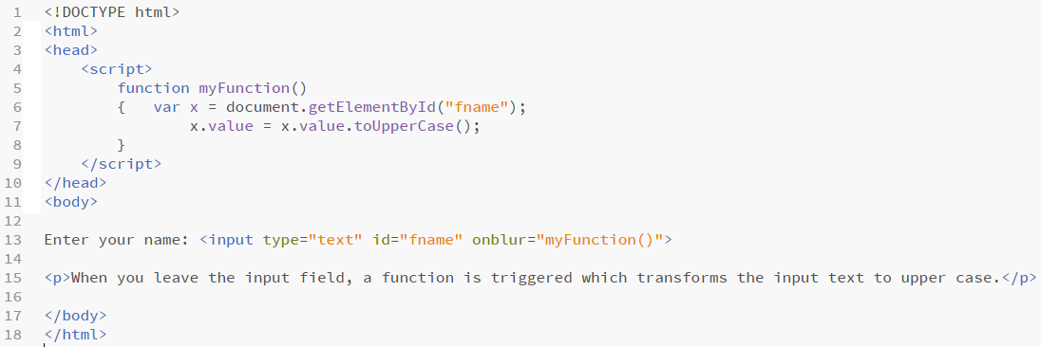
onblur Event
Listing-11-7.html

Slide 22
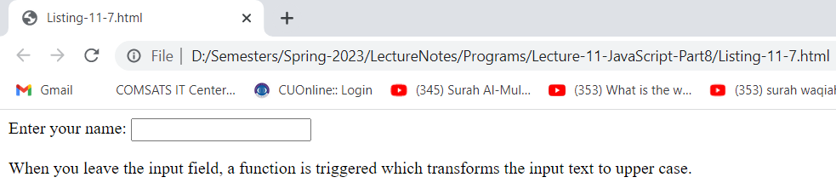
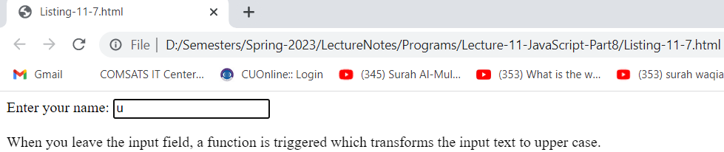
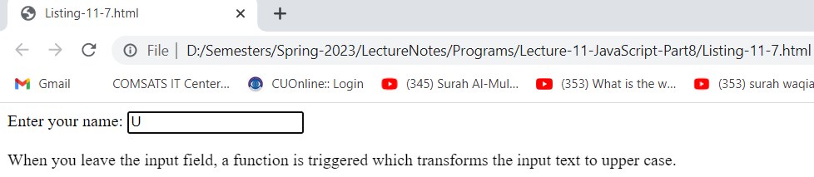
onblur Event
Output-11.7

Slide 23
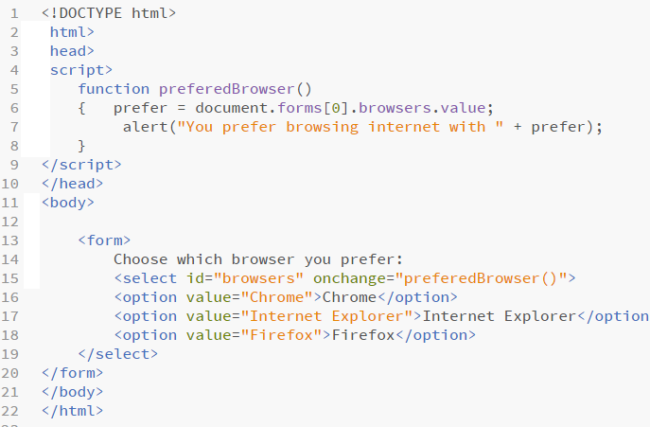
onchange Event
Listing-11-8.html

Slide 24
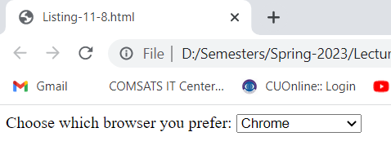
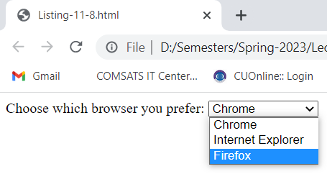
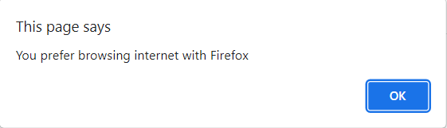
onchange Event
Output-11-8.html

Slide 25
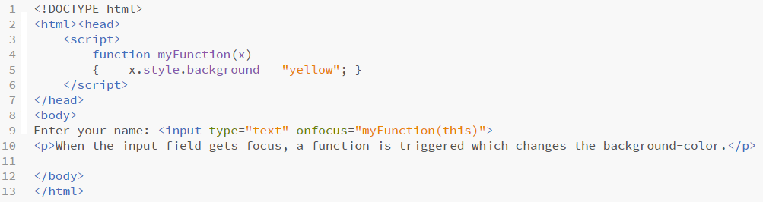
onfocus Event-example-1
Listing-11-9.html

Slide 26
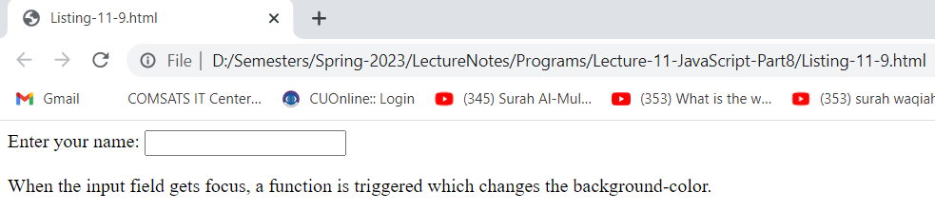
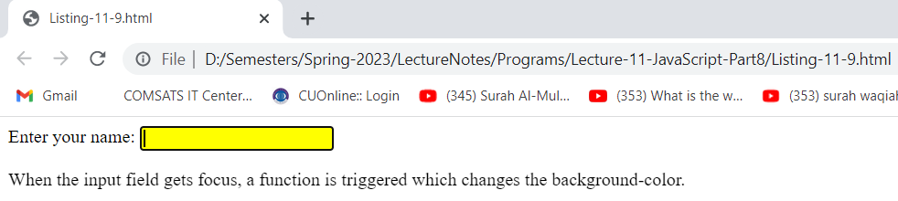
onfocus Event-example-1
Output-11-9.html

Slide 27
Onfocus/onblur Event-example-2
The focus and blur events can be useful when dealing with form elements that allow user input.
The focus event fires when an element gains the focus (i.e., when the user clicks a form field or uses the Tab key to move between form elements)
blur fires when an element loses the focus, which occurs when another control gains the focus.
The listing-11-10, 11-11 and 11-12 demonstrates these events.
Listing-11-10
HTML5 document which contains a form followed by a paragraph in which we’ll display help text for the input element that currently has the focus.
Listing-11-11
It is the cascading style sheet for our web page(listing 11-10)

Slide 28
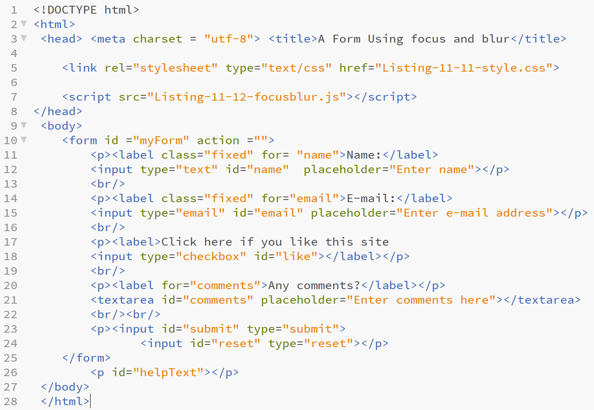
onfocus /onblur Event-example-2-html file
Listing-11-10.html
COMSATS University Islamabad, Abbottabad Campus

Slide 29
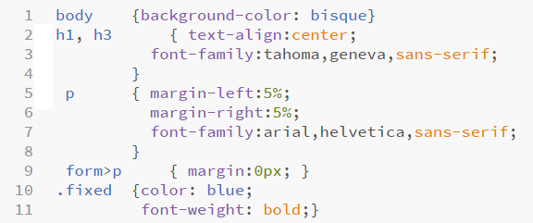
onfocus /onblur Event-example-2-style file
Listing-11-11-style.css

Slide 30
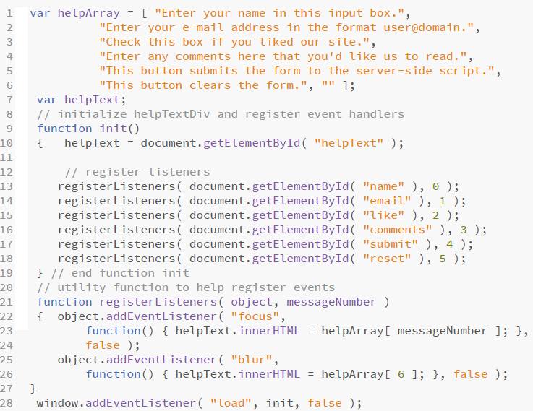
onfocus /onblur Event-example-2-javascript file
Listing-11-12-
focusblur.js

Slide 31
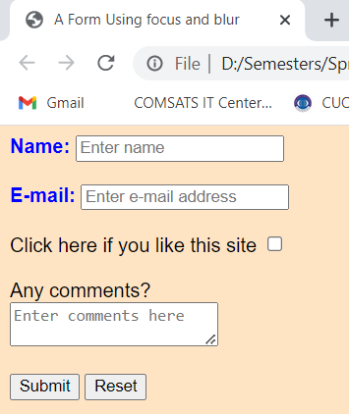
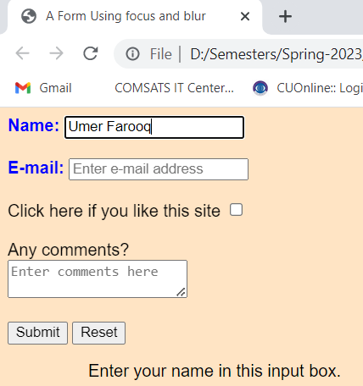
Output onfocus /onblur Event-example-2
As the user focus on name field, it display the helptext at bottom of web page
Output-Listing-11-10.html

Slide 32
onfocus /onblur Event-example-2
Listing-11-12----------focusblur.js
The javaScript code registers the event handlers for the window’s load event (line 30) and for the form elements’ focus and blur events.
Script-Level Variables
The helpArray (lines 1–6) contains the messages that are displayed when each input element receives the focus.
Variable helpText (line 7) will refer to the paragraph in which the help text will be displayed.
Function init
When the window’s load event occurs, function init (lines 10–20) executes.
Line 11 gets the helpText paragraph element from the document.
Then, lines 14–19 call the function registerListeners (lines 23–29) once for each element in the form.
The first argument in each call is the element for which we’ll register the focus and blur events, and
the second argument a helpArray index that indicates which message to display for the element.

Slide 33
Output onfocus /onblur Event-example-2
Function registerListeners—Using Anonymous functions
Function registerListeners:
registers the focus and blur events for the object it receives as its first argument.
In each case, we define an anonymous function to handle the event. An anonymous function is defined with no name—it’s created in nearly the same way as any other function, but with no identifier after the keyword function. This notation is useful when creating a function for the sole purpose of assigning it to an event handler. We never call the function ourselves, so we don’t need to give it a name, and it’s more concise to create the function and register it as an event handler at the same time. For example, line 25
function() { helpText.innerHTML = helpArray[ messageNumber ]; }
defines an anonymous function that sets the helpText paragraph’s innerHTML property to the string in helpArray at index messageNumber.
For the blur event handler, line 28 defines an anonymous function that sets the helpText paragraph’s innerHTML property to the empty string in helpArray[6].

Slide 34
onfocus /onblur Event-example-3
Two more events for processing forms are submit (which you’ve seen in earlier chapters) and reset.
These events fire when a form is submitted or reset, respectively
Listing-11-14-focusblur_modified.js enhances the one in Listing-11-12.js. The HTML5 document is identical, only we put Listing-11-14-focusblur_modified.js javascript file in line-7 listing-11-13.
The new JavaScript code(Listing-11-14-focusblur_modified.js ) for this example is in lines 19-31, which register event handlers for the form’s submit and reset events.
Line 21 gets the form element ("myForm"), then lines 22–27 register an anonymous
function for its submit event. The anonymous function executes in response to the user’s

Slide 35
onfocus /onblur Event-example-3
Key Points of Example-3
submitting the form by clicking the Submit button or pressing the Enter key. Line 23
In focusblur_modified.js: introduces the window object’s confirm method. As with alert and prompt, we do not need to prefix the call with window and a dot (.). The confirm dialog asks the users a question, presenting them with an OK button and a Cancel button. If the user clicks OK, confirm returns true; otherwise, confirm returns false

Slide 36
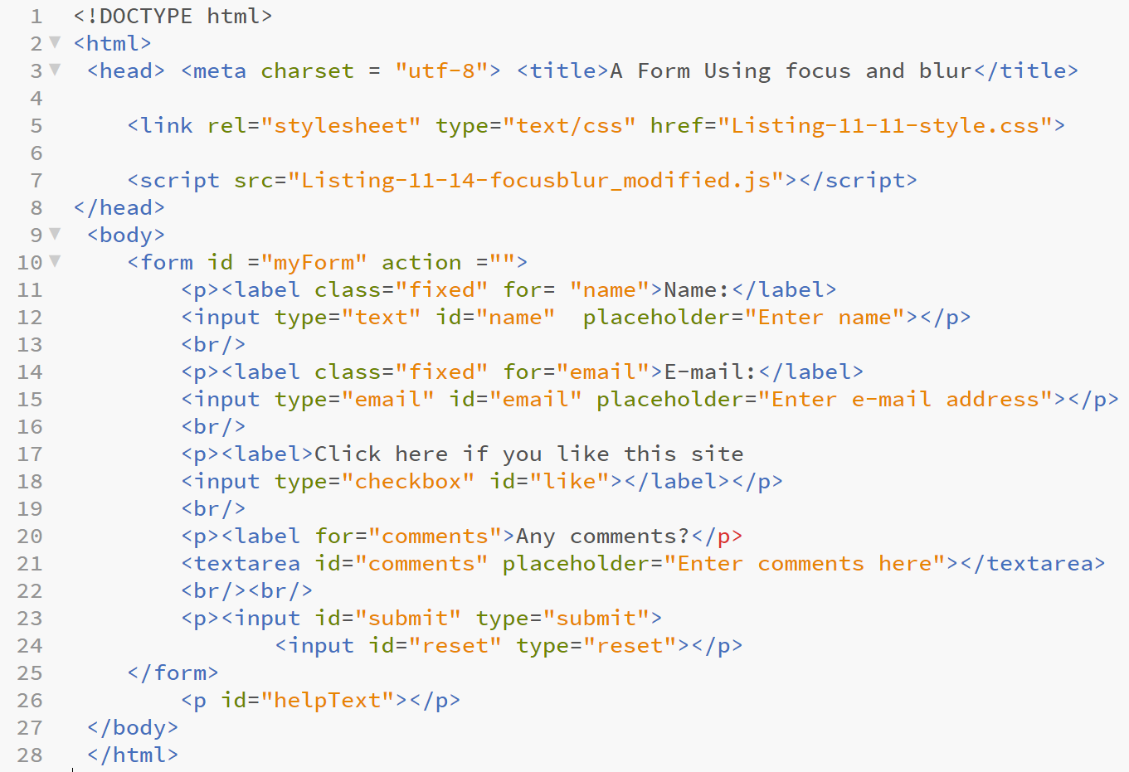
onfocus /onblur Event-example-3 html file
Listing-11-13.html

Slide 37
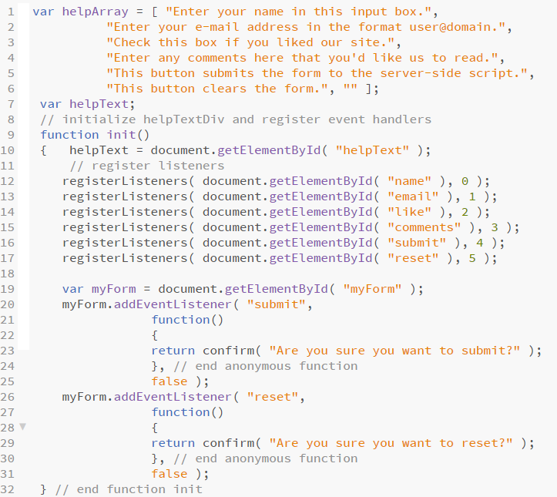
onfocus /onblur Event-example-3 javascript file
Listing-11-14
focusblur_modified.js

Slide 38
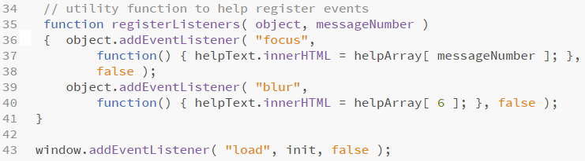
onfocus /onblur Event-example-3
Listing-11-14-focusblur_modified.js

Slide 39
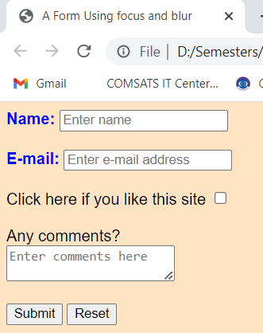
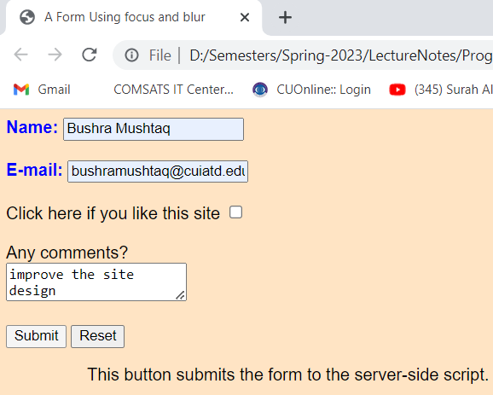
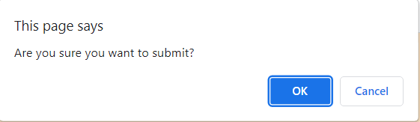
onfocus /onblur Event-example-3 output
As the user focus on submit button, it display the helptext at bottom of web page, also display alert message
Output-listing-11-13

Slide 40
Form validation before submission
Here we are presenting a simple example program in which we validate mobile number on click of submit button before final form submission to another document.
For above task we created three documents:
Listing-11-15-mobilenumberValidation.html
Listing-11-16-mobilenumberValidation.js
Listing-11-17-acceptForm.html
In Listing-11-15-mobilenumberValidation.html there is a form (line#12-19) in this form there is text box(line#14) to input any mobile number in Pakistan.
There is a span element in front of text box to show relevant error message on wrong input when the user click the submit button(line#17)
Note that in form tag(line#12) there is a return function call to valCheck() which will happened onSubmit event occur on submit button, so that before actual form submission to acceptForm.html

Slide 41
Form validation before submission
Note that here we only take informal html document to form submission, in later lectures when we study server side scripting then we submit form to actual server side document.
The valCheck() method is defined in the mobilenumberValidation.js file (Listing-11-16-mobilenumberValidation.js)which is included as external file in the script tag on line#5
There are 5 validation checks in the mobilenumberValidation.js file:
Line#4-6: if user does not enter any value in textbox then the error message displayed “**Please fill the mobile number” in place of right side span element and system will return false so that form cannot be submitted to relevant document

Slide 42
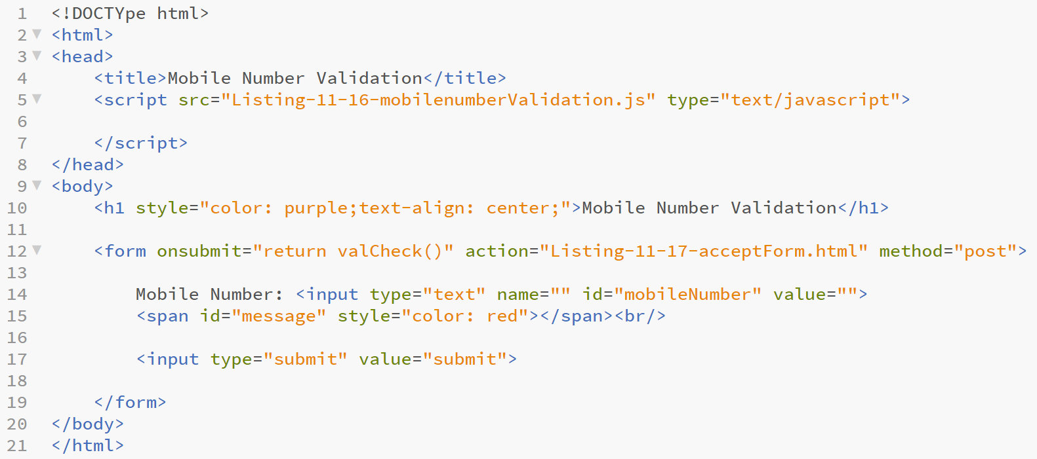
Form validation before submission
Listing-11-15-mobilenumberValidation.html

Slide 43
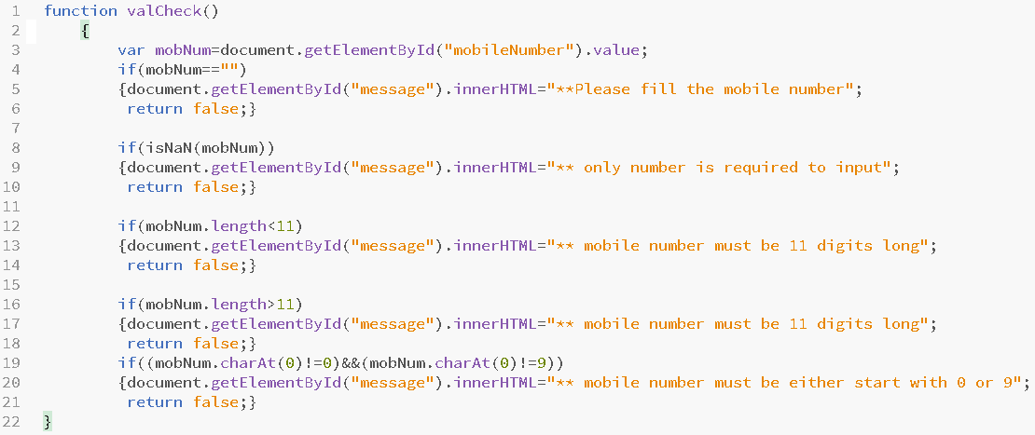
Form validation before submission
Listing-11-16--mobilenumberValidation.js

Slide 44
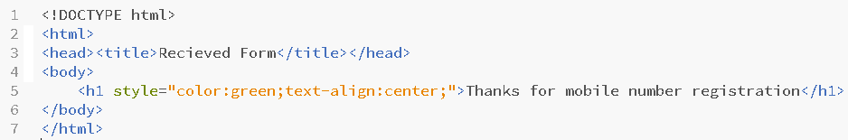
Form validation before submission
Listing-11-17-acceptForm.html

Slide 45
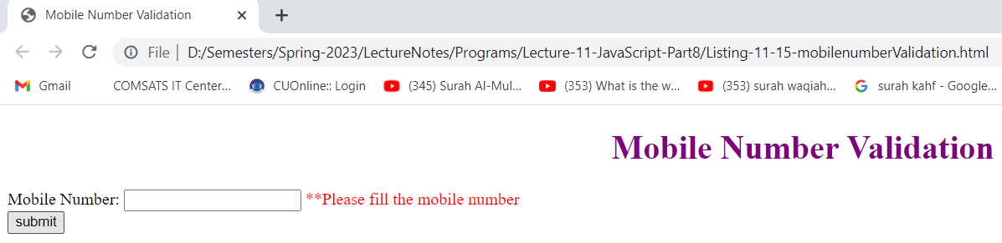
Form validation before submission
When text field is empty then error message displayed at right side on submit button click
Output-Listing-11-15-mobilenumberValidation.html

Slide 46
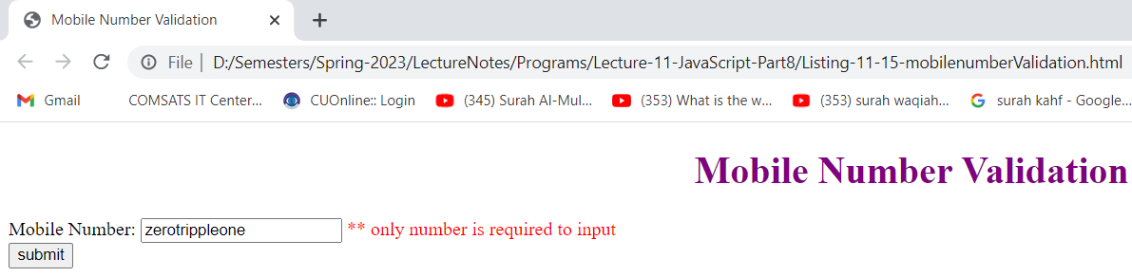
Form validation before submission
When non number value input in text field then error message displayed at right side on submit button click
Output-Listing-11-15-mobilenumberValidation.html

Slide 47
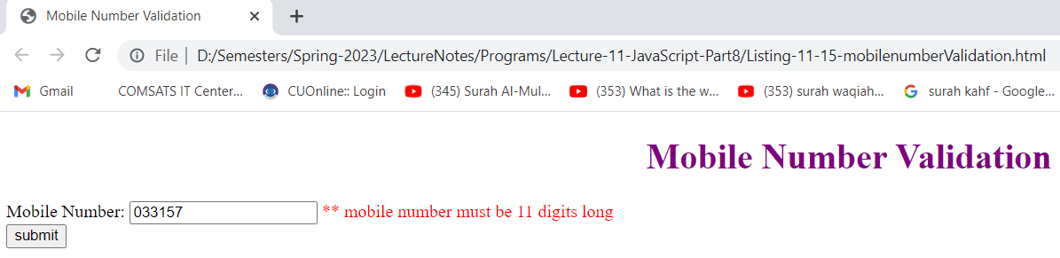
Form validation before submission
When entered number of digits are less than 11 or greater than 11 then error message displayed at right side on submit button click
Output-Listing-11-15-mobilenumberValidation.html

Slide 48
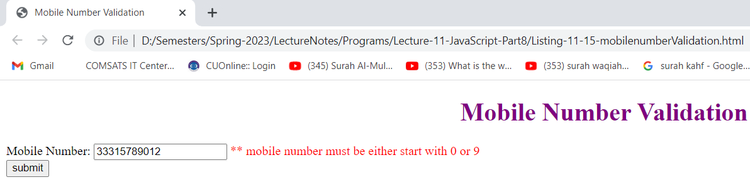
Form validation before submission
When entered mobilenumber does not start with 0 or 9 then error message displayed at right side on submit button click
Output-Listing-11-15-mobilenumberValidation.html

Slide 49
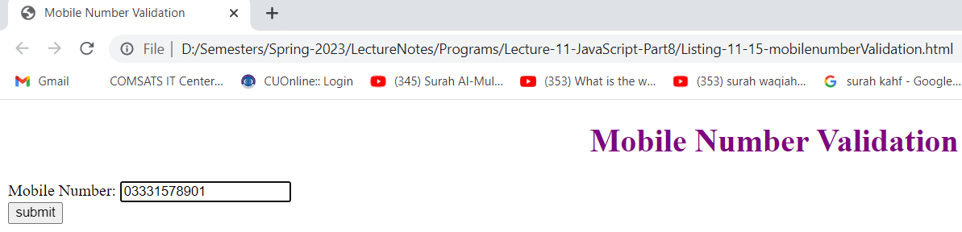
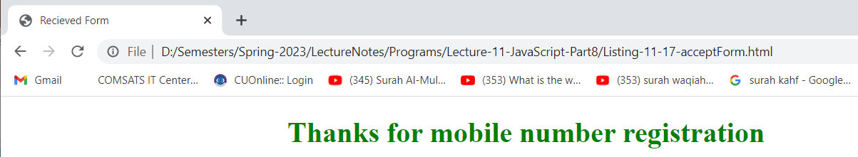
Form validation before submission
When correct number entered then on click of submit button the form submit to target page
Output-Listing-11-15-mobilenumberValidation.html

