Slide 1
嵌入式系统设计
第四讲

Slide 2
无符号整数乘法器

Slide 3
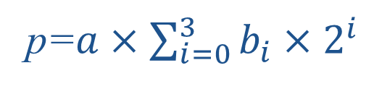
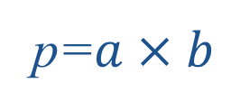
算法原理
p=$a×b$
a ：4 bit 无符号整数
b ：4 bit 无符号整数
p ：8 bit 无符号整数
p=$a×\sum_{i=0}^{3}{b_{i}×2^{i}}$
p=$a×2^{0}×b_{0}+a×2^{1}×b_{1}$+ $a×2^{2}×b_{2}$+ $a×2^{3}×b_{i}$

Slide 4
循环方式
基本单元
p=$a×2^{0}×b_{0}+a×2^{1}×b_{1}$+ $a×2^{2}×b_{2}$+ $a×2^{3}×b_{i}$
移位
选择器
a
0
b
移位
移位
+
D Q
a
b
+
D Q
EN
1
0

Slide 5
循环方式
伪代码
p = 0;
for( i=0; i<4; i++){
p += ( b[i]==1 ) ? a<<i : 0;
}
改写
p = 0;
sh_a = a;
sh_b = b;
for( i=0; i<4; i++){
p += ( sh_b[0]==1 ) ? sh_a : 0;
sh_a = sh_a << 1;
sh_b = sh_b >> 1;
}

Slide 6
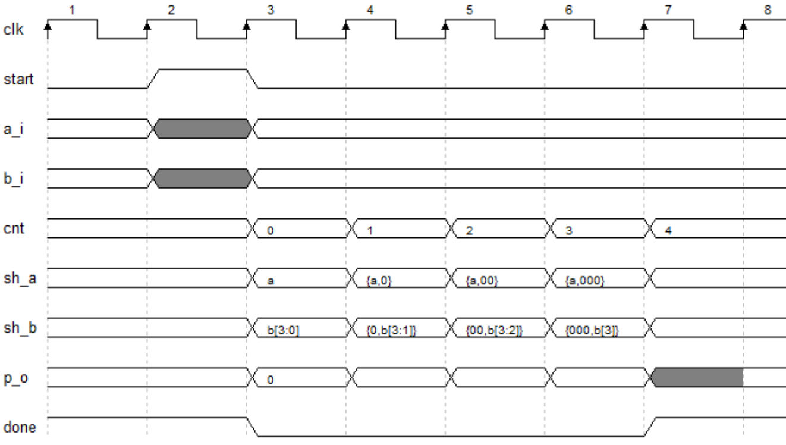
循环方式
p = 0; sh_a = a; sh_b = b;
for( i=0; i<4; i++){
p += ( sh_b[0]==1 ) ? sh_a : 0;
sh_a = sh_a << 1;
sh_b = sh_b >> 1;
}
时序图

Slide 7
循环方式
module mult4(
input start,
output done ,
input [3:0] a_i ,
input [3:0] b_i ,
output [7:0] p_o
);
reg [6:0] sh_a = 7’d0;
reg [3:0] sh_b = 4’d0;
reg [2:0] r_cnt = 3’d0;
reg [7:0] r_p = 8’d0;
always @(posedge clk) begin
if(start) r_cnt <= 3’d0;
else if(!done) r_cnt <= r_cnt+3’d1
end
assign done = r_cnt[2];
always @(posedge clk) begin
if(start) begin
sh_a <= {3’d0, a_i};
sh_b <= b_i;
else begin
sh_a <= { sh_a[5:0], 1’b0 };
sh_b <= { 1’b0, sh_b[3:1] };
end
end
wire adden;
assign adden = sh_b[0] & (~done)
always @(posedge clk) begin
if( start ) r_p <= 8’d0;
else if( adden ) r_p <= r_p + sh_a;
end
assign p_o = r_p;
endmodule

Slide 8
流水线方式
p=$a×2^{0}×b_{0}+a×2^{1}×b_{1}$+ $a×2^{2}×b_{2}$+ $a×2^{3}×b_{i}$
伪代码
p1 = ( b[0] == 1 ) ? a : 0;
p2 = p1 + ( b[1] == 1 ) ? a<<1 : 0;
p3 = p2 + ( b[2] == 1 ) ? a<<2 : 0;
p = p3 + ( b[3] == 1 ) ? a<<3 : 0;
4bit
4bit + 5bit = 6bit
6bit + 6bit = 7bit
7bit + 7bit = 8bit
需要加入寄存器
a
b
Z⁻¹
Z⁻¹
Z⁻¹
左移1位
左移2位
左移3位
+
+
+
D Q
p1
D Q
p2
D Q
p3
1
0
D Q
p
p
1
0
1
0
1
0
0
b[0]
b[1]
b[2]
b[3]
Z⁻¹
Z⁻¹
Z⁻¹

Slide 9
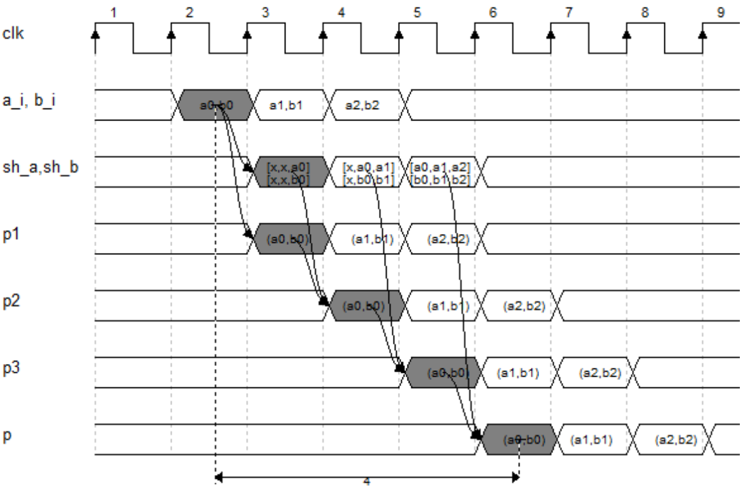
流水线方式
p1 = ( b[0] == 1 ) ? a : 0;
p2 = p1 + ( b[1] == 1 ) ? a<<1 : 0;
p3 = p2 + ( b[2] == 1 ) ? a<<2 : 0;
p = p3 + ( b[3] == 1 ) ? a<<3 : 0;

Slide 10
流水线方式
p1 = ( b[0] == 1 ) ? a : 0; // 4 bit
p2 = p1 + ( b[1] == 1 ) ? a<<1 : 0; // 6 bit
p3 = p2 + ( b[2] == 1 ) ? a<<2 : 0; // 7 bit
p = p3 + ( b[3] == 1 ) ? a<<3 : 0; // 8 bit
module mult4(
input [3:0] a_i ,
input [3:0] b_i ,
input val_i,
output reg [7:0] p_o ,
output val_o
);
// pip 1
reg [3:0] sh_a_1 = 4’d0;
reg [3:0] sh_b_1 = 4’d0;
reg [3:0] p1 = 4’d0;
always @(posedge clk)begin
p1 <= b_i[0] ? a_i : 4’b0;
sh_a_1 <= a_i;
sh_b_1 <= b_i;
end
// pip 2
wire [5:0] wp2;
assign wp2 = p1 + {sh_a_1, 1’b0};
reg [3:0] sh_a_2 = 4’d0;
reg [3:0] sh_b_2 = 4’d0;
reg [5:0] p2 = 6’d0;
always @(posedge clk) begin
p2 <= b_i[1] ? wp2 : {2’b0, p1};
sh_a_2 <= sh_a_1;
sh_b_2 <= sh_b_1;
end
// pip 3
wire [6:0] wp3;
assign wp3 = p2 + {sh_a_2, 2’b0};
reg [3:0] sh_a_3 = 4’d0;
reg [3:0] sh_b_3 = 4’d0;
reg [6:0] p3 = 7’d0;
always @(posedge clk)begin
p3 <= b_i[2] ? wp3 : {1’b0, p2};
sh_a_3 <= sh_a_2;
sh_b_3 <= sh_b_2;
end
// pip 4
wire [7:0] wpo;
assign wpo = p3 + {sh_a_3, 3’b0};
always @(posedge clk)
p_o <= b_i[3] ? wpo : {1’b0, p3};
// val_o
reg [4:1] sh_val;
always @(posedge clk)
sh_val <= { sh_val[3:1], val_i };
assign val_o = sh_val[4];
endmodule

Slide 11
并行方式
p=$a×2^{0}×b_{0}+a×2^{1}×b_{1}$+ $a×2^{2}×b_{2}$+ $a×2^{3}×b_{i}$
p00
p01
p02
p03
4bit 5bit 6bit 7bit
+
+
p10
p11
6bit
+
8bit
Z⁻¹
p
8bit

Slide 12
并行方式
module mult4(
input [3:0] a_i ,
input [3:0] b_i ,
input val_i,
output [7:0] p_o ,
output val_o
);
// level 0
wire [3:0] wp00;
assign wp10 = b_i[0] ? a_i : 4’d0;
wire [4:0] wp01;
assign wp10 = b_i[1] ? {a_i,1’b0} : 5’d0;
wire [5:0] wp02;
assign wp10 = b_i[2] ? {a_i,2’b0} : 6’d0;
wire [6:0] wp03;
assign wp10 = b_i[3] ? {a_i,3’b0} : 7’d0;
// level 1
wire [5:0] wp10;
assign wp10 = wp00 + wp01;
wire [7:0] wp11;
assign wp11 = wp02 + wp03;
// level 2
reg [7:0] r_p;
always @(posedge clk)
r_p <= wp10 + wp11;
assign p_o = r_p;
// val_o
reg sh_val;
always @(posedge clk)
sh_val <= val_i;
assign val_o = sh_val;
endmodule

Slide 13
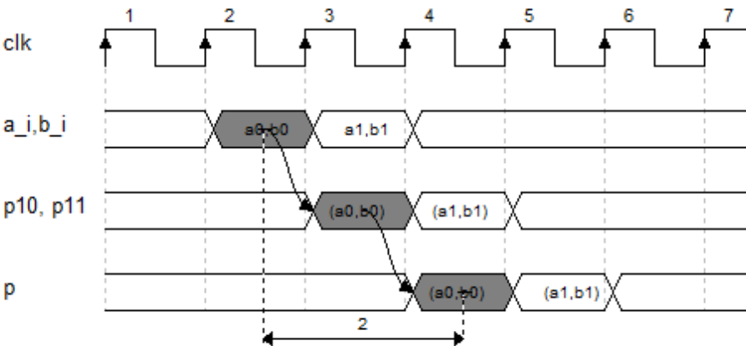
并行方式
p=$a×2^{0}×b_{0}+a×2^{1}×b_{1}$+ $a×2^{2}×b_{2}$+ $a×2^{3}×b_{i}$
p00
p01
p02
p03
4bit 5bit 6bit 7bit
+
+
Z⁻¹
p10
Z⁻¹
p11
6bit
+
8bit
Z⁻¹
p
8bit

Slide 14
并行方式
module mult4(
input [3:0] a_i ,
input [3:0] b_i ,
input val_i,
output [7:0] p_o ,
output val_o
);
// level 0
wire [3:0] wp00;
assign wp10 = b_i[0] ? a_i : 4’d0;
wire [4:0] wp01;
assign wp10 = b_i[1] ? {a_i,1’b0} : 5’d0;
wire [5:0] wp02;
assign wp10 = b_i[2] ? {a_i,2’b0} : 6’d0;
wire [6:0] wp03;
assign wp10 = b_i[3] ? {a_i,3’b0} : 7’d0;
// pip 1
reg [5:0] p10;
always @(posedge clk)
p10 <= wp00 + wp01;
reg [7:0] p11;
always @(posedge clk)
p11 = wp02 + wp03;
// pip 2
reg [7:0] r_p;
always @(posedge clk)
r_p <= wp10 + wp11;
assign p_o = r_p;
// val_o
reg [2:1] sh_val;
always @(posedge clk)
sh_val <= { sh_val[1:1], val_i };
assign val_o = sh_val[2];
endmodule
Notes:
说明基2的思路
大位宽

Slide 15
二维 高斯滤波

Slide 16
int coe[5]={1,4,6,4,1};
for( int y=0; y<H; y++ ){
for(int x=0; x<W; x++ ){
img_tp[y*W+x] = 0;
for( int dx=-2; dx<=2; dx++ ){
int sx = x+dx;
sx = ( sx < 0) ? –sx : ( sx >= W ) ? 2*(W-1)-sx : sx;
img_tp[y*W+x] += coe[dx+2] * img_in [y*W+sx];
}
img_tp[y*W+x] /= 16;
}
}
for( int x=0; x<W; x++ ){
for(int y=0; y<H; y++ ){
img_out[y*W+x] = 0;
for( int dy=-2; dy<=2; dy++ ){
int sy = y+dy;
sy = ( sy < 0 ) ? –sy : ( sy >= H ) ? 2*(H-1)-sy : sy;
img_out[y*W+x] += coe[dy+2] * imgs[sy*W+x];
}
img_out[y*256+x] /= 16;
}
}

Slide 17



Slide 18
source
img
buf
imgrd
filter_op
dt_0
dt_1
dt_2
dt_3
dt_4
dest
img
buf
imgwr

Slide 19
imgbuf
BRAM
pa(wr)
pb(rd)
wr_p1
wr_p2
写有效条件：
1、P1、2中仅有一个写使能
2、地址在范围内
读有效条件：
1、P1、2中仅有一个读使能
Z⁻¹
rd_p1
rd_p2
Z⁻¹
Z⁻¹
地址转换
rd_p1
rd_p2

Slide 20
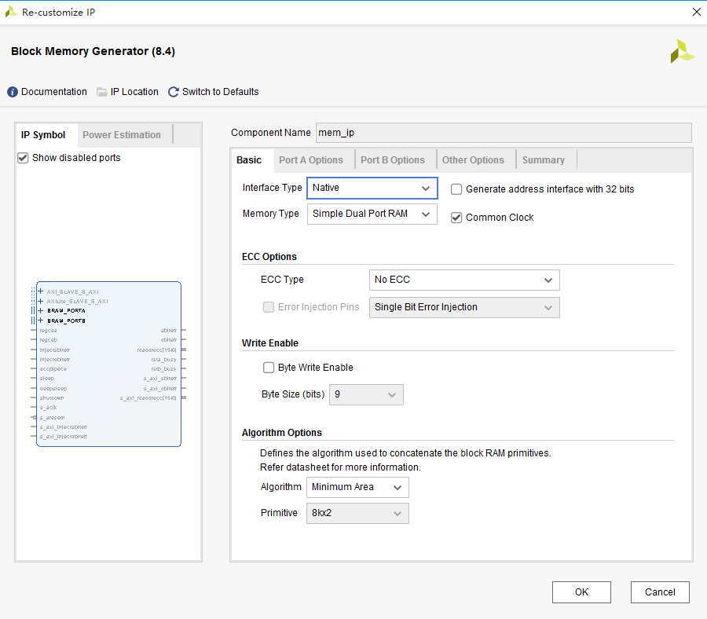

Slide 21
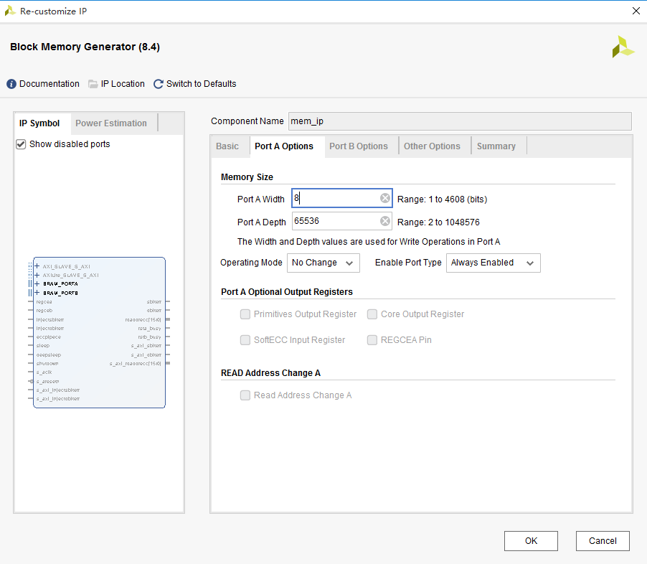

Slide 22
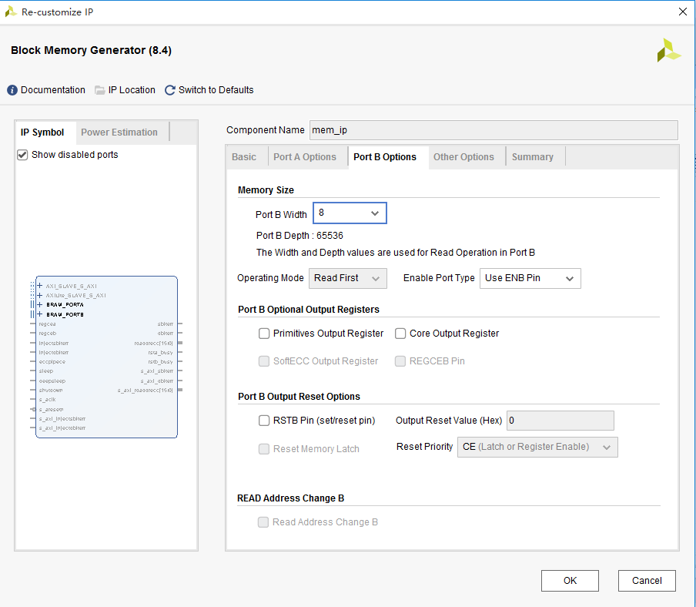

Slide 23
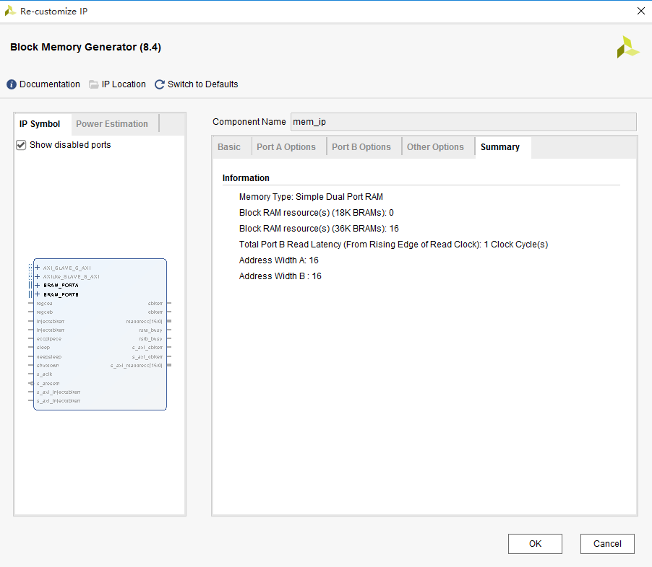

Slide 24
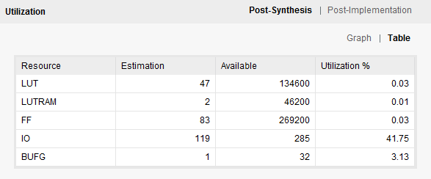
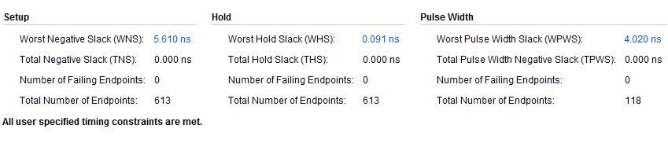
imgbuf

Slide 25
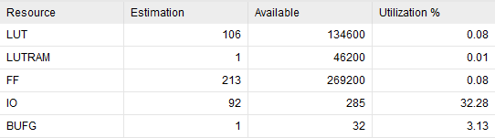
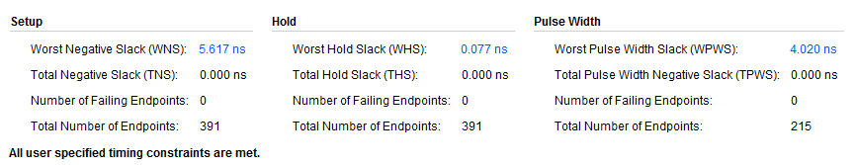
gauss filter

Slide 26
