Slide 1
Status Report
* Done *
1. Launch Weave Scope on Local machine and AWS
2. Read source code of weaveworks/scope (generate a map of application)
3. weave networks plugins :
a. [HTTP Statistics](https://github.com/weaveworks-plugins/scope-http-statistics)
b. [Traffic Control](https://github.com/weaveworks-plugins/scope-traffic-control)
* Ongoing *
1. Read source code of weaveworks/scope
render (pod.go and container.go)
2. implement a demo fetch data from influxdb and render it web browser

Slide 2
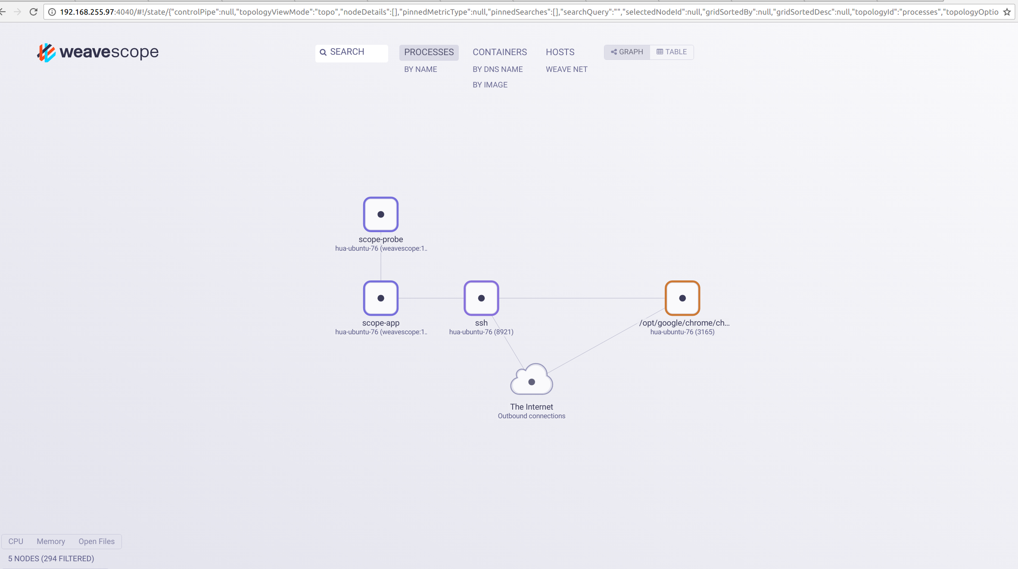
weave scope on local machine

Slide 3
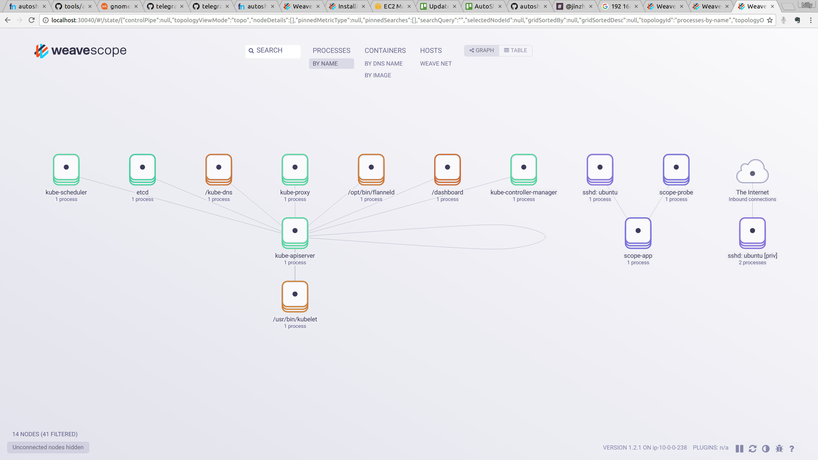
weave scope on aws

Slide 4
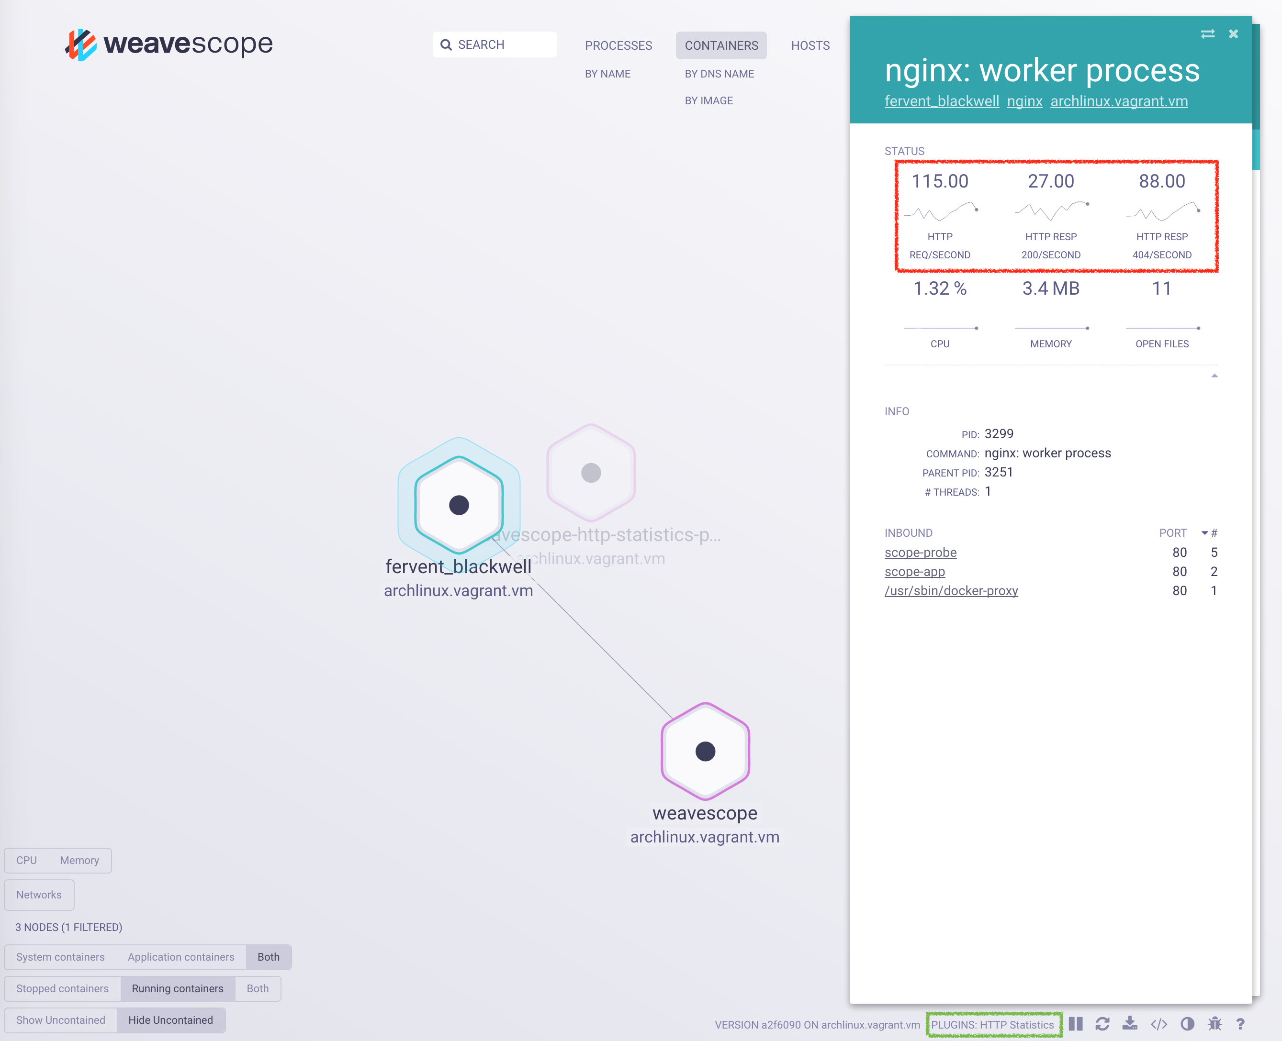
Scope HTTP Statistics Plugin

