Slide 1
C
Chenyang Cui
De Chen
Lihang Li
Li Li
Hansheng Zhang
崔晨阳
陈德
李立杭
李利
张汉生
Hot Search
Notes:
My Name: Hansheng Zhang
Team menbers: each
Explain the log
c: group c; almost a circle but not perfect; eye: help you to find interesting things

Slide 2
Agenda
Introduction
Features
Demonstration
Notes:
Introduciton first
Explain the feature details
Snipshot

Slide 3
Introduction
Hot Search
Food
Sight spots
Famous People
…
Google Search Trend:
Just display top searches
Notes:
Many are new to Tokyo. Curious about
Google search just … while we will show interesting things around you
Our Api can be easily used by other applications. framework

Slide 4
Plugin Features
Search Log
Record user search
Structured data is built for further use
Hot topics
Location
Time
Topic distribution
Display on the map
Notes:
Hot topics classification?
Certain topic

Slide 5
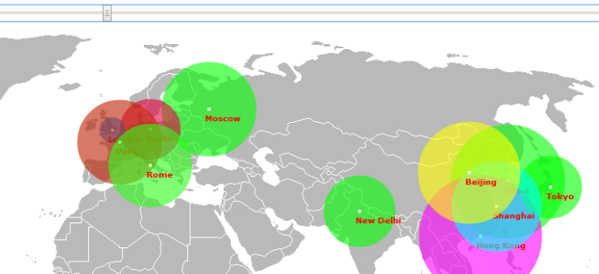
Hot topics
Display hot search topic with specific time and location
Select starting time
Click the city you are in
地震
ハイスコアガール
片瀬那奈
ねぷた
広島 原爆
…
Notes:
Click the city
lbs

Slide 6
Distribution of Certain Topic
Select starting time
Number of queries: Radius of circle

Slide 7
Thank you

