Slide 1
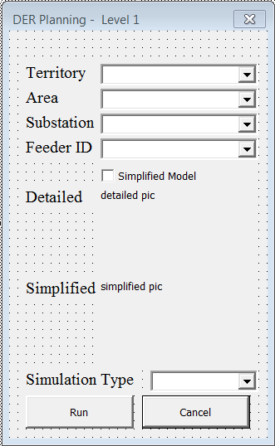
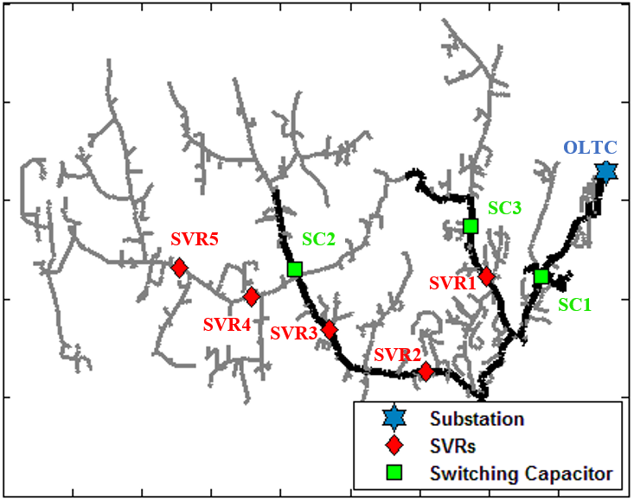
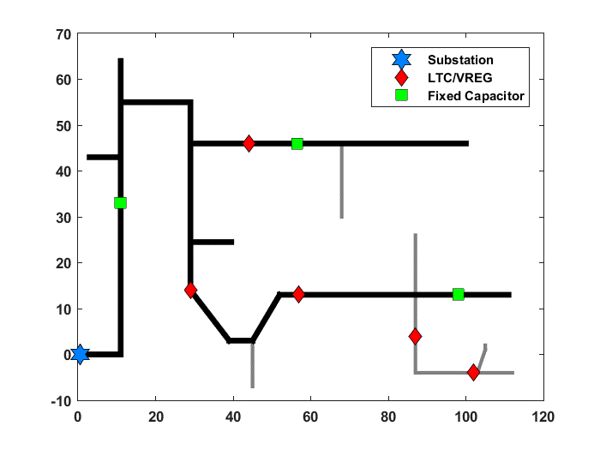
Python
Conversion Tool: converts binary to DSS
Produce Feeder Plots
Static Power Flow
Hosting Capacity
Probability Deployment of PV
. . .
Option N
Quasistatic Time Series
Visual Basic
Option 1
. . .
Option N

