Slide 1
Circuit Mapping with GIS
Joshua Smith, Undergraduate Research Assistant
Dr. Elham Makram, Faculty Advisor
The Holcombe Department of Electrical and Computer Engineering

Slide 2
Introduction
Feeder Reduction
Electrically equivalent feeder model, topographically different
Quasistatic Timer Series Analysis comparison to historical data
Circuit Mapping with GIS
Program flow with example
Future work with idealized program flows

Slide 3
Objectives
Develop a holistic distributed energy resource (DER) planning tool
Probabilistic deployment of DER
Determine future planning criteria involving voltage regulator and capacitor placement

Slide 4
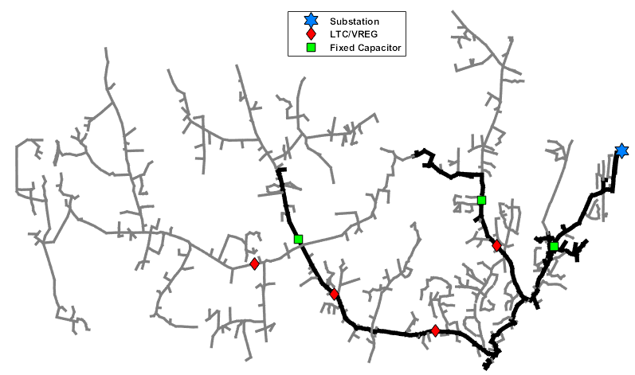
Feeder Reduction
Figure 1: Detailed Feeder Model

Slide 5
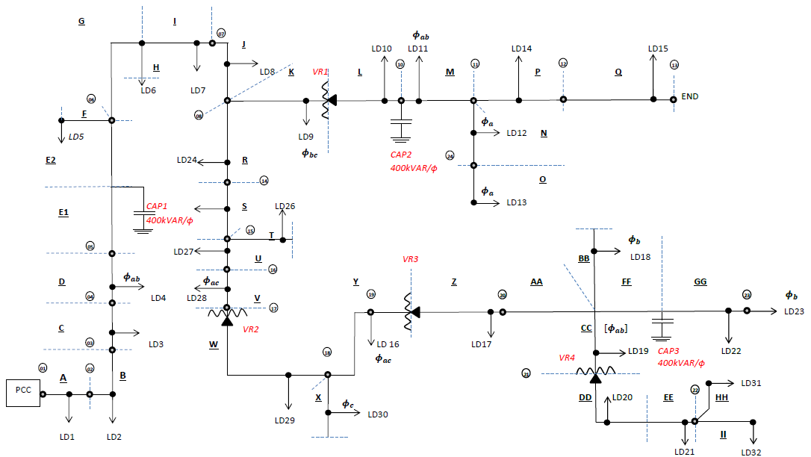
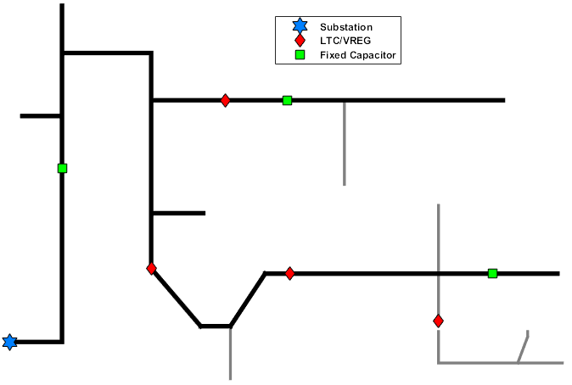
Feeder Reduction
Figure 2a: Simplified Feeder Planning
Figure 2b: Simplified Feeder Model
OpenDSS
Voltage regulators, capacitors, etc. maintained
Lines reduced by change in conductor type/spacing
Loads represented as spot loads
QSTS
Powerflow based on previous state

Slide 6
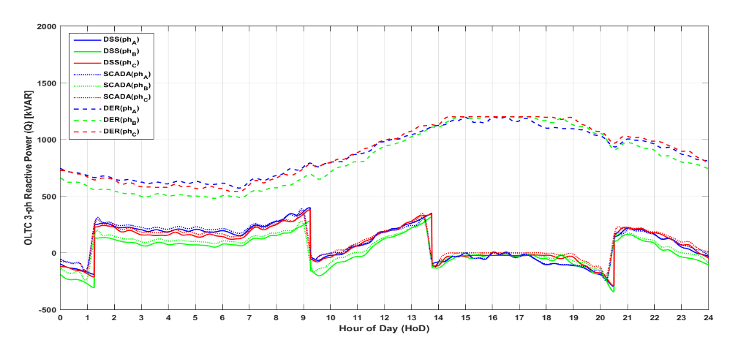
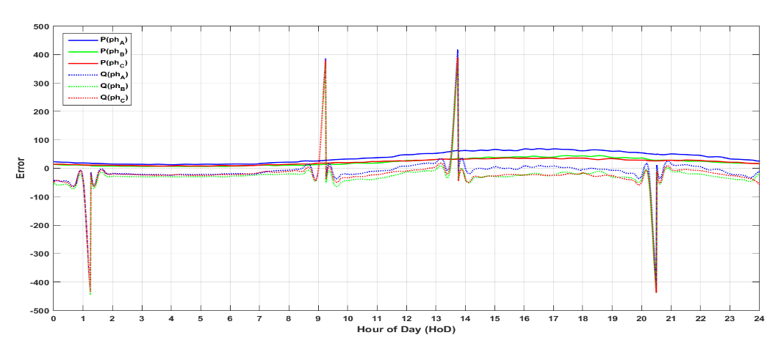
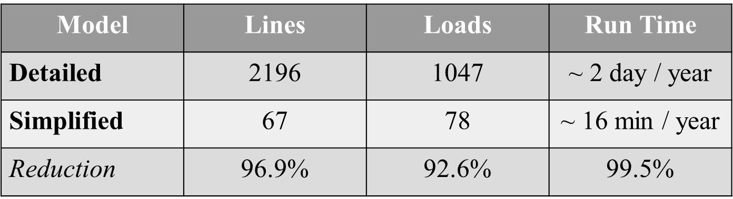
Feeder Reduction
Figure 3a: 24-hour QSTS kVAR
Figure 3b: 24-hour QSTS Error
Table 1: Reduction Percentages

Slide 7
Circuit Mapping with ArcGIS
CYME
Shape File
OpenDSS
Coordinates
Determine DG Location on Feeder
Suitable PV Locations
ID
Bus1
Bus2
Lat
Long
Reduce?
YES
Reduce
NO
YES
Update?
Analysis
NO

Slide 8
Circuit Mapping with ArcGIS
CYME
Shape File
OpenDSS
Coordinates
Determine DG Location on Feeder
Suitable PV Locations
ID
Bus1
Bus2
Lat
Long
Reduce?
YES
Reduce
NO
YES
Update?
Analysis
NO

Slide 9
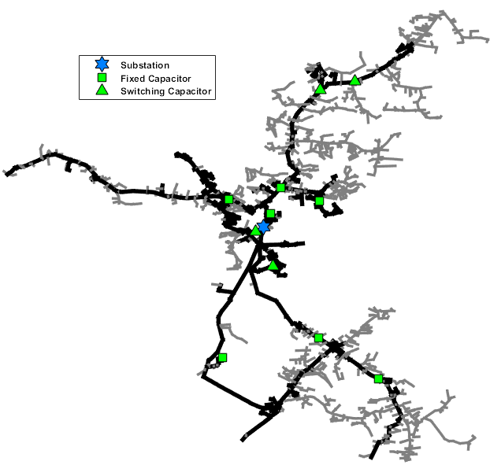
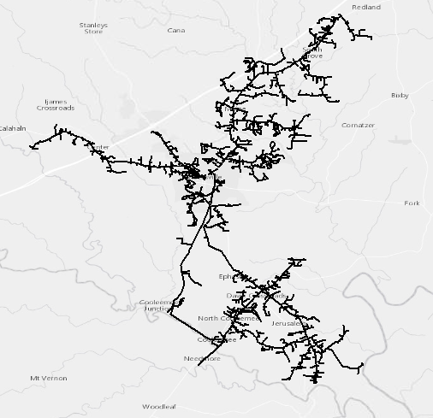
Circuit Mapping with ArcGIS
Figure 4a: MATLAB Feeder Plot
Figure 4b: ArcGIS Feeder Plot

Slide 10
Circuit Mapping with ArcGIS
CYME
Shape File
OpenDSS
Coordinates
Determine DG Location on Feeder
Suitable PV Locations
ID
Bus1
Bus2
Lat
Long
Reduce?
YES
Reduce
NO
YES
Update?
Analysis
NO

Slide 11
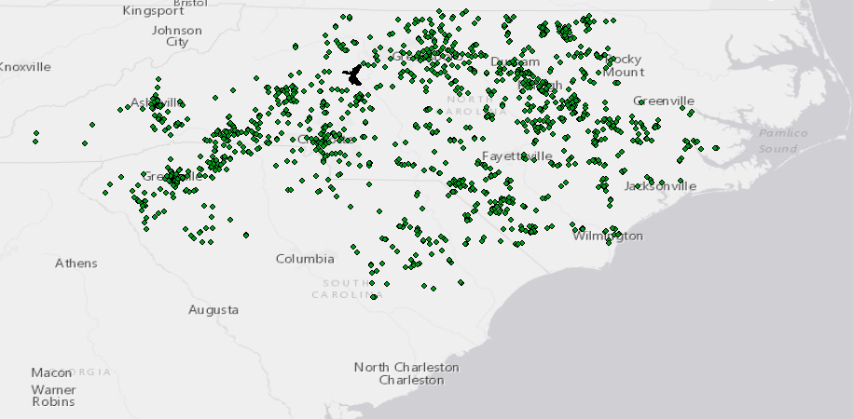
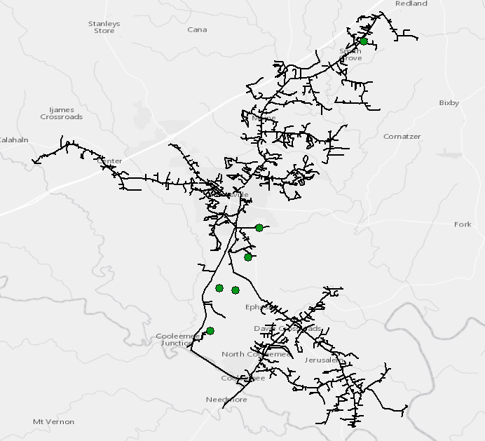
Circuit Mapping with ArcGIS
Figure 5: Circuit Plotted in ArcGIS with PV Requests

Slide 12
Circuit Mapping with GIS
Feeder Lines
Intersection?
Increment PV Point Buffer
NO
YES
PV Request
Add Intersect
Temporary PV Delete
Return
NO
Unmatched PV?
YES

Slide 13
Deliverables
Determine POI for current PV requests and add to DSS model as DG
Determine potential future PV sites by size utilizing land suitability and hosting capacity
Automated feeder simplification, maintaining electric integrity with newly added DG (and potential future DG)

