Slide 1

C PER
Center for Advanced Power Engineering Research
Presented By:
Morey Agnew
Clemson University

Slide 2
Datasets Used
DEC_PV_LIST
This excel file has all the substations in the area but we only used Distribution type substations
Lat_Long_Data
This excel file has all of the interconnection request but we are only interested in Distribution and Solar type requests that are in the Carolinas.
To make the plots we used the GridPV toolbox.

Slide 3
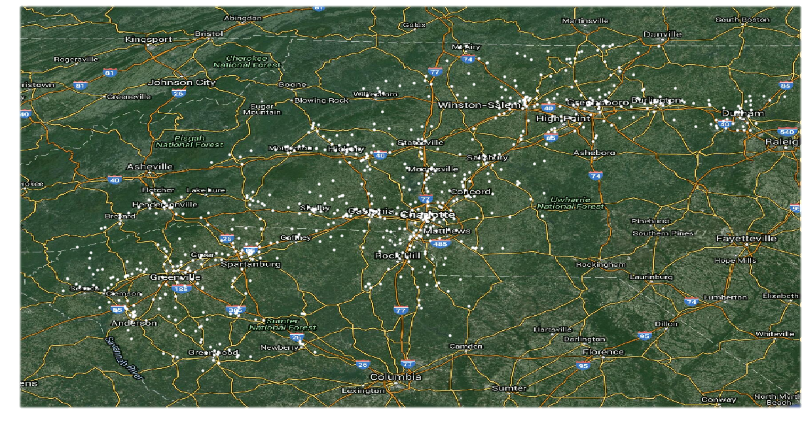
Substation Locations

Slide 4
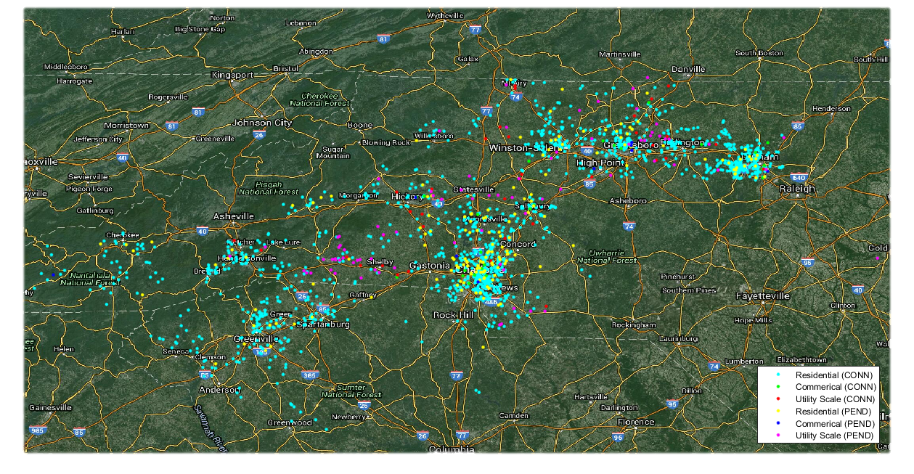
PV Requests Locations

Slide 5
Distance Formula
Haversine Formula – Used to calculate the shortest distance over the earth’s surface. We need this to be able to find the distance between each PV interconnection request and the substation to find out which substation it’s closest too. Then we matched each request to the substation it is closest to.
Δlon = lon2 - lon1
Δlat = lat2 - lat1
a = (sin(Δ lat/2))^2 + cos(lat1) * cos((lat2) * (Δlon/2))^2
b = 2 * atan2(sqrt(a), sqrt(1-a))
d = R * b, where R equals the radius of the Earth, which is 3961miles

Slide 6
Substations Only Provided to CAPER
Substation | Feeder Number | Residential (Conn) | Commercial (Conn) | Utility (Conn) | Residential (Pend) | Commercial (Pend) | Utility (Pend)
1 | 1 | 75.01 KW | 0 | 0 | 0 | 0 | 0
2 | 2 | 35.45 KW | 0 | 0 | 18.35 KW | 0 | 0
3 | 3 | 16.4 KW | 0 | 0 | 0 | 0 | 5000 KW
4 | 7 | 5.36 KW | 0 | 10000 KW | 0 | 0 | 5001 KW

Slide 7
Substation 1
In the first table we took Substation 1 but with a 20 mile radius(using the distance formula again) to show all connected and pending PV interconnection requests.
All the substations that have PV interconnection requests closest to them are summed together in this table
In the second table is the total amount Power each type of request has in the Carolinas
Type | Connected | Pending
Residential | 271.908 KW | 106.86 KW
Commercial | 135 KW | 358.6 KW
Utility | 21450 KW | 21890 KW
Type | Connected | Pending
Residential | 9.147 MW | 1.173 MW
Commercial | 5.438 MW | 2.281 MW
Utility | 140.11 MW | 288.8 MW

Slide 8
Substation 1 Percentage
This percentage column in this table has a weight of 20% for connected and 80% pending since we are more interested in future connections.
Type | Percentage
Residential | 5.0541%
Commercial | 10.7771%
Utility | 8.4158%

Slide 9
Remarks/Future Research
We want to use our data to simulate the distribution lines and to see what other problems may occur and see how we can fix them whether that means connecting to another feeder to another substation or using another method.

