Slide 1
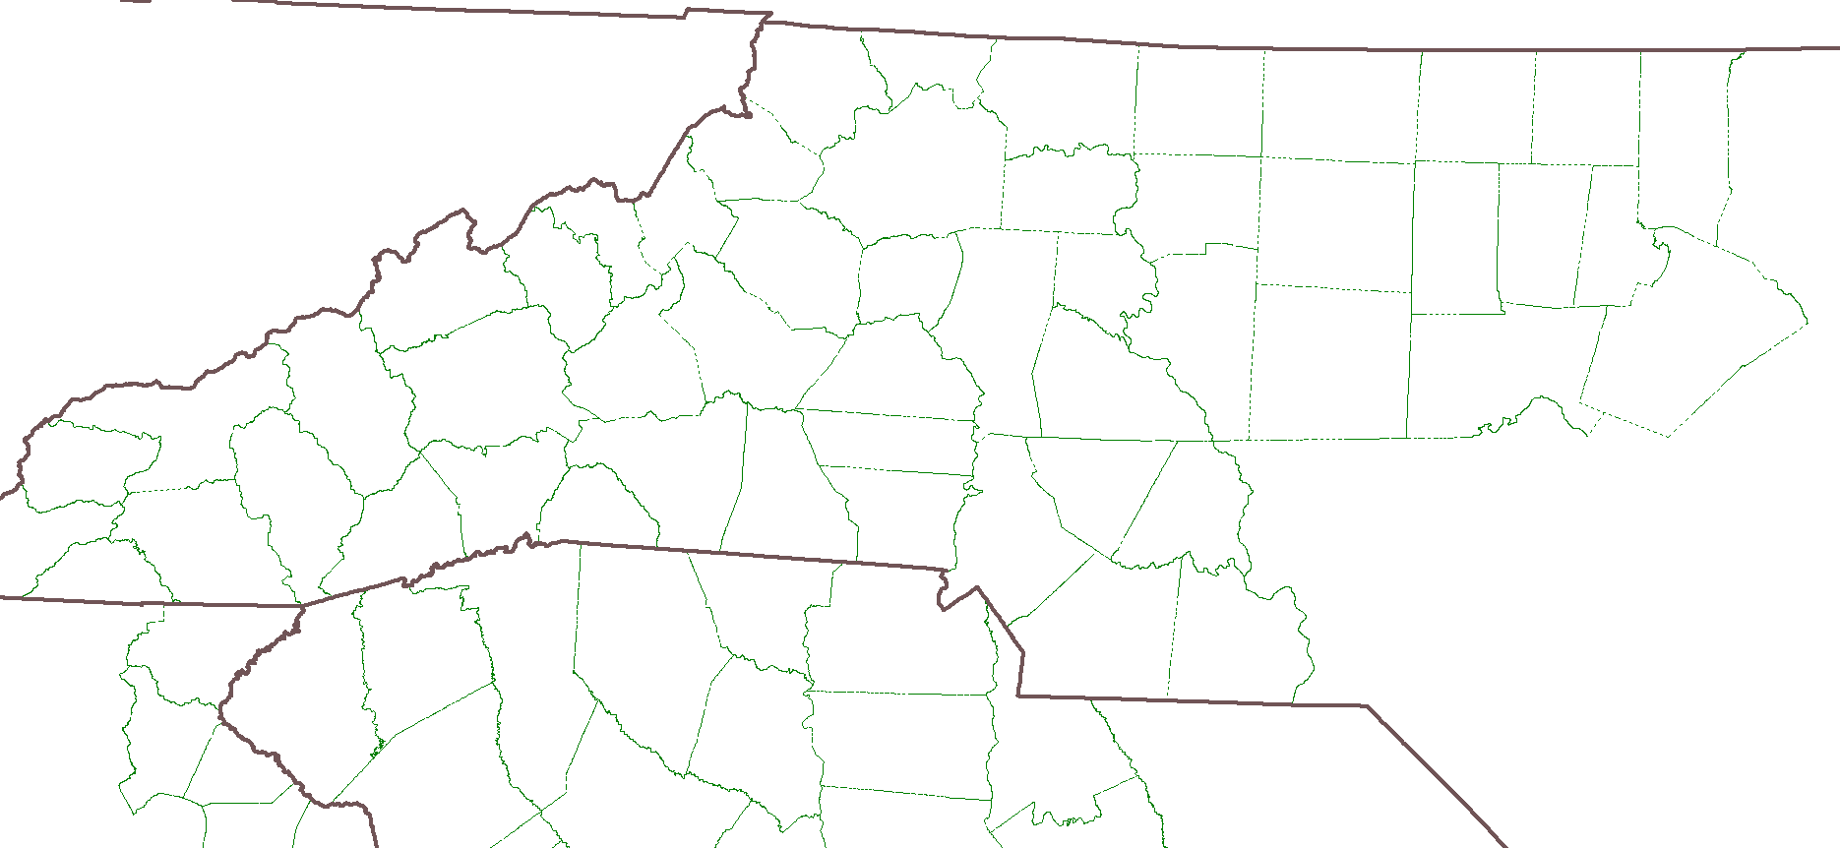
19
28
29
25
21
24
23
30
31
18/20
22/26
33
32
10
27
12
14
13
2
11
4
3
1
6
9
5
8
16
15
7
17
Notes:
36.44386672
-78.95227628

